Slide 1
You are the only developer in your company. Maybe you’re an independent consultant. Maybe you work from home, maybe not. Any way it goes, being the lone developer can be tough. Whether you work in a cube or the comfort of your home office or the local coffee shop, there are many challenges facing the solo developer. Project management, estimation, testing and even writing code all change when you work alone. In this session, I will discuss many of the lessons learned and practices I’ve developed working almost exclusively as a single developer for the past ten years.

Slide 2

Working Effectively as a Team of One
Michael Eaton
Validus Solutions, LLC.
@mjeaton

Slide 3


Slide 4

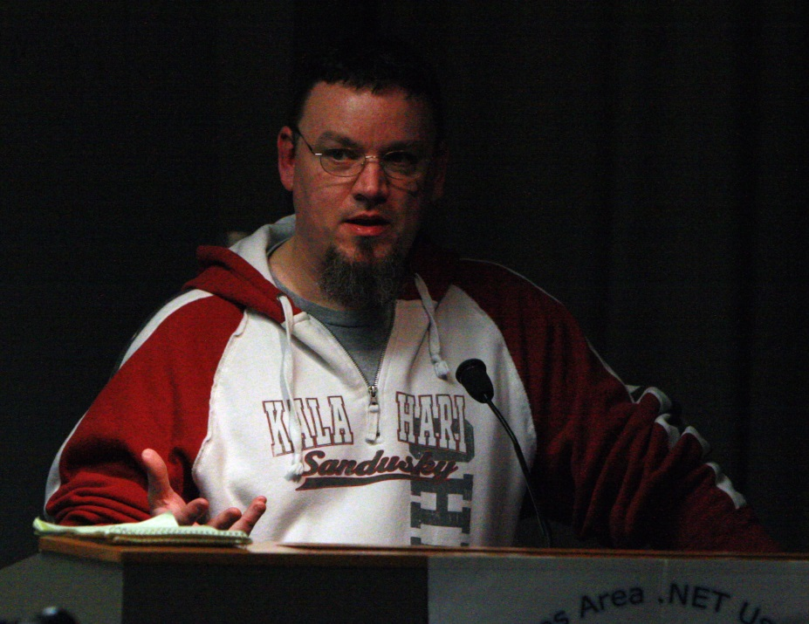
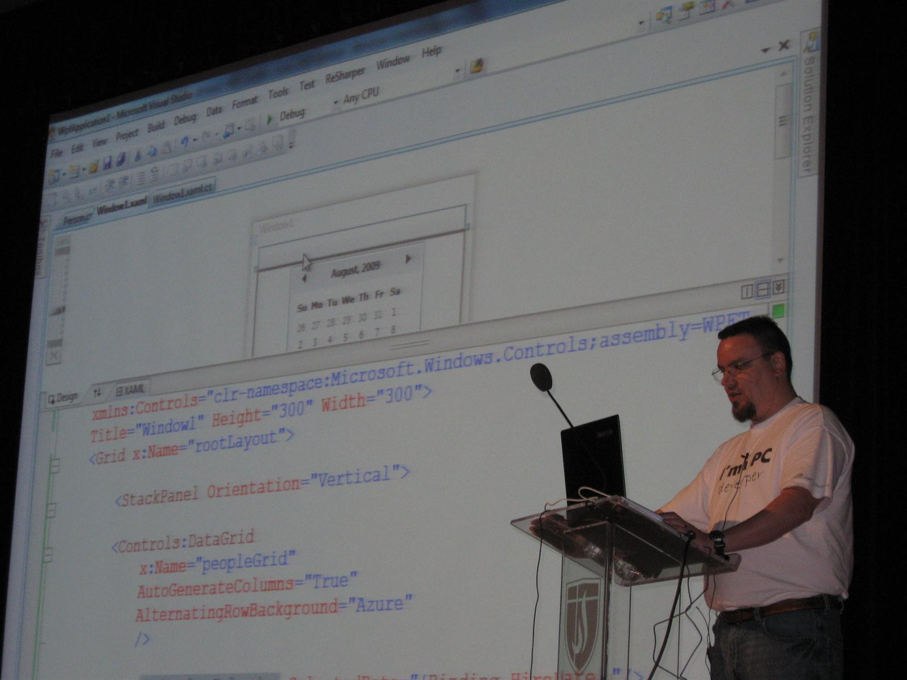
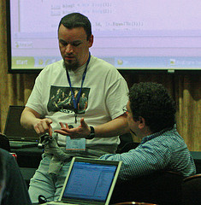
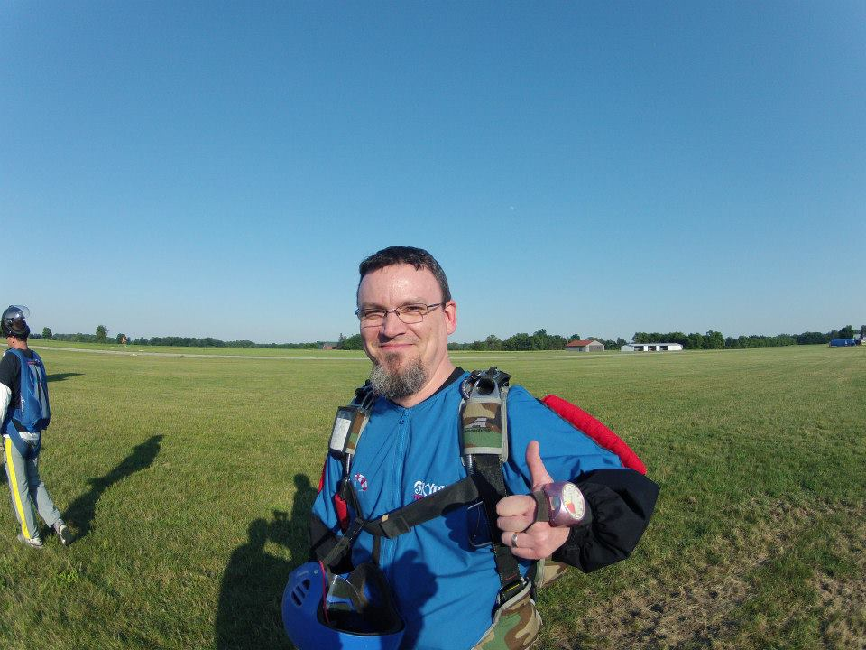
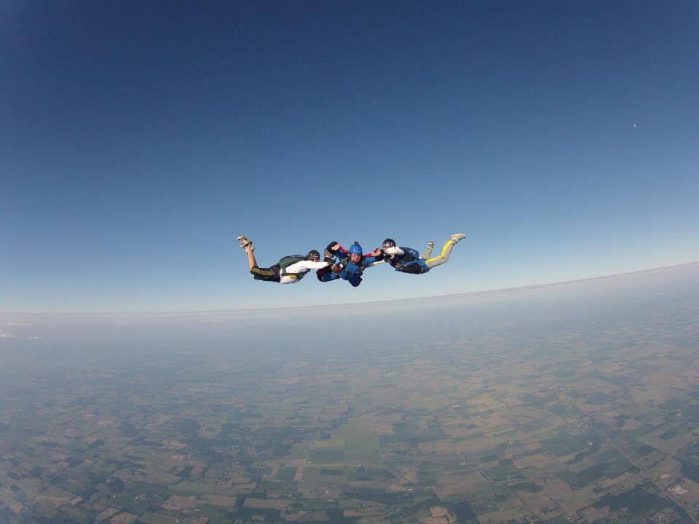

Slide 5

If parts of you don't change after #kalx13, you’re not listening.
"In a time where organizers are censoring speakers and their content, @mjeaton and @kalamazoox is a bastion of freedom. He is a luminary." "@mjeaton @kalamazoox believes in the open exchange of ideas, however uncomfortable, and trusts humans to think, collaborate and create."
"#kalx12 is like an All Star team of speakers. Every single one would have been the best talk at every other conference." "I've discovered @kalamazoox is a hidden gem. Today was like a braver, more profane set of dev-oriented TED talks. Lots of passion and humor."
Other confs are for the head, #kalx13 is for the heart.
#kalx13 part awesome insightful talks, part @mjeaton and friends roasting each other :)

Slide 6
about.me/mjeaton

Slide 7
History
1994 to 1995 – Worked remotely on a team of 6 or 7. Worked in a silo.
1996 – Sole developer for small, custom dev shop
1997 to 2000 – Worked on a team of 5. Best team EVER.
2000 to 2001 – Project Director/Team Lead for mid-size consulting firm. Led several project teams.
2001 to early 2006 – Independent consultant – worked mostly alone, but did contribute to a couple project teams during that time.
2006 (roughly 9 months) – Tried my hand at working for “The Man” again. Worked on a small dev team.
2006 to Now – Independent consultant. Work mostly alone, but recent projects have me on teams again.
Notes:
1994 to 1995 – Worked remotely on a team of 6 or 7. Worked in a silo.
1996 – Sole developer for small, custom dev shop
1997 to 2000 – Worked on a team of 5. Best team EVER.
2000 to 2001 – Project Director/Team Lead for mid-size consulting firm. Led several project teams.
2001 to early 2006 – Independent consultant – worked mostly alone, but did contribute to a couple project teams during that time.
2006 (roughly 9 months) – Tried my hand at working for “The Man” again. Worked on a small dev team.
2006 to Now – Independent consultant. Work mostly alone, but one of my projects has me on a team of 5 “local” developers + an offshore contingent.

Slide 8
“A team of one is never wrong” – Tim Wingfield, 2011

Slide 9
Considerations
Get hit by a bus
Get sick
Get fired
Quit
Someone else joins the team
Notes:
Get hit by a bus
Get sick
Get fired
Quit
Someone else joins the team

Slide 10
Technical

Slide 11
Always use source code control
It’s not about sharing code with others, it’s about security
A folder on your drive is NOT good enough
Dropbox is NOT good enough
External, when possible
Github
Bitbucket
Commit early, commit often
Notes:
It’s not about sharing code with others, it’s about security
A folder on your drive is NOT good enough
Dropbox is NOT good enough
External, when possible
Github
Bitbucket
Commit early, commit often

Slide 12
Write tests
Tests give you:
Confidence in your code
Safety net when changes come
Documentation
Potentially saves time
Notes:
Tests give you:
Confidence in your code
Safety net when changes come
Documentation
Potentially saves time

Slide 13
Continuous Integration
Move builds and deployment from your personal computer
Isolated from day-to-day changes to your system
Notes:
Move builds and deployment from your personal computer
Isolated from day-to-day changes to your system

Slide 14
Get virtual (machines)
Allows custom environments
Gives you a safety net if your laptop (or work computer) dies unexpectedly
Notes:
Allows custom environments
Gives you a safety net if your laptop (or work computer) dies unexpectedly

Slide 15
Non-technical

Slide 16
Track your tasks
Keep it simple, but keep your task list somewhere other than in your head
I <3 trello and my moleskine and my whiteboard and my phone and my Kindle Fire and RememberTheMilk
Notes:
Keep it simple, but keep your task list somewhere other than in your head
I <3 AgileZen and my moleskine and my whiteboard and my phone and my Kindle Fire and RememberTheMilk

Slide 17
Track your time
Be able to account for all your time, even if you’re not a “billable asset”
Harvest
Timesnapper
Notes:
Be able to account for all your time, even if you’re not a “billable asset”
Harvest
Timesnapper

Slide 18
Pomodoro
Focus, focus, focus
Notes:
Focus, focus, focus

Slide 19
social

Slide 20
Social Networks
The more people you know, the more you know
Notes:
The more people you know, the more you know

Slide 21
User Groups / Conferences
The more people you know, the more you know
Notes:
The more people you know, the more you know

Slide 22
Blogs
Run into a problem? Blog about it!
Figure out how to solve a complex problem? Blog about it!
Notes:
Run into a problem? Blog about it!
Figure out how to solve a complex problem? Blog about it!

Slide 23
“It's easier to ask forgiveness than it is to get permission.” – Grace Hopper

Slide 24
Contact Info
Email: mjeaton@validussolutions.com
Blog: http://mjeaton.net/blog
Twitter: @mjeaton
LinkedIn: http://www.linkedin.com/in/mjeaton

