Slide 1

Building XAML.C# for
Desktop, Store, and Phone
Philip Japikse (@skimedic)
Principal Architect, InterKnowlogy
Level: Intermediate

Slide 2
Phil.About()
Principal Architect, InterKnowlogy
http://interknowlogy.com
Microsoft MVP, MCSD, MCDBA, CSM, CSP
Lead Director, Cincinnati .NET User’s Group
Co-host Hallway Conversations Podcast
www.hallwayconversations.com
Founder, Agile Conferences, Inc.
www.dayofagile.org

Slide 3
Agenda
XAML Basics
Layouts
Binding
Element Binding
Data Binding
Styles & Resources
MVVM
Commands
Observables
Validation
Platform Specific
WPF
Windows 8.1
Windows Phone

Slide 4
What Is WPF?
Windows Presentation Foundation
Next Generation Rich User Application Platform
Declarative UI (XAML)
Based on DirectX (not GDI/GDI+)
Vector Based
Supports true Hardware Acceleration
Resolution Independence
Leaps ahead with binding
Data and other Elements

Slide 5
What Else is in WPF?
Flexible flow layout model
Styles and Templates
OOTB document handling features
True animation – not timer based
A/V support (through WMP)
Commands
Routed Events

Slide 6
What’s New in .NET 4?
DataGrid, DatePicker, Calendar
Visual State Manager
Layout Rounding
Multi-Touch support
Custom Dictionaries
Behaviors*
Animation Easing
Binding String Format

Slide 7
What’s New in .NET 4.5
Ribbon Control
Improved Performance with large data
Binding to Static Properties
Accessing Collections on non-UI Threads
Asynchronous Validation
Delay Updating Data Source
Retrieving Data Binding Info from Expression
And more…
http://tinyurl.com/wpf4-5

Slide 8
What’s Missing
WPF – What’s missing
Visual Inheritance
MDI – complete lack of support

Slide 9
XAML Basics

Slide 10
What is XAML
eXtensible Application Markup Language
Based on XAML
XAML Documents define the arrangement of:
Panels, Buttons, Controls, UIElements
Used to create UIs for
Windows Presentation Foundation (WPF)
Windows 8.x apps (WIN8)
Windows Phone apps (WP)
Windows Workflow Foundation (WF)

Slide 11
XAML Benefits
Declarative User Interface
Separation of Design/Markup from programming
Flexible flow layout model
Styles and Templates
Leaps ahead with binding
Data and other Elements
Styles and Templates
True storyboard-based animations

Slide 12
The Foundation
Every XAML elements maps to a .NET class
Elements can be nested
Properties can be set through:
Attributes
Tag content (for the Content property)
Nested tags (with special syntax)

Slide 13
XAML Documents
Can only have one top level element
Typically
Window (WPF)
Page (WIN8, WP8)
UserControl
Application

Slide 14
Menus
Use “_” instead of “&” for Hot-Key
Beware for XAML order vs Grid Order
Similar to WinForms except
MenuItem is a container control
Use <Separator> instead of “-”

Slide 15
XAML *is* XML At Its Core
All tags must be closed
<Grid> <!-- stuff here --></Grid> <Image/>
Special Characters must be escaped
&lt; &gt; &amp; &quot;
Elements can have attributes
<Image Source="Assets/Logo.png" />
Elements can have nested tags
<Image> <Image.Source>Assets/Logo.png</Image.Source> </Image>

Slide 16
Element Naming
Named elements can be referred to in code
Full intellisense support
Two ways of naming
XAML Name
x:Name=“Foo”
Element Name Property
Name=“Foo”
Both generate the same code
internal System.Windows.Controls.Image Foo;

Slide 17
Sample Window Document
<Window x:Class="WPFDemo.Window1“ xmlns="http://schemas.microsoft.com/winfx/2006/xaml/presentation" xmlns:x="http://schemas.microsoft.com/winfx/2006/xaml" Title="Window1" Height="300" Width="300"> <Grid> </Grid> </Window>
Sample Window Document
Notes:
xmlns="http://schemas.microsoft.com/winfx/2006/xaml/presentation” = controls, classes
xmlns:x="http://schemas.microsoft.com/winfx/2006/xaml" = XAML utiliies
Same for WPF, WIN8, WP8

Slide 18
Namespaces
Microsoft namespaces do not map to specific .NET namespaces
Creators of XAML combined them under /presentation
Your namespaces will
xmlns:Prefix=“clr-namespace:Namespace[;assembly=AssemblyName]”
Two prefixes that are “reserved” (by convetion)
xmlns:sys="clr-namespace:System;assembly=mscorlib“
xmlns:local="clr-namespace:WPFDemo"

Slide 19
Properties
Simple properties
Set with Attributes or as tag content
Always set as a string
Converted using a typeconverter
Declared on the property or the class
Complex Properties
Set with property-element syntax and nested elements
<Grid ShowGridLines="True" UseLayoutRounding="True"> <Grid.RowDefinitions> <RowDefinition/>

Slide 20
Markup Extensions
Used to set properties that can’t be set any other way
Dynamically setting properties
Setting to other elements
Example:
Foreground="{x:Static SystemColors.ActiveCaptionBrush}“
<x:Static Member=“SystemColors.ActiveCaptionBrush”/>

Slide 21
Attached Properties
Properties defined in one element used in another
Grid.Row/Grid.Column
Translated into method calls
Grid.SetRow(control,x)

Slide 22
Dependency Properties
Use more efficient storage
Support additional features
Change notification
Dynamic value resolution
Required for key WPF/WIN8/WP8 features
Animations
Databinding
Styles
Wrapped with “normal” .NET properties

Slide 23
From XAML to Executable
InitializeComponent()
In the code behind file
THIS MUST STAY IN
Compiles to intermediate file
<filename>.g.cs
Gets added to the .exe

Slide 24
Tools for Creating XAML Apps
Visual Studio
2013 needed for Universal Apps
Blend
Now free with Visual Studio
Your favorite editor
Anything you can do in XAML you can do in code

Slide 25
Questions?
?

Slide 26
Layouts and Layout Containers

Slide 27
Layout
“Web”-like layout model with Flexible Flow
Gone are explicit sizing, absolute positioning, etc
Containers try to allocate element’s requested space
Layout Process
Measure
Loop through all elements asking for preferred size
Arrange
Container places elements in appropriate position

Slide 28
Layout Containers
All derive from the Panel class
Standard
Grid, UniformGrid
Most commonly used (default Window Panel)
StackPanel, WrapPanel, DockPanel
Used for UI Tweaks
Canvas
Absolute (think WinForms) positioning
InkCanvas - Supports Digital Ink
Notes:
Specialized
UniformGrid, TabPanel, ToolBarPanel, ToolBarOverflowPanel

Slide 29
Layout Properties
Alignment (Horizontal || Vertical)
Center, Left/Top, Right/Bottom, Stretch
Margin || Padding
Left, Top, Right, Bottom
MinWidth/MinHeight
Requested Minimum dimension
MaxWidth/MaxHeight
Maximum dimensions (trumps Stretch)
Width/Height – (note: shouldn’t really do this)
Dimensions (trumps Stretch, trumped by Min/Max settings)
ActualHeight/ActualWidth (read only)

Slide 30
Measure and Arrange
Containers check (in order):
Minimum Size
Maximum Size
The content
Size of the container (clipping if necessary)
Alignment

Slide 31
Border
Not a true layout panel
Provides:
Border
Background
Rounded Corners
<Border Grid.Row="1" Background="Aqua" CornerRadius="45" BorderBrush="BlueViolet"> <Grid> </Grid> </Border>

Slide 32
StackPanel
Stacks children in a single row or column
Typically used nested in another panel
<StackPanel Name="MyStackPanel" Orientation="Vertical" > <!-- Children --> </StackPanel>

Slide 33
Wrap Panel
Stacks children in row or column
Wraps children around who don’t fit on one row
Typically used nested in another panel
<WrapPanel Name="MyWrapPanel" Orientation="Horizontal"> <!-- Children --> </WrapPanel>

Slide 34
Dock Panel
Stretches controls against its edges
Top, Right, Bottom, Left
Use LastChildFill to fill the middle
<DockPanel LastChildFill="True"> <Button DockPanel.Dock="Top" >First</Button> <Button DockPanel.Dock="Left">Second</Button> <Button DockPanel.Dock="Right">Third</Button> <Button DockPanel.Dock="Bottom">Fourth</Button> <Button DockPanel.Dock="Bottom">Fifth</Button> <Button Name="button5">Last</Button> </DockPanel>

Slide 35
Canvas
Only use for special use cases
Ink (w/ InkCanvas)
Games
<Canvas> <Button Content="Button" Canvas.Left="80" Canvas.Top="42" Width="75"/> <Button Content="Button" Canvas.Left="63" Canvas.Top="214" Width="75"/> <Label Content="Label" Canvas.Left="155" Canvas.Top="121"/> </Canvas>

Slide 36
Grid
Most powerful and versatile layout
Default layout panel when you add a new windows
Carves up the window into sections for other layout containers
Convention is to place one element in each cell
Can be split with the GridSplitter

Slide 37
Grid
Three ways to size
Proportional
Automatic
Absolute
Can span rows and columns
Use Layout Rounding
<Grid UseLayoutRounding-"True"> <Grid.RowDefinitions> <RowDefinition Height="100" /> <RowDefinition Height="*" /> <RowDefinition Height="Auto" /> </Grid.RowDefinitions> <Grid.ColumnDefinitions> <ColumnDefinition Width="Auto" /> <ColumnDefinition Width="*" /> <ColumnDefinition Width="Auto" /> </Grid.ColumnDefinitions> <Label Grid.Row="0" Grid.Column="0"> Home:</Label> <TextBox Grid.Column="1" Margin="3,0 Grid.ColumnSpan="3" /> </Grid>

Slide 38
Shared Size Groups
Ensures that Rows or Columns in different grids stay the same size
<Grid Grid.IsSharedSizeScope="True> <!-- Row Definitions --> <Grid Background="LightYellow" UseLayoutRounding="True"> <Grid.ColumnDefinitions> <ColumnDefinition Width="Auto SharedSizeGroup="Text"/> <ColumnDefinition Width="Auto"/> </Grid.ColumnDefinitions> <!-- Content --> </Grid> <Grid Grid.Row="2" Margin="3" UseLayoutRounding="True"> <Grid.ColumnDefinitions> <ColumnDefinition Width="Auto" SharedSizeGroup="Text"/> <ColumnDefinition/> </Grid.ColumnDefinitions> <!-- Content --> </Grid> </Grid>

Slide 39
Nesting Layout Containers
Layout Panels can (and should) be nested
Combine layouts to create compelling user interfaces
Typically will start with a Grid
Remember to keep the flow flexible
Avoid hard coding size (except for main margins)

Slide 40
Nested Example
Create a Dialog by combining StackPanel and DockPanel
<DockPanel LastChildFill="True"> <StackPanel DockPanel.Dock="Bottom HorizontalAlignment="Right" Orientation="Horizontal"> <Button Content="OK"/> <Button Content="Cancel"/> </StackPanel> <TextBox DockPanel.Dock="Top"> Here's the Dialog </TextBox> </DockPanel>

Slide 41
Layouts & Containers

Slide 42
Elements, Controls, and More

Slide 43
Elements & Controls
Everything is an Element
Controls are elements that can:
Receive Focus, Accept User Input
Content Controls
Hold a single element
Window, Page, UserControl (Special)
Labels, Buttons, CheckBox, RadioButton, ToolTips
ScrollViewer, Border, Expander, etc
Text Controls
TextBox , PasswordBox – Strings Only
RichTextBox – Sophisticated Content – FlowDocument

Slide 44
List Controls
List Controls (ItemsControl)
Selectors
ListBox, ComboBox, TabControl
Non-Selectors
Menus, ListView, GridView, TreeView, ToolBar
Range Based Controls
ScrollBar, ProgressBar, Slider

Slide 45
Content Controls
Can only hold one element
Element can be a panel
Just because you can doesn’t mean you should!
<Button> <Image Source="photo.jpg"/> </Button>

Slide 46
Specialized Content Controls

Slide 47
ScrollViewer
Used to fit large amounts of data in a tight area
Typically used to wrap a layout panel
<ScrollViewer VerticalScrollBarVisibility="Auto“ HorizontalScrollBarVisibility="Hidden" CanContentScroll="True"> </ScrollViewer>

Slide 48
GroupBox
Often used with RadioButtons
Still needs a Panel to layout it’s controls
<GroupBox Header="GroupBox"> <StackPanel> <RadioButton/> <RadioButton/> <RadioButton/> <RadioButton/> </StackPanel> /GroupBox>

Slide 49
Expander
Wraps content that user can show or hide
<Expander Header="Region One"> <Button/> </Expander> <Expander Header="Region Two“ IsExpanded="True"> <TextBox> </TextBox> </Expander> <Expander Header="Region Three"> <Button>Hidden Button Two</Button> </Expander>

Slide 50
List Controls

Slide 51
Add data to the Items property
Bind to the ItemsSource property
The item controls derive from ContentControl
ListBoxItem, TabItem
Selectors have SelectItem and SelectedIndex
ListBox, CombBox, TabControl
Containers don’t support selection
Menus, ToolBars, Trees

Slide 52
ListBox, ComboBox
Support
SelectedItem
SelectedIndex
Can build complex lists through nested controls
Better with Binding and Styles
Coming later today
<ListBox Grid.Row="0"> <ListBoxItem> <StackPanel Orientation="Horizontal"> <CheckBox /> <Label Content="First Item"/> </StackPanel> </ListBoxItem> </ListBox>

Slide 53
TabControl
List control for TabItems
Tab string can be placed on any side
TabItem is a container control
<TabControl TabStripPlacement="Left"> <TabItem Header="Scrolling" IsSelected="False"> <!-- Content --> </TabItem> <TabItem Header="Expander" IsSelected="True"> <!-- Content --> </TabItem> </TabControl>

Slide 54
Controls

Slide 55
Questions?
?

Slide 56
Resources

Slide 57
XAML Resources
Reusable markup stored in a resource collection
Think function or stored procedure
Provide for consistency throughout your app
E.g. Font Family, size, style
UI Elements
Allows for updates at runtime
E.g. Skinning your app, Localization
Separate design from code

Slide 58
Defining Resources
Resources can be defined at many levels
Controls
Page
Application
Controls look up the Element Tree to find resources
Must be declared in the XAML *before* they are called if static
Resources by default are shared
Change to non shared with x:Shared=“False”

Slide 59
Defining and Using Resources
<Window.Resources> <ImageBrush x:Key="TileBrush" TileMode="Tile" ViewportUnits="Absolute" Viewport="0 0 32 32" ImageSource="happyface.jpg" Opacity="0.3"></ImageBrush> </Window.Resources>
<Button Background="{StaticResource TileBrush}" Margin="5" Padding="5" FontWeight="Bold" FontSize="14"> A Tiled Button </Button>

Slide 60
Static vs Dynamic Resources
Static Resources are applied when the element is first rendered
Must be defined before referenced
Changes don’t affect controls unless the resources derive from Freezable (e.g. Brushes)
Dynamic Resources look up the details every time they are needed
Can change entire object at runtime
*Can* add significant overhead

Slide 61
System Resources
Used to get system settings and apply them to your application
System.Windows is for WPF, System.Drawing is for WinForms
SystemFonts
Provides access to user’s font settings
SystemColors
Provides access to user’s color settings
SystemParameters
Wraps list of settings, including standard sizes, keyboard & mouse settings, and status of graphical effects such as drop shadows

Slide 62
Defining and Using System Resources
Use Dynamic
Otherwise changes won’t get picked up by your application
The resources are system defined, so use x:Static
<Label Foreground="{DynamicResource {x:Static SystemColors.WindowTextBrushKey}}">
Ordinary text
</Label>

Slide 63
Resource Dictionaries
Allow for sharing resources between projects/assemblies
Resource Dictionary is a XAML document
<ResourceDictionary xmlns="http://schemas.microsoft.com/winfx/2006/xaml/presentation" xmlns:x="http://schemas.microsoft.com/winfx/2006/xaml">
Resource Dictionaries are key to localization
To share between applications and load with markup
Place resource dictionary in a file called generic.xaml

Slide 64
Using Resource Dictionaries
Must be merged into a resource collection in your application
<Application.Resources>
<ResourceDictionary>
<ResourceDictionary.MergedDictionaries>
<ResourceDictionary Source="AppBrushes.xaml"/>
<ResourceDictionary Source="WizardBrushes.xaml"/>
</ResourceDictionary.MergedDictionaries>
</ResourceDictionary>
</Application.Resources>
Bar

Slide 65
Resources

Slide 66
Styles

Slide 67
XAML Styles
Conceptually the same as CSS styles
Enables applying design choices consistently throughout the app or page
Can work automatically across the app or target specific types
Can set any dependency property
Support triggers
Can be defined at the Control, Page, or Application level

Slide 68
Style Elements
Setters
Collection of Setter or EventSetter objects that set dependency property values or event handlers
Triggers
Allow changing styles based on an external value
Resources
Resource Collection to be used with the style
BasedOn
Provides way to derive from another style
TargetType
If set, the style is automatically applied to the type specified.

Slide 69
Style Examples
<Style x:Key="BigFontButtonStyle"> <Setter Property="Control.FontFamily" Value="Times New Roman" /> <Setter Property="Control.FontSize" Value="18" /> <Setter Property="Control.FontWeight" Value="Bold" /> </Style> <Style x:Key="BigFontButtonStyle"> <Setter Property="Button.FontFamily" Value="Times New Roman" /> <Setter Property="Button.FontSize" Value="18" /> <Setter Property="Button.FontWeight" Value="Bold" /> </Style> <Style x:Key="BigFontButtonStyle" TargetType="Button"> <Setter Property="FontFamily" Value="Times New Roman" /> <Setter Property="FontSize" Value="18" /> <Setter Property="FontWeight" Value="Bold" /> </Style>

Slide 70
Triggers
Allow for declaratively handling style changes based on dependency property values
Dependency Property Triggers
Trigger
MultiTrigger
Binding Triggers
DataTrigger
MultiDataTrigger
Event Triggers - Animations
EventTrigger

Slide 71
Triggers in Action
Triggers wait for the condition to be true
Apply the correct value
When condition is false
Resets the value
Last Trigger wins
In XAML order
<Style x:Key="BigFontButton"> <Style.Setters> ... </Style.Setters> <Style.Triggers> <Trigger Property="Control.IsFocused" Value="True"> <Setter Property="Control.Foreground" Value="DarkRed" /> </Trigger> <Trigger Property="Control.IsMouseOver" Value="True"> <Setter Property="Control.Foreground" Value="LightYellow" /> <Setter Property="Control.FontWeight" Value="Bold" /> </Trigger> <Trigger Property="Button.IsPressed" Value="True"> <Setter Property="Control.Foreground" Value="Red" /> </Trigger> </Style.Triggers> </Style>

Slide 72
MultiTriggers
All conditions must be met before the trigger will call the setters
Since all must be true, XAML order doesn’t matter
<Style x:Key="BigFontButton"> <Style.Setters> ... </Style.Setters> <Style.Triggers> <MultiTrigger> <MultiTrigger.Conditions> <Condition
Property="Control.IsFocused"
Value="True"> <Condition
Property="Control.IsMouseOver"
Value="True"> </MultiTrigger.Conditions> <MultiTrigger.Setters> <Setter
Property="Control.Foreground"
Value="DarkRed" /> </MultiTrigger.Setters> </MultiTrigger> </Style.Triggers> </Style>

Slide 73
Styles

Slide 74
EventTriggers
Launch an animation based on an event
Event Triggers need to be reversed
Triggers can fire EventTriggers
Useful for launching animations
<Style x:Key="BigFontButtonStyle">
... <Style.Triggers> <EventTrigger
RoutedEvent="Mouse.MouseEnter"> <EventTrigger.Actions> <BeginStoryboard> <Storyboard> <DoubleAnimation ... /> </Storyboard> </BeginStoryboard> </EventTrigger.Actions> </EventTrigger>
<EventTrigger
RoutedEvent="Mouse.MouseLeave"> ...
</EventTrigger
</Style.Triggers> </Style>

Slide 75
Behaviors

Slide 76
Behaviors
Introduced in Expression Blend v3
Encapsulate functionality into reusable components
Drag & Drop
Pan and Zoom
Input Validation
Watermark Text
InvokeCommand
Additional Behaviors are available from the Expression Gallery
http://msdn.microsoft.com/en-us/expression/jj873995

Slide 77
Behaviors

Slide 78
Questions?
?

Slide 79
Binding

Slide 80
Binding in XAML
Set a target dependency property to the value of a public property on a source object
Dependency properties can bind to
Other UIElements
Data objects
Lists
Binding failures are “silent”

Slide 81
Binding Modes
OneWay
Target property is updated when the source property changes
TwoWay
Target property is updated when the source changes and the source property is updated when the target property changes
OneTime
OneWay that only fires when the XAML is rendered
OneWayToSource
OneWay in reverse
Default
Base on the target property. User settable are two way.

Slide 82
Binding Updates
PropertyChanged
Updates when the property is changed
Default for checkbox, radiobutton, etc.
LostFocus
Updates when the property loses focus
Default for a text box
Explicit
Only updates when called through code
Default

Slide 83
Setting the Binding Target
ElementName
UIElement in the same XAML tree
Source
Points directly to a source object
RelativeSource
Used to locate another object in a relative position to the element being bound
Used mainly in data templates
DataContext
Set the source for multiple elements in one statement

Slide 84
The Binding Expression
Starts with Binding
Then can contain
Target
Path
Mode
UpdateSourceTrigger
TargetNullValue
Delay
Text={Binding ElementName=Foo, Path=Value, Mode=TwoWay, UpdateSourceTrigger= PropertyChanged, TargetNullValue=[N/A]}

Slide 85
Setting Bindings in Code
Everything you can do in XAML you can do in code
Create a Binding object
Set the properties
Call SetBinding on the Element
Pass in the Binding and the DependencyProperty
Binding binding=new Binding(); binding.Source = <some object>; binding.Path = <some property>; binding.Mode = BindingMode.TwoWay; myControl.SetBinding( TextBox.Text,binding);

Slide 86
Getting Binding Info From Code
New in WPF 4.5
Call GetBinding on BindingOperations
Pass in
Element name
Dependency Property
Can also call GetBindingExpression
Returns the ResolvedSource property
BindingOperations. GetBinding( myTextBox,TextBox.Text); BindingOperations. GetBindingExpression( myTextBox,TextBox.Text);

Slide 87
Element Binding
Allows for powerful UI constructs all defined in XAML
Can bind elements value directly to another elements
No more coding “onChanged” events!
Example: Master Detail layouts

Slide 88
Element Binding
Target property doesn’t know it’s being bound to
Multiple bindings can be created
<Label Grid.Row="4" Name="label1" Content="{Binding ElementName=textBox1, Path=Text,Mode=TwoWay, UpdateSourceTrigger=PropertyChanged}" FontSize="{Binding ElementName=FontSlider, Path=Value,Mode=TwoWay}" Foreground="{Binding ElementName=lstColors, Path=SelectedItem.Tag,Mode=TwoWay}"> </Label>

Slide 89
Element Binding

Slide 90
DataBinding

Slide 91
Binding to Objects
Can bind to
Static objects
Objects defined as resources
Any object that is “reachable”
Font="{Binding Source={x:Static SystemFonts.IconFamily}, Path=Source}"

Slide 92
Relative Source
Select mode
Self
FindAncestor
Select Type
Select Level
PreviousData
TemplatedParent
Text= "{Binding Path=Title, RelativeSource= {RelativeSource FindAncestor, AncestorType= {x:Type Window}, AncestorLevel=2}}"

Slide 93
DataContext
Sets the target for all child elements
If target isn’t set on an element, it will look up the tree to find the first DataContext setting
DataContext="{Binding ElementName=cboProducts, Path=SelectedItem}"

Slide 94
DataBinding
Use Observables
Implement INotifyPropertyChange
Use ObservableCollections
Use Validation
INotifyDataErrorInfo
Best to bind to data objects
Use an ORM (like EF) to get the data
Return an object graph via MVVM (more on this later today)

Slide 95
Observables
Models
Leverage INotifyPropertyChanged
Beware of magic strings
Collections
Leverage ObservableCollections
Implements
INotifyCollectionChanged
INotifyPropertyChanged

Slide 96
INotifyPropertyChanged (Prior to 4.5)
public class Product : INotifyPropertyChanged { private string _modelName; public string ModelName { get { return _modelName; } set { if (_modelName == value) return; _modelName = value; onPropertyChanged(FieldNames.ModelName); } } public bool IsDirty { get; set; } public event PropertyChangedEventHandler PropertyChanged; private void onPropertyChanged(Enum fieldName) { IsDirty = true; if (PropertyChanged != null) { PropertyChanged(this, new PropertyChangedEventArgs(string.Empty)); //PropertyChanged(this, new PropertyChangedEventArgs(fieldName.ToString())); }
} }

Slide 97
INOtifyPropertyChanged (4.5+)
public class Product : INotifyPropertyChanged { private string _modelName; public string ModelName { get { return _modelName; } set { if (_modelName == value) return; _modelName = value; OnPropertyChanged(); } } public event PropertyChangedEventHandler PropertyChanged;
private void onPropertyChanged([CallerMemberName]string fieldname = "") { if (fieldname != "IsDirty") IsDirty = true; if (PropertyChanged != null) { PropertyChanged(this, new PropertyChangedEventArgs(string.Empty)); //PropertyChanged(this, new PropertyChangedEventArgs(fieldName)); }
} }

Slide 98
ObservableCollections – The Hard Way
public class ProductList : IProductList { private readonly IList<Product> _products; public ProductList(IList<Product> products) { _products = products; } public void Add(Product item) { _products.Add(item); notifyCollectionChanged(new NotifyCollectionChangedEventArgs(NotifyCollectionChangedAction.Add, item)); } public void Clear() { _products.Clear(); notifyCollectionChanged(new NotifyCollectionChangedEventArgs(NotifyCollectionChangedAction.Reset)); } //Ommitted for brevity public event NotifyCollectionChangedEventHandler CollectionChanged; private void notifyCollectionChanged(NotifyCollectionChangedEventArgs args) { if (CollectionChanged != null) { CollectionChanged(this, args); } } }

Slide 99
ObservableCollections – The Easy Way
Use the built in ObservableCollection class
Constructor takes an IEnumerable
Products = new ObservableCollection<Product>(new ProductService().GetProducts());

Slide 100
Where to Implement for MVVM?
Anemic Model
Implemented in ViewModel
“Cleaner” model
Lots of code duplication
Anemic ViewModel
Implemented in Model
Less code duplication
Mixing of concerns?

Slide 101
Observables

Slide 102
Validation

Slide 103
Validation Methods
Raise an error on your data object
Normally errors are ignored on bindings
Set
Use INotifyDataErrorInfo or IDataErrorInfo
INotifyDataErrorInfo is new in WPF 4.5
Define validation at the binding level
Note: Validation only occurs with TwoWay or OneWayToSource binding modes

Slide 104
ValidatesOnException
Raises exceptions from bound property
Sets Validation.HasError = True
Creates ValidationError object
If NotifyOnValidationError = true
WPF raises Validation.Error

Slide 105
IDataErrorInfo
Add an string indexer for the Item property
Error property is not used by WPF
Relies on INotifyPropertyChanged
Requires ValidatesOnDataErrorrs in binding

Slide 106
Implementing IDataErrorInfo
public class Product : IDataErrorInfo { public string this[string columnName] { get { var field = (FieldNames)Enum.Parse(typeof(FieldNames), columnName); switch (field) { case FieldNames.Inventory: if (Inventory < 0) { return "Inventory can not be less than zero";} break; case FieldNames.Price: if (Price < 0) {return "Price can not be less than zero";} break; } return string.Empty; } }
public string Error { get { throw new NotImplementedException();} } }

Slide 107
Leveraging Validation in XAML
<TextBox Text="{Binding ElementName=ProductSelector, Path=SelectedItem.ModelName, ValidatesOnExceptions=true, ValidatesOnDataErrors=true}" /> <Style.Triggers> <Trigger Property="Validation.HasError" Value="true"> <Setter Property="Background" Value="Pink" /> <Setter Property="Foreground" Value="Black" /> </Trigger> </Style.Triggers> <Setter Property="Validation.ErrorTemplate"> <Setter.Value> <ControlTemplate>
<! Omitted for brevity --> </ControlTemplate> </Setter.Value> </Setter>

Slide 108
INotifyDataErrorInfo
New in WPF 4.5
Contains
ErrorsChanged event
HasError Boolean
GetErrors() method to return the errors
Relies on INotifyPropertyChanged

Slide 109
Implementing INotifyDataErrorInfo
private Dictionary<string, List<string>> errors = new Dictionary<string, List<string>>(); public event EventHandler<DataErrorsChangedEventArgs> ErrorsChanged;
public bool HasErrors { get { return (errors.Count > 0); } } public IEnumerable GetErrors(string propertyName) { if (string.IsNullOrEmpty(propertyName)) { return errors.Values; } else { if (errors.ContainsKey(propertyName)) { return (errors[propertyName]); } else { return null; } } } private void RaiseErrorsChanged(string propertyName) { if (ErrorsChanged != null) {
ErrorsChanged(this, new DataErrorsChangedEventArgs(propertyName));
} }

Slide 110
The Support Code
private void SetErrors(List<string> propertyErrors, [CallerMemberName]string propertyName = "") { errors.Remove(propertyName); errors.Add(propertyName, propertyErrors); RaiseErrorsChanged(propertyName); } private void AddError(string error, [CallerMemberName]string propertyName = "") { if (!errors.ContainsKey(propertyName)) { errors.Add(propertyName, new List<string>()); } if (!errors[propertyName].Contains(error)) { errors[propertyName].Add(error); RaiseErrorsChanged(propertyName); } } private void ClearErrors([CallerMemberName]string propertyName = "") { errors.Remove(propertyName); RaiseErrorsChanged(propertyName); }

Slide 111
Validation in the Setter
public decimal Price { //Getter Omitted set { if (_price == value) return; _price = value; if (Price < 0) { var errors = new List<string>() { "Price can not be less than zero" }; SetErrors(errors); } else { ClearErrors(); } OnPropertyChanged(); } }

Slide 112
Custom Validation Rules
Derive from ValidationRule
Add additional properties for custom configuration
Override Validate()
Return new ValidationResult(true || false, [Error Message])
Add to Binding.ValidationRules collection

Slide 113
Validation

Slide 114
Value Conversion

Slide 115
Converting Data
String Formatting
Convert data represented as text
Use Binding.StringFormat property
Value Converters
Convert any type of data to any other type of data
Use
IValueConverter
IMultiValueConverter (WPF only)

Slide 116
String Formatting
Use the standard .NET formatting strings
Escape with {}
Text=“{Binding Path=SalePrice, StringFormat={}{0:C}}”
Or use a string literal to preface the format
Text=“{Binding Path=SalePrice, StringFormat=SalePrice{0:C}}”
When editing, must clear out the string literal

Slide 117
Standard Formatters
Currency: C
Scientific: E
Percentage: P
Fixed Decimal: Fx
Short Date: d
Long Date: D
Long Date, Short Time: f
Long Date, Long Time: F

Slide 118
Value Converters
Converts source data just before it’s displayed and converts back just before its applied to the source
Similar to Parse and Format methods in Windows Forms
Can create custom objects
E.g. Command Parameters
Can alter properties on elements
E.g. Background Color

Slide 119
Implementing MultiValue Converters
public class LoginMultiConverter : IMultiValueConverter { public object Convert( object[] values, Type targetType, object parameter, System.Globalization.CultureInfo culture) { var param = new LoginParameter(); //Omitted for brevity return param; } public object[] ConvertBack(object value, Type[] targetTypes, object parameter, System.Globalization.CultureInfo culture) { throw new NotImplementedException(); } }

Slide 120
Using MultiValueConverters
<Button Command="{Binding Path=LoginCmd}"> <Button.CommandParameter> <MultiBinding Converter="{StaticResource LoginMultiConverter}"> <MultiBinding.Bindings> <Binding Path="UserName" /> <Binding Path="Password" /> <Binding ElementName="pgLogin" /> </MultiBinding.Bindings> </MultiBinding> </Button.CommandParameter> </Button>

Slide 121
Value Conversion

Slide 122
Binding To Collections

Slide 123
The Basics
All controls that derive from ItemsControl can bind to a collection
ListBox, ComboBox, ListView, DataGrid, Menu, TreeView
Three key properties (more later today)
ItemsSource
DisplayMemberPath
ItemTemplate
Can bind to anything that derives from IEnumerable

Slide 124
Simple Binding
Set
ItemsSource
Then either
Set
DisplayMemberPath
Or Override
ToString()
<ListBox Name="lstProducts" Margin="5" DisplayMemberPath="ModelName/>
products = FakeRepo.GetAllProducts(); lstProducts.ItemsSource = products;

Slide 125
Overriding ToString()
Convenient if you just want to combine some properties together
But –
No flexibility
Limited formatting
public override string ToString()
{
return ModelName + " (" + UnitCost.ToString() + ")";
}

Slide 126
List Styles
Provide mechanism for more advanced rendering of list items
ItemContainerStyle
Uses Setters and Triggers to alter
DisplayMemberPath
ItemTemplate (next section)

Slide 127
ItemContainerStyle
Each list control has an ItemContainer
ListBoxItem
ComboBoxItem
Etc.
<ListBox Name="lstProducts" Margin="5" DisplayMemberPath="ModelName"> <ListBox.ItemContainerStyle> <Style TargetType="{x:Type ListBoxItem}"> <Setter Property="Background“
Value="LightSteelBlue" /> <Setter Property="Margin"
Value="5" /> <Style.Triggers> <Trigger Property="IsSelected"
Value="True"> <Setter
Property="Background"
Value="DarkRed" /> <Setter
Property="Foreground"
Value="White" /> </Trigger> </Style.Triggers> </Style> </ListBox.ItemContainerStyle> </ListBox>

Slide 128
Updating the ItemTemplates
Create new ControlTemplare for the Item
<ControlTemplate TargetType="{x:Type ListBoxItem}">
Add Content Controls
<RadioButton Focusable="False" IsChecked="{Binding Path=IsSelected, RelativeSource={RelativeSource TemplatedParent},Mode=TwoWay}“>
Add ContentPresenter to get original content
<ContentPresenter> </ContentPresenter>

Slide 129
Setting the Control Template
Setting the ControlTemplate like any other property
For reuse, place into a resource
<Setter Property="Template"> <Setter.Value> <ControlTemplate
TargetType="{x:Type
ListBoxItem}"> <RadioButton …> <ContentPresenter>
</ContentPresenter> </RadioButton> </ControlTemplate> </Setter.Value> </Setter>

Slide 130
Setting Alternating Item Style
Set AlternationCount in the ListControl
<ListBox … AlternationCount="2">
Add Trigger for AlternationIndex in the Style
<Trigger Property="ItemsControl.AlternationIndex" Value="1">
AlternationIndex gets trumped by IsSelected

Slide 131
Style Selectors
Can only be created in code
Derive from StyleSelector
Override SelectStyle(object item, DependencyObject container)
Styles must be accessible through code
Either Control, Windows, or Global resources
Better: Create properties for the styles on the StyleSelector

Slide 132
Data Templates
XAML Used to represent an item in the list
ControlTemplate used for Content property
ItemTemplates used for ItemsControls
Based on ControlTemplates
Each item is wrapped in an ItemControl

Slide 133
Sample Data Template
<ListBox.ItemTemplate> <DataTemplate> <Grid Margin="0" Background="White"> <Border Margin="5" BorderThickness="1" BorderBrush="SteelBlue" CornerRadius="4"
HorizontalAlignment="Stretch" Background="{Binding Path=Background, RelativeSource={RelativeSource Mode=FindAncestor,AncestorType={x:Type ListBoxItem}}}"> <Grid Margin="3" Width="Auto" ShowGridLines="True" HorizontalAlignment="Stretch"> <Grid.RowDefinitions> <RowDefinition></RowDefinition> <RowDefinition></RowDefinition> <RowDefinition></RowDefinition> </Grid.RowDefinitions> <TextBlock FontWeight="Bold" Width="Auto" Text="{Binding Path=ModelNumber}"></TextBlock> <TextBlock Grid.Row="1" Width="Auto" Text="{Binding Path=ModelName}"></TextBlock> <TextBlock Grid.Row="2" Width="Auto" Text="{Binding
ElementName=lbProducts,Path=ActualWidth}"></TextBlock> </Grid> </Border> </Grid> </DataTemplate> </ListBox.ItemTemplate>

Slide 134
Collection Binding

Slide 135
Handling Large Lists

Slide 136
Virtualization
UI Virtualization
List control only creates containers for the visual items
Implemented by the VirtualizationStackPanel
Default in ListBox, ListView, DataGrid automatically support it
ComboBox does not – need to add an ItemsPanelTemplate
TreeView supports it, but disabled for backward compat

Slide 137
Virtualization Considerations
Breaking Virtualization
Using a ScrollView
Not using an ItemsPresenter in a control template
Not using DataBinding
Enable Container Recycling
Reuses controls and loads with new data
VirtualizationStackPanel.VirtualizationMode=“Recycling”

Slide 138
Controlling the Virtualization Cache
CacheLength
How many additional items are created (before,after)
VirtualizingStackPanel.CacheLength="10,50"
CacheLengthUnit
Page, Item, Pixel
VirtualizingStackPanel.CacheUnit="Page"

Slide 139
And Finally
Deferred Scrolling
Doesn’t refresh list until user stops scrolling
ScrollViewer.IsDeferredScrollingEnabled="true"
Items scroll at the item level
Doesn’t clip partial items
Enable clipping by setting the ScrollUnit to Pixel
VirtualizingStackPanel.ScrollUnit = "Pixel"

Slide 140
Virtualization

Slide 141
The Command Pattern

Slide 142
Encapsulating Logic
Wire commands through markup
Reuse command code (where appropriate)
Leverage converters
IValueConverter
IMultiValueConverter

Slide 143
Implementing ICommand by Hand-WPF
public class DoSomethingCommand : ICommand { public DoSomethingCommand() { //do something if necessary } public void Execute(object parameter) { _messenger.Show("Clicked!"); } public bool CanExecute(object parameter) { return (parameter != null && (bool) parameter); } //http://joshsmithonwpf.wordpress.com/2008/06/17/allowing-commandmanager-to-query-your-icommand-objects/ public event EventHandler CanExecuteChanged { add { CommandManager.RequerySuggested += value; } remove { CommandManager.RequerySuggested -= value; } } }

Slide 144
The Command Pattern

Slide 145
Questions?
?

Slide 146
The Model View View-Model Pattern

Slide 147
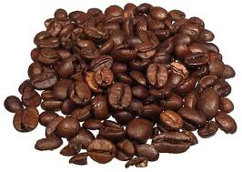


Models
The data of the application
(Can be) Optimized for storage

Slide 148
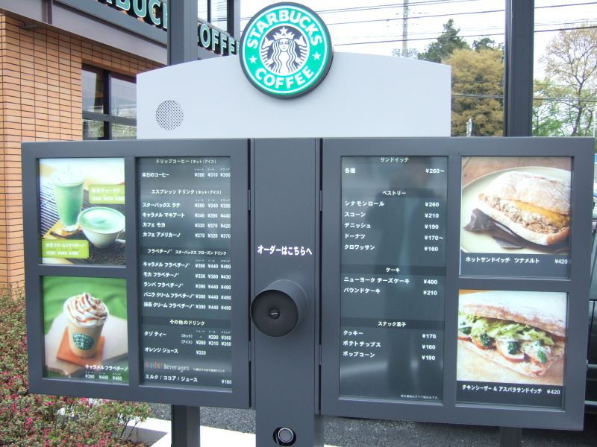
Views
Accepts Interactions from User
Returns results of interactions back to user

Slide 149

View model – Job 1
Façade for individual models
Transport mechanism for models

Slide 150

View Model – Job 2
Process Incoming requests
Perform changes to the model

Slide 151
Why MVVM?

Slide 152

Don’t Repeat Yourself

Slide 153

Separation Of Concerns

Slide 154
MVVM != 0 Code Behind
Temper your actions with wisdom
Code Behind is hard to test
Complicated markup is hard to understand

Slide 155
Implementing MVVM in WPF

Slide 156
MVVM By Hand

Slide 157

UI Interaction

Slide 158
Challenges
Challenges
Must keep separation of concerns
Must still be testable
One suggestion
Create Interfaces representing UI
Code to UI instead of element
Another suggestion:
Create notification system
More complicated, more powerful

Slide 159
Create and Leverage Interfaces
public interface IAnimationController { void StartAnimation(); void EndAnimation(); } public override void Execute(object parameter) { _param = parameter as LoginParameter; if (_param == null) { return;} _param.AnimationController.StartAnimation(); _bgw.RunWorkerAsync(_param); }

Slide 160
UI Interaction

Slide 161
Review
MVVM is a pattern
Not a specific implementation or code sample
Goal is to increase
Single Responsibility
Code Re-use (DRY)
Testability
SOLID
Many frameworks available
Pick the one that best matches your needs

Slide 162
Custom Dictionaries

Slide 163
Custom Dictionaries
Enable by setting SpellCheck.IsEnabled=“True”
Text File (<name>.lex) for custom words
Add as a resource, assign to the CustomDictionaries collection, copy to output directory
Four languages supported
English, Spanish, German, French

Slide 164
Custom Dictionaries

Slide 165
Asynchronous Everywhere

Slide 166
async - await
await is the easiest way to run asynchronously and in order
private async void DownloadPage()
{
HttpClient client = new HttpClient();
string bing = await client.GetStringAsync("http://www.bing.com");
string ms = await client.GetStringAsync("http://www.microsoft.com");
}

Slide 167
Tasks
Tasks provide more control, like running in parallel
private async void DownloadPage()
{
HttpClient client = new HttpClient();
var tasks = new Task<string>[]
{
client.GetStringAsync("http://www.bing.com"),
client.GetStringAsync("http://www.microsoft.com"),
};
int first = await Task.WaitAny(tasks);
string firstPage = tasks[first].Result;
}

Slide 168
Windows 8.1

Slide 169
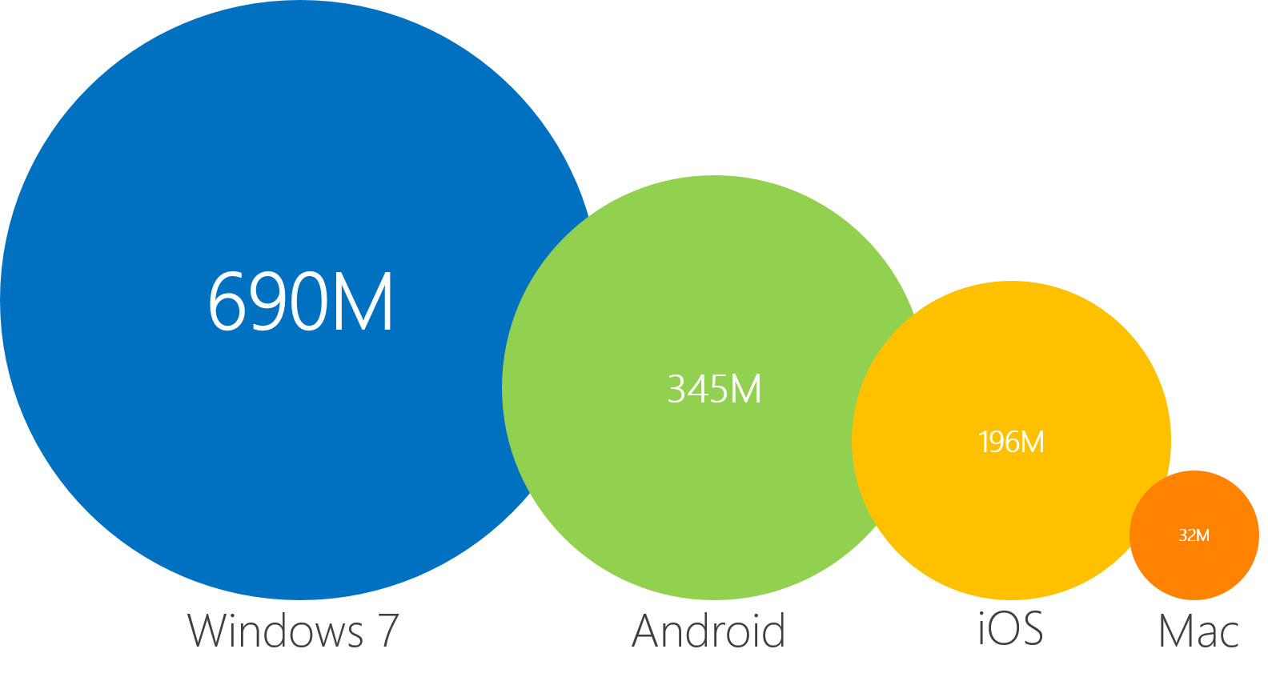
Windows 8.1 is Windows vNext
Units Since Launch of Windows 7 as of March 2012, IDC
Notes:
As of now, over 700M Windows 7 licenses have been sold, all of which can be upgraded to Windows 8. And we expect to see 450M new PC purchases in the 5 quarters, all of which will be running Windows 8. (Goldman Sachs estimate for October 2012 to December 2013)
PC versus smartphones
With smartphones surpassing PCs in annual shipments, some people recommend that entrepreneurs focus only on the phone. And of course, there’s lots of opportunity and we’re excited about Windows Phone and our partnership with Nokia.
But at the same time, we see huge opportunity and value creation happening with experiences on the PC/web. If you take a look at major SW exits, IPOs in the last 12 months, you’ll find the vast majority of the action is happening there.
Of course, the folks in the second column also create mobile apps. But often their PC experience dominates revenues thanks to higher ad rates (>5x) and/or engagement.
Windows 8 creates new opportunities
A common pushback might be that it’s hard to get noticed on the PC as an entrepreneur because there are so many incumbents. “Isn’t it better to focus on mobile since it’s new and growing?” Of course, there isn’t a universal answer and you might be interested in a problem space that’s only relevant to mobile (like phones).
What you’ll be surprised to know is that the PC as a device is being completely reimagined with Windows 8.
Modern UI – Touch (in addition to mouse / keyboard)
Easy app discovery – Windows Store
Exciting form factors – Tablet, All in one, Hybrids
Seamless across devices – Cloud storage, universal app model
And the fact that this is happening at the scale of Windows – 400M units annually – creates massive opportunities for new entrants and entrepreneurs.

Slide 170
User Interfaces Reimagined

Slide 171
Traits of Modern Application Design
Be Fast and fluid
Size beautifully
Use the right contracts
Invest in a great Tile
Feel connected & alive
Roam to the cloud
Embrace Modern Design principles

Slide 172
Modern Design Principles
Show pride in Craftsmanship
Be authentically digital
Do more with less
Win as One

Slide 173
Content Before Chrome
Skeuomorphism (noun) - an object or feature which imitates the design of a similar artefact in another material.
Windows 8.1 Goal – anti-skeuomorphism
Common Chrome
Layout
Interactions
Navigation

Slide 174
Notes:
The shift in focus is crucial – it means that the users, instead of remembering how to use the software, are remembering the content – the news story they read about, the social updates from their friends, the products they are shopping for.

Slide 176
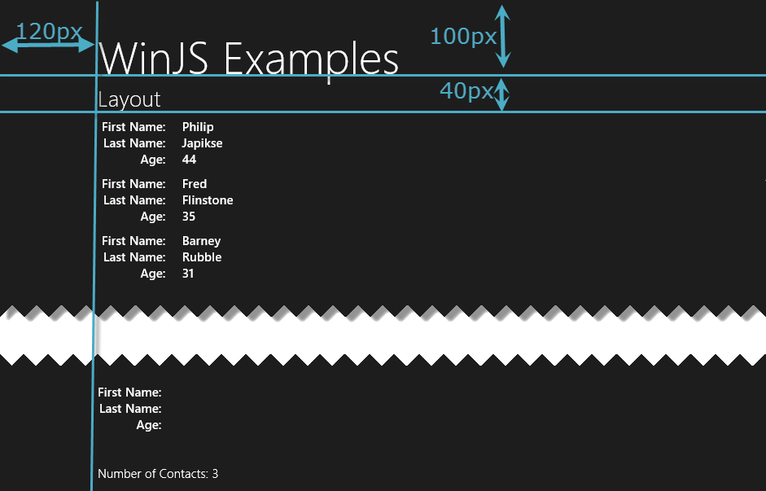
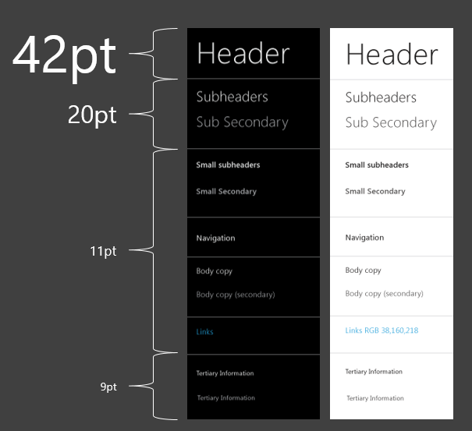
Layout Guidelines

Slide 177
Scale Beautifully
Orientation
Landscape
Portrait
Edges
Left
Right
Both
Scaling
Windows 8.1 supports many form factors – so should your app

Slide 178
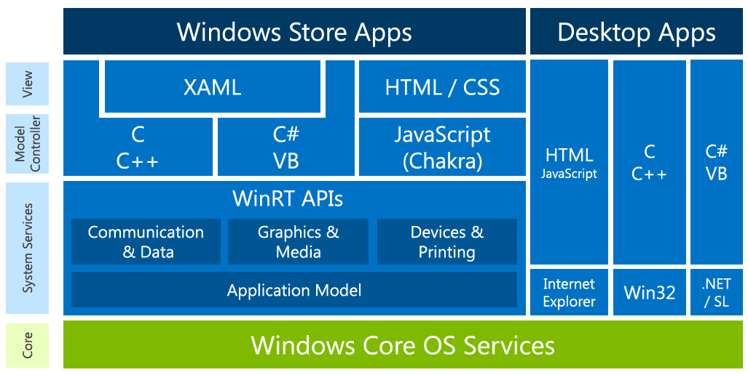
Windows 8.1 – (C# || VB.NET)/XAML
Notes:
You are here !! The focus will be HTML/JS…
Click… But do remember WInRT is helping.. And is available to provide infrastructure.. We will see a little bit of WinRT in action in some demos

Slide 179
Windows 8.1 Controls

Slide 180
Many Controls Out of the Box
Designed for
Touch
Mouse
Keyboard
Follow Modern Application Design Principles
Native to XAML/HTML

Slide 181




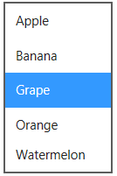

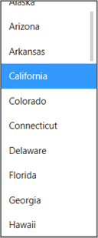




Everyday Widgets
Button
Hyperlink
Ratings*
ListBox
Checkbox
Slider
Combo Box
Progress Bar
Time Picker
Progress Ring
Date Picker
Toggle Switch
Radio Button

Slide 182


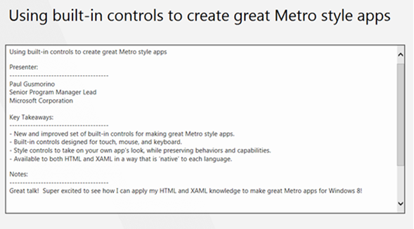
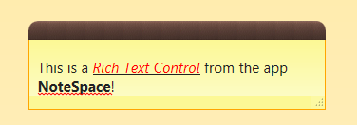
Text Editing Controls
Single-Line Text Box
Clear Button
Password
Reveal Button
Multi-Line Text Box
Rich Text Box

Slide 183
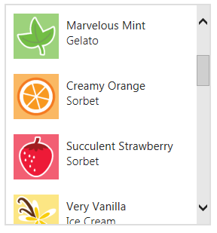
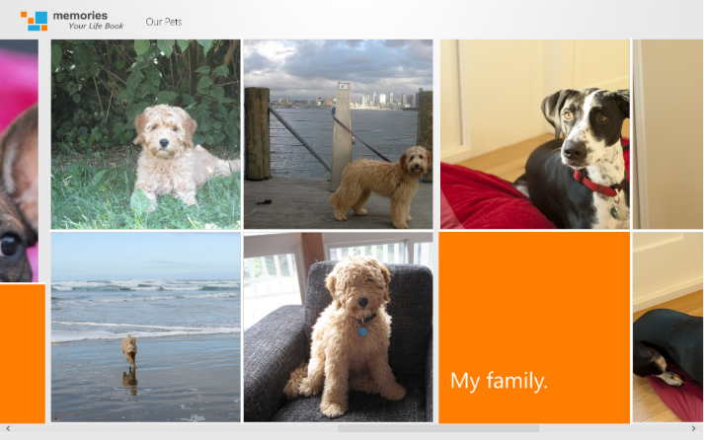

Data views
List View
Grid View
Flip View

Slide 184
Windows 8.1 Application

Slide 185
Why Add XAML Basic Page?
Updates the layout of your application
Adds framework classes (including)
Navigation
RelayCommands
SuspensionManager
Observable Dictionary
For more information see ReadMe.txt (also added to the project)

Slide 186
Why Use XAML Resources?
Resources are
Reusable
Easier to maintain
Easier to localize

Slide 187
Application Architecture

Slide 188
Architecture – (C# || VB.NET)/XAML
App.xaml + App.cs
Frame
pagex.xaml + pagex.cs
(injected into Frame as navigation occurs)
pages
pages

Slide 189
NavBars, AppBars, CommandBars

Slide 190
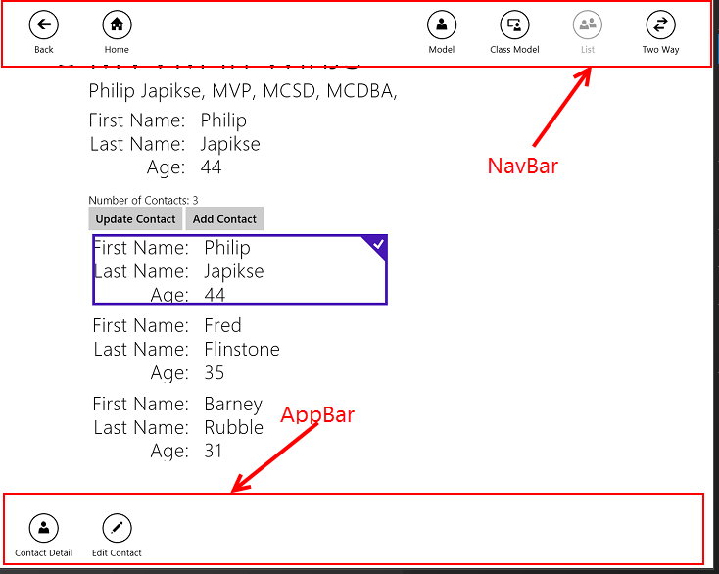
AppBars and CommandBars (CS)

Slide 191

AppBars Simplified In Windows 8.1 (CS)
<Page.TopAppBar> <CommandBar> <CommandBar.SecondaryCommands> <AppBarButton Label="AppBarButton" Icon="Filter"/> </CommandBar.SecondaryCommands> <AppBarButton x:Name="SearchNav" Label="Search" Icon="Zoom" Click="SearchNav_Click"/> <AppBarButton x:Name="ShareSourceNav" Label="Share (Source)" Icon="Forward" Click="ShareSourceNav_Click"/> </CommandBar> </Page.TopAppBar>

Slide 192
Navigation (CS)
private void ppBarButton_Click(object sender, RoutedEventArgs e) { this.Frame.Navigate(typeof(PhotoPage)[, myArgs]); } protected override void OnNavigatedTo(NavigationEventArgs e) { if ((SearchActivatedEventArgs)e.Parameter != null) { //Do something } }

Slide 193
Layout

Slide 194
Use Visual State Groups (CS)
Create a Visual State for each layout (XAML)
Add Storyboard for each control
Handle the size changed event (Code)
Use portrait Visual State Group
Height > Width
ApplicationViewOrientation == ApplicationViewOrientation .Portrait
Use VisualStateManager.GoToState

Slide 195
Visual State Groups (XAML)
<VisualStateManager.VisualStateGroups> <VisualStateGroup> <VisualState x:Name="DefaultLayout"> <Storyboard> </Storyboard> </VisualState> <VisualState x:Name="Portrait"> <Storyboard> <ObjectAnimationUsingKeyFrames Storyboard.TargetProperty="(StackPanel.Orientation)" Storyboard.TargetName="imagePanel"> <DiscreteObjectKeyFrame KeyTime="0"> <DiscreteObjectKeyFrame.Value> <Orientation>Vertical</Orientation> </DiscreteObjectKeyFrame.Value> </DiscreteObjectKeyFrame> </ObjectAnimationUsingKeyFrames> </Storyboard> </VisualState> </VisualStateGroup> </VisualStateManager.VisualStateGroups>

Slide 196
Size Changed Event (XAML/CS)
<Page x:Name="pageRoot" x:Class="Lab3.PhotoPage" RequestedTheme="Light" SizeChanged="pageRoot_SizeChanged"> --------------------------------------------------------------------------------
private void pageRoot_SizeChanged(object sender, SizeChangedEventArgs e) { //if (ApplicationView.GetForCurrentView().Orientation == ApplicationViewOrientation.Portrait) if (e.NewSize.Height / e.NewSize.Width >= 1) { VisualStateManager.GoToState(this, "Portrait", true); } else { VisualStateManager.GoToState(this, "DefaultLayout", true); } }

Slide 197
Size changed Event (CS)
protected override void OnNavigatedTo(NavigationEventArgs e) { navigationHelper.OnNavigatedTo(e); this.SizeChanged += PhotoPage_SizeChanged; } protected override void OnNavigatedFrom(NavigationEventArgs e) { navigationHelper.OnNavigatedFrom(e); this.SizeChanged -= PhotoPage_SizeChanged; } void PhotoPage_SizeChanged(object sender, SizeChangedEventArgs e) {
//if (ApplicationView.GetForCurrentView().Orientation == ApplicationViewOrientation.Portrait) if (e.NewSize.Height / e.NewSize.Width >= 1) { VisualStateManager.GoToState(this, "Portrait", true); } else { VisualStateManager.GoToState(this, "DefaultLayout", true); } }

Slide 198
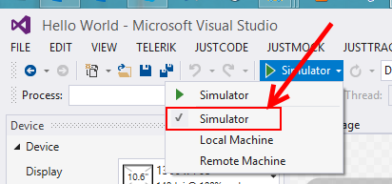
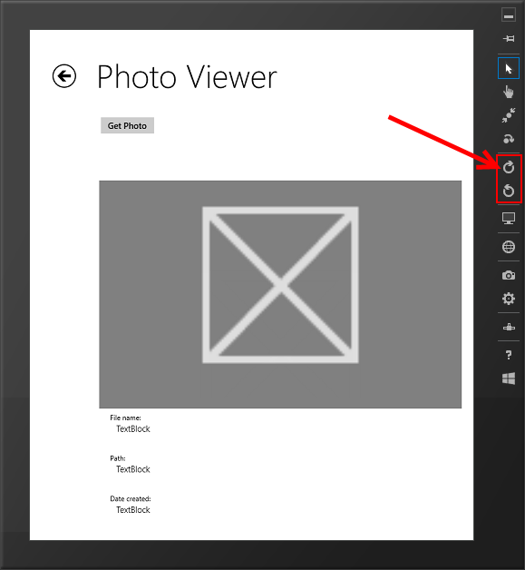
Testing Layout In Simulator

Slide 199
Navigation, Layout, and Views

Slide 200
Key Points - XAML
Navigation commands belong in NavBar
Navigate through Frame object
BackButton is handled through Basic Page
XAML Layout containers flow
Grids and StackPanels
Use Document Outline to wrap controls in a layout

Slide 201
Key Points (Continued)
Create Applications that Snap and Scale
Device Panel
Change layout and dimensions
Record changes based on layout

Slide 202
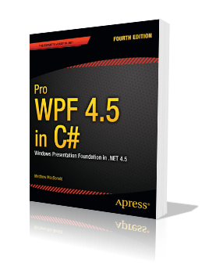
Resources
Pro WPF 4.5 in C#
Mathew McDonald
Apress
http://bit.ly/1wk4AaM
Microsoft Virtual Academy
http://www.microsoftvirtualacademy.com/

Slide 203
Contact Me
Thank You!
philj@interknowlogy.com
www.interknowlogy.com
skimedic@gmail.com
www.skimedic.com/blog
www.twitter.com/skimedic
www.hallwayconversations.com
www.about.me/skimedic

Slide 204
Events
Routed Events replace usual .NET events
Direct
Originate in one element and don’t pass on
Bubbling
Travel up the element tree
Tunneling
Travel down the element tree
Can add event handlers for child elements
<Grid Button.Click=“ClickEvent” …

