Slide 1
Alzheimer’s Awareness Crypto Game
Group 14 - Tom Roller, Michael Jedziniak, Blaine Edwards, Ilyas Khaja

Slide 2
Project Overview
The Alzheimer’s Awareness Crypto Game will be a video game that brings awareness to diseases like Alzheimer’s and other Dementias.
The application is created for the benefit of the Alzheimer’s Association and its mission to help individuals and their families suffering from these diseases by accelerating research, driving risk reduction and early detection, and maximizing quality patient care and support.
The application will have three separate parts:
A game to simulate the experience of those suffering with the disease.
A learning mode where the user can learn more about disease and the Association.
A cryptocurrency mining mode that allows the player to mine for coins to be donated to the Alzheimer’s Association.

Slide 3
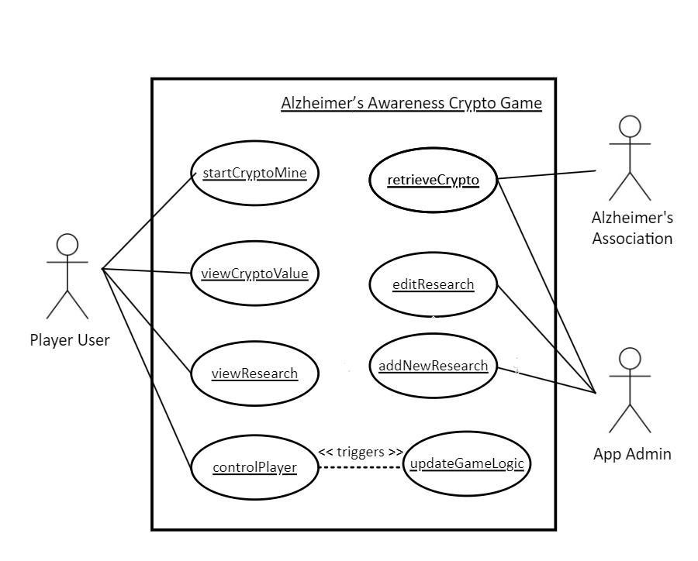
Use Cases
Player User will be able to interact with all frontend sections of the Game (e.g Playing the Game, View Research, and starting Cryptomine)
Alzheimer’s Association User will be the Charity Organisation which can receive the Crypto funds
App Admin User will be able to access all backend sections of the Game such as the Research Database and Crypto Funds.

Slide 4
Requirements & Tests
Functional: Game Interface, Viewing Research, Start/View Cryptomining
Data: Crypto Address
Performance: Game smoothness, How Precise is the Simulation, Simultaneous Users
Dependability: Reliability of Mining, Can the user run 99% of the time?, Crypto service down, Mining safety
Security: Crypto Wallet, User Privacy
Usability: Ease of Use, Multicurrency, Learnability
More requirements etc.

Slide 5
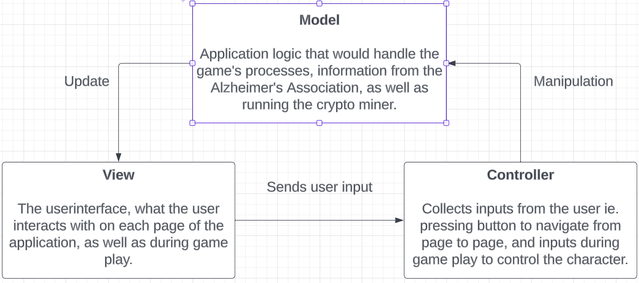
System Architecture (MVC)
The Model handles the applications logic and processes
The View displays everything for the user
The Controller collects all input

Slide 6
Subsystems
There will be 3 main subsystems: Simulation Mode, Learning Mode, and Crypto Miner.
Simulation Mode: The Simulation Mode subsystem will include the backend game logic for managing simulation scenarios, player interactions and responses to player actions, as well as the game UI that the player will interact with via keyboard/controller inputs
Learning Mode: The Learning Mode subsystem encompasses an interactive front end incorporating textual and visual elements to engage the user and reinforce learning.
Crypto Miner: This subsystem handles the crypto mining portion of the application, allowing for customization of the mining process (GPU allocation, mining duration, etc.). An emphasis is placed on security, ensuring that the wallet and transaction processes are fully encrypted and invulnerable.

Slide 7
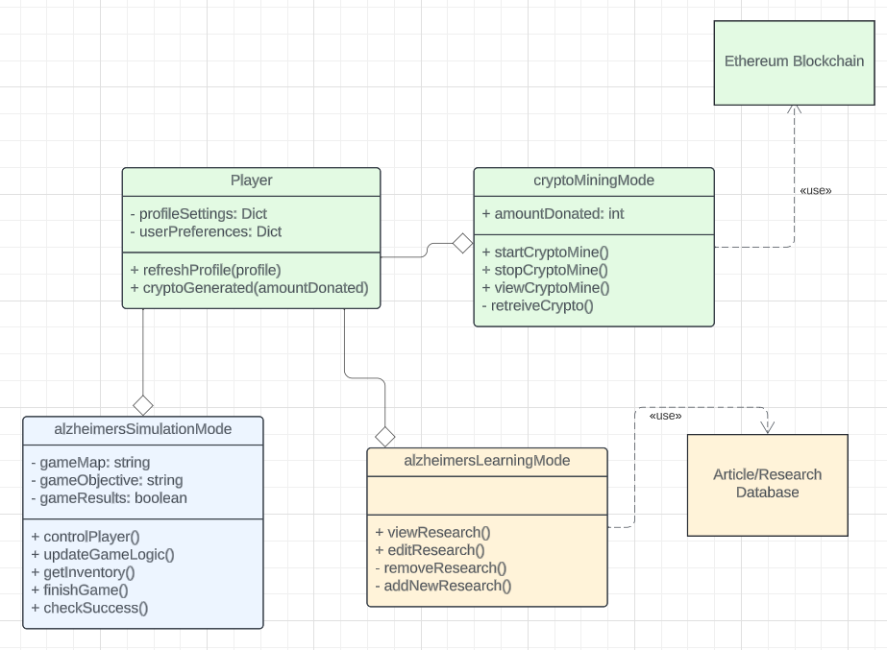
System Design
Green: Crypto Miner Subsystem
Orange: Learning Subsystem
Blue: Game Subsystem

Slide 8
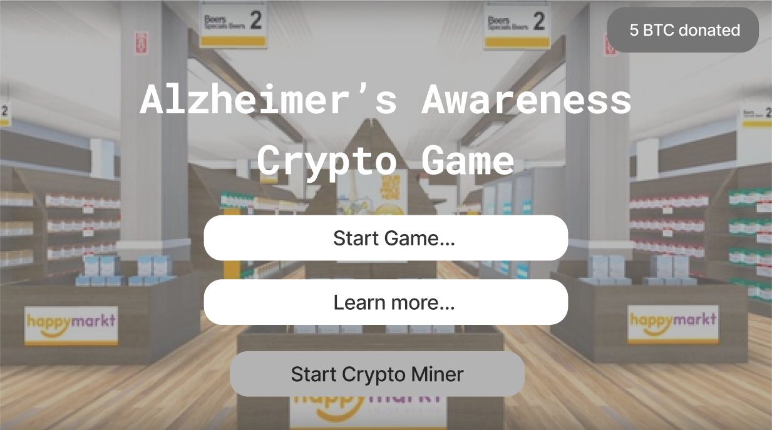
User Interface (Title Screen)

Slide 9
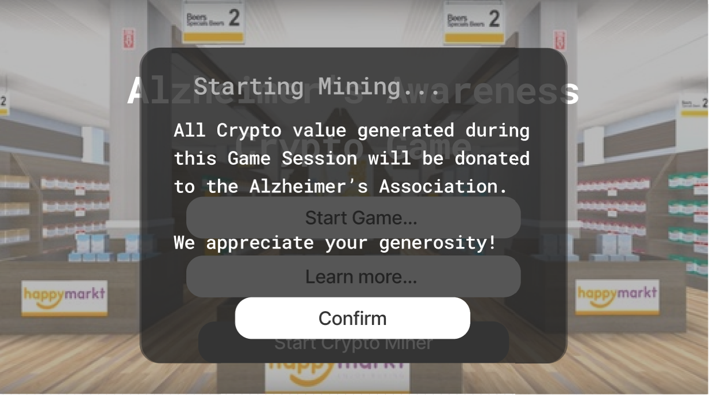
User Interface (Crypto Miner)

Slide 10
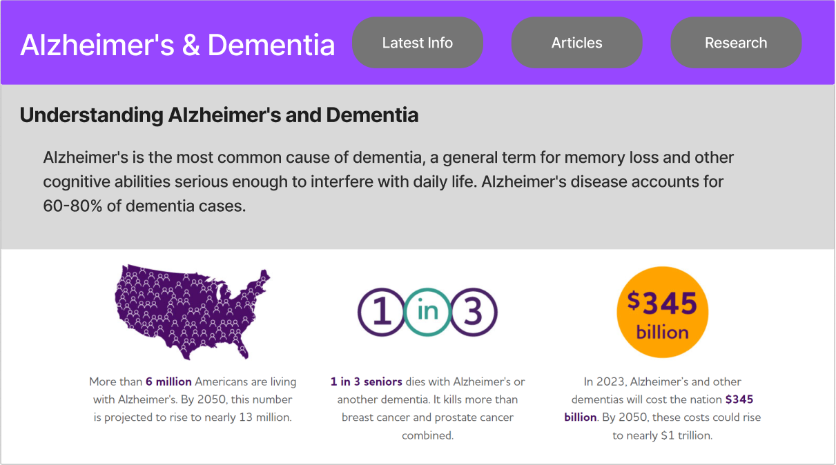
User Interface (Learning Mode)

Slide 11
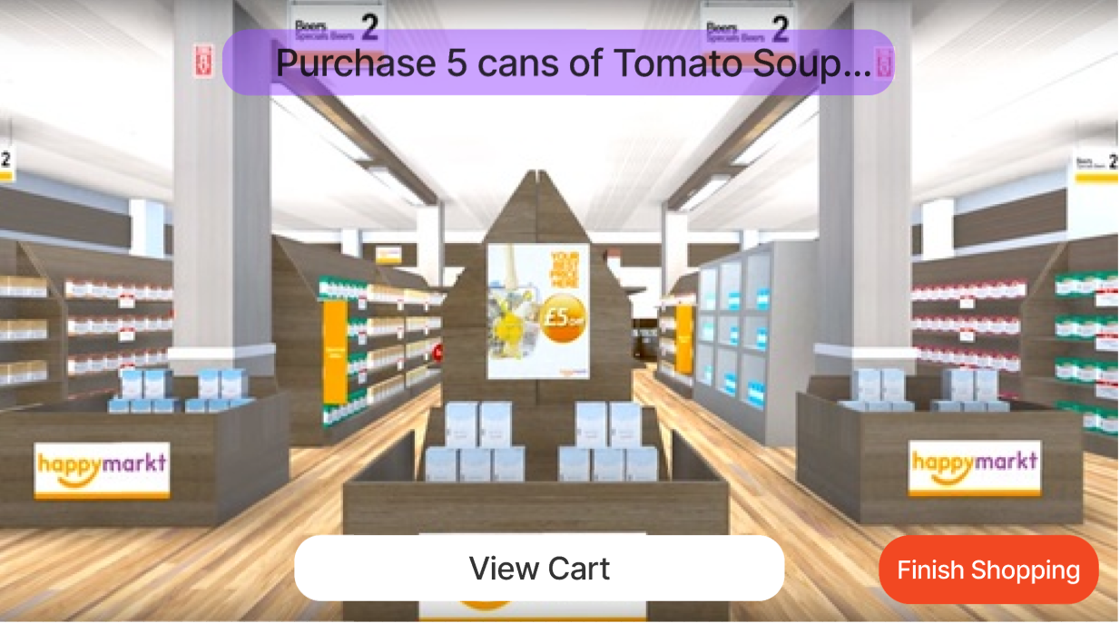
User Interface (Game Mode)

Slide 12
Conclusion & Purpose
Our main goal in creating this project is to help raise awareness and donations to the Alzheimer's Association
The Alzheimer’s Association predicts the number of americans living with alzheimer’s to more than double in the next thirty years. By then we’ll be paying one trillion dollars yearly.
Awareness is key, however donations are also very important and giving everyday users the option to help out easily would be very significant.
Source: Alzeimer’s Association, “Alzeimer’s Disease Facts and Figures”, https://www.alz.org/alzheimers-dementia/facts-figures#:~:text=More%20than%206%20million%20Americans%20of%20all%20ages%20have%20Alzheimer's,older%20(10.7%25)%20has%20Alzheimer's.

