Slide 1

Presentation
Gym class scheduling web application

Slide 2
Table of Contents
Objective
Solution
Architecture
Entity Relationship Diagrams
Testing
Deployment
Technologies Used
Risk Assessment
Improvements for the Future
Authors
Acknowledgements

Slide 3
Objective
To create CRUD application using the feature branch model and with the utilisation of supporting tools, methodologies and technologies that encapsulate all core modules covered during training.

Slide 4
Solution
I have created a gym class scheduling application that would allow the user to book activities/classes at a gym, as well as add, update and delete. There is a many to many relationship between gym and classes, therefore I added a joining table as explained and shown the the ERD below

Slide 5
Architecture - ERD

Slide 6
Testing
Unit Testing has been used

Slide 7
Deployment
The build, test and deployment process was automated using Jenkins, with a webhook to GitHub which was triggered with every push event.
This application can be deployed both locally and externally through a virtual machine.

Slide 8
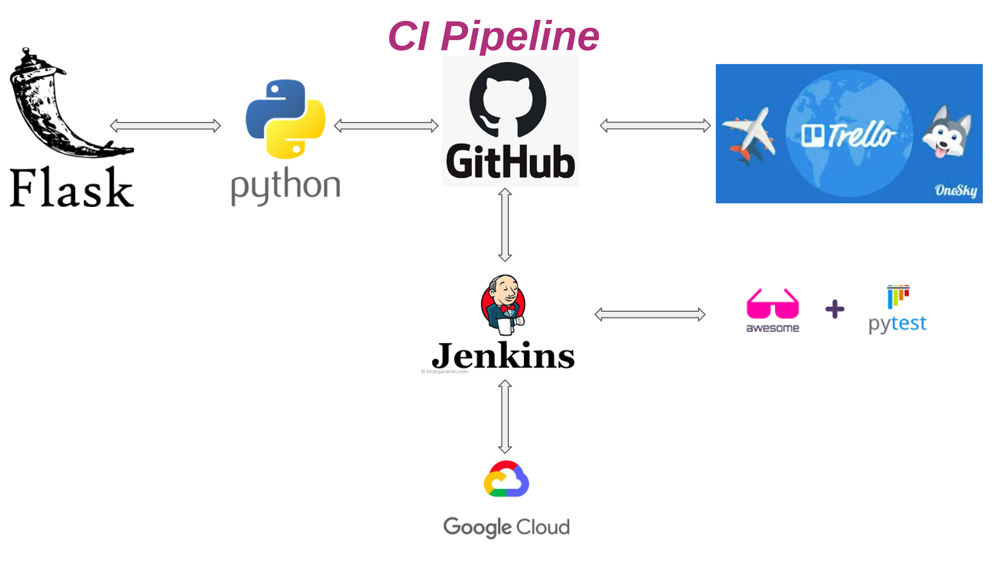

Slide 9
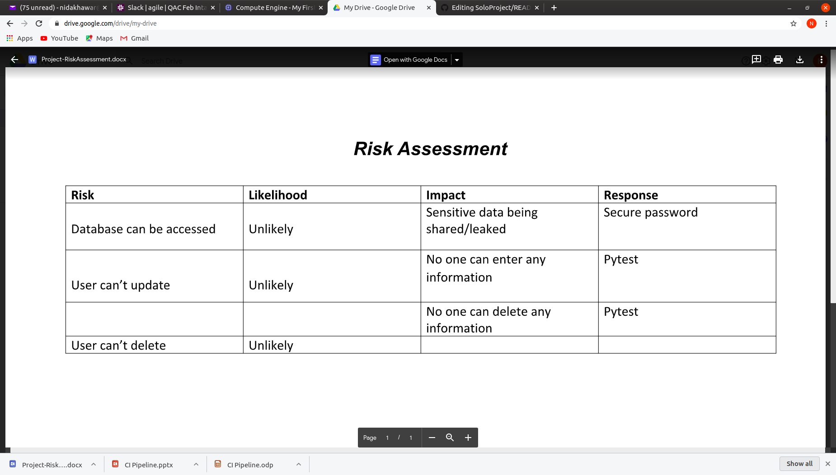
Risk Assessment

Slide 10
Technologies Used
Project Tracking - Trello
Version Control - Git
Database - SQL
Front-end - Flask(HTML)
Programming Language - Python
Unit Testing - Pytest
CI Server - Jenkins
Live Environment - GCP

Slide 11
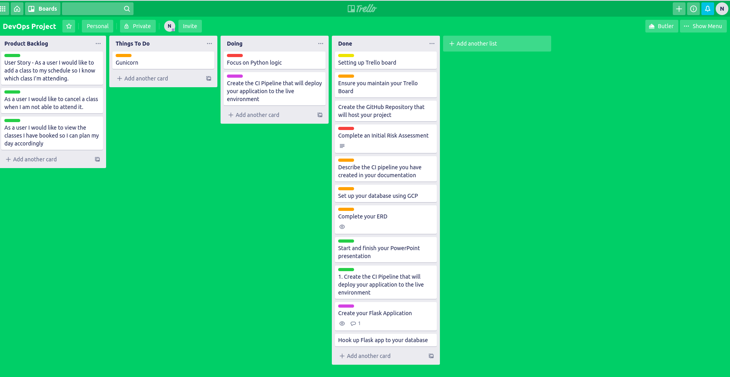
Trello Board

Slide 12
Improvements for the Future
In future I would like to clear my concepts further and add further functionalities to my app, where users are able to perform these functionalities.

Slide 13
Authors
Nida Khawar

Slide 14
Acknowledgements
Special thanks to:
Luke, Ben, Matt
My wonderful team members on the programme

Slide 15
Thanks
Any questions please?

