Slide 1

A
ATTATAE
AI DEVELOPMENT & APPLICATIONS · LONDON
ILLUMINATIO
ATTATAE LTD / ESTABLISHED IN LONDON
Building a Better
Post-Trade Platform
Why it was built, the design choices, and what they make possible
Jeremy Miller
30 years in financial technology
Notes:
Timing: 20 seconds
My name is Jeremy. I have spent around 30 years in financial technology, working across sales, support, business analysis, development and architecture. This is the story of why I built Illuminatio, the design choices behind it, and what those choices make possible.
Transition: The story starts with a frustration that became an epiphany.

Slide 2
A
ATTATAE
AI DEVELOPMENT & APPLICATIONS · LONDON
ILLUMINATIO
The epiphany
The same frustrations appeared across systems, firms and roles
EXPENSIVE CHANGE
Fragmented processes and identifiers
Support handed problems between teams
Bespoke changes made the next upgrade harder
I can do better than this
ATTATAE LTD 02
Notes:
Timing: 55 seconds
Across middle- and back-office systems I kept seeing the same pattern. Simple changes became expensive. Similar processes worked differently in each module. Identifiers changed at every boundary. Support needed several teams to follow one problem. Bespoke customer changes made the next upgrade harder.
The epiphany was simple: I can do better than this. The question was whether an experienced analyst-developer, using modern tools including AI, could build a coherent enterprise post-trade platform without repeating those compromises.
Transition: AI made the experiment practical, but it did not remove the hard part.

Slide 3
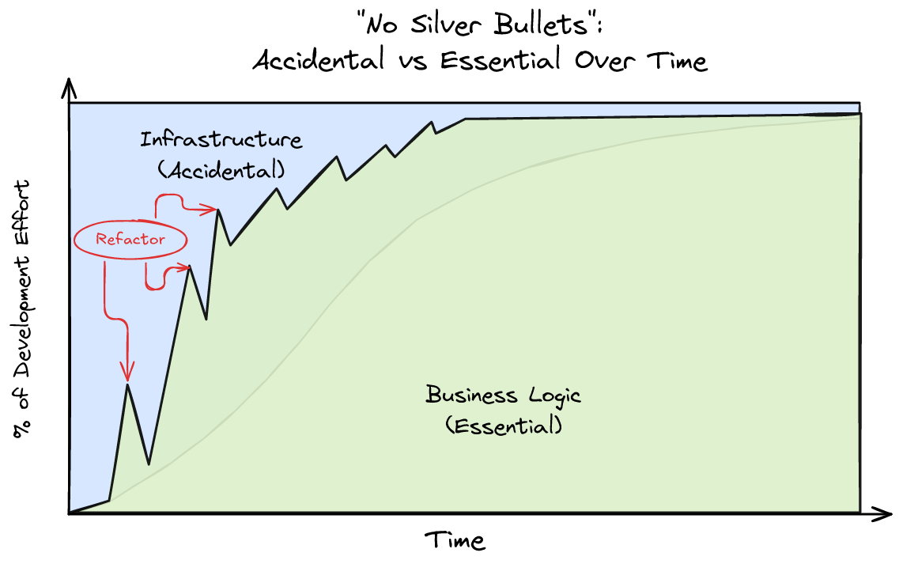
A
ATTATAE
AI DEVELOPMENT & APPLICATIONS · LONDON
ILLUMINATIO
No silver bullet
AI reduces accidental complexity while business judgement remains essential
AI HELPS WITH
Implementation
Test scaffolding
Documentation
Refactoring
Pattern completion
Domain knowledge and architecture still decide what should be built
ATTATAE LTD 03
Notes:
Timing: 55 seconds
Fred Brooks' argument still holds. AI does not remove the essential complexity of finance. It reduces a large amount of accidental complexity around implementation, tests, documentation and repeated patterns.
The graph also captures the iterative development process. When a foundation proved wrong, I stopped, refactored it, and then continued. That stop-the-line discipline prevented a weak pattern from spreading across the estate.
The result depends on domain judgement, architecture, testing and taste. AI amplifies the environment it receives.
Transition: I therefore designed the environment to make the correct path easy.

Slide 4
A
ATTATAE
AI DEVELOPMENT & APPLICATIONS · LONDON
ILLUMINATIO
Design choices that remove friction
A small set of rules shapes every module
01 ONE CANONICAL IDENTITY
04 EVENTS, WORKFLOW AND RULES
The same typed identifier crosses data, APIs, messages, workflow and screens
Accepted facts, recoverable processing, and maker-checker (four-eyes) approval share one framework
02 KISS CLEAN ARCHITECTURE
05 EXECUTABLE SPECIFICATIONS
Infrastructure calls concrete use cases; the domain stays clear
BDD, deterministic data and controlled business time define done
03 CQRS WITHOUT DOGMA
06 OPEN AND FAMILIAR TECHNOLOGY
Commands and queries separate cleanly, with extra infrastructure only when scale justifies it
Java, Spring, SQL, GraphQL, messaging, Docker and established web standards
ATTATAE LTD 04
Notes:
Timing: 80 seconds
Six choices matter most.
First, every addressable object has one canonical typed identity, with external provenance retained explicitly.
Second, the architecture stays simple. Infrastructure calls concrete application use cases, which protect the domain.
Third, command and query responsibilities separate without forcing the heaviest deployment model everywhere.
Fourth, events carry accepted facts while workflow and rules provide recoverable business processing and maker-checker (four-eyes) approval.
Fifth, BDD scenarios, deterministic data and controlled business time make the specification executable.
Finally, familiar technology reduces invention and gives both developers and AI a deep body of knowledge.
Transition: These decisions become more valuable when every service shares them.

Slide 5
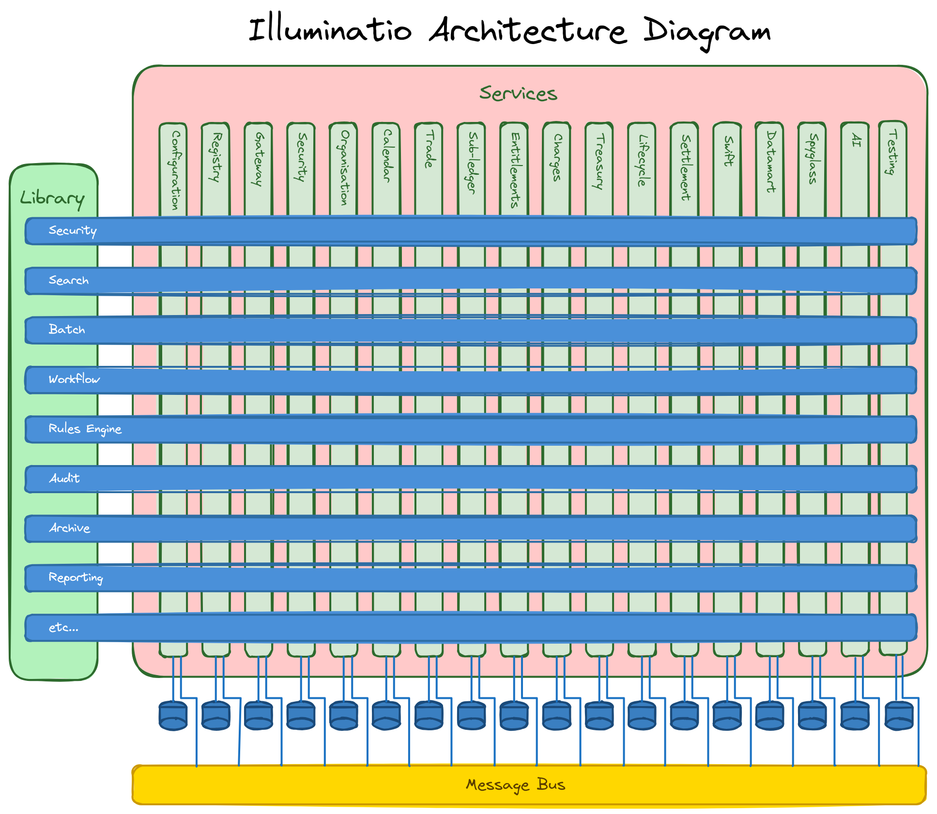
A
ATTATAE
AI DEVELOPMENT & APPLICATIONS · LONDON
ILLUMINATIO
One foundation beneath every service
Business modules add specialisation instead of rebuilding enterprise plumbing
SHARED CAPABILITIES
Security and tenancy
Search and reporting
Batch and scheduling
Workflow and approval
Rules and validation
Audit and archive
Messaging and recovery
Testing and observability
New modules focus on business vocabulary and policy
ATTATAE LTD 05
Notes:
Timing: 75 seconds
This diagram explains the platform-first design. The vertical services own their business data and vocabulary. The horizontal capabilities provide security, search, batch, workflow, rules, audit, archive, reporting and other shared functions. Each service owns its database and communicates through explicit APIs and the message bus.
A trade or settlement module should contain trade or settlement knowledge. It should not invent another workflow engine, security convention or reporting framework. When a shared foundation is missing, I fix the foundation first.
This consistency reduces cognitive load for developers, support teams, users and AI.
Transition: It also removes practical blockers from the complete delivery cycle.

Slide 6
A
ATTATAE
AI DEVELOPMENT & APPLICATIONS · LONDON
ILLUMINATIO
No blockers from laptop to cluster
The platform supports quick progress across the complete client relationship
SALES
Demonstrates
All on a laptop
SUPPORT
Reproduces
The same architecture scales to containers and distributed services
DEVELOPMENT
Changes and proves
Easy to understand
Easy to investigate
Easy to change
Easy to prove
Easy to run
ATTATAE LTD 06
Notes:
Timing: 65 seconds
No blockers is a design requirement. Sales can demonstrate a client need without waiting for a large environment. Support can reproduce a problem and follow the same identifiers, events and workflow locally. Development can change and test the system without competing for a shared environment.
Deterministic data and repeatable scenarios allow useful demonstrations on a laptop. The same architecture can then move into containers and distributed services when volume or resilience requires it.
The wider test is equally important: design, investigation, development, testing, support and deployment should all be easy. If a common activity repeatedly requires specialist knowledge, the platform still needs work.
Transition: Those same boundaries also create a safe environment for embedded AI.

Slide 7
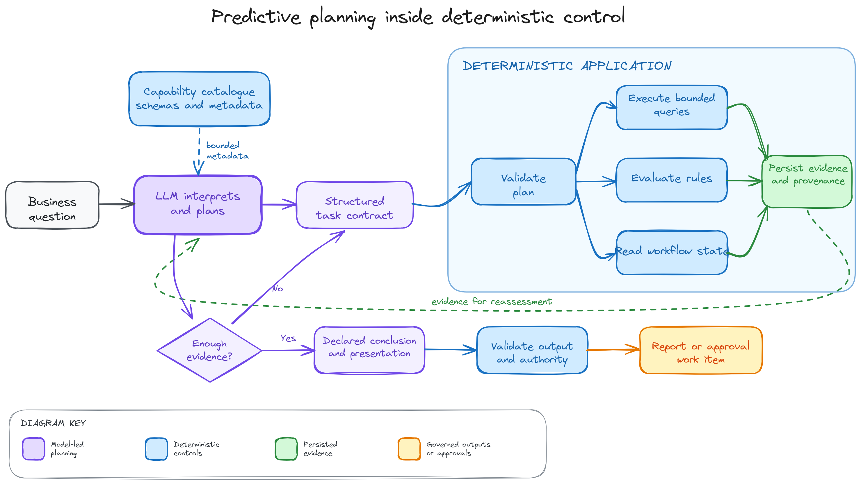
A
ATTATAE
AI DEVELOPMENT & APPLICATIONS · LONDON
ILLUMINATIO
AI inside the application
The model plans the investigation; deterministic code validates and performs the work
ATTATAE LTD 07
Notes:
Timing: 65 seconds
The AI does not receive arbitrary SQL or unrestricted system access. It receives a bounded language of query capabilities, datasets, rules, workflow, navigation and presentation choices.
The model decides which evidence it needs. Deterministic code validates the plan, executes bounded queries, evaluates approved rules and persists the evidence with provenance. Security follows the requesting user.
The current boundary matters. The AI investigates, explains and recommends. It can route a recommendation for human approval, but approval does not yet let the model execute an unrestricted business remediation.
Transition: Rather than describe that process further, I will show it.

Slide 8
A
ATTATAE
AI DEVELOPMENT & APPLICATIONS · LONDON
ILLUMINATIO
Demonstration
One operational break, followed from source to audit evidence
DEMO FLOW
Connected evidence across trade, settlement, payment and posting
AI investigation with bounded queries and deterministic calculations
Recommendation, maker-checker approval and audit evidence
I can do better than this
ATTATAE LTD 08
Notes:
Timing: 4 minutes
Demo path:
1. Open one settlement, payment or reconciliation break.
2. Follow the canonical identifiers and external references across the related records.
3. Start the AI investigation as the current user.
4. Show the structured task, selected capabilities and evidence queries.
5. Show the deterministic comparison or derived dataset.
6. Navigate from the finding to the underlying operational evidence.
7. Show the recommendation and maker-checker approval item.
8. Finish with the audit trail and evidence lineage.
Closing line: The epiphany was that I could do better than the systems that had frustrated me for years. The operating principle became simple: remove unnecessary blockers, respond quickly, and retain control.

