Slide 1

Introduction to React
Michael Jeries
2016-10-27
SEIS 605-02: Technical Communications
Graduate Programs in Software
University of St. Thomas

Slide 2
Purpose
Why
Describe the React javascript library.
How
Getting started with React.js.
Who
This presentation is targeted to other software developers.

Slide 3
Overview
Architecture
React in practice
What is needed to get started

Slide 4
Architecture: Most other frameworks
MVC Framework
Model: Structured data
View: Presentation of data
Controller: Handles all interactions with application
Actions and events can have a cascade effect with other.
Models
Views
Controllers

Slide 5
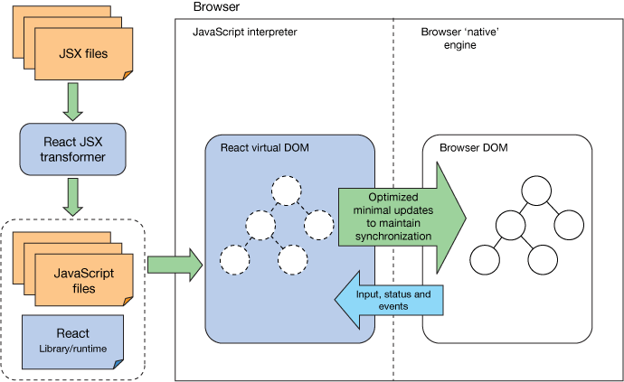
Architecture: React
Unidirectional Data Flow
Virtual DOM Diffing
Components and Composition
JSX: HTML and JavaScript combined
Li, S. (2015) React operations. [Diagram]

Slide 6
Architecture: React (continued)
<ul>
<li class=“web active”>Alice</li>
<li class=“web active”>Bob</li>
<li class=“web active”>Charles</li>
</ul>
shouldcomponentUpdate() returned false
SearchPage
AutoCompleteField
Filters
ResultsList
ResultsBox
SearchBar
Pagination
<ul>
<li class=“web active”>Alice</li>
<li class=“web active”>Bob</li>
<li class=“mobile idle”>Charles</li>
</ul>
Component will update
Component will not update

Slide 7
JSX in action
import { MyReactComponent, ResultsList, MyButton } from ‘./myOtherJSXfile’
export default class MyTopLevelComponent extends React.Component {
constructor(props) {
super(props)
}
shouldComponentUpdate(nextProps) { // if this returns false, all children won’t update
if(nextProps.x === 5) { // the choice of 5 is arbitrary
return false;
}
}
render() {
const { dataArray } = this.props
return <MyReactComponent>
<ResultsList type=“placeholder”>
{dataArray.map((rowItem) => {
return <li> {rowItem.title} </li>
})}
<MyButton color="blue" shadowSize={2}> Click Me </MyButton>
</ResultsList>
</MyReactComponent>
}
}

Slide 8
Using React: Recommendations
Developed internally at Facebook, outside developers do not have access to Facebook’s internal tools.
React tooling maturing rapidly.
Sanctioned starting point built by Facebook
https://github.com/facebookincubator/create-react-app

Slide 9
Using React: Action Items
Install create-react-app with npm.
Pick a bundling approach: Browserify, Webpack*
Pick a data library: Flux, Redux*, MobX, Relay
Pick additional libraries (e.g. in-app routing, prebuilt open source UI components, Google Maps)
*Recommended choice

Slide 10
Summary
React is the View in the MVC paradigm.
React builds upon HTML composition
React redefines separation of concerns when building interfaces.

Slide 11
References
[1] Abramov, D., & O’Shannessy, P. (2016). A JavaScript library for building user interfaces - react. Retrieved October 26, 2016, from https://facebook.github.io/react/
[2] Li, S. (2015, February 27). React: Create maintainable, high-performance UI components. Retrieved October 26, 2016, from https://www.ibm.com/developerworks/library/wa-react-intro/

Slide 12
Questions?

