Slide 1
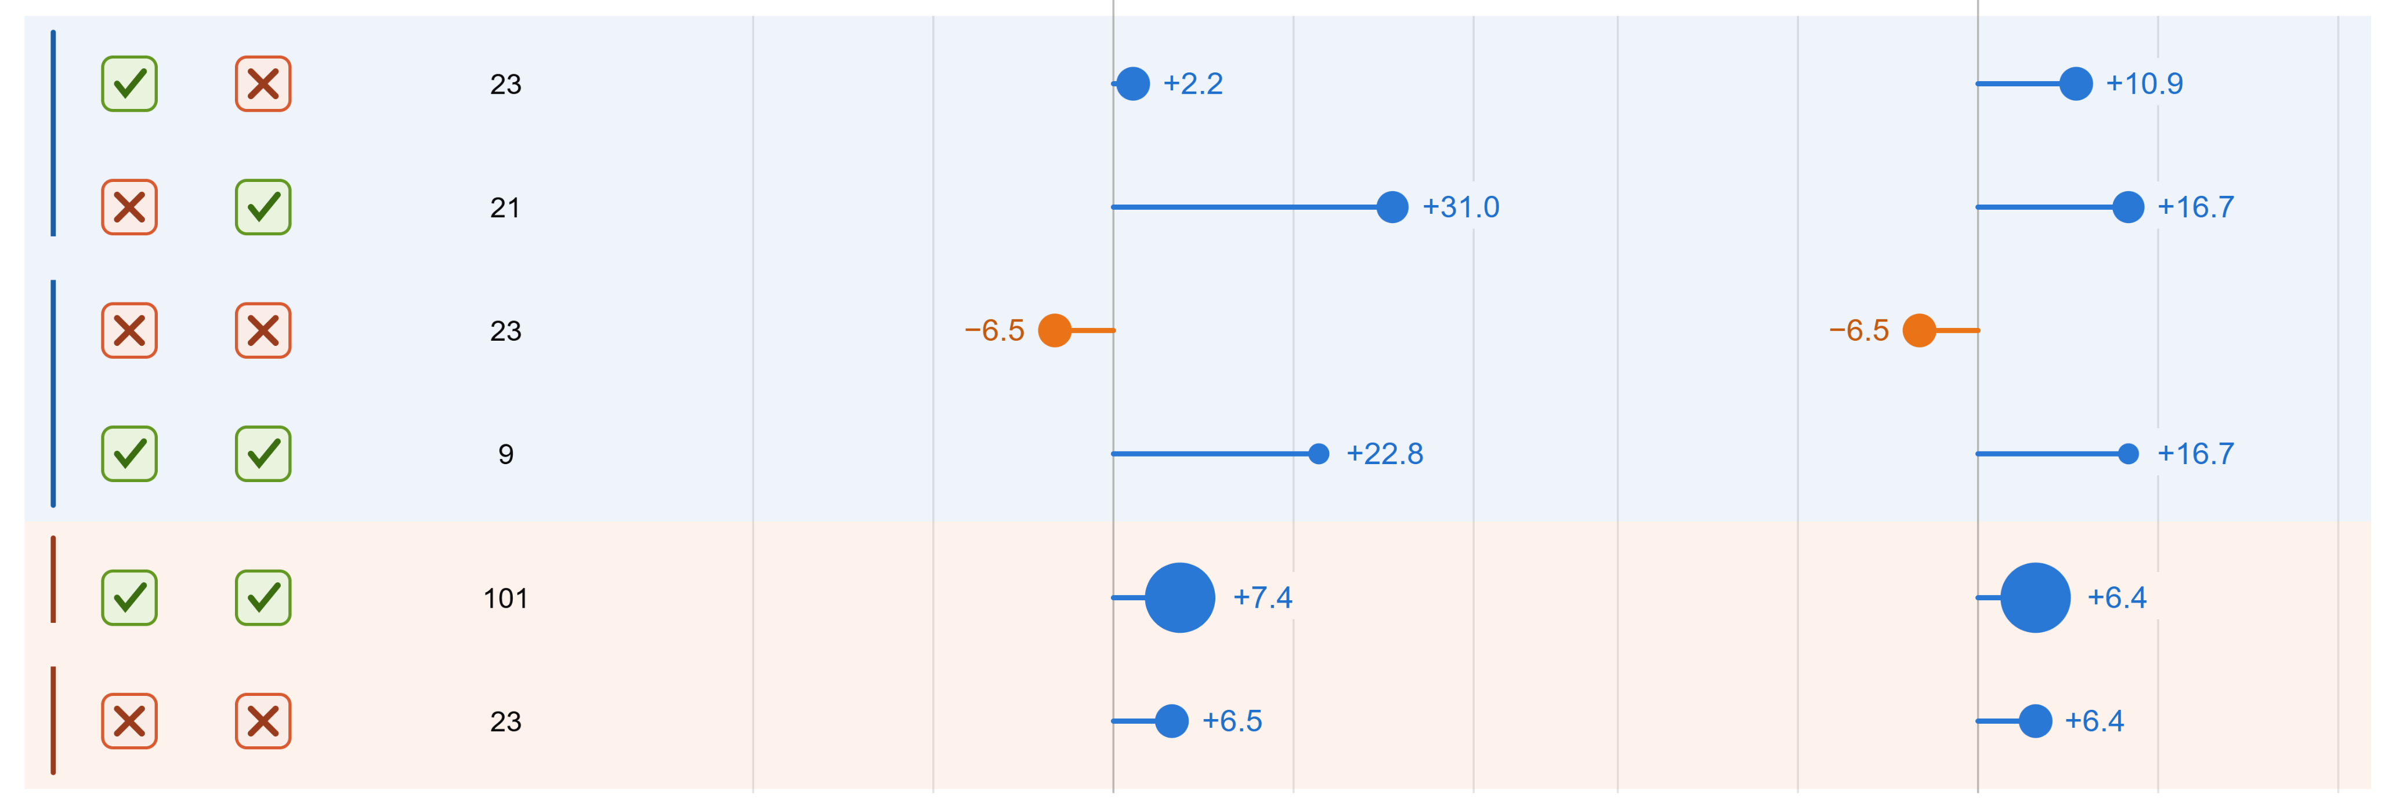


Grounded in scene?
Lateral ADE
Longitudinal ADE
S
R
n
50%
50%
21
21
CoT changed
23
9
101
CoT same
23
-40
-20
0
20
40
-40
-20
0
20
40
Win rate vs. baseline (pp from 50%)
Win rate vs. baseline (pp from 50%)
baseline wins RL wins

Slide 2



The Reasoning Chain
See
Think
Act
Move Justification
z₂
E1
Scene
z₁
E2
E3
E4
Observation
camera • ego
Meta-Action z₃
Action
waypoints
E5
E1 • scene grounding
E2 • justification entailed by scene
E3 • meta-action follows justification
E4 • trajectory realizes meta-action
E5 • trajectory enacts justification

Slide 3
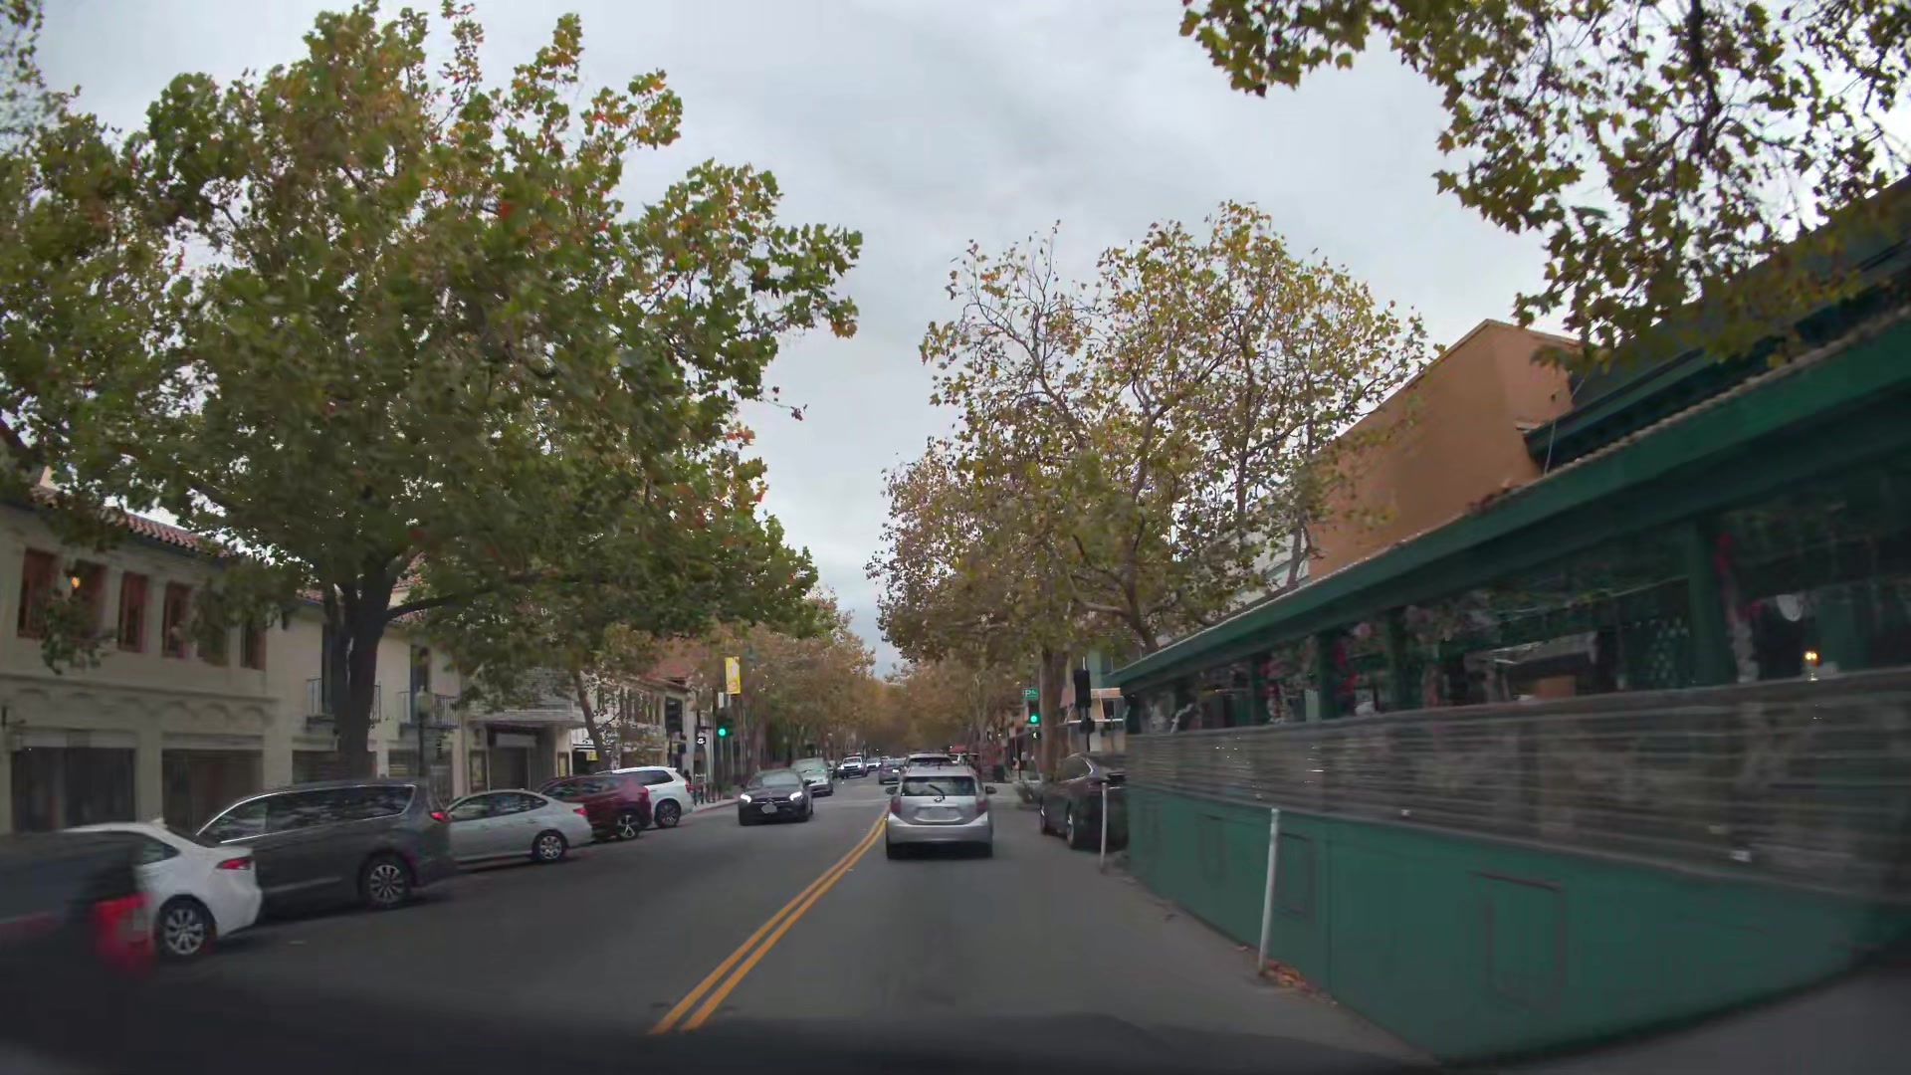
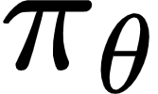


Observed After the Fact
Embodied Chain-of-Thought
Scene
Faithfulness
Robot Policy
Justification
Evaluation
Read-only
Meta-Action
Waypoints
❌ cannot update the policy
Robot Actions
“Proceed straight to the intersection ahead …”
trajectory error
reward

Slide 4
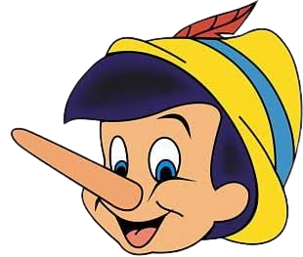
Optimized in the Loop
Embodied Chain-of-Thought
Scene
Faithfulness
Robot Policy
Justification
Pinocchio
A learned critic
Meta-Action
Waypoints
“Proceed straight to the intersection ahead …”
Robot Actions
faithfulness
reward
trajectory error
reward
+

