Slide 1


Honeypots and IoT Security
Featuring Two Honeypots you can build yourself with a Raspberry Pi
Mike Fernez
FCM 745
Muath Obiadat

Slide 2
Outline
What is a honeypot?
  Types of honeypots
  Research
Why IoT?
  Raspberry Pi
Demo
  HoneyPi made by Matt South
  https://github.com/mattymcfatty)
  Glastopf made by Lukas Rist
  (https://github.com/mushorg/ )

Slide 3
What is a Honeypot?
Etymology
  From the trope that bears are attracted to steal honey
In networking:
  A server that is designed to to attract, detect, and counteract attempts to probe or attack it
Typical behavior:
  Emulate vulnerabilities and server responses
  Emulate other legitimate servers on the network
  Collect attacks and notify or defend against them
https://en.wikipedia.org/wiki/Honeypot_(computing)

Slide 4
Types of Honeypots
Research Honeypots
  Servers intended to attract attackers so that their behavior can be analyzed
  Can be a high or low interaction honeypot depending on what services are being run
Production Honeypots
  Servers intended to waste time of an attacker by serving as a decoy (and also alerting security)
  Often employ low-interaction honeypots

Slide 5
Current Research on Honeypot Servers
Strategy and Scalability
  How can we deploy and isolate honeypots without disrupting the rest of the network?
IoT Honeypots
  IoT is particularly attractive to attackers because the defaults are often insecure
  Within an IoT network, an insecure-looking honeypot could draw attention away from other devices
Virtualized Honeynets
  VMs allow you to run an entire network within a computer

Slide 6
Weaknesses of Honeypots
Can be easy to spot by attackers
  Since honeypots emulate responses for attacks, the responses themselves can tip off an attacker
Potential to be compromised themselves!
  If connected to a network, a honeypot can be a vector for malware
https://adamdoupe.com/publications/honeyproxy-cns2017.pdf

Slide 7
Why IoT?
IoT Honeypots have several advantages
  Inexpensive (this project cost about $50 total)
  Portable and easy to deploy on network
  Looks like other insecure IoT systems
Disadvantages
  Hardware not ideal for servers, limited to Low-Interaction solutions

Slide 8
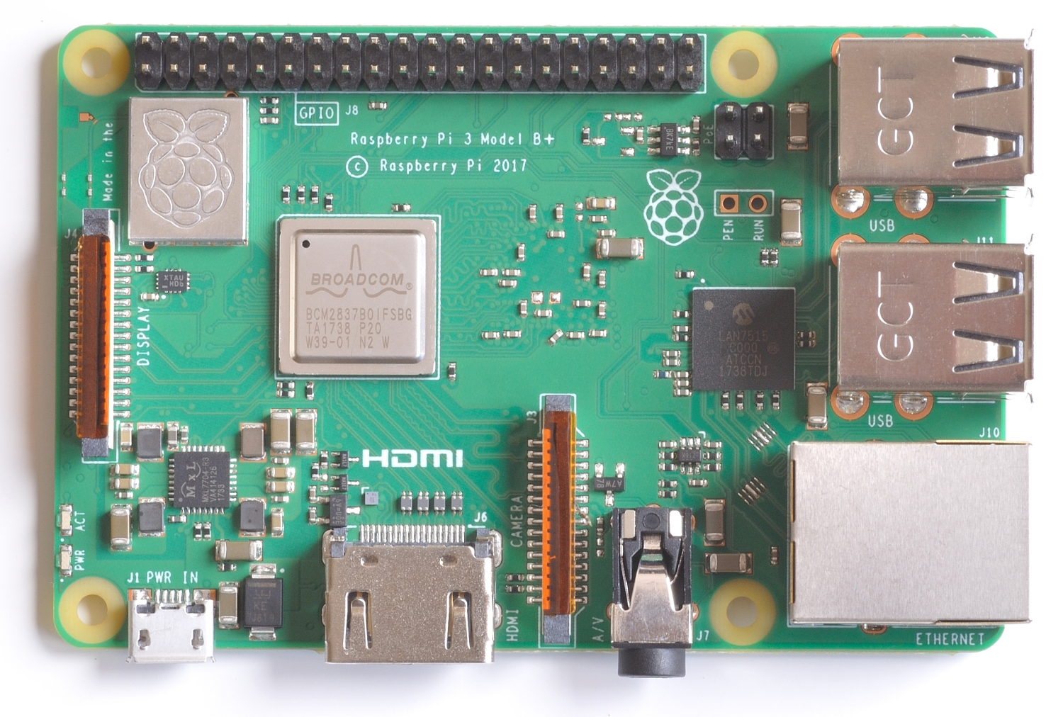
Raspberry Pi 3B+
Small wireless Linux computer
Specs
  1.4GHz Broadcom BCM2837B0 64-bit CPU
  On board wifi and bluetooth
General Purpose Pins
Wi-Fi antenna
USB Port (4)
Processor
DSI display
Ethernet Port
Power
HDMI
Camera
Audio Jack
https://blog.pimoroni.com/introducing-the-raspberry-pi-3-b/
https://www.raspberrypi.org/products/raspberry-pi-3-model-b/

Slide 9
HoneyPi - Installation
Compile from source (for latest updates)
  $git clone https://github.com/mattymcfatty/HoneyPi
  $cd HoneyPi
  $chmod +x *.sh
  $sudo ./honeyPiInstaller.sh
Prompts take you through setting up your iptables, updating, installing PSAD, alert type, and email setup*
  *Note: you will need to generate an app password in order to enable email alerts (https://support.google.com/accounts/answer/185833?hl=en)
https://trustfoundry.net/honeypi-easy-honeypot-raspberry-pi/https://github.com/mattymcfatty/HoneyPi

Slide 10
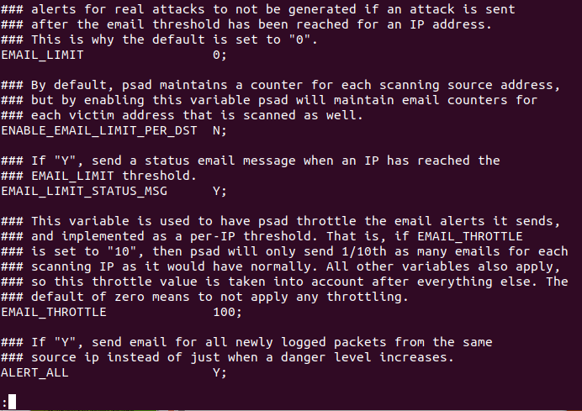
HoneyPi - Tweaks
To avoid getting flooded with emails, I recommend you change this setting in /etc/psad.conf

Slide 11
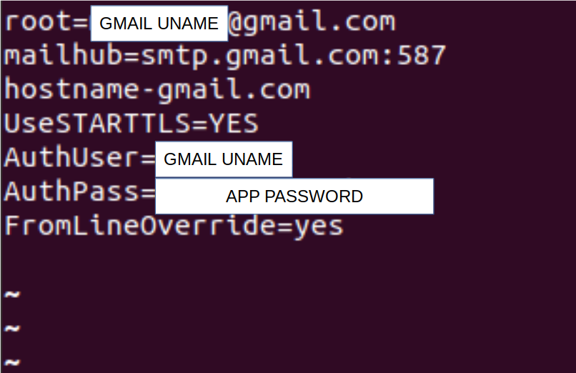
HoneyPi - Tweaks
Your /etc/sstmp/sstmp.conf should look like

Slide 12
HoneyPi – Testing the system
Ping detection (classified as DL 2)
  To do a ping sweep of the network you’re connected to, you can use nmap -sP 10.0.0.0/24
nmap detection (classified as DL 2-4)
  Easy as Pi! $nmap 10.0.0.9
    For the whole subnet: $nmap 10.0.0.0/24
    It can also pick up flags: $nmap -sV 10.0.0.9
    Trying to run decoys will increase noise/raise danger level:
    $nmap -D 10.0.0.7,10.0.0.5,10.0.2.15,10.0.0.29 10.0.0.9
Connection attempts ( classified as DL 3-4)
  Test open ports with $nc 10.0.0.9 21 (or whatever port is open)
  Will even pick up what port hacking attempts were made (attempted privilege escalation, attempted backdoor, attempted DoS)

Slide 13
Glastopf - Installation
Outdated on the links shared below as project is only maintained
1. Installing the dependencies
  Add “deb http://backports.debian.org/debian-backports squeeze-backports main” to /etc/apt/sources.list (without the quotes)
  Put all of the following in a file (like updates.sh) and run it:
    sudo apt-get update
    sudo apt-get install python python-openssl python-gevent libevent-dev python-dev build-essential make
    sudo apt-get install python-argparse python-chardet python-requests python-sqlalchemy python-lxml
    sudo apt-get install python-beautifulsoup python-pip python-dev python-numpy python-numpy-dev
    sudo apt-get install python-setuptools python-scipy libatlas-dev g++ git
    sudo apt-get install php7.0 php7.0-dev liblapack-dev gfortran
    sudo apt-get install libxml2-dev libxslt-dev
    sudo pip install --upgrade distribute
https://resources.infosecinstitute.com/glastopf-pi-a-simple-yet-cool-web-honeypot-for-your-raspberry-pi/

Slide 14

Glastopf - Installation
2. Install PHP Sandbox (BFR – Better Function Replacer)
  Install from source:
    cd /opt
    sudo git clone git://github.com/glastopf/BFR.git
    cd BFR
    sudo phpize
    sudo ./configure --enable-bfr
    sudo make && make install
It should have this following message after the make install:
  Installing shared extensions: /usr/lib/php/20151012/
  *The path/number may be different for you
Add it to your php.ini file:
  $sudo nano /etc/php/7.0/cli/php.ini
  Add "zend_extension = /usr/lib/php/20151012/bfr.so" to the end of this file (no quotes)
If you did it right run $php --version
https://resources.infosecinstitute.com/glastopf-pi-a-simple-yet-cool-web-honeypot-for-your-raspberry-pi/

Slide 15
Glastopf - Installation
3. Install Glastopf
  cd /opt
  git clone https://github.com/mushorg/glastopf.git
  git clone https://github.com/client9/libinjection.git
  git clone https://github.com/mushorg/pylibinjection.git
  cd glastopf
  python setup.py install
4. Prepare your environment:
  Make a directory in /opt to name your honeypot
  All logs and config files will go here
  Run $sudo glastopf-runner to start the serve
5. Make a startup script
  https://www.dexterindustries.com/howto/run-a-program-on-your-raspberry-pi-at-startup/
https://resources.infosecinstitute.com/glastopf-pi-a-simple-yet-cool-web-honeypot-for-your-raspberry-pi/

Slide 16
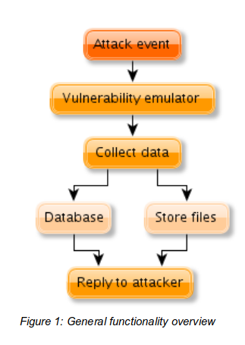
Glastopf - Concept
https://www.honeynet.org/sites/default/files/files/KYT-Glastopf-Final_v1.pdf

Slide 17
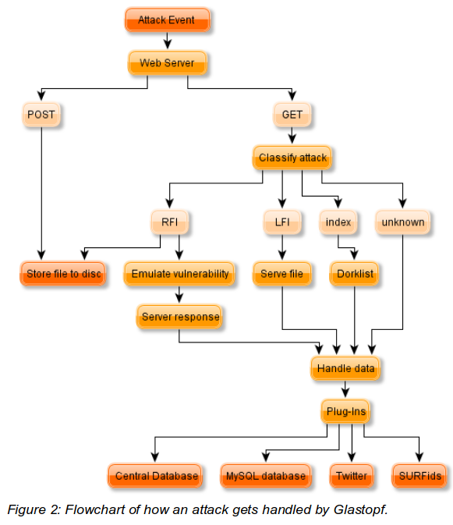
Glastopf - Concept

Slide 18

Glastopf - Concept
Google dorks are the honey
  Attackers running automated scans can search for vulnerabilities via Google
https://www.exploit-db.com/google-hacking-database/
https://nextleveltricks.net/latest-google-dorks-list/
https://null-byte.wonderhowto.com/how-to/use-google-hack-googledorks-0163566/

Slide 19
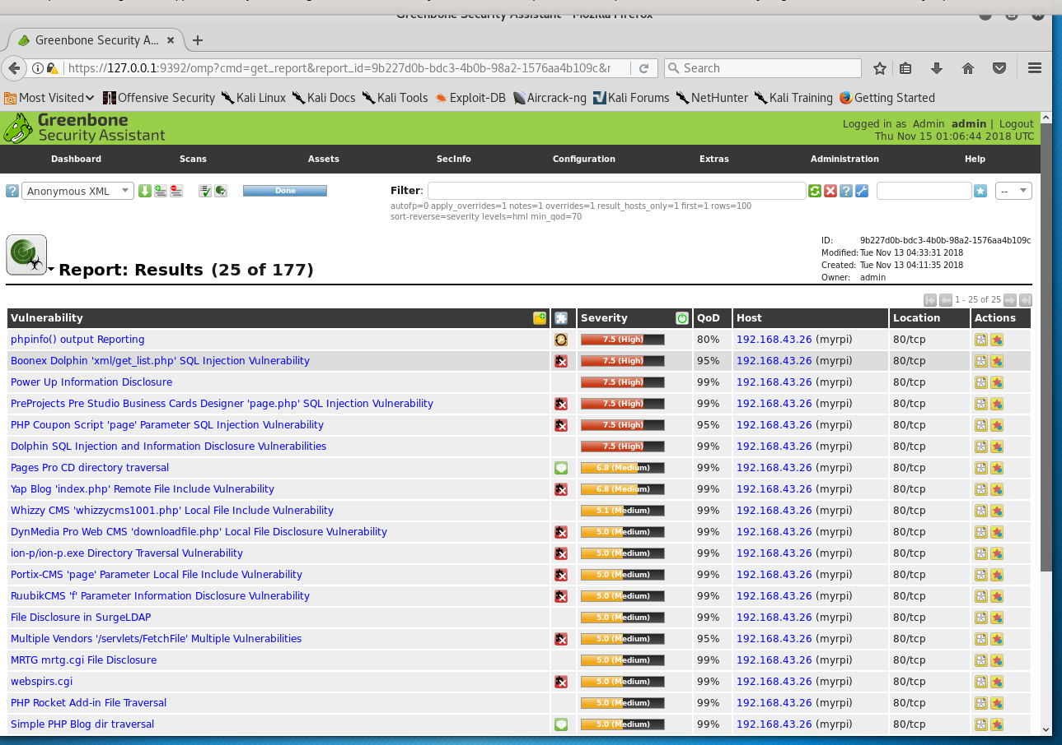
Glastopf – Dork List

Slide 20
Glastopf – Testing the Server
RFI and LFI attacks
  Idea is to get the server to execute php code (stored remotely or locally)
  All scripts shown here can be found on https://github.com/mjfernez/Glastopf-RFI-Test
A Glastopf server is full of dork links (i.e vulnerable php code)
  You can see these enumerated in a tool like burp suite, OpenVAS or Nikto
Your web page lives in /opt/myhoneypot/data/
  Here you can mess around with your site’s cover page to make it seem more like a real website

Slide 21
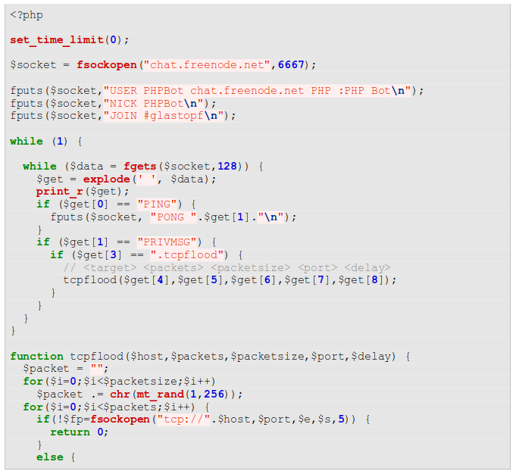
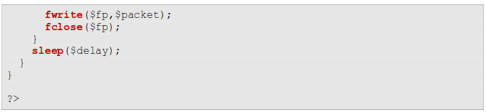
Glastopf – DOS example
Joins IRC Channel
Sets up Listener
Spams packets with random chars

Slide 22
Glastopf – Glastopf Analytics
This tool provides a handy web interface to analyze attacks:
https://github.com/katkad/Glastopf-Analytics
  Install libcpan-sqlite-perl,libdancer2-perl,libgeo-ip-perl
  Change username and password if needed in /lib/MyWeb/App.pm
  ~/Glastopf-Analytics$ perl ./bin/app.pl
  Connect on port 3000

Slide 23
References
Research
  G. K. Sadasivam and C. Hota, "Scalable Honeypot Architecture for Identifying Malicious Network Activities," 2015 International Conference on Emerging Information Technology and Engineering Solutions, Pune, 2015, pp. 27-31. doi: 10.1109/EITES.2015.15
  S. Djanali, F. Arunanto, B. A. Pratomo, A. Baihaqi, H. Studiawan and A. M. Shiddiqi, "Aggressive web application honeypot for exposing attacker's identity," 2014 The 1st International Conference on Information Technology, Computer, and Electrical Engineering, Semarang, 2014, pp. 212-216. doi: 10.1109/ICITACEE.2014.7065744
  Wafi, Hibatul & Fiade, Andrew & Hakiem, Nashrul & Bahaweres, Rizal. (2017). Implementation of a modern security systems honeypot Honey Network on wireless networks. 91-96. 10.1109/YEF-ECE.2017.7935647.
  http://people.etf.unsa.ba/~smrdovic/publications/TETFOR2017_Semic_Mrdovic.pdf

Slide 24
Extra Resources
Excellent reviews of Glastopf and it’s capabilities
  https://www.youtube.com/watch?v=ElzDqPrGZpM
  https://www.youtube.com/watch?v=SKqbHPnLnVI
Vulnerability Scanners
  Open VAShttps://tools.kali.org/vulnerability-analysis/openvas
  Nikto https://cirt.net/nikto2
The Honeynet Project
  http://www.honeynet.org/
Long list of honeypots:
  https://github.com/paralax/awesome-honeypots

