Slide 1

A CLOSER LOOK AT KECCAK
Keccak Basics
  Parameters
  Sponge Function
Internal Structure
  Padding
  F-functions
Security and Performance Analysis

Slide 2
PARAMETERS
All SHA-3 functions are governed by 4 main parameters:
  Output bits—the length of the message digest: 224, 256, 384, and 512
  b—buswidth, b=25*2^l where 2^l is the width of a processor’s register
    For SHA-3 this is fixed for a 64-bit processor b=1600 bits
  r—rate (defines the speed)
  c—capacity (defines the security)
https://keccak.team/keccak_specs_summary.html

Slide 3
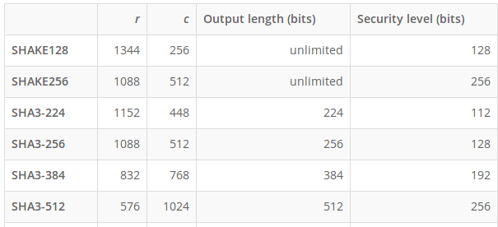
PARAMETERS
https://keccak.team/keccak_specs_summary.html

Slide 4
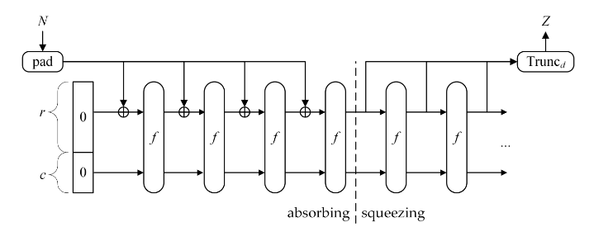
SPONGE FUNCTION
SHA-3 HASH
Stops here
https://nvlpubs.nist.gov/nistpubs/FIPS/NIST.FIPS.202.pdf

Slide 5
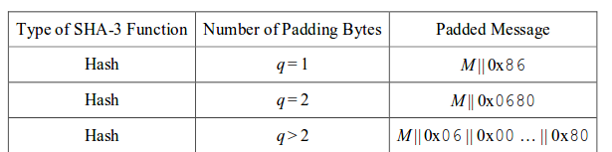
INTERNAL STRUCTURE: PADDING
Main goal of padding is to make sure message is divisible by r
Here, the length of the padding is:
r/8-M/8 mod (r/8), where M is length of the message
https://keccak.team/keccak_specs_summary.html
https://nvlpubs.nist.gov/nistpubs/FIPS/NIST.FIPS.202.pdf

Slide 6
EXAMPLE
Let’s say we’re taking the hash of a 1kB file using SHA-3 256:
B=1600, r=1088, c=512
  We start with 1600 bits of zeros and xor the first 1088 bits of the padded message
Padded M is 1kB plus padding (88B) or 8704 bits
  So we absorb 8 times for each chunk of the padded message
After the last absorption, we rip off the first 1088 bits, and truncate to 256 bits (64 characters)

Slide 7
INTERNAL STRUCTURE: F-FUNCTIONS
Consists of 5 functions that each run for 24 rounds:
  Theta (θ)
  Pi (π)
  Rho (ρ)
  Chi (χ)
  Iota (ι)
These functions operate by organizing the input block into a 3-d array 5x5x64
http://www.crypto-textbook.com/
https://github.com/XKCP/XKCP/blob/master/Standalone/CompactFIPS202/Python/CompactFIPS202.py

Slide 8
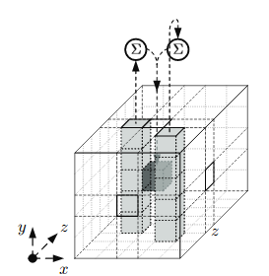
INTERNAL STRUCTURE: F-FUNCTIONS
Theta (θ): takes the XOR sum of 11 bits

Slide 9
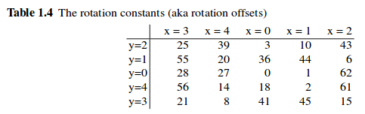
INTERNAL STRUCTURE: F-FUNCTIONS
Rho (ρ) and Pi (π)
  ρ bit rotates each of the 64-bit lanes by a fixed amount
  π permutes these lanes with others

Slide 10
INTERNAL STRUCTURE: F-FUNCTIONS
Chi (χ)
  take lane [x+2,y] AND inverse of lane [x+1, y]
  XOR this result with lane (x,y)

Slide 11
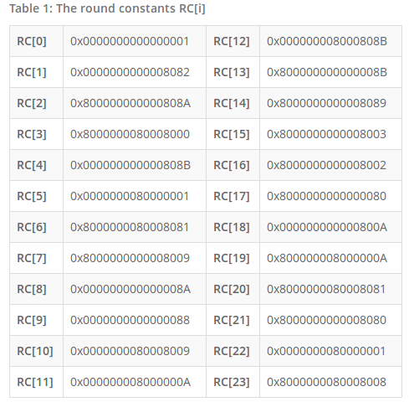
INTERNAL STRUCTURE: F-FUNCTIONS
Iota (ι)
  Simply add a bit constant to the first lane:
    A[0,0] =A[0,0]⊕RC[i]

Slide 12
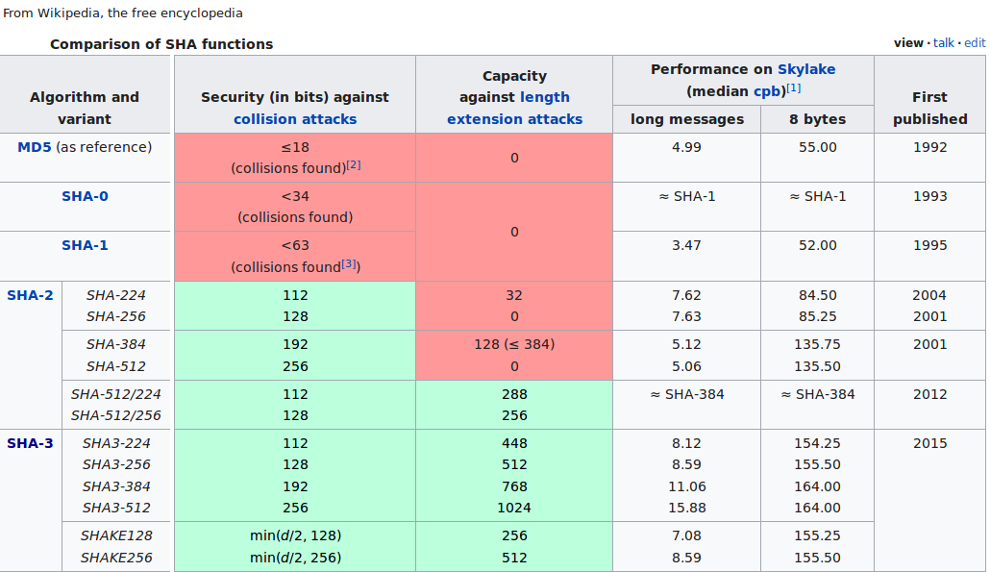
SECURITY AND PERFORMANCE
https://en.wikipedia.org/wiki/SHA-3

Slide 13
MORE INFO
The author of our textbook has published an excellently detailed lecture on this algorithm!
  (you might pick up some German too)
https://www.youtube.com/watch?v=JWskjzgiIa4
If you want to check out other uses for Keccak other than hashing see:
  https://nvlpubs.nist.gov/nistpubs/ir/2012/NIST.IR.7896.pdf
  https://keccak.team/files/SpongeDuplex.pdf
  https://en.wikipedia.org/wiki/Authenticated_encryption
  https://www.youtube.com/watch?v=wgR3VYHdd4Y

