Slide 1
The Past, Present, and Future of Honeynets Implemented in Virtual Networks
Michael Fernez
FCM 745
Muath Obaidat

Slide 2
Outline
Background
  Honeypots
  Honeynets
    Generation I
    Generation II and III
  Virtual Honeynets
    Self-contained systems
    Hybrid systems
Challenges for Developers
  Hardware and cost limitations
  Security
Implementations
  Hybrid System based on VMWare (L. Tian-Hua, Y. Xiu-Shuang and M. Shi-Wei)
  Optimized Self-contained System based on Virtual Box (R. Gautam, S. Kumar and J. Bhattacharya)
  Hybrid System with SDN controller HoneyProxy (Kyung et al)
Summary

Slide 3
Honeypots
“an information system resource whose value lies in unauthorized or illicit use of that resource.”—Lance Spitzner, founder of Honeynet Project
Low-interaction honeypots
  Emulates services and responses to attackers (Glastopf, honeyd)
  Easy to deploy and secure but also easy to fingerprint
High-interation honeypots
  Creates a an isolated environment to deepen the level of interaction (HIHAT, Sebek)
  Can be compromised due to complexity of interaction
Honeynets combine both into one high-interaction system

Slide 4
Core Functions of Honeynets
Control
  Ensure the request does not compromise the system
Capture
  Log all requests and attacks
Collecting
  Attacks are collected in a database for analysis

Slide 5
Honeynets
Generation I – Two interfaces with an IDS as a gateway
  Problem was the Honeywall was a Network Layer device that could easily be discovered
Generation II and III added a third interface to isolate the Honeywall
  Gen-III added a collection and control tool called Sebek

Slide 6
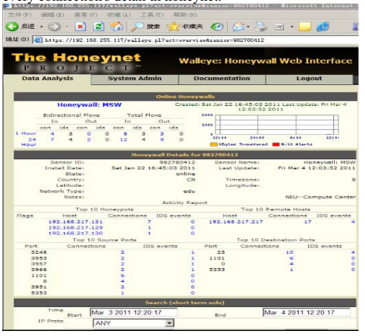
Honeynets: The Honeywall

Slide 7
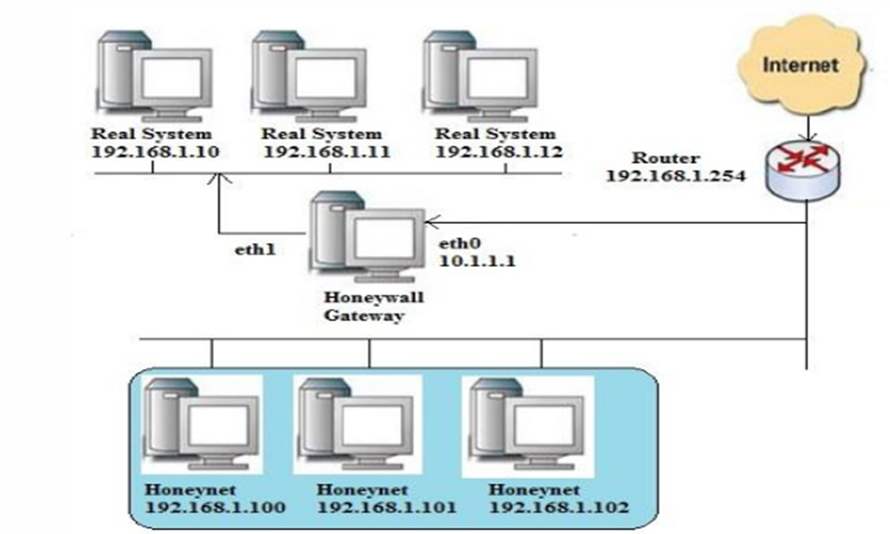
Honeynet Architecture

Slide 8
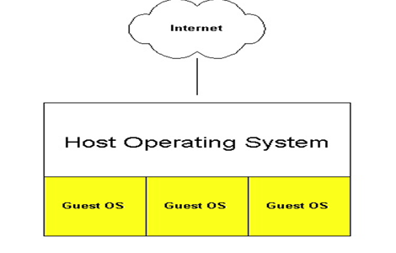
Virtual Honeynets
Self-contained Systems
  Advantage: Use one physical machine (good portability)
  Disadvantage: Single point-of-failure, requires powerful system

Slide 9
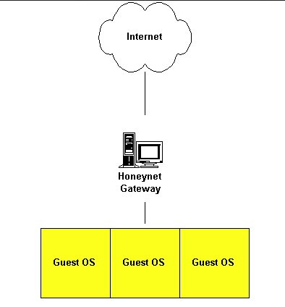
Virtual Honeynets
Hybrid Systems
  Advantage: Isolates Honeywall and contains attacker to honeynet
  Disadvantage: Uses two or more systems (bad portability, higher cost)

Slide 10
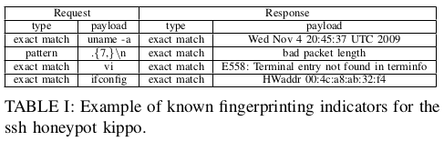
Challenges for Developers
Virtual Machine Security
  Limited virtual memory or CPU can introduce vulnerabilities
  Cannot effectively monitor communication between VMs
Honeypot Security
  Some honeypots vulnerable to fingerprinting attacks
  If identified and compromised, can be vector for malware

Slide 11
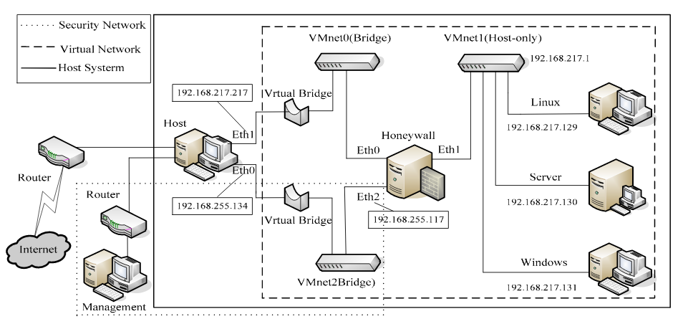
Hybrid System based on VMWare
L. Tian-Hua, Y. Xiu-Shuang and M. Shi-Wei
Ideal for security but high cost and difficult to implement

Slide 12
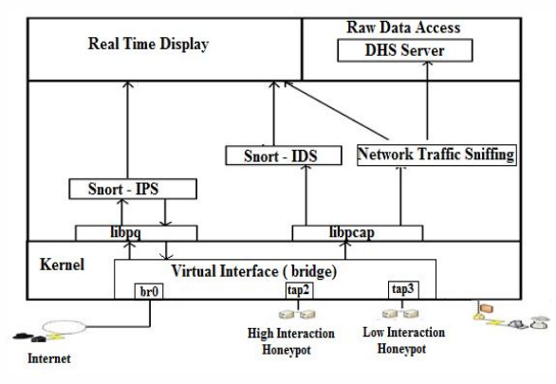
Optimized Self-contained System based on Virtual Box
R. Gautam, S. Kumar and J. Bhattacharya
Low-cost/open-source and provides decent security, but may introduce vulnerabilities to virtual machines

Slide 13
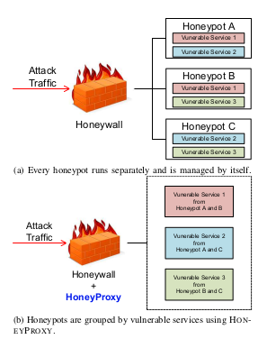
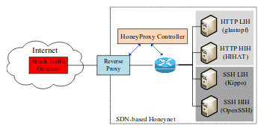
Hybrid System with SDN controller HoneyProxy
Kyung et al
Uses SDN architecture so honeypots can work together rather than separately

Slide 14
Summary
Honeynet Architectures have not evolved much since 2004 introduced Generation III architectures
Honeypot software sometimes can be easily identified and needs to be updated or customized by the operator
Virtual Machines can provide isolation of the honeynet, but also may introduce vulnerabilities if not configured correctly
Software Defined Networking may be an approach for next-generation honeynets to monitor communication between VMs and get the most out of honeypots in the network

Slide 15
References
Spitzner, L. (n.d.). Know Your Enemy: Defining Virtual Honeynets. Retrieved November 24, 2018, from http://old.honeynet.org/papers/virtual/
W. Fan, Z. Du and D. Fernández, "Taxonomy of honeynet solutions," 2015 SAI Intelligent Systems Conference (IntelliSys), London, 2015, pp. 1002-1009. doi: 10.1109/IntelliSys.2015.7361266,URL: http://ieeexplore.ieee.org.ez.lib.jjay.cuny.edu/stamp/stamp.jsp?tp=&arnumber=7361266&isnumber=7361074
Z. Heng-ru and G. Jie, "Research and Design of Network Attack and Defense Platform Based on Virtual Honeynet," 2010 International Conference on Computational and Information Sciences, Chengdu, 2010, pp. 507-510. doi: 10.1109/ICCIS.2010.130, URL: http://ieeexplore.ieee.org.ez.lib.jjay.cuny.edu/stamp/stamp.jsp?tp=&arnumber=5709135&isnumber=5708911
F. Daryabar, A. Dehghantanha, F. Norouzi and F. Mahmoodi, "Analysis of virtual honeynet and VLAN-based virtual networks," 2011 International Symposium on Humanities, Science and Engineering Research, Kuala Lumpur, 2011, pp. 73-77. doi: 10.1109/SHUSER.2011.6008503, URL: http://ieeexplore.ieee.org.ez.lib.jjay.cuny.edu/stamp/stamp.jsp?tp=&arnumber=6008503&isnumber=6008470
Dornseif, M., & May, S. (2004). Modelling the costs and benefits of Honeynets. Third Annual Workshop on Economics and Information Security. Retrieved November 25, 2018, from https://arxiv.org/pdf/cs/0406057.pdf
Abbasi, F. H., & Harris, R. J. (2009, November). Experiences with a generation iii virtual honeynet. In Telecommunication Networks and Applications Conference (ATNAC), 2009 Australasian (pp. 1-6). IEEE. URL: https://www.researchgate.net/profile/Richard_Harris9/publication/224138278_Experiences_with_a_Generation_III_virtual_Honeynet/links/0f31753b488089fc36000000.pdf
R. Gautam, S. Kumar and J. Bhattacharya, "Optimized virtual honeynet with implementation of host machine as honeywall," 2015 Annual IEEE India Conference (INDICON), New Delhi, 2015, pp. 1-6. doi: 10.1109/INDICON.2015.7443696, URL: http://ieeexplore.ieee.org.ez.lib.jjay.cuny.edu/stamp/stamp.jsp?tp=&arnumber=7443696&isnumber=7443105
L. Tian-Hua, Y. Xiu-Shuang and M. Shi-Wei, "Core Functions Analysis and Example Deployment of Virtual Honeynet," 2011 First International Conference on Robot, Vision and Signal Processing, Kaohsiung, 2011, pp. 212-215. doi: 10.1109/RVSP.2011.16,
URL: http://ieeexplore.ieee.org.ez.lib.jjay.cuny.edu/stamp/stamp.jsp?tp=&arnumber=6114940&isnumber=6114587
Kyung, Sukwha, et al. "HoneyProxy: Design and implementation of next-generation honeynet via SDN." Communications and Network Security (CNS), 2017 IEEE Conference on. IEEE, 2017. URL: https://adamdoupe.com/publications/honeyproxy-cns2017.pdf
M. Dornseif, T. Holz and C. N. Klein, "NoSEBrEaK - attacking honeynets," Proceedings from the Fifth Annual IEEE SMC Information Assurance Workshop, 2004., West Point, NY, 2004, pp. 123-129.doi: 10.1109/IAW.2004.1437807 URL: http://ieeexplore.ieee.org/stamp/stamp.jsp?tp=&arnumber=1437807&isnumber=30958
Honeynet Project - Projects. (n.d.). Retrieved November 25, 2018, from https://www.honeynet.org/project

