Slide 1
Application of Blockchain Technology
Xiyang Wang (Tony) 04/21/2018

Slide 2
Introduction
Recently, savvy individuals have recognized the technical potential behind the Bitcoin
IPFS
Bitshares
Steemit
CDT

Slide 3
Smart Contract
Facilitate the transfer and exchange of money or property in a transparent way without middleman
Define all of the obligations and potential penalties involved in an agreement
Smart contract platform also automatically enforces all of these obligations and penalties
Smart contract platforms allow the development of decentralized applications to run on the network

Slide 4

Ethereum VS EOS

Slide 5
Ethereum
Described as application-agnostic
“No features”

Slide 6
EOS
No transaction fees
More flexibility
Improved scalability

Slide 7
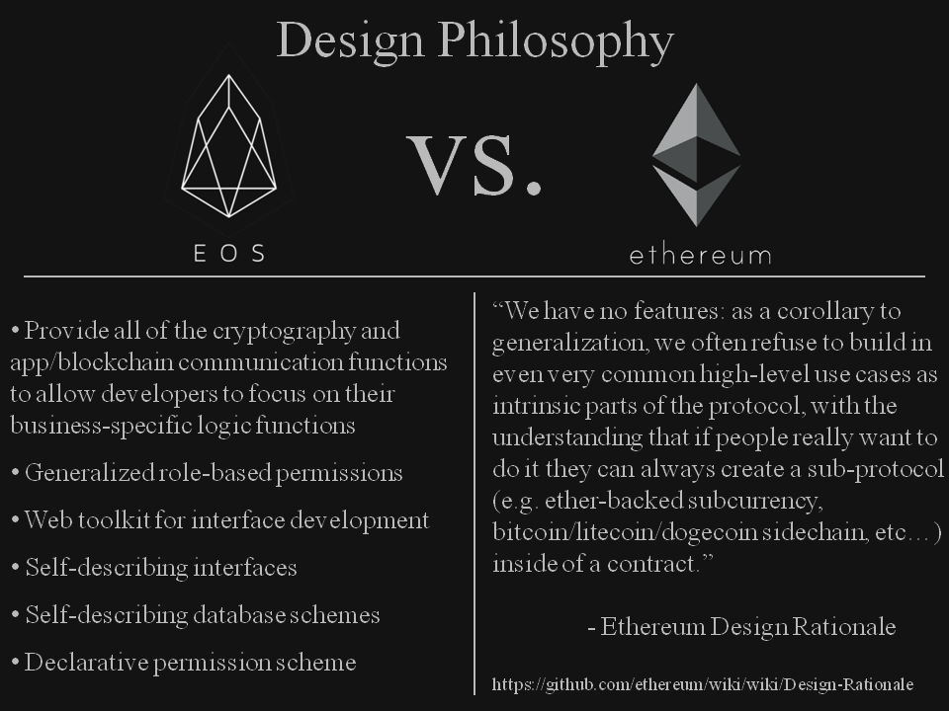

Slide 8
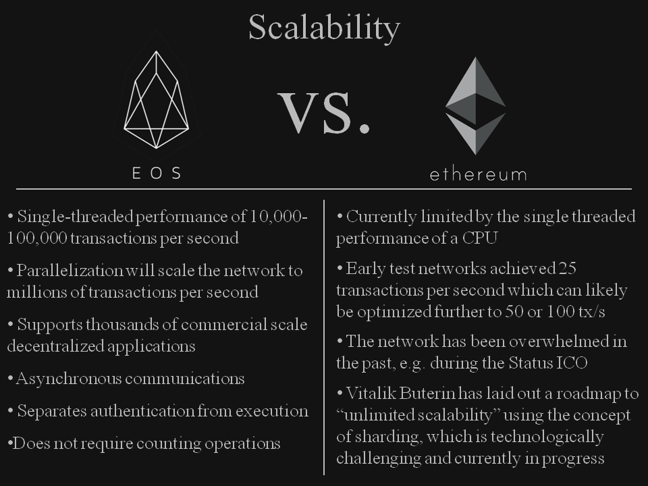

Slide 9
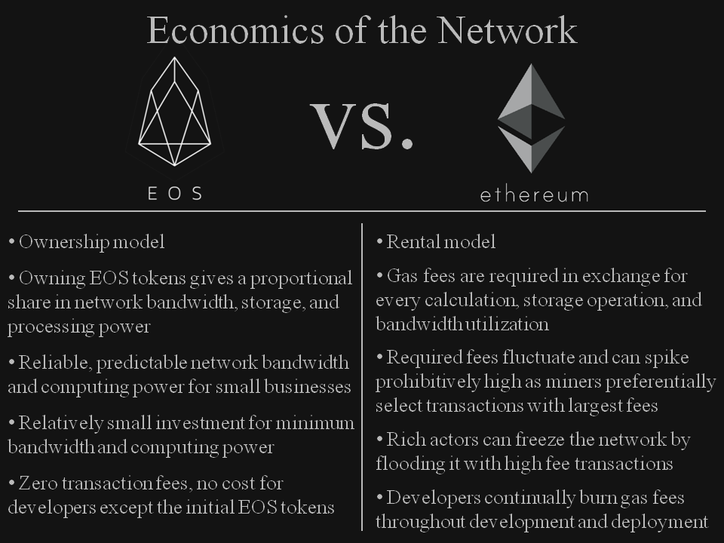

Slide 10
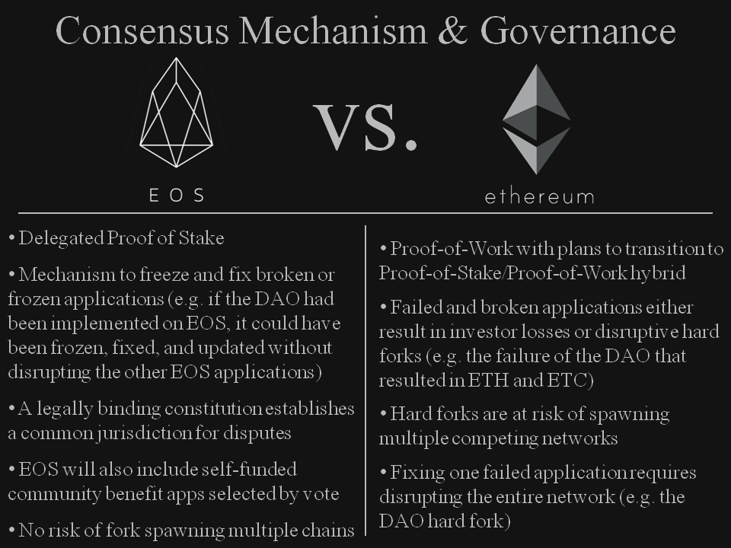

Slide 11
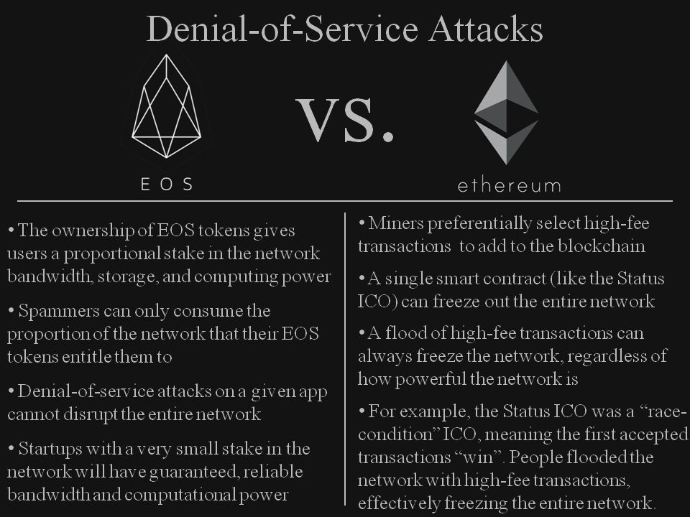

Slide 12
Consensus mechanism
Proof of work (PoW)
Proof of stake (PoS)
Delegated Proof of stake (DPoS)

Slide 13
Proof of Work
Bitcoin as an example of a cryptocurrency system secured with a proof of work algorithm
Mining
Mining requires a great deal of computing power to run different cryptographic calculations to unlock the computational challenges. The computing power translates into a high amount of electricity and power needed for the proof of work.

Slide 14
Proof of Stake
The proof of stake (PoS) seeks to address above issue by attributing mining power to the proportion of coins held by a miner. This way, instead of utilizing energy to answer PoW puzzles, a PoS miner is limited to mining a percentage of transactions that is reflective of his or her ownership stake.
For instance, a miner who owns 3% of the Bitcoin available can theoretically mine only 3% of the blocks.

Slide 15
Delegated Proof of Stake
Delegated proof of stake (DPoS) is a generic term describing an evolution of the basic PoS consensus protocols
In the protocol, blocks are minted by a predetermined set of users of the system (delegates), who are rewarded for their duty and are punished for malicious behavior
In DPoS algorithms, delegates participate in two separate processes:
• building a block of transactions
• verifying the validity of the generated block by digitally signing it

Slide 16
Vulnerability
Proof of Work
PoW is vulnerable to a “51% attack,” meaning — in theory — nefarious miners could capture 51 percent of a network’s computing power, gain what’s termed “dominance“ and manipulate the blockchain to their advantage.

Slide 17
Vulnerability
Proof of Stake
Someone with enough money to invest exclusively into the destruction of this system can do so by investing only money, as opposed to PoW where they need to invest money, time, expertise, hardware, electricity, etc.
Only the richest stakeholders are permitted to have control of consensus in the blockchain

Slide 18
Vulnerability
Delegated Proof of Stake
Cartels: Witnesses could organize into cartels.
Easier to organize an attack: Because fewer people are in charge of keeping the network alive, it’s easier to organize a “51%” attack
Potentially more centralized: Power is again concentrated in the hands of a few

Slide 19
Which one is better?

Slide 20
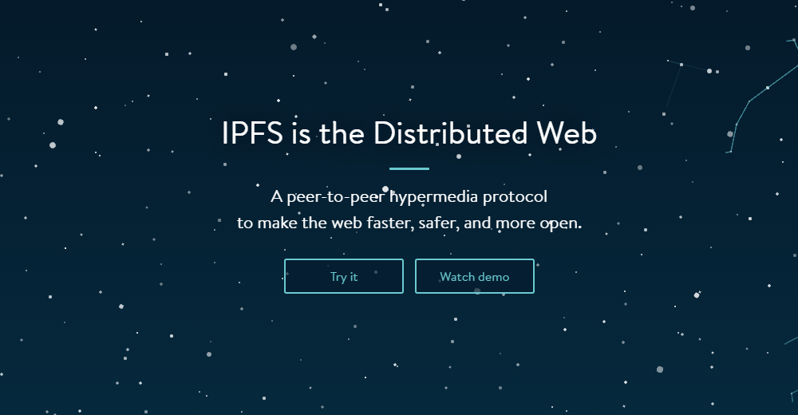
IPFS
IPFS stands for Inter Planetary File System

Slide 21
The basic idea of IPFS
IPFS is a peer-to-peer file sharing system, which is by nature, distributed. In particular, it uses cryptographic hashes of the content as the pointer to the file, not the address of the file
Anybody who has the same content, will have the matching hash, and that peer can share that file with you, vice-versa. In a distributed network such as this, bandwidth consumption and speed of file transfer is much more efficient
Not only that, if the file is moved, it does not matter. As long as there is a peer with the matching hash, the file can be distributed

Slide 22
Difference between IPFS and HTTP
HTTP is based on the centralized server model. This means that there is a single server somewhere that manages the links to other systems for exchange of information
IPFS is not just a protocol. It is a distributed, hypermedia protocol that aims to make the web safer, faster and more open
HTTP tries to download the whole file from one system. However, IPFS allows multiple parts of a file to be downloaded simultaneously from many different systems. This results in faster downloads and almost no loss of bandwidth

Slide 23
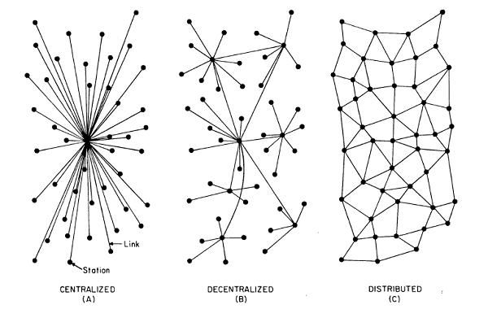

Slide 24
Problems with centralized file sharing
Bandwidth
a small piece of file has to transfer through dozens of centralized servers, all across the globe
Provenance
people need some sort of guarantee that the content they requested, is the content they will receive

Slide 25
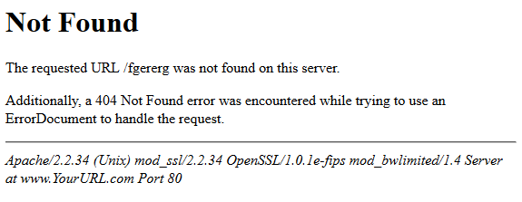
It means that the website location has been changed and the server previously hosting it has gone down and no one knows the current location. This usually occurs if the web pages are too old and the server hosting them too outdated.

Slide 26
Blockchain with IPFS
Like Bitcoin, the IPFS is a peer-to-peer network run by multiple nodes that store files that are submitted to the network. These nodes store only content that are interesting, including common indexing information that helps users find the nodes that keep the files they are looking for within the network.
Each file submitted to the network is given a unique cryptographic hash that allows the IPFS network to automatically delete duplicates and track version history for every file. Historic versioning prevents information from being easily erased. Since the files are provided by distributed nodes, download speeds are higher.
These characteristics make the IPFS a perfect place to store data, which can be referenced and time stamped with blockchain technology.

Slide 27
Since blockchain technology is not fit to store large amounts of data, the IPFS can be used by blockchain applications that need a publicly accessible database. While the immutability provided by miners and the transparency of the blockchain, make it the perfect place to timestamp content and make it publically verifiable.

Slide 28
Set up IPFS
Set up GPG
Set up IPFS
Encrypt a file with someone else’s public key
Upload the encrypted file to IPFS
Download the file from another computer (or Virtual Machine) and make sure only the privileged party can decrypt and view it

Slide 29

Tutorial

Slide 30

Blockchain Tutorial

