Slide 1


Mike Fitzpatrick, NOAO
4/11/11

Slide 2

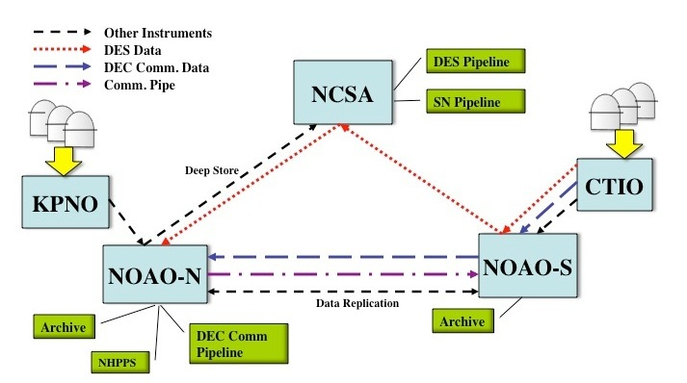
DTS is designed for DECam, but is suitable for use elsewhere as well
Must make better use of network
Must allow data to be routed based on DES/Community use
Must interface with both NOAO and DECam systems
Must be configurable for data rates and sizes other than DES
Must operate in variety of network environments
4/19/13

Slide 3

XML-RPC based
  Provides basic services without requiring persistent connections
  Can be configured as unix service for automatic recovery in case of crash
  Allows for remote monitoring and management
  Client applications are language independent
  Central DTS process providing services at each site
  Highly multi-threaded and configurable

Slide 4

4/11/11

Slide 5

Must transfer a typical DES night in 18 hrs. So, what is typical ?
  350 images (60 bias/flat calibrations, remainder are science frames in various filters)
  Differing sizes
    ~389 MB for a Bias thru ~701 MB for z-band object
    Average file size: 589 MB
    Total for the night: ~206 GB
Must play nice with the rest of the network
  To meet transfer requirement, we need a sustained 27 Mbps assuming we use only 75% of current bandwidth
Must interface with external entities
  Not all of which are NOAO-controlled
4/19/13

Slide 6

Task | Description | Who/Where | Status
DTSD | Main DTS Daemon | All DTS Nodes | Complete
DTSQ | Queuing Agent | Instrument | Complete
DTSMON | Monitoring Application | SDM/Tucson | Complete
DTSH | Shell/Command-line Tool | SDM/Tucson | Complete
DTSTAT | Status Tool | Operators | Complete
DTSCLEAN | Clean src and DTS directories | DES Per./Ops | Pending
DTSTRACE DTSCP | Trace File History Point-to-Point Copy | Operators Users | Pending Complete
4/19/13

Slide 7

DTSD – The DTS Daemon
Provides all DTS services on the machine
Responsible for managing transport queues
  separate threads manage each queue
Requires only command port be open to firewall
  Transport sockets can be managed in configuration
Sandboxed filesystem view for security
Can be run as xinetd service or run entirely in user-space
RPC methods permit remote management, monitoring
4/19/13

Slide 8
DTSQ – DTS Queuing Agent
Queues data for ingestion into the DTS system
Provides quick response so it won't block caller
SISPI requires no other DTS components to be installed
Logs all requests
Verifies DTS status before allowing transfer
Permits recovery of failed requests for later re-queuing
Leaves a “token” file with details of transfer on success
4/19/13

Slide 9
DTSH – DTS Utility/Shell
Provides low-level access to all DTS methods
Can be used to script utility commands
DTSMON – DTS System Monitor
Collects all DTSD log messages
Collects runtime status information for web interface
4/19/13

Slide 10
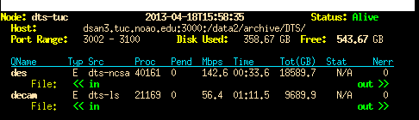
DTSTAT – DTS Status Utility
Status from single node or entire network
Compact summary format
Color coded to alert to problems
4/19/13

Slide 11
DTSCP – DTS Point-to-point copy
Copy to any running DTSD directly (/copy dir)
Copy to specific queue
User-running DTSD provides arbitrary endpoint
Choice of transport protocols, direction of transfer, method used
4/19/13

Slide 12

Parallel TCP Sockets
Data striped over multiple-sockets, transferred in parallel
Performance “tuned” by number of connections
Achieves good performance for decam, but not really scalable on current network
UDT over UDP Sockets
Requires only a single port
UDT provides guaranteed delivery, takes care of ordering
Significantly faster in some cases
4/19/13

Slide 13

Blue CTIO – Tucson
Orange KPNO – Tucson
Yellow Local ethernet
Transfer throughput normalized to rsync over that connection

Slide 14

Limitations of current system
32-bit binaries (not vetted for 64-bit, but seems to work)
Memory-to-memory transfers limit sizes
  A streaming model for disk/memory transfers planned
Not all features not utilized (e.g. tarfiles for many small files)
Stable but not yet packaged for end-user distribution
  Documentation, packaging
DTS will be participating in the LSST Data Challenges
  Changes made as needed
Other in-house uses being considered
Use by DES outside nightly data transfer almost definite
4/19/13

