Slide 1



DECam Community Pipeline Review
NCSA
August 30-31, 2010
CP Review 30 August 2010

Slide 2
DTS – The NOAO Data
Transport System
NOAO SDM
Mike Fitzpatrick

Slide 3
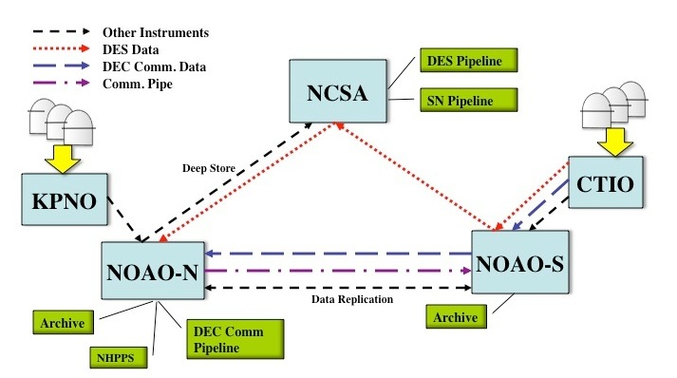
DTS Project Background
DTS is designed for DECam, but it will eventually be used throughout
the NOAO E2E system:
observing systems:
will be used throughout NOAO
observing systems:
Must make better use of network
Must allow data to be routed based on DES/Community use
Must interface with both NOAO and DECam systems
Must be configurable for data rates and sizes other than DES
Must operate in variety of network environments

Slide 4
DTS Dataflow

Slide 5
DTS Requirements
Must transfer a typical DES night in 18 hrs. So, what is typical ?
  350 images (60 are bias/flat calibrations, remainder are science frames in various filters)
  Differing sizes
    ~389 MB for a Bias thru ~701 MB for z-band object
    Average file size: 589 MB
    Total for the night: ~206 GB
Must play nice with the rest of the network
  To meet transfer requirement, we need a sustained 27 Mbps assuming we use only 75% of current bandwidth
Must interface with external entities
  Not all of which are NOAO-controlled

Slide 6
External Entities
At the telescope
  SISPI must queue the data for transport
On the mountain
  iSTB must modify the headers to add archiving keywords
NOAO-S (La Serena)
  Save copy of raw data saved to local data store
NCSA / DES-DM
  Delivery to DM for (DES) pipeline processing
  Separate Delivery for SN pipeline (?)
NOAO-N (Tucson)
  Ingest into NSA
Ad-hoc Transport
  SLAC-Fermi for eng, DB sync, PreCam, etc

Slide 7





DTS Implementation
SOA based on XML-RPC
  Provide and consume basic services without requiring persistent connections
  Can be configured as Unix service for automatic recovery in case of crash
  Allows for remote monitoring and management
  Client applications are language independent
  Common DTS process providing services at each site
  Highly multi-threaded and configurable
Written in ANSI-C
  Self-contained
  Currently ~30 KLOC
XML-RPC Abstract Interface Library
XMLRPC-C Protocol Library
cURL Transport Library

Slide 8
DTS Features
XML-RPC Based
  Designed for remote monitoring/control, automated operation
  Fully configurable at each node in the network
Multiple, independent transport queues
  Continuous FIFO, scheduled or priority
  Queues define the data routing, transfer can be tee’d
Multiple transport methods permitted
  Parallel TCP/IP sockets (current), UDP packets/other TBD
  Configurable to optimize for few large files, many small ones or particular network characteristics (e.g. more threads for slow links)
Allows processing at each stage in transfer
  Interface with external entities
Guarantees file integrity and graceful error recovery

Slide 9
Bulk Transport Models
The transport model is independent of transport method. One describes the direction of transport and the RPC activity, the other refers to the actual network protocol used.
PUSH / PULL
  A push-to or pull-from a node assumes that node is offering a transport service and is willing to supply the transport sockets
GIVE / TAKE
  A give-to or take-from a node is used when we’re willing to provide the service and sockets to ensure successful transport
CP Review 30 August 2010

Slide 10
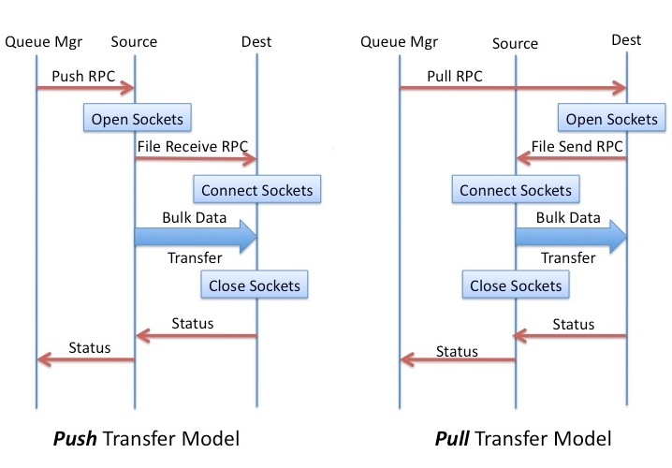
Bulk Transport Models

Slide 11
Bulk Transport Methods
Currently only implements a Parallel TCP/IP Socket transfer method
  Number of threads allocated used to regulate bandwidth usage
  Multiple levels of checksum validation allowed (not all used):
    Chunk – data transferred in one request, e.g. 64Kb
    Stripe – data transferred on each thread
    File – whole-file checksum value
  Multiple checksum values available (BSD/SYSV, MD5, etc)
  No assumptions made about contents of files being transferred
Other methods can (theoretically) be added for use in all transport modes
CP Review 30 August 2010

Slide 12
Queue Types & Modes
Queue Types:
  Ingest -- Entry point to DTS
    Can modify data for before transport using Delivery App
  Transfer -- Midpoint node in the data path
    Normal delivery mechanism
  Endpoint -- Terminal point of data path
    Data can be removed from queue on completion
Queue Modes:
  Normal – FIFO processing as long as data available
  Scheduled – Transfers at specific times / intervals
  Priority – Blocks all other queues until complete
CP Review 30 August 2010

Slide 13
Configurability
Sample DTS (daemon) configuration file.
The configuration file is made up of one or more entries with the
following structure:
<global values> # debug, verbose, etc
dts # define DTS node
<dts parameters> #
queue # define a queue
<queue parameters> #
CP Review 30 August 2010

Slide 14
Configurability
Sample Queue Configuration
# Queue configuration
queue
name test # queue name
node transfer # ingest, transfer, or endpoint
type normal # normal, scheduled, priority
mode push # push or give
method dts # dts or [TBD]
nthreads 4 # No. of outbound threads
port 3001 # base transfer port
src denali # source machine
dest tucana # destination machine
deliveryDir /tmp/foo.crux # spool or /path/to/copy
deliveryCmd /home/fitz/imtest -i $inst $F
CP Review 30 August 2010

Slide 15
DTS Components
DTSD – The DTS Daemon
DTSQ – The DTS Queuing Agent
DTSH – A DTS shell and command-line tool
DTSMON – A DTS monitoring application

Slide 16
DTS Components
DTSD – The DTS Daemon
Provides all DTS services on the machine
  assumed there is one per 'site’
Responsible for managing transport queues
  separate threads manage each queue
Requires only command port be open to firewall
  Transport sockets can be managed in configuration
Sandboxed filesystem view for security
Can be run as xinetd service or run entirely in user-space
Set/Get methods permit remote management, Status methods permit monitoring

Slide 17
DTS Components
DTSQ – DTS Queuing Agent
Queues data for ingestion into the DTS system
Provides quick response so it won't block caller
Acts as a dtsd to provide its own transport methods to the DTS,
  i.e. SISPI requires no other DTS components to be installed
Logs all requests
Verifies DTS status before allowing transfer
Permits recovery of failed requests for later re-queuing
Leaves a “token” file with details of transfer on success

Slide 18
DTS Components
DTSH – A DTS shell and command-line tool
Allows direct communication with a DTSD site
Provides scripting capability for DTS commands
  E.g. cron jobs to collect transport logs, monitor/restart services
  Full access to all DTSD functionality
DTSMON – A DTS monitoring application
Simple monitoring application
  echoes messages generated by remote DTS components
  Advanced tool / GUI planned for later development
Runs on a reserved port
Primarily meant for operations and development use
  not required for routine use of DTS

Slide 19
DTS Relative Throughput
Blue CTIO – Tucson
Orange KPNO – Tucson
Yellow Local ethernet
Transfer throughput normalized to rsync over that connection

Slide 20
SISPI-DTS Interface
At the telescope: IB system invokes dtsq as e.g.
  dtsq -q des -f inst=decam /path/image.fits
The '-q' names the transport queue (i.e. data route) to be used
The '-f' forks the command after verifying DTS is ready
  transfer happens in child process
The ‘inst=decam’ shows use of a pass-thru parameter
IB gets (near) immediate OK/ERR response
On successful completion of transfer, details of transfer (time of request, time of completion, comments, etc) left on calling system logfile
On error of transfer, request is logged for later recovery

Slide 21
DESDM-DTS Interface
At the DES (or SN) Pipeline:
DTS invokes an external 'delivery application’.
This application:
  Requires a single argument: the local path to the file
    Additional parameters may be passed through from DTSQ
  Is free to modify the file, the delivery app runs on a copy of the file in the configured ‘delivery directory’
  Must be provided by DES
    DES knows best how to interface to their system

Slide 22
SDM-DTS Interface
On the mountain:
iSTB invoked as 'delivery application’ for DTS ingestion
  Modifies image to add necessary archiving keywords
  This modified image is what is transferred through the system
At NOAO Archive Centers:
A TBD delivery application is used to trigger an NSA ingest of the file
  File will be moved from delivery directory to final mass-store location

Slide 23
DTS Status
Functional development complete
Final documentation still pending
  DESDM-DTS ICD document awaiting sign-off
System currently undergoing stress-testing, e.g.
  10,000+ file transfers to eliminate memory leaks
  Artificial failures of network connectivity, checksum failures, etc
  Validate there is a proper recovery
First real-world test expected with PreCam
Likely requires small additional development for use in final E2E deployment
Final throughput test waiting for CTIO network upgrade

