Slide 1



DTS (Data Transport System)
Status, Readiness & Testing
Mike Fitzpatrick, NOAO
DES Director’s Review
5/10/11

Slide 2
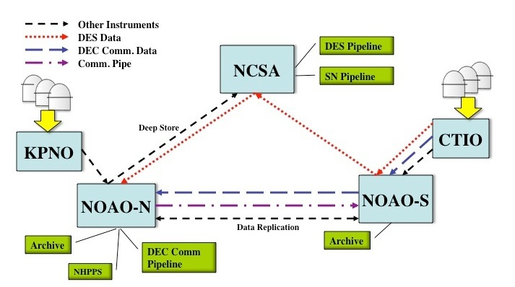
DTS Project Overview
DTS is designed for DECam, but it will eventually be used throughout
the NOAO E2E system:
observing systems:
will be used throughout NOAO
observing systems:
Must make better use of network
Must allow data to be routed based on DES/Community use
Must interface with both NOAO and DECam systems
Must be configurable for data rates and sizes other than DES
Must operate in variety of network environments
5/10/11

Slide 3
DECam Data Flow
4/11/11

Slide 4
DTS Requirements
Must transfer a typical DES night in 18 hrs. So, what is typical ?
  350 images (60 bias/flat calibrations, remainder are science frames in various filters)
  Differing sizes
    ~389 MB for a Bias thru ~701 MB for z-band object
    Average file size: 589 MB
    Total for the night: ~206 GB
Must play nice with the rest of the network
  To meet transfer requirement, we need a sustained 27 Mbps assuming we use only 75% of current bandwidth
Must interface with external entities
  Not all of which are NOAO-controlled
5/10/11

Slide 5
DTS Components
Task | Description | Who/Where | Status
DTSD | Main DTS Daemon | All DTS Nodes | Complete
DTSQ | Queuing Agent | SISPI | Complete
DTSMON | Monitoring Application | SDM/Tucson | Complete
DTSH | Shell/Command-line Tool | SDM/Tucson | Complete
DTSTAT | Status Tool | Operators | Complete
DTCLEAN | Clean src and DTS directories | DES Per./Ops | Pending
DTTRACE DTSCP | Trace File History Point-to-Point Copy | Operators Users | Pending Pending

Slide 6
DTS Components
DTSD – The DTS Daemon
Provides all DTS services on the machine
Responsible for managing transport queues
  separate threads manage each queue
Requires only command port be open to firewall
  Transport sockets can be managed in configuration
Sandboxed filesystem view for security
Can be run as xinetd service or run entirely in user-space
RPC methods permit remote management, monitoring
5/10/11

Slide 7
DTS Components
DTSQ – DTS Queuing Agent
Queues data for ingestion into the DTS system
Provides quick response so it won't block caller
SISPI requires no other DTS components to be installed
Logs all requests
Verifies DTS status before allowing transfer
Permits recovery of failed requests for later re-queuing
Leaves a “token” file with details of transfer on success
5/10/11

Slide 8
DTS Status Summary
Internal ICD being developed to integrate DTS system for DECam into current operational system
  Deployment targeted end of May2011
  Ingest and Delivery applications in development
  Operational requirements being defined
DTS being installed/configured at CTIO/NCSA/Tucson
  Need to identify CTIO machines on “upgraded” (125Mbs) network
  Temporary bandwidth of 500 Mbs being configured for LSST testing
  Additional data paths being discussed (e.g. to mirror data)
  Final v1.0 packaging and documentation still pending
4/11/11

Slide 9
DTS Testing
DTS Transfer Tests conducted Nov 2010 (docdb 5109), demonstrates:
  Ability to throttle throughput to targeted values
  Automated queue processing under “observing conditions”
  Exposed unexpected failure modes (since corrected)
Reliability tests transferred many 10,000 images through a complete network with no unexpected resource problems (e.g. memory leaks, zombie threads etc).
Catastrophe simulation (e.g. network outage in the middle of a transfer) in progress
5/10/11

Slide 10
DTS Readiness
Slightly behind on SISP/NCSA integration due to competing project pressures
No problems expected in having deployed system on schedule
4/11/11

