Slide 1



Data Transport System (DTS)
Mike Fitzpatrick, NOAO
DECam Integration and Installation Review
4/11/11

Slide 2
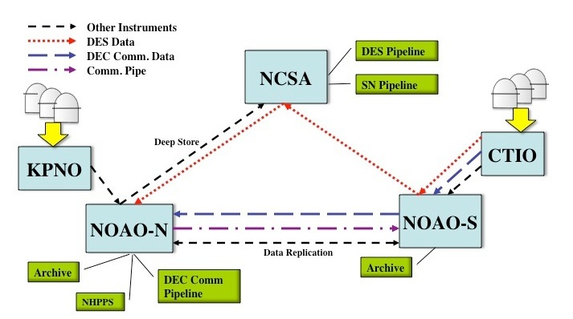
DTS Project Background
DTS is designed for DECam, but it will eventually be used throughout
the NOAO E2E system:
observing systems:
will be used throughout NOAO
observing systems:
Must make better use of network
Must allow data to be routed based on DES/Community use
Must interface with both NOAO and DECam systems
Must be configurable for data rates and sizes other than DES
Must operate in variety of network environments
4/11/11

Slide 3
DTS Requirements
Must transfer a typical DES night in 18 hrs. So, what is typical ?
  350 images (60 are bias/flat calibrations, remainder are science frames in various filters)
  Differing sizes
    ~389 MB for a Bias thru ~701 MB for z-band object
    Average file size: 589 MB
    Total for the night: ~206 GB
Must play nice with the rest of the network
  To meet transfer requirement, we need a sustained 27 Mbps assuming we use only 75% of current bandwidth
Must interface with external entities
  Not all of which are NOAO-controlled
4/11/11

Slide 4
Queue Types & Modes
Queue Types:
  Ingest -- Entry point to DTS
    Can modify data for before transport using Delivery App
  Transfer -- Midpoint node in the data path
    Normal delivery mechanism
  Endpoint -- Terminal point of data path
    Data can be removed from queue on completion
Queue Modes:
  Normal – FIFO processing as long as data available
  Scheduled – Transfers at specific times / intervals
  Priority – Blocks all other queues until complete
4/11/11

Slide 5
DTS Components
DTSD – The DTS Daemon
DTSQ – The DTS Queuing Agent
DTSH – A DTS shell and command-line tool
DTSMON – A DTS monitoring application
DTSTAT – Command-line status tool*
DTCLEAN – Clean up src and DTS spool files*
DTTRACE – Trace file histories through the DTS*
* New tasks in development
4/11/11

Slide 6
DTS Components
DTSD – The DTS Daemon
Provides all DTS services on the machine
  assumed there is one per 'site’
Responsible for managing transport queues
  separate threads manage each queue
Requires only command port be open to firewall
  Transport sockets can be managed in configuration
Sandboxed filesystem view for security
Can be run as xinetd service or run entirely in user-space
Set/Get methods permit remote management, Status methods permit monitoring
4/11/11

Slide 7
DTS Components
DTSQ – DTS Queuing Agent
Queues data for ingestion into the DTS system
Provides quick response so it won't block caller
Acts as a dtsd to provide its own transport methods to the DTS,
  i.e. SISPI requires no other DTS components to be installed
Logs all requests
Verifies DTS status before allowing transfer
Permits recovery of failed requests for later re-queuing
Leaves a “token” file with details of transfer on success
4/11/11

Slide 8
DTS Relative Throughput
Blue CTIO – Tucson
Orange KPNO – Tucson
Yellow Local ethernet
4/11/11
Transfer throughput normalized to rsync over that connection

Slide 9
SISPI-DTS Interface
At the telescope: IB system invokes dtsq as e.g.
  dtsq -q des -f inst=decam /path/image.fits
The '-q' names the transport queue (i.e. data route) to be used
The '-f' forks the command after verifying DTS is ready
  transfer happens in child process
The ‘inst=decam’ shows use of a pass-thru parameter
IB gets (near) immediate OK/ERR response
On successful completion of transfer, details of transfer (time of request, time of completion, comments, etc) left on calling system logfile
On error of transfer, request is logged for later recovery
4/11/11

Slide 10
DESDM-DTS Interface
At the DES-DM at NCSA:
DTS invokes an external 'delivery application’.
NCSA currently working on this application to accept data from the DTS
  Data now simply being dumped to a directory at NCSA site
4/11/11

Slide 11
SDM-DTS Interface
On the mountain:
iSTB invoked as 'delivery application’ for DTS ingestion
  Modifies image to add necessary archiving keywords
  This modified image is what is transferred through the system
  This application still pending
At NOAO Archive Centers:
A TBD delivery application is used to trigger an NSA ingest of the file in the archive
  No plan to archive images until commissioning begins
  This application still pending
4/11/11

Slide 12
DTS Status
Core functional development complete
Operations tasks now in development
Automated recovery being tested
Final documentation / packaging still pending
Additional development for use in final E2E deployment being discussed w/ SDM Ops
Final throughput test waiting for CTIO network upgrade
New version of software to be installed today, updates as needed
4/11/11

