Slide 1

DTS Status and Review

Slide 2
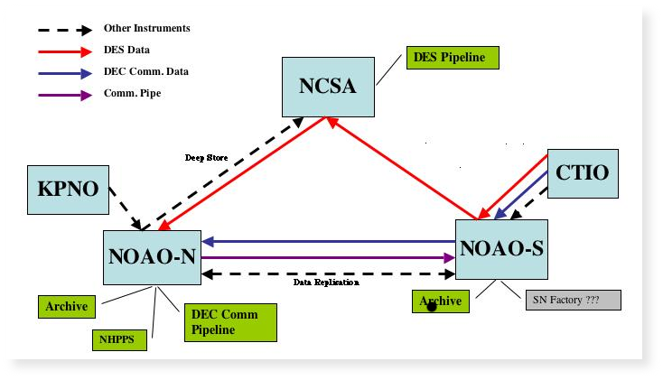
DTS Background
DTS is designed for DECam, but will be used throughout NOAO
observing systems:
Must make better use of network
Must allow data to be routed based on DES/Community use
Must interface with both NOAO and DECam systems
Must be configurable for data rates and sizes other than DES
Must operate in variety of network environments

Slide 3
DTS Architecture
XML-RPC based
  Provides basic services without requiring persistent connections
  Can be configured as unix service for automatic recovery in case of crash
  Allows for remote monitoring and management
  Client applications are language independent
  Central DTS process providing services at each site
  Highly multi-threaded and configurable

Slide 4
DTS Components
DTSD – DTS Daemon
  Provides all DTS services on the machine (assumed one per 'site')
  Responsible for managing transport queues (one Manager thread for each queue)
  Requires command port be open to firewall
  Sandboxed filesystem view for security
  Can be run as xinetd service or run entirely in user-space
  Set/Get methods permit remote management

Slide 5
DTS Components
DTSQ – DTS Queueing Agent
  Queues data for ingestion into the DTS system
  Provides quick response so it won't block caller
  Acts as a dtsd to provide its own transport methods to the DTS, i.e. SISP requires no other components be installed
  Logs all requests
  Verifies DTS status before allowing transfer
  Permits recovery of failed requests for later re-queueing
  Leaves a “token” file with details of transfer on success

Slide 6
DTS Components
DTSD – DTS Daemon
DTSQ – DTS Queueing Agent
DTSH – DTS shell and command-line tool
DTSMON – DTS monitoring application

Slide 7
DTS Components
DTSH – DTS shell and command-line tool
  Allows direct interaction with DTS site
  Provides scripting capability for DTS commands
DTSMON – DTS monitoring application
  Simple monitoring application, echos messages generated by remote DTS components
  Runs on a reserved port
  Meant for operations use, not required for routine use of DTS

Slide 8
SISPI-DTS Interfaces
At the telescope: IB system invokes dtsq
  dtsq -q des -f /path/image.fits
The '-q' names the transport queue to be used
The '-f' forks the command after verifying DTS will accept the file, transfer happens in child
IB gets immediate OK/ERR response
On success, details of transfer (time of request, time of completion, comments, etc) left on calling system
On error of transfer, request is logged for later recovery

Slide 9
SISPI-DTS Interfaces
At the DES Pipeline: DTS invokes an external 'delivery' application. This application
- takes a single argument: the local path to the file
- Is expected to make a private copy of the file, moving it out of the DTS sandbox where it can be manipulated
- Must be provided by DES since only they know what they want to do with the image once it arrives

Slide 10
DTS Status
Still in hi-priority development
All components implemented (some partially)
Provides point-to-point data transport, queue management and data routing still in development
Snapshot release available for IB interface testing (in progress)
Scripting capability can be used to support Nov T&E run without configuring full system

Slide 11
DTS Relative Throughput
Blue CTIO – Tucson
Orange KPNO – Tucson
Yellow Local ethernet
Transfer throughput normalized to rsync over that connection

Slide 12
November Support
Using dtsh we can do simple P2P transfer to one or more sites, require only dtsh at the telescope and dtsd running remotely.
For example, could create script file 'dts_xfer' such as
#!/usr/local/bin/dtsh -f
push -t <IP at Fermi> $1 &
give -t <IP in Brazil> $1 &
This would be invoked by the observing environment simply as
dts_xfer /path/image.fits
And background transfers would begin of the file to a remote “drop directory.
More requirements are needed if anything more sophisticated in needed.

