Slide 1
NEWFIRM
Data Processing System
Delta-CoDR
Dick Shaw
(Presenting for Lindsey Davis)
Data Products Program

Slide 2
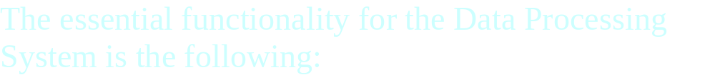
DPS Core Functionality
Capture data from the instrument
Quick-look Data Quality Assessment (DQA)
Quick-reduce DQA
Transport data safely to NOAO Science Archive
Generate science-grade data products for NSA

Slide 3
Updates from the CoDR
Refinement of system requirements for:
  Quick-Look
  Quick-Reduce
NOAO Science Archive has been created
Mosaic data pipeline design is underway
Design of Data Transport System is underway
DHS interfaces to NEWFIRM and Monsoon are in design

Slide 4
Quick-Look
The primary function of QL is to verify that:
The instrument is functioning normally
The telescope is functioning normally
The observing conditions are acceptable
The key point is that QL is highly automated, and that the analysis/reporting can, but need not, keep up with the observing cadence.

Slide 5
QL Functionality
Automated, real-time display
Automated, real-time DQA
Automated, post-readout DQA
Post-readout observer Toolkit

Slide 6
Quick-Reduce
The primary function of QR is to:
Evaluate the observing protocol
Check whether sufficient data have been obtained
Check whether the data set is complete
QR will run at a slower cadence than QL, and will aid the evaluation of observing sequences (e.g., dither sets)

Slide 7
QR Functionality
The QR software will be much the same as science-grade pipeline, but streamlined:
Skip or simplify time-consuming reduction steps
  No cross-talk or CR detection/correction
  Simplified algorithms for background subtraction, resampling, image combination
Use library calibration reference files where possible (BPM, darks, flats, etc.)

Slide 8
Evaluate Observing Protocol
QR will address the following:
How applicable is the flat-field?
How good is the sky subtraction?
Is the WCS calibration adequate?
Are the conditions photometric?
Is the dither pattern adequate?
Is the mapping pattern adequate?

Slide 9
Determine When Sufficient Data Have Been Obtained
The following questions will be addressed:
Has the target S/N for faint objects been achieved?
Are there variations or discontinuities in the background?
Is the S/N ratio in the background variable?
Is the seeing variable?
Is the observation (pattern) complete?
Is the data set (e.g. calibration data, header meta-data, associations) complete?

Slide 10
Processing Data Flow

Slide 11
Implementation Plan

