Slide 1
CiteGuard
Catching fabricated citations with evidence, not with LLM judgement
LLM-Based Fake Citation Detection and Verification System
Miten Gandhi
Introduction to Large Language Models (ILLM) · Final Project · November 2026

Slide 2
Problem: for every citation, decide if it is real and correct, and explain why
A citation an LLM might write
Output per citation
Zhang, L., & Kumar, R. (2021). Contrastive graph transformers for protein folding dynamics. Nature Machine Intelligence, 3(4), 211–223. doi:10.1038/s42256-021-00…
Verified
real record, fields agree
Verified with errors
real paper, wrong year / venue / DOI
Misattributed
real title, wrong authors or DOI
Title: plausible, but no such paper exists
Fabricated
no such work in any index
Venue and formatting: real and correct
Unverifiable
too little evidence: not “fake”
DOI: real, but belongs to another paper
+ evidence, an explanation, and a fix (corrected citation or real alternatives)
Example citation is invented for illustration.

Slide 3
Motivation: LLMs invent references, and asking an LLM to check them is unreliable
55% / 18%
146,932
4 – 70%
of references written by GPT-3.5 / GPT-4 were fabricated
estimated non-existent citations in 2025 papers alone
false-positive rate of zero-shot LLM citation verifiers
Reviewers cannot check every reference by hand
An LLM judging from memory confuses “I don’t know this paper” with “this paper does not exist”
Walters & Wilder (2023), Sci. Rep.; Zhao et al. (2026), arXiv:2605.07723; Kim et al. (2026), HALLMARK, arXiv:2607.18360.

Slide 4
Dataset: CiteBench has 4 splits of 150 labelled citations, each scored once
Group | n | How it is built | Gold label
Real | 60 | random articles from OpenAlex + Crossref; APA / IEEE / Vancouver / BibTeX | Verified
Real, cited with errors | 30 | year shifted, venue swapped, or non-existent DOI | Verified w/ errors
Misattributed | 20 | authors swapped, or another paper’s DOI | Misattributed
Fabricated | 40 | invented plausible title (30), or invented title + real DOI (10) | Fabricated
Held-out protocol
dev
develop + fix
test
score once, then fix
test2
score once, then fix
test3
new for this report
No DOI shared between splits; + 25 papers × 2 claims for the claim check

Slide 5
Approaches: four ways to judge a citation; only retrieval separates “unknown” from “fake”
Offline heuristics
DOI lookup
LLM-only judge
CiteGuard (ours)
Uses
Bad DOI syntax, future year, odd pages
Fails when
Plausible fakes have no surface defect
Uses
Does the DOI resolve? (HALLMARK baseline)
Fails when
Blind to fakes without a DOI, or with a borrowed one
Uses
Ask gpt-oss-20b / qwen3.8-27b / gpt-oss-120b: “does this exist?”
Fails when
Rejects real papers it does not recognise
Uses
Retrieve from 6 indexes, link records, apply rules; LLM only for checkable tasks
Fails when
Needs network access and index coverage
Only CiteGuard returns a verdict a user can act on: which field is wrong, the evidence, and a fix.

Slide 6
CiteGuard confines the LLM to five tasks whose output is checked against evidence
LLM task (Groq) | Model | The check that keeps it honest
Parse messy references | gpt-oss-20b | Parsed title must appear in the raw string
Adjudicate close matches | gpt-oss-120b | May only pick a retrieved candidate ID, or none
Rewrite failed searches | gpt-oss-20b | Code runs the queries; linkage model scores results
Explain the verdict | gpt-oss-120b | Every reason cites an evidence ID; every quoted value must be in the evidence
Check claim support (opt-in) | gpt-oss-120b | Quote must appear verbatim in the cited abstract
The LLM never decides that a paper exists: if any output fails its check, the deterministic result stands.

Slide 7
Pipeline: retrieval and record linkage decide; the LLM assists in checked steps
Input
PDF · DOCX · LaTeX · BibTeX · text
1 Ingest
references + citing sentences
2 Parse
regex IDs, GROBID / rules
3 Screen
offline risk signals
4 Retrieve
doi.org · Crossref · OpenAlex · S2 · arXiv · PubMed
5 Link
P(same work), accept ≥ 0.9
6 Decide
rules + parse recovery
deterministic: decides existence
LLM parse
low-confidence refs
LLM query rewrite
code runs queries
LLM adjudicator
0.5 ≤ p < 0.9: pick ID or none
Verdict
streamed with evidence
LLM: output checked before use
9 Report
JSON · HTML · CSV · .bib
8 Suggest
correction or alternatives
7 Explain
cites evidence → validator
Claim check
opt-in, verbatim quote
Pass 2, after verdicts stream →

Slide 8
Results: on a fresh held-out split, CiteGuard finds every fake and flags no correct citation
CiteGuard: F1 1.00, 0 correct citations called fake
Best LLM-only (gpt-oss-120b): F1 0.73, 13% of correct citations called fake
Qwen3.8-27B is worse still: 32% of correct citations called fake
DOI lookup misses every fabrication: fakes lack a DOI or borrow a real one
The LLM changes no verdict here; its value is explanations and claim checks
CiteBench test3: 150 citations (60 correct, 30 real with errors, 20 misattributed, 40 fabricated), scored once.

Slide 9
Results: LLM-only judges doubt real papers; CiteGuard’s LLM outputs stay grounded
19 / 19
LLM explanations passed the evidence validator
0 / 25
false alarms when claims were supported
23 / 25
mismatched claims flagged as not supported
Explanations: 30 dev citations. Claim check: 25 test2 papers × (own conclusion, another paper’s conclusion).

Slide 10
Challenges: most failures came from messy formats and fragile external services
Messy reference formats
Vancouver names (“Van Tinteren H”, “Helland Å”), “St. Petersburg”, ALL-CAPS titles turned real papers into “fakes”
→ Unicode-aware parser + parse recovery safety net
External APIs
Crossref / OpenAlex / S2 time-outs and rate limits; Groq free tier: 8K tokens/min
→ 20 s hard deadline per call, circuit breakers, caching, per-model token limiter
Unreliable LLM output
≈1 in 5 strict-JSON calls failed (json_validate_failed); one headline called a real paper “fabricated”
→ Same-model retry, schema validation, evidence validator, template fallback
Honest evaluation
Synthetic data saturates; fixing on test data inflates scores
→ Held-out protocol: each split scored once; fresh test3 for this report

Slide 11
Learnings: let evidence decide, measure false alarms, and hold data out
1
Evidence before generation: An LLM is a poor oracle for facts it may not know, but a good assistant when its output can be checked
2
False positives are the metric: Flagging a real paper as fake costs a user more than missing a rare fake
3
“Not found” ≠ “fake”: An explicit Unverifiable verdict keeps thin index coverage from becoming an accusation
4
Structured output still fails: Strict schemas, validators and fallbacks are needed around every LLM call
5
Evaluate like a researcher: A fresh held-out split exposed errors the dev set never showed

Slide 12
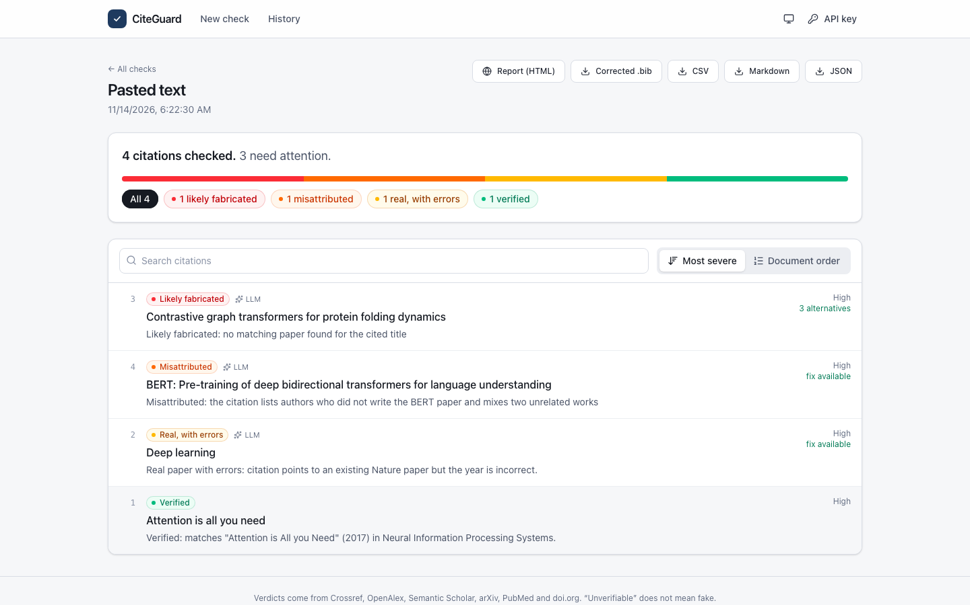
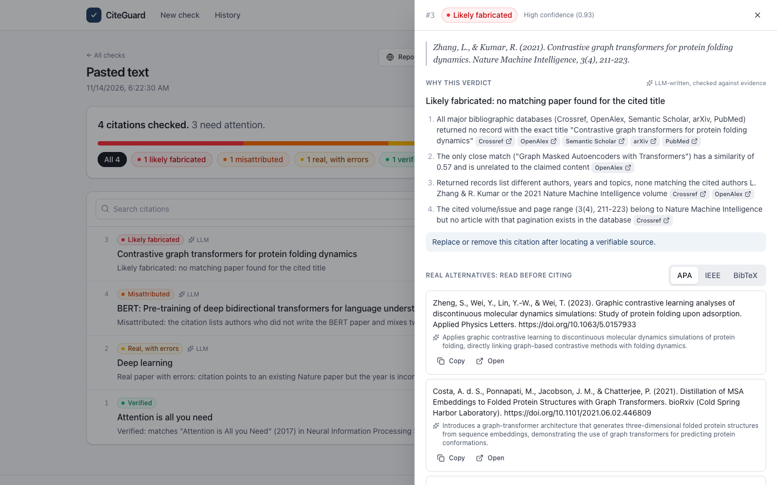
Demo: paste references, get verdicts with evidence, explanations and fixes
Run it: make up → http://localhost:8088 · CLI: citeguard check refs.bib · Video: demo/citeguard_demo.webm
Left: verdicts for a mixed reference list. Right: evidence and validated LLM explanation for a fabricated citation.

Slide 13
References
Agrawal, Suzgun, Mackey & Kalai (2024). Do Language Models Know When They’re Hallucinating References? Findings of EACL.
Khajavi, Sadeghi, Adhikari & Tessier (2026). CiteCheck: Retrieval-Grounded Detection of LLM Citation Hallucinations. arXiv:2605.27700.
Kim, Brendel & Reizinger (2026). HALLMARK: How to Diagnose LLM Citation Verifiers and When to Deploy Them. arXiv:2607.18360.
Li, Lin & Ma (2026). Source or It Didn’t Happen: A Multi-Agent Framework for Citation Hallucination Detection. arXiv:2605.08583.
Lopez (2009). GROBID: Combining Automatic Bibliographic Data Recognition and Term Extraction. ECDL, LNCS 5714.
OpenAI (2025). gpt-oss-120b & gpt-oss-20b Model Card. arXiv:2508.10925.
Walters & Wilder (2023). Fabrication and errors in the bibliographic citations generated by ChatGPT. Scientific Reports 13, 14045.
Zhao, Wang, Stuart, De Vaan, Ginsparg & Yin (2026). LLM hallucinations in the wild: Large-scale evidence from non-existent citations. arXiv:2605.07723.
All references verified with CiteGuard itself (28 verified, 2 minor metadata differences, 0 fake). Full list in the report.

Slide 14
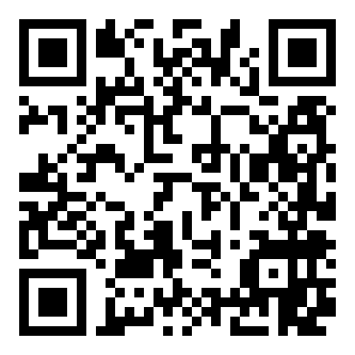
Evidence decides whether a paper exists; the LLM explains, repairs and checks claims
Fresh held-out split: fake-detection F1 1.00, 0 correct citations called fake
LLM-only judges call 10%–13% of correct citations fake
Grounded explanations (19/19) and claim checks (0 false alarms on 25)
Next: chatbot-written references with human labels
GitHub: https://github.com/mjgandhi2305/ILLM_FinalProject_Citeguard
Hugging Face: none (no trained weights; uses Groq-hosted gpt-oss models)
Demo: web app (make up → localhost:8088), CLI, REST API, recorded video in demo/
Miten Gandhi · ILLM Final Project · Questions welcome

