Slide 1
EECE.3170
Microprocessor Systems Design I
Instructor: Dr. Michael Geiger
Spring 2016
Lecture 25:
PIC assembly programming (continued)

Slide 2
Lecture outline
Announcements/reminders
  HW 7 to be posted; due date TBD
  Exams returned Wednesday
Review
  Common simple operations
Today’s lecture
  Multi-byte data
  Sample programming sequences
Microprocessors I: Lecture 24

Slide 3
Review: complex operations
Multiple registers
  Data must be transferred through working register
Conditional jumps
  Usually btfsc/btfss instruction + goto
  Equality/inequality—use subtract in place of CMP
  If you subtract X – Y:
    X > Y → Z = 0, C = 1
    X == Y → Z = 1, C = 1
    X < Y → Z = 0, C = 0
    X <= Y → Z == C
    X != Y → Z = 0
    X >= Y → C = 1
Shift/rotate
  Manipulate carry before operation (or appropriate bit after)
  Use loop for multi-bit shift/rotate
Microprocessors I: Lecture 24

Slide 4
Multi-byte data
Logical operations can be done byte-by-byte
Arithmetic and shift/rotate operations require you to account for data flow between bytes
  Carry/borrow in arithmetic
  Bit shifted between bytes in shift/rotate
Order of these operations is important
  Arithmetic: must do least significant bytes first
  Shift/rotate: move through bytes in same order as shift → bits being shifted will move through carry
    Initial instruction should be appropriate operation (shift or rotate)
    All other instructions must be rotate operations
Microprocessors I: Lecture 24

Slide 5
Working with 16-bit data
Assume a 16-bit counter, the upper byte of the counter is called COUNTH and the lower byte is called COUNTL.
Decrement a 16-bit counter
movf COUNTL, F ; Set Z if lower byte == 0
btfsc STATUS, Z
decf COUNTH, F ; if so, decrement COUNTH
decf COUNTL, F ; in either case decrement COUNTL
Test a 16-bit variable for zero
movf COUNTL, F ; Set Z if lower byte == 0
btfsc STATUS, Z ; If not, then done testing
movf COUNTH, F ; Set Z if upper byte == 0
btfsc STATUS, Z ; if not, then done
goto BothZero ; branch if 16-bit variable == 0
CarryOn
Microprocessors I: Lecture 24
Notes:
Chapter 9

Slide 6
Examples
Translate these x86 operations to PIC code
Assume that there are registers defined for each x86 register (e.g. AL, AH, BL, BH, etc.)
  16-bit values (e.g., AX) must be dealt with as individual bytes
MOVZX AX, BL
MOVSX AX, BL
INC AX
SUB BX, AX
RCL AX, 5
Microprocessors I: Lecture 24

Slide 7
Example solutions
MOVZX AX, BL
movf BL, W ; Copy BL to W
movwf AL ; Copy W to AL
clrf AH ; Clear upper byte
MOVSX AX, BL
movf BL, W ; Copy BL to W
movwf AL ; Copy W to AL
clrf AH ; Clear upper byte
btfsc AL, 7 ; Test sign bit
decf AH, F ; If sign bit = 1, set
; AH = 00 - 1 = 0xFF
Microprocessors I: Lecture 24

Slide 8
Example solutions
INC AX
incf AL, F ; Increment low byte
btfsc STATUS, Z ; Check zero bit
incf AH, F ; If Z == 1, increment
; high byte
SUB BX, AX
movf AL, W ; Copy AL to W
subwf BL, F ; BL = BL – AL
movf AH, W ; Copy AH to W
subwfb BH, F ; BH = BH - AH
Microprocessors I: Lecture 24

Slide 9
Example solutions
RCL AX, 5
movlw 5 ; W = 5
movwf COUNT ; COUNT = W = 5
; Assumes register
; COUNT is defined
L: rlf AL, F ; Rotate low byte
; Bit transferred from
; low to high byte is
; now in carry
rlf AH, F ; Rotate high byte
decfsz COUNT, F ; Decrement & test COUNT
goto L ; Return to start of loop if
; COUNT != 0
Microprocessors I: Lecture 24

Slide 10

A Delay Subroutine
; ***********************************************************************************
; TenMs subroutine and its call inserts a delay of exactly ten milliseconds
; into the execution of code.
; It assumes a 4 MHz crystal clock. One instruction cycle = 4 * Tosc.
; TenMsH equ 13 ; Initial value of TenMs Subroutine's counter
; TenMsL equ 250
; COUNTH and COUNTL are two variables
TenMs
nop ; one cycle
movlw TenMsH ; Initialize COUNT
movwf COUNTH
movlw TenMsL
movwf COUNTL
Ten_1
decfsz COUNTL,F ; Inner loop
goto Ten_1
decfsz COUNTH,F ; Outer loop
goto Ten_1
return
Microprocessors I: Lecture 24
Notes:
Chapter 9

Slide 11
Blinking LED example
Assume three LEDs (Green, Yellow, Red) are attached to Port D bit 0, 1 and 2. Write a program for the PIC16F874 that toggles the three LEDs every half second in sequence: green, yellow, red, green, ….
For this example, assume that the system clock is 4MHz.
Microprocessors I: Lecture 24

Slide 12
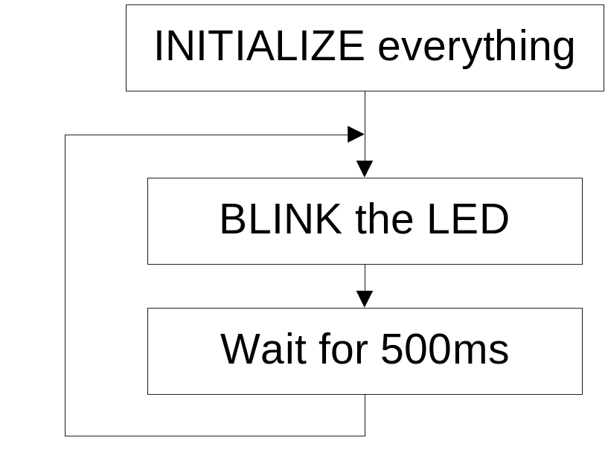
Top Level Flowchart
Initialize: Initialize port D, initialize the counter for 500ms.
Blink: Toggle the LED in sequence, green, yellow, red, green, …. Which LED to be toggled is determined by the previous state.
Wait for 500ms: Keep the LED on for 500ms and then toggle the next one.
Microprocessors I: Lecture 24

Slide 13

Strategy to “Blink”
The LEDs are toggled in sequence - green, yellow, red, green, yellow, red…
Let’s look at the lower three bits of PORTD
  001=green, 010=yellow, 100=red
The next LED to be toggled is determined by the current LED.
001->010->100->001->…
Microprocessors I: Lecture 24

Slide 14
“Blink” Subroutine
Blink
btfsc PORTD, 0 ; is it Green?
goto toggle1 ; yes, goto toggle1
btfsc PORTD, 1 ; else is it Yellow?
goto toggle2 ; yes, goto toggle2
;toggle0
bcf PORTD, 2 ; otherwise, must be red, change to green
bsf PORTD, 0 ; 100->001
return
toggle1
bcf PORTD, 0 ; change from green to yellow
bsf PORTD, 1 ; 001->010
return
toggle2
bcf PORTD, 1 ; change from yellow to red
bsf PORTD, 2 ; 010->100
return
Microprocessors I: Lecture 24

Slide 15
Another way to code “Blink” ---- Table Use
BlinkTable
movf PORTD, W ; Copy present state of LEDs into W
andlw B'00000111' ; and keep only LED bits
addwf PCL,F ; Change PC with PCLATH and offset in W
retlw B'00000001' ; (000 -> 001) reinitialize to green
retlw B'00000011' ; (001 -> 010) green to yellow
retlw B'00000110' ; (010 -> 100) yellow to red
retlw B'00000010' ; (011 -> 001) reinitialize to green
retlw B'00000101' ; (100 -> 001) red to green
retlw B'00000100' ; (101 -> 001) reinitialize to green
retlw B'00000111' ; (110 -> 001) reinitialize to green
retlw B'00000110' ; (111 -> 001) reinitialize to green
In calling program
call BlinkTable ; get bits to change into W
xorwf PORTD, F ; toggle them into PORTD
Microprocessors I: Lecture 24

Slide 16
Final notes
Next time:
  Exam 2 Preview
Reminders
  HW 7 to be posted; due date TBD
  Exams returned Wednesday
Microprocessors I: Lecture 24

