Slide 1
EECE.4810/EECE.5730 Operating Systems
Instructor:
Dr. Michael Geiger
Spring 2018
Lecture 23:
Protection
Security

Slide 2
Lecture outline
Announcements/reminders
Program 3 due today
Extra credit HW due 5/4
Clarification posted for two-level page table problem
Exam 3: Friday, 5/11, 8-11 AM in Ball 314
Course evaluations to be posted; to be returned at final exam
Today’s lecture
Review
Reliability
Protection and security

Slide 3
Review: Reliability
Reliability major factor for file systems
Losing data (due to system crash, power outage, etc.) in process’s address space is not a problem
Losing data in file system is
Transactions: mechanism for making multi-step operation atomic
Atomic HW operation: single-sector write
2 common methods
Shadowing: maintain two copies of data to update (inode, file block) with pointer to “current” version, update “shadow” version, then change pointer
Logging: write data to append-only log + commit sector, replay log later to write changes into file system

Slide 4
Goals of Protection
Computer system: collection of objects (HW/SW)
Each object has unique name and can be accessed through well-defined set of operations
Protection problem
Ensure that each object is accessed correctly
Ensure only processes allowed to access object can do so

Slide 5
Principles of Protection
Guiding principle – principle of least privilege
Programs, users and systems should be given just enough privileges to perform their tasks
Limits damage if entity has a bug, gets abused
Can be static (during life of system, during life of process)
Or dynamic (changed by process as needed) – domain switching, privilege escalation
“Need to know” a similar concept regarding access to data

Slide 6
Principles of Protection (Cont.)
Must consider “grain” aspect
Rough-grained privilege management easier, simpler, but least privilege now done in large chunks
For example, traditional Unix processes either have abilities of the associated user, or of root
Fine-grained management more complex, more overhead, but more protective
File ACL (access control lists)
RBAC (role-based access control)
Domain can be user, process, procedure

Slide 7
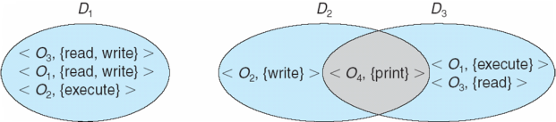
Domain Structure
Access-right = <object-name, rights-set> where rights-set is a subset of all valid operations that can be performed on the object
Domain = set of access-rights

Slide 8
Domain Implementation (UNIX)
Domain = user-id
Domain switch accomplished via file system
Each file has associated with it a domain bit (setuid bit)
When file is executed and setuid = on, then user-id is set to owner of the file being executed
When execution completes user-id is reset
Domain switch accomplished via passwords
su command temporarily switches to another user’s domain when other domain’s password provided
Domain switching via commands
sudo command prefix executes specified command in another domain (if original domain has privilege or password given)

Slide 9
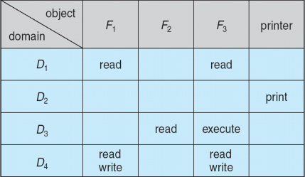
Access Matrix
View protection as a matrix (access matrix)
Rows represent domains
Columns represent objects
Access(i, j) is the set of operations that a process executing in Domain_{i} can invoke on Object_{j}

Slide 10
Use of Access Matrix
If a process in Domain D_{i} tries to do “op” on object O_{j}, then “op” must be in the access matrix
User who creates object can define access column for that object
Can be expanded to dynamic protection
Operations to add, delete access rights
Special access rights:
owner of O_{i}
copy op from O_{i} to O_{j} (denoted by “*”)
control – D_{i} can modify D_{j} access rights
transfer – switch from domain D_{i} to D_{j}
Copy and Owner applicable to an object
Control applicable to domain object

Slide 11
Use of Access Matrix (Cont.)
Access matrix design separates mechanism from policy
Mechanism
Operating system provides access-matrix + rules
It ensures that the matrix is only manipulated by authorized agents and that rules are strictly enforced
Policy
User dictates policy
Who can access what object and in what mode

Slide 12
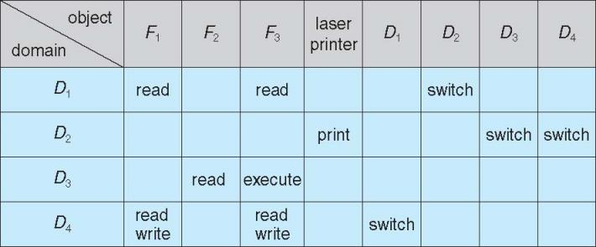
Access Matrix of Figure A with Domains as Objects

Slide 13
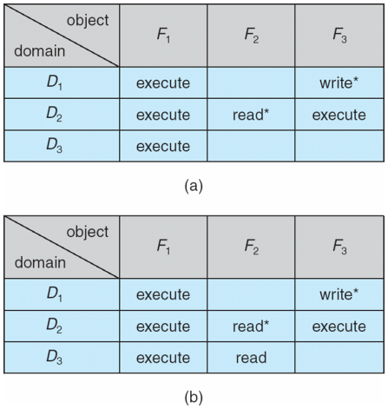
Access Matrix with Copy Rights
Starred rights can be copied across domains
Example: process in domain 2 can give read access on F₂

Slide 14
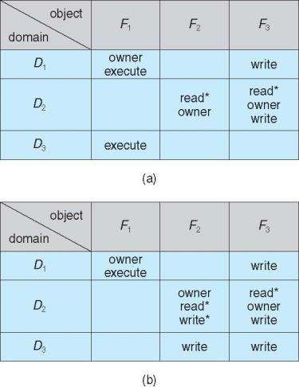
Access Matrix With Owner Rights
Owner domain can add/subtract rights

Slide 15
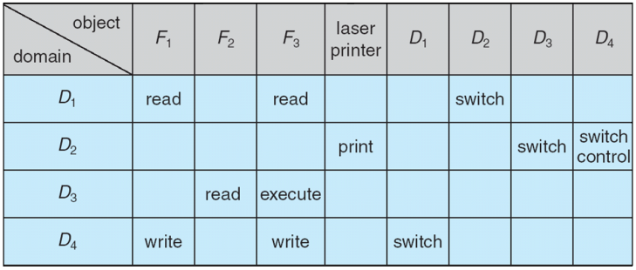
Control rights
Control right gives processes in one domain ability to add/remove rights from other domains

Slide 16
Implementation of Access Matrix
Generally, a sparse matrix
Option 1 – Global table
Store ordered triples <domain, object, rights-set> in table
A requested operation M on object O_{j} within domain D_{i} -> search table for < D_{i}, O_{j}, R_{k} >
with M ∈ R_{k}
But table could be large -> won’t fit in main memory
Difficult to group objects (consider an object that all domains can read)

Slide 17
Implementation of Access Matrix (Cont.)
Option 2 – Access lists for objects
Each column implemented as an access list for one object
Resulting per-object list consists of ordered pairs <domain, rights-set> defining all domains with non-empty set of access rights for the object
Easily extended to contain default set -> If M ∈ default set, also allow access

Slide 18
Implementation of Access Matrix (Cont.)
Each column = Access-control list for one object Defines who can perform what operation Domain 1 = Read, Write Domain 2 = Read Domain 3 = Read
Each Row = Capability List (like a key) For each domain, what operations allowed on what objects
Object F1 – Read
Object F4 – Read, Write, Execute
Object F5 – Read, Write, Delete, Copy

Slide 19
Implementation of Access Matrix (Cont.)
Option 3 – Capability list for domains
Instead of object-based, list is domain based
Capability list for domain is list of objects together with operations allows on them
Object represented by its name or address, called a capability
Execute operation M on object O_{j}, process requests operation and specifies capability as parameter
Possession of capability means access is allowed
Capability list associated with domain but never directly accessible by domain
Rather, protected object, maintained by OS and accessed indirectly
Like a “secure pointer”
Idea can be extended up to applications

Slide 20
Implementation of Access Matrix (Cont.)
Option 4 – Lock-key
Compromise between access lists and capability lists
Each object has list of unique bit patterns, called locks
Each domain has list of unique bit patterns called keys
Process in a domain can only access object if domain has key that matches one of the locks

Slide 21
Comparison of Implementations
Many trade-offs to consider
Global table is simple, but can be large
Access lists correspond to needs of users
Determining set of access rights for domain non-localized so difficult
Every access to an object must be checked
Many objects and access rights -> slow
Capability lists useful for localizing information for a given process
But revocation capabilities can be inefficient
Lock-key effective and flexible, keys can be passed freely from domain to domain, easy revocation

Slide 22
Comparison of Implementations (Cont.)
Most systems use combination of access lists and capabilities
First access to an object -> access list searched
If allowed, capability created and attached to process
Additional accesses need not be checked
After last access, capability destroyed
Consider file system with ACLs per file

Slide 23
The Security Problem
Protection: internal problem
Security: external problem
System secure if resources used and accessed as intended under all circumstances
Intruders attempt to breach security
Threat is potential security violation
Attack is attempt to breach security
Attack can be accidental or malicious
Protection mechanisms handle (most) accidental misuse

Slide 24
Program Threats
Many variations, many names
Trojan Horse
Code segment that misuses its environment
Exploits mechanisms for allowing programs written by users to be executed by other users
Spyware, pop-up browser windows, covert channels
Up to 80% of spam delivered by spyware-infected systems
Trap Door
Specific user identifier or password that circumvents normal security procedures
Could be included in a compiler
Generate standard software + trap door regardless of source
How to detect them?
Analyze all source code

Slide 25
Program Threats (Cont.)
Logic Bomb
Program that initiates a security incident under certain circumstances
Stack and Buffer Overflow
Exploits a bug in a program (overflow either the stack or memory buffers)
Failure to check bounds on inputs, arguments
Write past arguments on the stack into the return address on stack
When routine returns from call, returns to hacked address
Pointed to code loaded onto stack that executes malicious code
Unauthorized user or privilege escalation

Slide 26
C Program with Buffer-overflow Condition
#include <stdio.h>
#define BUFFER SIZE 256
int main(int argc, char *argv[])
{
char buffer[BUFFER SIZE];
if (argc < 2)
return -1;
else {
strcpy(buffer,argv[1]);
return 0;
}
}

Slide 27
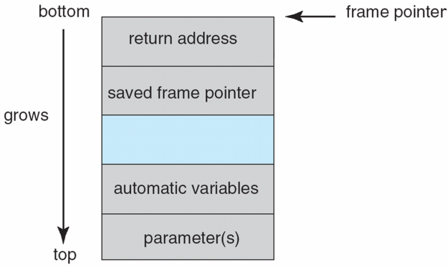
Layout of Typical Stack Frame

Slide 28
Modified Shell Code
#include <stdio.h>
int main(int argc, char *argv[])
{
execvp(‘‘\bin\sh’’,‘‘\bin \sh’’, NULL);
return 0;
}

Slide 29
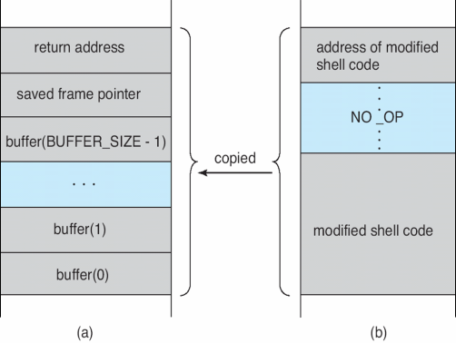
Hypothetical Stack Frame
Before attack
After attack

Slide 30
Great Programming Required?
For the first step of determining the bug, and second step of writing exploit code, yes
Attack code can get a shell with the processes’ owner’s permissions
Or open a network port, delete files, download a program, etc
Depending on bug, attack can be executed across a network using allowed connections, bypassing firewalls
Buffer overflow can be disabled by disabling stack execution or adding bit to page table to indicate “non-executable” state
Available in SPARC and x86
But still have security exploits

Slide 31
Program Threats (Cont.)
Viruses
Code fragment embedded in legitimate program
Self-replicating, designed to infect other computers
Very specific to CPU architecture, operating system, applications
Usually borne via email or as a macro
Visual Basic Macro to reformat hard drive
Sub AutoOpen()
Dim oFS
Set oFS = CreateObject(’’Scripting.FileSystemObject’’)
vs = Shell(’’c:command.com /k format c:’’,vbHide)
End Sub

Slide 32
Program Threats (Cont.)
Virus dropper inserts virus onto the system
Many categories of viruses, literally many thousands of viruses
File / parasitic
Boot / memory
Macro
Source code
Polymorphic to avoid having a virus signature
Encrypted
Stealth
Tunneling
Multipartite
Armored

Slide 33
System and Network Threats
Some systems “open” rather than secure by default
Open systems enable many services (FTP, telnet, etc.) by default
Secure by default → reduce attack surface
But harder to use, more knowledge needed to administer
Network threats harder to detect, prevent
Protection systems weaker
More difficult to have a shared secret on which to base access
No physical limits once system attached to internet
Or on network with system attached to internet
Even determining location of connecting system difficult
IP address is only knowledge

Slide 34
System and Network Threats (Cont.)
Worms – use spawn mechanism; standalone program
Internet worm
Exploited UNIX networking features (remote access) and bugs in finger (directory) and sendmail programs
Exploited trust-relationship mechanism used by rsh to access friendly systems without use of password
Grappling hook program uploaded main worm program
99 lines of C code
Hooked system then uploaded main code, tried to attack connected systems
Also tried to break into other users accounts on local system via password guessing
If target system already infected, abort, except for every 7th time

Slide 35
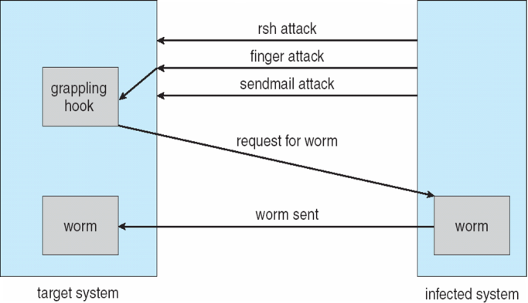
The Morris Internet Worm

Slide 36
Cryptography as a Security Tool
Broadest security tool available
Internal to a given computer, source and destination of messages can be known and protected
OS creates, manages, protects process IDs, communication ports
Source and destination of messages on network cannot be trusted without cryptography
Local network – IP address?
Consider unauthorized host added
WAN / Internet – how to establish authenticity
Not via IP address

Slide 37
Cryptography
Means to constrain potential senders (sources) and / or receivers (destinations) of messages
Based on secrets (keys)
Enables
Confirmation of source
Receipt only by certain destination
Trust relationship between sender and receiver

Slide 38
Encryption
Constrains the set of possible receivers of a message
Encryption algorithm consists of
Set K of keys
Set M of Messages
Set C of ciphertexts (encrypted messages)
A function E : K → (M→C). That is, for each k ∈ K, E_{k} is a function for generating ciphertexts from messages
Both E and E_{k} for any k should be efficiently computable functions
A function D : K → (C → M). That is, for each k ∈ K, D_{k} is a function for generating messages from ciphertexts
Both D and D_{k} for any k should be efficiently computable functions

Slide 39
Encryption (Cont.)
An encryption algorithm must provide this essential property: Given a ciphertext c ∈ C, a computer can compute m such that E_{k}(m) = c only if it possesses k
Thus, a computer holding k can decrypt ciphertexts to the plaintexts used to produce them, but a computer not holding k cannot decrypt ciphertexts
Since ciphertexts are generally exposed (for example, sent on the network), it is important that it be infeasible to derive k from the ciphertexts

Slide 40
Symmetric Encryption
Same key used to encrypt and decrypt
Therefore k must be kept secret
DES was most commonly used symmetric block-encryption algorithm (created by US Govt)
Encrypts a block of data at a time
Keys too short so now considered insecure
Triple-DES considered more secure
Algorithm used 3 times using 2 or 3 keys
For example
2001 NIST adopted new block cipher - Advanced Encryption Standard (AES)
Keys of 128, 192, or 256 bits, works on 128 bit blocks
RC4 is most common symmetric stream cipher, but known to have vulnerabilities
Encrypts/decrypts a stream of bytes (i.e., wireless transmission)
Key is a input to pseudo-random-bit generator
Generates an infinite keystream

Slide 41
Asymmetric Encryption
Public-key encryption based on each user having two keys:
public key – published key used to encrypt data
private key – key known only to individual user used to decrypt data
Must be an encryption scheme that can be made public without making it easy to figure out the decryption scheme
Most common is RSA block cipher
Efficient algorithm for testing whether or not a number is prime
No efficient algorithm is know for finding the prime factors of a number

Slide 42
Asymmetric Encryption (Cont.)
Formally, it is computationally infeasible to derive k_{d,N} from k_{e,N}, and so k_{e} need not be kept secret and can be widely disseminated
k_{e} is the public key
k_{d} is the private key
N is the product of two large, randomly chosen prime numbers p and q (for example, p and q are 512 bits each)
Encryption algorithm is E_{ke,N}(m) = m^{ke} mod N, where k_{e} satisfies k_{e}k_{d} mod (p−1)(q −1) = 1
The decryption algorithm is then D_{kd,N}(c) = c^{kd} mod N

Slide 43
Asymmetric Encryption Example
For example. make p = 7and q = 13
We then calculate N = 7∗13 = 91 and (p−1)(q−1) = 72
We next select k_{e} relatively prime to 72 and< 72, yielding 5
Finally, we calculate k_{d} such that k_{e}k_{d} mod 72 = 1, yielding 29
We how have our keys
Public key, k_{e,N} = 5, 91
Private key, k_{d,N} = 29, 91
Encrypting the message 69 with the public key results in the cyphertext 62
Cyphertext can be decoded with the private key
Public key can be distributed in cleartext to anyone who wants to communicate with holder of public key

Slide 44
Cryptography (Cont.)
Note symmetric cryptography based on transformations, asymmetric based on mathematical functions
Asymmetric much more compute intensive
Typically not used for bulk data encryption

Slide 45
Final notes
Next time: Exam 3 Preview
Reminders
Program 3 due today
Extra credit HW due 5/4
Clarification posted for two-level page table problem
Exam 3: Friday, 5/11, 8-11 AM in Ball 314
Course evaluations to be posted; to be returned at final exam

Slide 46
Acknowledgements
These slides are adapted from the following sources:
Silberschatz, Galvin, & Gagne, Operating Systems Concepts, 9th edition
Anderson & Dahlin, Operating Systems: Principles and Practice, 2nd edition
Chen & Madhyastha, EECS 482 lecture notes, University of Michigan, Fall 2016

