Slide 1
EECE.4810/EECE.5730 Operating Systems
Instructor:
Dr. Michael Geiger
Spring 2018
Lecture 24:
Exam 3 Preview

Slide 2
Lecture outline
Announcements/reminders
Extra credit HW due 5/4
Clarification posted for two-level page table problem
Exam 3: Friday, 5/11, 8-11 AM in Ball 314
Course evaluations to be posted on website
Blank copies will also be available outside my office
Please complete an evaluation and bring it to the final exam
Today’s lecture: Exam 3 Preview

Slide 3
Exam 3 notes
Allowed one 8.5” x 11” double-sided sheets of notes
No other notes; no electronic devices (calculator, phone)
Exam will last 3 hours—please be on time
Covers lectures 16-23
Multiple part questions on:
Memory management (segmentation, paging)
File systems (file operations and directories, example file systems, reliability)
Protection and security
Formats include short answer (i.e., explain concept) or problem-solving (i.e. 1 correct numeric answer)
EECE.5730 students will have additional work on some problems

Slide 4
Review: Segmentation
Segment: contiguous region of memory
Base & bounds = 1 segment
Generalized segmentation allows >1 segment per program
Each process has a segment table
Entry in table = segment
Maps segment # to base/bounds for that segment
Segment can be anywhere in physical memory
Each segment has: start, length, access permission
Processes can share segments
Same start, length, same/different access permissions

Slide 5
Review: Segmentation
Notes:
This should seem a bit strange: the virtual address space has gaps in it! Each segment gets mapped to contiguous locations in physical memory, but may be gaps between segments.
This is a little like walking around in the dark, and there are huge pits in the ground where you die if you step in the pit.
But! of course, a correct program will never step off into a pit, so ok.
A correct program will never address gaps; if it does, trap to kernel and then core dump. Minor exception: stack, heap can grow. In UNIX, sbrk() increases size of heap segment. For stack, just take fault, system automatically increases size of stack.
Detail: Protection mode in segmentation table entries. For example, code segment would be read-only (only execution and loads are allowed). Data and stack segment would be read-write (stores allowed).
What must be saved/restored on context switch? Typically, segment table stored in CPU, not in memory, because it’s small.
Contents must be saved/restored.

Slide 6
Review: Segment table
Segment # | V | Base | Bounds | Access
0 | 1 | 4000 | 700 | read/exec | code segment
1 | 1 | 0 | 500 | read/write | data segment
2 | 0 | n/a | n/a |  | unused segment
3 | 1 | 2000 | 1000 | read/write | stack segment
Protection handled by segment table contents
Valid bit (V) indicates if segment in use
Access indicates privileges (read/write/execute)
Virtual address: segment #, offset
Segment number must be valid
Offset must be < bound
If either false, trap to OS → invalid address

Slide 7
Review: Paged Translation
Manage memory in fixed size units
Virtual memory blocks: pages
Physical memory blocks: frames
Bitmap tracks free frames
Each process has its own page table
Tracks translation, permissions, etc.
Translation
Virtual address: page # & offset
Page # indexes into page table → get frame #
Physical address: frame # & offset
Notes:
Simpler, because allows use of a bitmap. What's a bitmap?
001111100000001100
Each bit represents one page of physical memory -- 1 means allocated, 0 means unallocated. Lots simpler than base&bounds or segmentation

Slide 8
Review: Paged Translation (Abstract)

Slide 9
Review: Paged Translation (Implementation)

Slide 10
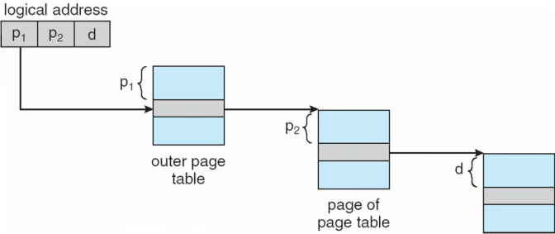
Review: Multi-level page table
Space saving technique
Outer page table points to second-level page table
Second-level page table points to physical frame
Could extend to >2 levels

Slide 11
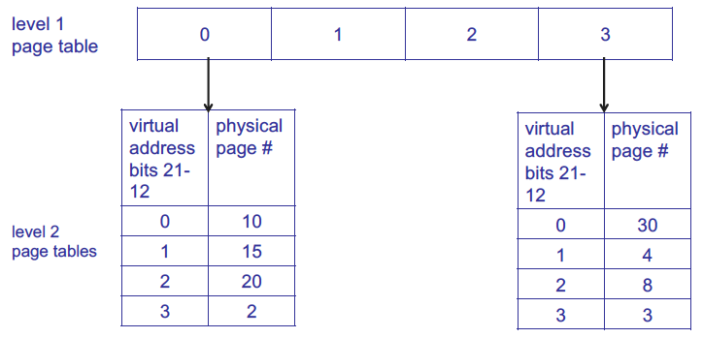
Review: Multi-level page table
1st level page table points to 2nd level page tables
Example assumes 4 KB page size, 1K PTEs at each level

Slide 12
Review: Hashed Page Tables
Common in address spaces > 32 bits
The virtual page number is hashed into a page table
This page table contains a chain of elements hashing to the same location
Each element contains (1) the virtual page number (2) the value of the mapped page frame (3) a pointer to the next element
Virtual page numbers are compared in this chain searching for a match
If a match is found, the corresponding physical frame is extracted

Slide 13
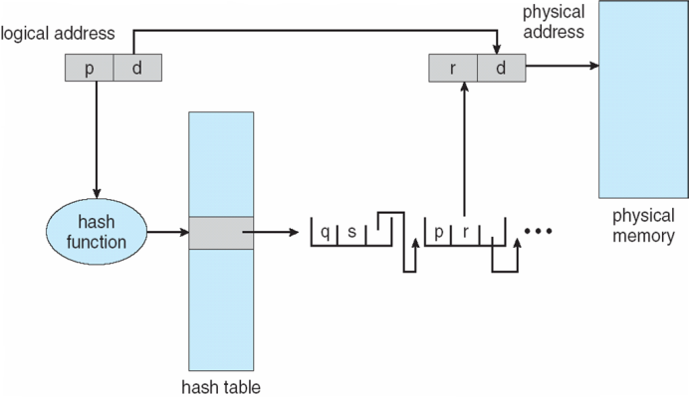
Review: Hashed Page Table

Slide 14
Review: Inverted Page Table
Rather than each process having a page table and keeping track of all possible logical pages, track all physical pages
One entry for each real page of memory
Entry consists of the virtual address of the page stored in that real memory location, with information about the process that owns that page
Decreases memory needed to store each page table, but increases time needed to search the table when a page reference occurs
Use hash table to limit the search to one — or at most a few — page-table entries
TLB can accelerate access
But how to implement shared memory?
One mapping of a virtual address to the shared physical address

Slide 15
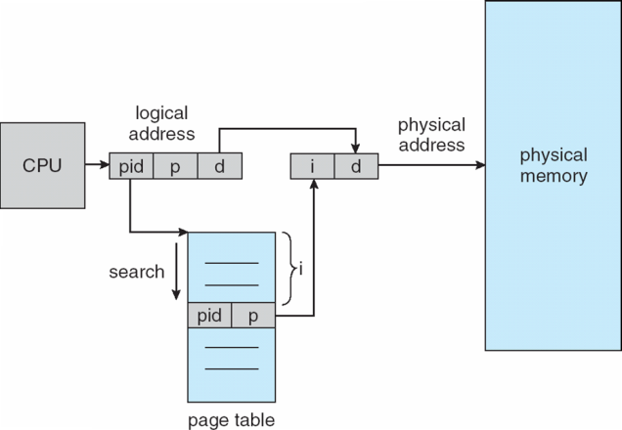
Review: Inverted Page Table Architecture

Slide 16
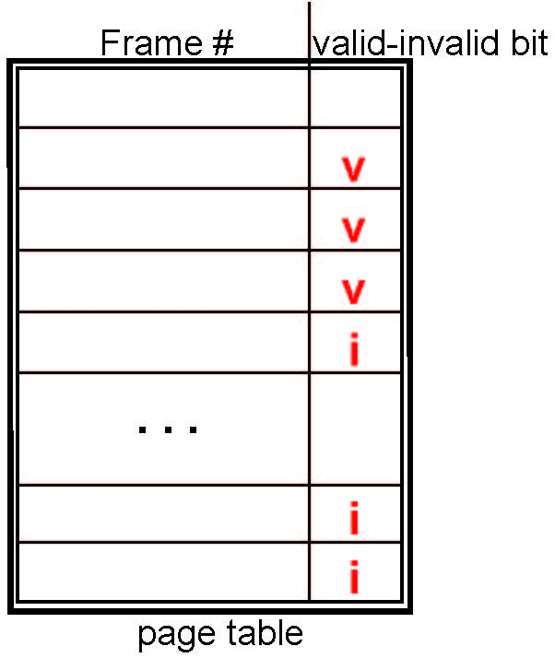
Review: Valid-Invalid Bit
With each page table entry a valid–invalid bit is associated (v ⇒ in-memory – memory resident, i ⇒ not-in-memory)
Initially valid–invalid bit is set to i on all entries
During MMU address translation, if valid–invalid bit in page table entry is i ⇒ page fault

Slide 17
Review: Page Fault
If there is a reference to a page, first reference to that page will trap to operating system:
page fault
Operating system looks at another table to decide:
Invalid reference ⇒ abort
Just not in memory
Find free frame
Swap page into frame via scheduled disk operation
Reset tables to indicate page now in memory Set validation bit = v
Restart the instruction that caused the page fault

Slide 18
Review: Page replacement
How do we determine page to evict if physical address space is full?
Goal: minimize page faults
Closest optimal approximation: least recently-used (LRU)
Use reference bits to approximate LRU
Clock algorithm commonly used to manage clearing of reference bits

Slide 19
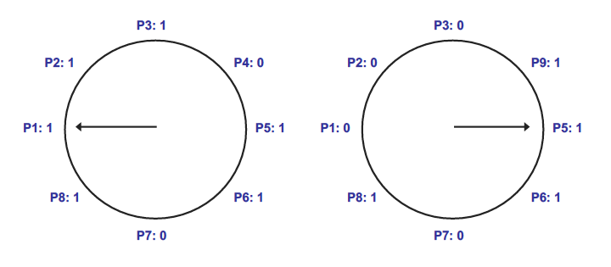
Review: Clock algorithm
In example above, 8 resident pages
Consider pages starting with P1
P4 is first non-referenced page—evicted for P9
Reference bit clear for P1-P3

Slide 20
Review: File details
File: unit of logical storage
Abstract away low-level details of storage device
Contiguous logical address space
Structure of file defines types
At a minimum, OS supports executable file
Other types usually imposed by applications
Text, source, etc.
Extensions → more detailed file typing
File system tracks file attributes (name, ID, type, file pointer, etc.)

Slide 21
Review: File Operations
Operations provide programmer interface to file system
What operations should file system provide?
Create
Write – at write pointer location
Read – at read pointer location
Reposition within file - seek
Delete
Truncate – remove some data from file without deleting entire file
Open(F_{i}) – search the directory structure on disk for entry F_{i}, and move the content of entry to memory
Close (F_{i}) – move the content of entry Fi in memory to directory structure on disk

Slide 22
Review: Working with open files
Open-file table: tracks open files
Per-process info
File pointer: pointer to last read/write location
Access rights: operations allowed by this process
Centralized info
File-open count: number of processes accessing file
Table entry can be removed when count == 0
Disk location of the file: cache of data access information
Accesses supported as sequential or direct (relative to start of file)

Slide 23
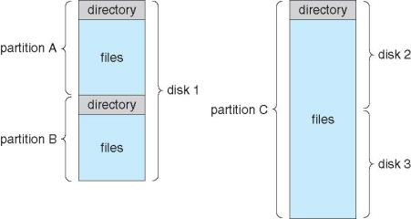
Review: Directory structure
Disk can be split into multiple partitions
Partitions can be raw (no file system) or formatted
Volume: formatted partition (e.g., C:\ on Windows)
Each volume needs its own directory
Effectively table of contents for volume
Tracks information about all files on volume
Imposes hierarchical structure in flat space

Slide 24
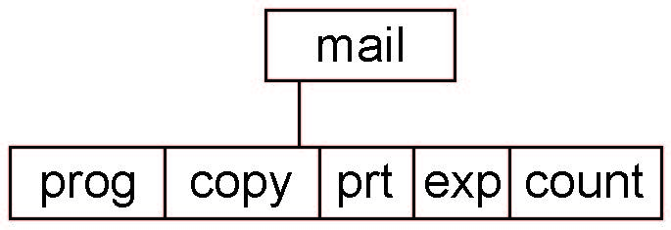
Review: Tree-Structured Directories
Absolute or relative path name
Absolute name is full path
Relative name—relative to current subdirectory or some other subdirectory
Creating a new file is done in current directory
Delete a file
rm <file-name>
Creating a new subdirectory is done in current directory
mkdir <dir-name>
Example: if in current directory /mail
mkdir count
Deleting “mail” ⇒ deleting the entire subtree rooted by “mail”

Slide 25
Review: Free-space management
File system maintains free-space list to track available blocks/clusters
Implementations
Bit vector or bit map
Linked list
Contiguous free blocks may be clustered to reduce amount of space needed to track free blocks

Slide 26
Review: File System Examples
 | FAT | FFS | NTFS
Index structure | Linked list | Tree (fixed, asym) | Tree (dynamic)
granularity | block | block | extent
free space allocation | FAT array | Bitmap (fixed location) | Bitmap (file)
Locality | defrag | Block groups + reserve space | Extents Best fit defrag

Slide 27
Review: File Allocation Table (FAT)
Linked list index structure
Simple, easy to implement
Still widely used (e.g., thumb drives)
File table:
Linear map of all blocks on disk
Each file a linked list of blocks

Slide 28
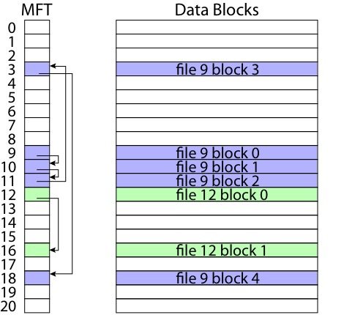
FAT

Slide 29
Review: Berkeley FFS
Metadata
File owner, access permissions, access times, …
Set of 12 data pointers
With 4KB blocks => max size of 48KB
Indirect block pointer
pointer to disk block of data pointers
4KB block size => 1K data blocks => 4MB
Doubly indirect block pointer
Doubly indirect block => 1K indirect blocks
4GB (+ 4MB + 48KB)
Triply indirect block pointer
Triply indirect block => 1K doubly indirect blocks
4TB (+ 4GB + 4MB + 48KB)

Slide 31
Review: NTFS
Master File Table
Flexible 1KB storage for metadata and data
Extents
Block pointers cover runs of blocks
Similar approach in linux (ext4)
File create can provide hint as to size of file
Journalling for reliability

Slide 33
Review: Free-Space Management
File system maintains free-space list to track available blocks/clusters
(Using term “block” for simplicity)
Bit vector or bit map (n blocks)
0
1
2
n-1
…
1 ⇒ block[i] free
0 ⇒ block[i] occupied
bit[i] =

Block number calculation
(number of bits per word) *
(number of 0-value words) +
offset of first 1 bit
CPUs have instructions to return offset within word of first “1” bit

Slide 34
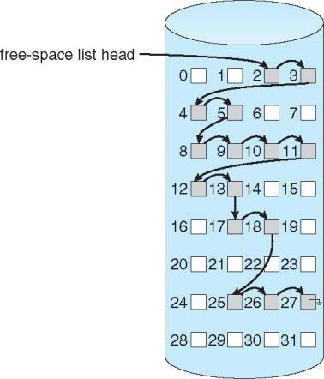
Review: Linked Free Space List
Linked list (free list)
Cannot get contiguous space easily
No waste of space
No need to traverse the entire list (if # free blocks recorded)

Slide 35
Review: Free-Space Management
Grouping
Modify linked list to store address of next n-1 free blocks in first free block, plus a pointer to next block that contains free-block-pointers (like this one)
Counting
Because space is frequently contiguously used and freed, with contiguous-allocation allocation, extents, or clustering
Keep address of first free block and count of following free blocks
Free space list then has entries containing addresses and counts

Slide 36
Review: Reliability
Reliability major factor for file systems
Losing data (due to system crash, power outage, etc.) in process’s address space is not a problem
Losing data in file system is
Transactions: mechanism for making multi-step operation atomic
Atomic HW operation: single-sector write
2 common methods
Shadowing: maintain two copies of data to update (inode, file block) with pointer to “current” version, update “shadow” version, then change pointer
Logging: write data to append-only log + commit sector, replay log later to write changes into file system

Slide 37
Review: Protection
Ensure each object accessed correctly and only by those processes allowed to do so
Objects: HW (e.g. CPU, memory, printers, storage), SW (e.g. files, programs, semaphores)
Guiding principle – principle of least privilege
Programs, users and systems should be given just enough privileges to perform their tasks
Processes operate within domains
Collections of access rights
Access-right = <object-name, rights-set> where rights-set is a subset of all valid operations that can be performed on the object

Slide 38
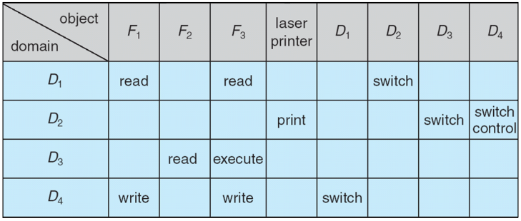
Review: Access Matrix
View protection as a matrix (access matrix)
Rows represent domains
Columns represent objects
Access(i, j) is the set of operations that a process executing in Domain_{i} can invoke on Object_{j}
Control change through copy, owner, control rights

Slide 39
Review: Access list implementations
Global table is simple, but can be large
Can’t group objects/domains
Access lists correspond to needs of users
Per-object list of domains, privileges
Capability lists useful for localizing information for a given process
Per-domain list of objects, privileges
Lock-key effective and flexible, keys can be passed freely from domain to domain, easy revocation
Object holds lock patterns, domain has keys

Slide 40
Review: Security
System secure if resources used and accessed as intended under all circumstances
Intruders attempt to breach security
Threat is potential security violation
Program threats: trojan horse, trap door, logic bomb, stack/buffer overflow, viruses
Network threats: worms, port scanning, DoS
Attack is attempt to breach security
Network attacks: masquerading, replay attack, man-in-middle, session hijacking

Slide 41
Review: Cryptography
Means to constrain potential senders (sources) and / or receivers (destinations) of messages
Based on secrets (keys)
Enables
Confirmation of source
Receipt only by certain destination
Trust relationship between sender and receiver
Sender encrypts data; receiver decrypts
Cryptography can be symmetric (same key for decryption/encryption) or asymmetric (often public key for encryption; private key for decryption)

Slide 42
Final notes
Next time: Final Exam (Friday, 5/11, 8-11 AM in Ball 314)
Reminders
Course evaluations to be posted on website
Blank copies will also be available outside my office
Please complete an evaluation and bring it to the final exam

Slide 43
Acknowledgements
These slides are adapted from the following sources:
Silberschatz, Galvin, & Gagne, Operating Systems Concepts, 9th edition
Anderson & Dahlin, Operating Systems: Principles and Practice, 2nd edition
Chen & Madhyastha, EECS 482 lecture notes, University of Michigan, Fall 2016

