Slide 1
EECE.4810/EECE.5730 Operating Systems
Instructor:
Dr. Michael Geiger
Spring 2018
Lecture 19:
Virtual memory examples

Slide 2
Lecture outline
Announcements/reminders
Program 3 due 4/18
No lecture Monday, 4/16 (Patriots Day)
Today’s lecture
Review
Page table organization
Eviction policies
Dirty bits
Virtual memory example

Slide 3
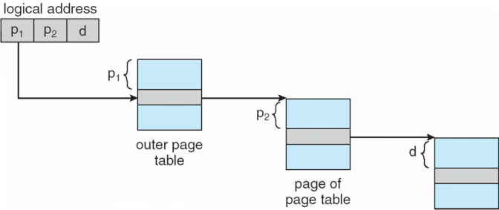
Review: Multi-level page table
Space saving technique
Outer page table points to second-level page table
Second-level page table points to physical frame
Could extend to >2 levels

Slide 4
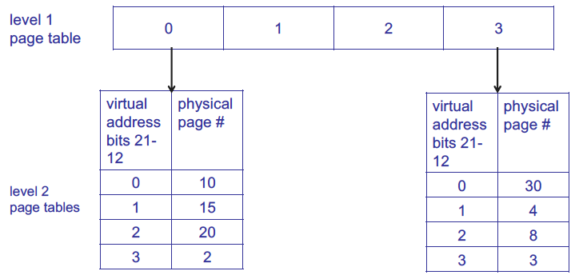
Review: Multi-level page table
1st level page table points to 2nd level page tables
Example assumes 4 KB page size, 1K PTEs at each level

Slide 5
Review: Hashed Page Tables
Common in address spaces > 32 bits
The virtual page number is hashed into a page table
This page table contains a chain of elements hashing to the same location
Each element contains (1) the virtual page number (2) the value of the mapped page frame (3) a pointer to the next element
Virtual page numbers are compared in this chain searching for a match
If a match is found, the corresponding physical frame is extracted

Slide 6
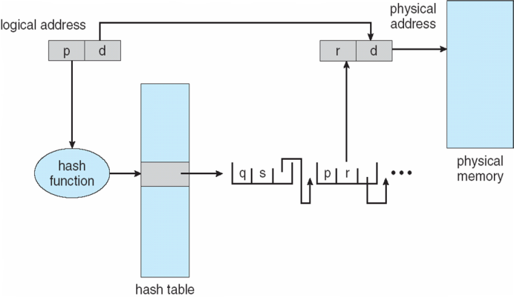
Review: Hashed Page Table

Slide 7
Review: Inverted Page Table
Rather than each process having a page table and keeping track of all possible logical pages, track all physical pages
One entry for each real page of memory
Entry consists of the virtual address of the page stored in that real memory location, with information about the process that owns that page
Decreases memory needed to store each page table, but increases time needed to search the table when a page reference occurs
Use hash table to limit the search to one — or at most a few — page-table entries
TLB can accelerate access
But how to implement shared memory?
One mapping of a virtual address to the shared physical address

Slide 8
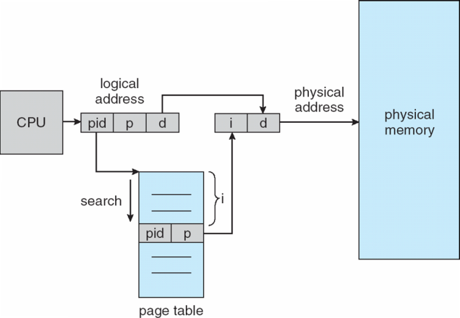
Review: Inverted Page Table Architecture

Slide 9
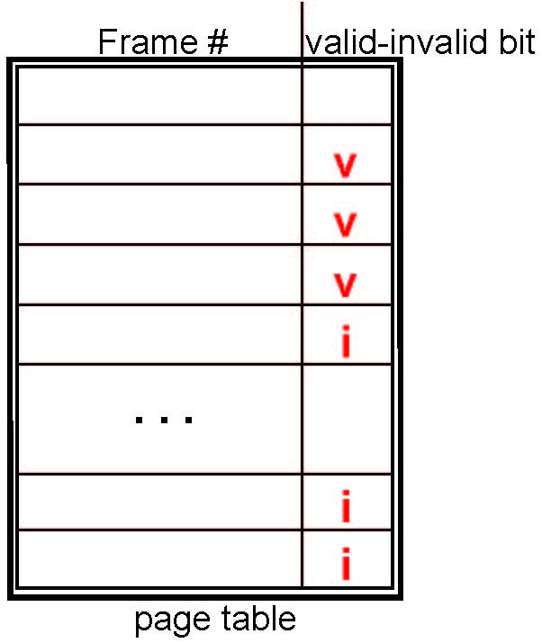
Review: Valid-Invalid Bit
With each page table entry a valid–invalid bit is associated (v ⇒ in-memory – memory resident, i ⇒ not-in-memory)
Initially valid–invalid bit is set to i on all entries
During MMU address translation, if valid–invalid bit in page table entry is i ⇒ page fault

Slide 10
Review: Page Fault
If there is a reference to a page, first reference to that page will trap to operating system:
page fault
Operating system looks at another table to decide:
Invalid reference ⇒ abort
Just not in memory
Find free frame
Swap page into frame via scheduled disk operation
Reset tables to indicate page now in memory Set validation bit = v
Restart the instruction that caused the page fault

Slide 11
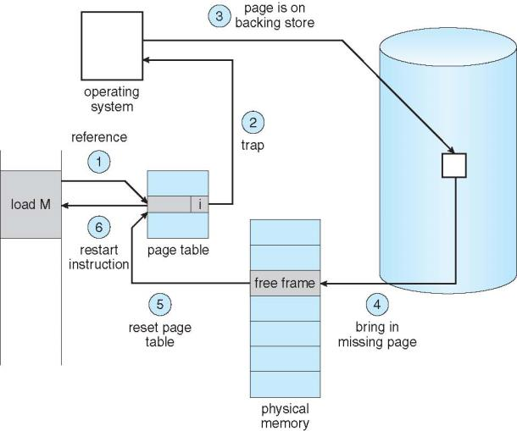
Review: Steps in Handling a Page Fault

Slide 12
Review: Page replacement
How do we determine page to evict if physical address space is full?
Goal: minimize page faults
Closest optimal approximation: least recently-used (LRU)
Use reference bits to approximate LRU
Clock algorithm commonly used to manage clearing of reference bits

Slide 13
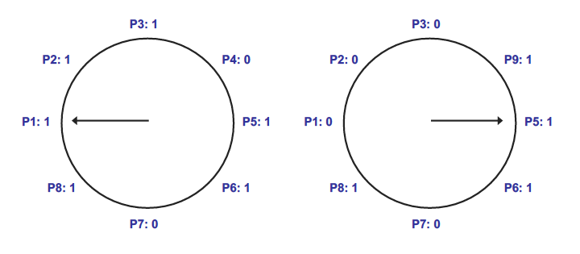
Review: Clock algorithm
In example above, 8 resident pages
Consider pages starting with P1
P4 is first non-referenced page—evicted for P9
Reference bit clear for P1-P3

Slide 14
Dirty bits
What happens on eviction?
Simplest case: evicted page written back to disk
When is write to disk actually necessary?
Only if page has been modified
Dirty bit tracks changed pages
Dirty bit = 1 → page modified
How can dirty bit be used to modify eviction policy?
More performance-effective to evict non-dirty pages—no need to take time to write to disk

Slide 15
Virtual memory example
Assume the current process uses the page table below:
Which virtual pages are present in physical memory?
Which resident pages are candidates for eviction?
Assuming 1 KB pages and 16-bit addresses, what physical addresses would the virtual addresses below map to?
0x041C
0x08AD
0x157B
Virtual page # | Valid bit | Reference bit | Dirty bit | Frame #
0 | 1 | 1 | 0 | 4
1 | 1 | 1 | 1 | 7
2 | 0 | 0 | 0 | --
3 | 1 | 0 | 0 | 2
4 | 0 | 0 | 0 | --
5 | 1 | 0 | 1 | 0

Slide 16
Virtual memory example soln.
Which virtual pages are present in physical memory?
All those with valid PTEs: 0, 1, 3, 5
Which resident pages are candidates for eviction?
All those with valid PTEs and ref bit = 0: 3, 5
Assuming 1 KB pages and 16-bit addresses (both VA & PA), what PA, if any, would the VA below map to?
1 KB pages → 10-bit page offset (unchanged in PA)
Remaining bits: virtual page # → upper 6 bits
Virtual page # chooses PTE; frame # used in PA
0x041C = 0000 0100 0001 1100₂
Upper 6 bits = 0000 01 = 1
PTE 1 → frame # 7 = 000111
PA = 0001 1100 0001 1100₂ = 0x1C1C
0x08AD = 0000 1000 1010 1101₂
Upper 6 bits = 0000 10 = 2
PTE 2 is not valid → page fault
0x157B = 0001 0101 0111 1011₂
Upper 6 bits = 0001 01 = 5
PTE 5 → frame # 0 = 000000
PA = 0000 0001 0111 1011₂ = 0x017B

Slide 17
Final notes
Next time (Wednesday, 4/18)
File systems
Reminders:
Program 3 due 4/18
No lecture Monday, 4/16 (Patriots Day)

Slide 18
Acknowledgements
These slides are adapted from the following sources:
Silberschatz, Galvin, & Gagne, Operating Systems Concepts, 9th edition
Anderson & Dahlin, Operating Systems: Principles and Practice, 2nd edition
Chen & Madhyastha, EECS 482 lecture notes, University of Michigan, Fall 2016

