Slide 1
EECE.2160 ECE Application Programming
Instructors:
Dr. Michael Geiger
Fall 2018
Lecture 20:
PE2: Functions

Slide 2
Lecture outline
Announcements/reminders
Program 4 due today
Program 5 to be posted; due 10/31
Exam 1, Q3b: if you answered (ii), (iii), and (iv), please see me to get partial credit
Advising period starts today
Today’s lecture
More pointer argument examples
PE3: Functions

Slide 3
Example: pointer arguments
What does the following print?
int f(int *a, int *b);
int main() {
int x = 1;
int y = 2;
int result1, result2, result3;
result1 = f(&x, &y);
result2 = f(&y, &result1);
result3 = f(&result1, &result2);
printf("x = %d, y = %d\n", x, y);
printf("Result 1: %d\n", result1);
printf("Result 2: %d\n", result2);
printf("Result 3: %d\n", result3);
return 0;
}
int f(int *a, int *b)
{
int copyB = *b;
while (*a > 1) {
*b += copyB;
(*a)--;
}
return *b;
}

Slide 4
Example solution
After first call to function
x = 1, y = 2, result1 = 2
After second call to function
y = 1, result1 = 4, result2 = 4
After third call to function
result1 = 1, result2 = 16, result3 = 16
Final output
x = 1, y = 1
Result 1: 1
Result 2: 16
Result 3: 16

Slide 5
Example: writing functions with pointers
Write a function that:
Given two integer arguments, x and y, store the quotient and remainder of x / y into locations specified by arguments q and r, respectively.
Uses pointers to swap the values of two double-precision variables

Slide 6
Example solution
Given two integer arguments, x and y, store the quotient and remainder of x / y into locations specified by arguments q and r, respectively.
void divQR(int x, int y,
int *q, int *r)
{
*q = x / y;
*r = x % y;
}

Slide 7
Example solution (cont.)
Use pointers to swap the values of two double-precision variables
void swap(double *a, double *b)
{
double temp;
temp = *a;
*a = *b;
*b = temp;
}

Slide 8
PE3: Change problem
Given any amount of change under $2.00, determine and print out the minimum number of coins required to make that amount of change.
Available coins are Halves (half dollars), Quarters, Dimes, Nickels, and Pennies.

Slide 9
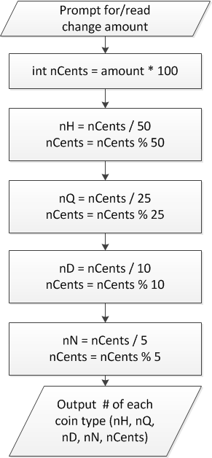
Flowchart
Treat change amount as integer (nCents)
Can now use division & modulus
nCents = # pennies after previous four coin types have been taken out

Slide 10
When to use functions
Find a particular step or series of steps being repeated in your code
If code is exactly the same, you need no arguments
If one or more values change, but actual calculations are the same, values can be function arguments
If function modifies:
1 variable: just return it
2+ variables: use pointer argument(s)
Reassess change example
Steps for creating change are extremely similar
What changes each time?
How should we use those values in a function?
Inputs, outputs, variables … ?

Slide 11
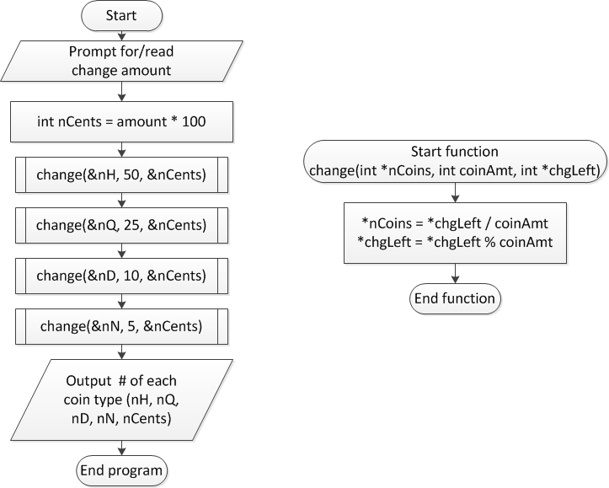
Overall flowchart

Slide 12
Final notes
Next time
Arrays
Reminders:
Program 4 due today
Program 5 to be posted; due 10/31
Exam 1, Q3b: if you answered (ii), (iii), and (iv), please see me to get partial credit
Advising period starts today

