Slide 1
EECE.4810/EECE.5730 Operating Systems
Instructor:
Dr. Michael Geiger
Spring 2019
Lecture 13
Exam 1 Preview

Slide 2
Lecture outline
Announcements/reminders
Program 2 still to be posted; due date TBD
Exam 1: Monday, 2/25, 3-5 PM, Ball 214
Covers lectures through Wednesday
Will be allowed two 8.5” x 11” double-sided note sheets
No electronic devices, other notes allowed
No Monday lecture; will be in office until ~1:45 PM
Today’s lecture: Exam 1 preview
Exam guidelines
Review of relevant material

Slide 3
Exam 1 notes
Allowed two 8.5” x 11” double-sided sheets of notes
No other notes; no electronic devices (calculator, phone)
Exam will last 2 hours—please be on time
Covers lectures 2-12
4 questions, each with multiple parts
Process management (creation, deletion, etc.)
Inter-process communication
General multithreading
Synchronization
Formats include short answer (i.e., explain concept) or problem-solving (i.e. 1 correct numeric answer)
EECE.5730 students will have additional work on some problems

Slide 4
Test policies
Prior to passing out exam, your instructor will verify that you only have two note sheets
If you have >2 sheets, I will take all notes
You will not be allowed to remove anything from your bag after you receive your exam
If you need an additional pencil, eraser, or piece of scrap paper during the exam, ask me
Only one person will be allowed to use the bathroom at a time
You must leave your cell phone either with me or clearly visible on the table near your seat

Slide 5
Review: Processes
Process: program in execution
1+ running pieces of code (threads) + everything code can read/write
Program counter
Registers
Address space
Address space: all code/data stored in memory
Text section: code
Data section: global variables
Stack: temporary data related to functions
Heap: dynamically allocated data

Slide 6
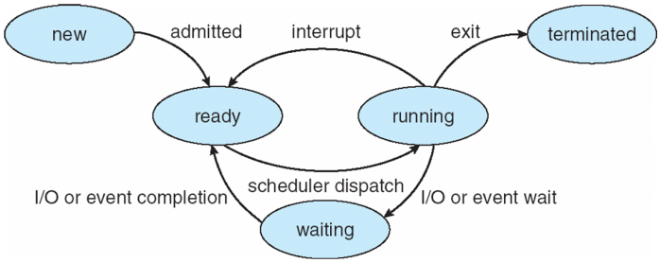
Review: Process State
new: Process is being created
running: Instructions are being executed
waiting: Process waiting for some event to occur
ready: Process waiting to be assigned to a processor
terminated: Process has finished execution

Slide 7
Review: Process creation
Each process has to be created by another process
Creator is called parent process
Created process is child process
Children can create other processes, forming process tree
Parent/child processes may share resources
Parent/child processes may execute concurrently, or parent may wait for child to terminate

Slide 8
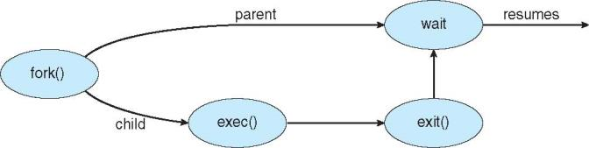
Review: Process creation (cont.)
Address space
Initially, child duplicate of parent
Child can load a separate program
UNIX examples
fork() system call creates new process
exec() system call used after a fork() to replace the process’ memory space with a new program

Slide 9
Review: more details on fork() and wait()
fork() return value is:
<0 if fork() fails (no child created)
0 within child process
PID of child (>0) within parent process
Can use to differentiate child from parent
Run same program but use conditional statement to send parent/child down different paths
wait() system call allows parent to wait for child to finish execution

Slide 10
Review: exec system calls
To start new program, replace address space of current process with new process
On UNIX systems, use exec system calls
Family of functions allowing you to specify
Location of executable
execlp(), execvp() don’t require full path
Command line arguments to executable, either as
Separate strings passed to execl(), execle(), execlp()
Array of strings passed to execv(), execve(), execvp()
Optional list of new environment variables

Slide 11
Review: Forking Separate Process
int main() {
pid_t pid;
pid = fork(); // Create a child process
if (pid < 0) { // Error occurred
fprintf(stderr, "Fork failed");
return 1;
}
else if (pid == 0) { // Child process
printf("Child: listing of current directory\n\n");
execlp("/bin/ls", "ls", NULL);
}
else { // Parent process—wait for child to complete
printf("Parent: waits for child to complete\n\n");
wait(NULL);
printf("Child complete\n\n");
}
return 0;
}

Slide 12
Review: Process Termination
Process ends using exit() system call
May be explicit, implicit (return from main → exit())
Returns status data from child to parent (via wait())
Process’ resources are deallocated by operating system
Parent may abort() executing child process if:
Child has exceeded allocated resources
Task assigned to child is no longer required
Parent exiting and OS does not allow child to continue if parent terminates
Not true in Linux, for example
OS initiates cascading termination

Slide 13
Review: Process Termination
Parent may wait() for child termination
wait() returns child PID, passes return status through pointer argument
pid = wait(&status);
If child terminates before parent invokes wait(), process is a zombie
If parent terminated without wait() , process is an orphan
Return status must be checked
In Linux, orphans assigned init as parent

Slide 14
Review: Interprocess Communication
Shared memory
Communication largely process-managed after OS used to set up shared region
Message passing
OS responsible for send/receive primitives
Direct communication: processes send messages directly to one another
Indirect communication: processes send to/receive from mailboxes

Slide 15
Review: IPC Models
(a) Message passing (b) Shared memory

Slide 16
Review: Threads
Thread: active sequence of instructions
Basic unit of CPU utilization
Thread creation is lightweight
Multiple threads in same process can share address space
Each thread needs own PC, register copies, stack + SP
Threads provide concurrency within application
HW support necessary for parallelism
Major issue: non-deterministic ordering
Solutions require atomic operations
Avoid race condition: solution depends on timing/ordering of earlier events

Slide 17
Review: Critical section
Code section that needs to be run atomically with respect to selected other pieces of code
A and B often same piece of code
Protects access to shared resource
Critical section requirements:
Mutual exclusion: ≤1 thread executes CS at a time
Progress: if >1 thread attempts CS at same time, 1 thread guaranteed to be selected
Bounded waiting: if thread T requests access to its CS, limit on # times other threads can access their CS before T does

Slide 18
Review: Locks
A lock (or mutex) prevents another thread from entering a critical section
“Lock fridge while checking milk & shopping”
Two operations:
lock(): wait until lock is free, then acquire it
do {
if (lock is free) { // code in red
acquire lock // is atomic
break out of loop
}
} while (1);
unlock(): release lock

Slide 19
Review: Condition variables
Avoid busy waiting by enabling thread to sleep inside critical section by (steps in red are atomic):
Release lock
Put thread on waiting list
Go to sleep
After being woken, call lock()
Each condition variable tracks list of threads waiting on that specific condition
Each condition variable associated with lock

Slide 20
Review: Condition variable operations
wait()
Atomically release lock, add thread to waiting list, then go to sleep
Thread must hold lock when calling wait()
signal()
Wake up one thread waiting on condition variable
If no thread waiting, does nothing
broadcast()
Wake up all threads waiting on condition variable
If no thread waiting, does nothing

Slide 21
Final notes
Next time
Exam 1—PLEASE BE ON TIME
Reminders:
Program 2 still to be posted; due date TBD
Exam 1: Monday, 2/25, 3-5 PM, Ball 214
Covers lectures through Wednesday
Will be allowed two 8.5” x 11” double-sided note sheets
No electronic devices, other notes allowed
No Monday lecture; will be in office until ~1:45 PM

