Slide 1
EECE.2160 ECE Application Programming
Instructors:
Dr. Michael Geiger & Dr. Lin Li
Spring 2019
Lecture 13:
For loops

Slide 2
Announcements/reminders
Program 2 resubmissions due Friday, 3/1
Program 3 due today
Program 4 to be posted; due TBD
Will intro in class later this week
Exams to be returned Wed. or Fri.

Slide 3
Today’s lecture
For loops
(Time permitting) Start PE2: Loops/ conditionals

Slide 4
Justifying for loops
Common loop structure
Initialize variable
Loop until that variable reaches certain limit
At end of each iteration, change variable by fixed amount
Example: squares program
i = 0;
while (i <= 10) {
iSquared = i * i;
printf("%2d%10d\n", i, iSquared);
i = i + 1;
}

Slide 5
for loops
for loops include all three aspects in one construct
Form:
for (<init var>; <test>; <change var>)
<statements>
<init var> is basic assignment
<test> same type of condition as if, while
<change var> change variable by fixed amount
Example: for (i = 0; i < 20; i++)
… You may be wondering what i++ means

Slide 6
Changing variables
Can do operation + assignment w/one operator
Simply adding/subtracting 1:
x++ → x = x + 1 (post-increment)
x-- → x = x – 1 (post-decrement)
++x → x = x + 1 (pre-increment)
--x → x = x – 1 (pre-decrement)
Augmented assignment: change variable by amount other than 1
x += y → x = x + y
x -= y → x = x – y
x *= y → x = x * y
x /= y → x = x / y

Slide 7
Pre- vs. post-increment/decrement
Pre-increment/decrement: perform increment/ decrement, then evaluate expression
Post-increment/decrement: evaluate expression, then perform increment/decrement
Example: what does the following print?
int n = 5;
printf(“n = %d\n”, ++n);
printf(“Now, n = %d\n”, n++);
printf(“Finally, n = %d\n”, n);

Slide 8
Example soln.
int n = 5;
printf(“n = %d\n”, ++n);
printf(“Now, n = %d\n”, n++);
printf(“Finally, n = %d\n”, n);
Output:
n = 6 (n pre-incremented)
Now, n = 6 (n post-incremented)
Finally, n = 7 (Shows effect of n++)

Slide 9
Simple usage of for loop
Common sequence of code:
x=0; while (x<12) { printf("%d ",x); x++; }
Output:
0 1 2 3 4 5 6 7 8 9 10 11

Slide 10
Intro to for loops
Common sequence of code:
x=0; while (x<12) { printf("%d ",x); x++; }
Equivalent for construct
for (x=0 ; x<12 ; x++ ) { printf("%d ",x); }
Initial value
Test condition
Body of loop (may be 0, 1, or several statements)
End of loop change

Slide 11
Repetition with for loop
Rewriting squares program with loop
int main() {
int i; // Number to square
int iSquared; // Square of the number
printf(" i i^2\n"); // Column headings
// Compute and display the squares of numbers 0 to 10
for (i = 0; i <= 10; i++) { // Loop until i > 10
iSquared = i * i;
printf("%2d%10d\n", i, iSquared);
}
return 0;
}

Slide 12
Repetition with for loop (cont.)
Generalizing program:
int main() {
int i; // Number to square
int iSquared; // Square of the number
int iStart; // Initial value
int iStop; // Last value
int iStep; // Increment
printf(“Enter start, stop, and increment: “);
scanf(“%d %d %d”, &iStart, &iStop, &iStep);
printf(" i i^2\n"); // Column headings
// Compute and display the squares of numbers iStart to iStop
// with increment iStep
for (i = iStart; i <= iStop; i += iStep) {
iSquared = i * i;
printf("%2d%10d\n", i, iSquared);
}
return 0;
}

Slide 13
Example: for loops
What does each of the following print?
for (i=5; i<40; i+=8) { printf("%d ", i); }
for (i=10; i<=100; i=i+10) { if (i%20) printf("%d ", i); }
for (i=-5; i<-10; i--) { printf("%d ", i); }
for (i=5; i<10; i+=i%2) { printf("%d ", i++); }

Slide 14
Example solution
What does each of the following print?
for (i=5; i<40; i+=8) { printf("%d ", i); }
OUTPUT: 5 13 21 29 37
for (i=10; i<=100; i=i+10) { if (i%20) printf("%d ", i); }
OUTPUT: 10 30 50 70 90
for (i=-5; i<-10; i--) { printf("%d ", i); }
OUTPUT: No output
for (i=5; i<10; i+=i%2) { printf("%d ", i++); }
OUTPUT: 5 6 8

Slide 15
PE2: Today’s program should:
Prompt user to enter an input character and an integer, n.
If not correctly formatted, print error, clear line, and repeat
Depending on the character entered, do the following:
‘F’ or ‘f’: Compute and print the factorial of n, n!
For example, if the user enters F 5, print 5! = 120
‘P’ or ‘p’: Compute 2^{n} (if n >= 0)
For example, if the user enters p 2, print 2^2 = 4
Print an error if n < 0.
‘X’ or ‘x’: Exit the program
In all other cases, print an error:
For example: Invalid command Z entered
If the user enters any command other than ‘X’ or ‘x’, return to the initial prompt and repeat the program

Slide 16
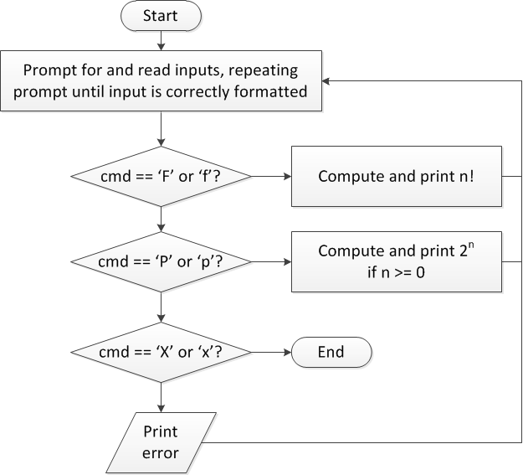
Flow charts: overall flow

Slide 17
Discussion: Overall flow
Whole program contains loop
Repeats process until user enters ‘X’ or ‘x’
Use while or do-while—unknown # of iterations
Since exit condition ends program, “infinite” loop
Testing cmd: switch statement
Checking equality of cmd to constant values
Exiting program: return statement
Use return at any point to end current function (including main)

Slide 18
Code: overall flow (skeleton code)
while (1) { // Loop repeats until user enters 'X' or 'x'
/* Code to read cmd, n */
/* Evaluate cmd and perform appropriate operation */
switch (cmd) {
case 'F':
case 'f':
/* Calculate n! */
break;
case 'P':
case 'p':
/* Calculate 2^n, if n >= 0; print error otherwise */
break;
case 'X':
case 'x':
return; // Exit program
default:
printf("Invalid command %c entered\n", cmd);
}
}

Slide 19
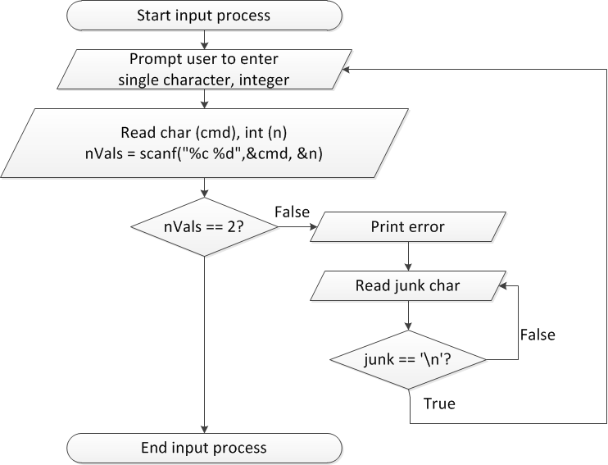
Flow charts: reading input

Slide 20
Discussion: Reading input
Loop that repeats as long as input incorrect
Loop inside that one to handle reading of remainder of line
Read character until you reach end of line
Both while/do-while loops

Slide 21
Code: Reading input
do {
printf("Enter command and integer: ");
nVals = scanf("%c %d", &cmd, &n);
// Otherwise, print error & clear line
if (nVals != 2) {
printf("Incorrectly formatted input\n“);
do {
scanf("%c", &junk);
} while (junk != '\n');
}
} while (nVals != 2);

Slide 22
Input errors
In general, may want to repeat prompt if any error occurs
Logical OR of all error conditions to continue loop
Prioritize error testing—format errors usually first
Why test inputs if they weren’t read correctly?
Example: also test for n < 0 as an error
do {
printf("Enter command and integer: ");
nVals = scanf("%c %d", &cmd, &n);
if (nVals != 2) {
// Handle error
}
else if (n < 0) { ← Test after we know no
// Handle error formatting error
}
} while ((nVals != 2) || (n < 0));

Slide 23
Error flags
Flag: variable that indicates a particular condition occurred
Allows you to simplify conditional tests later in program
Possible uses
Waiting for some condition—set flag when condition occurs
Testing multiple errors—set/increment flag any time there’s an error
int flag;
do {
flag = 0;
printf("Enter command and integer: ");
nVals = scanf("%c %d", &cmd, &n);
if (nVals != 2) {
// Handle error
flag = 1;
}
else if (n < 0) {
// Handle error
flag = 1;
}
} while (flag == 1);

Slide 24
Finishing PE2: overall flow (review)

Slide 25
Finishing PE2: next steps
Write flowcharts for
Computing n!
Computing 2^{n} if n >= 0
Complete code

Slide 26
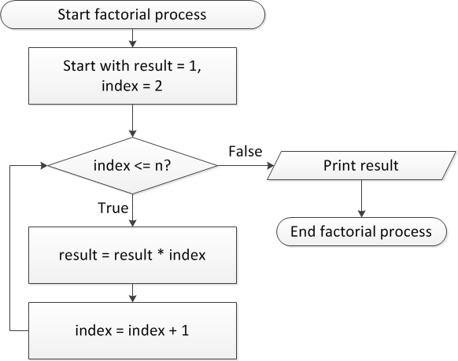
Flow charts: Calculating n!

Slide 27
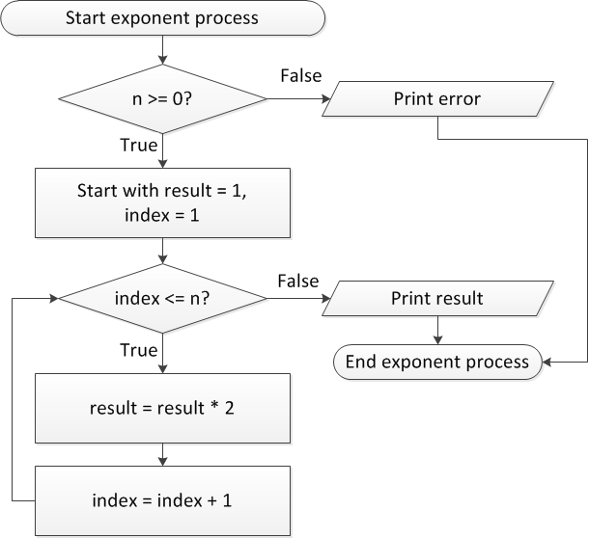
Flow charts: Calculating 2^{n}

Slide 28
Discussion: Factorial/2^{n}
Loop for each process covers fixed range of values
Use for loop
Can declare single variable to hold both results, since only one will be calculated

Slide 29
Code: factorial
result = 1;
for (i = n; i > 1; i--) {
result *= i;
}
printf("%d! = %d\n", n, result);
Slightly different approach than flow chart
Counts down instead of counting up
No benefit to doing one over the other

Slide 30
Code: 2^{n}
if (n < 0)
printf("Error: bad n value\n");
else {
result = 1;
for (i = 0; i < n; i++) {
result *= 2;
}
printf("2^%d = %d\n", n, result);
}

Slide 31
Final notes
Next time
PE2 (cont.) –or– Exam 1 Review
Reminders:
Program 2 resubmissions due Friday, 3/1
Program 3 due today
Program 4 to be posted; due TBD
Will intro in class later this week
Exams to be returned Wed. or Fri.

