Slide 1
EECE.3170
Microprocessor Systems Design I
Instructor: Dr. Michael Geiger
Spring 2016
Lecture 20:
PIC instruction set

Slide 2
Lecture outline
Announcements/reminders
  HW 5 due 1:00 PM, 3/21
  Coming up:
    HW 6 due 1:00 PM, 3/28—no late submissions
    Exam 2 in class Wednesday, 3/30
    PICkits to be handed out after break
      Will have to work in groups (3 students preferred size)
Today’s lecture: PIC instruction set intro
Microprocessors I: Lecture 20

Slide 3
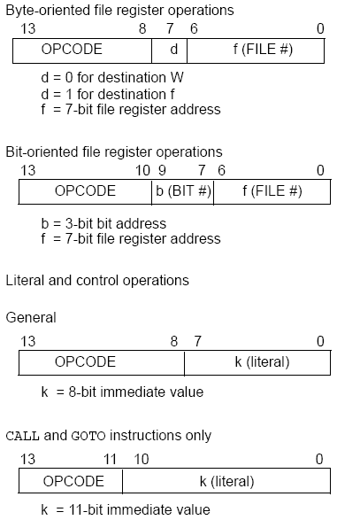
PIC16F1829
Instructions
49 instructions
Each instruction is 14 bits
Byte-oriented OPCODE f, F(W)
  Source f: name of a SFR or a RAM variable
  Destination F(W):
    F if the destination is to be the same as the source register
    W if the destination is to be the working register
Bit-oriented OPCODE f, b
  Bit address b (0≤b≤7)
Literal and control OPCODE k
  Literal value k
Microprocessors I: Lecture 20
Notes:
Chapter 9

Slide 4
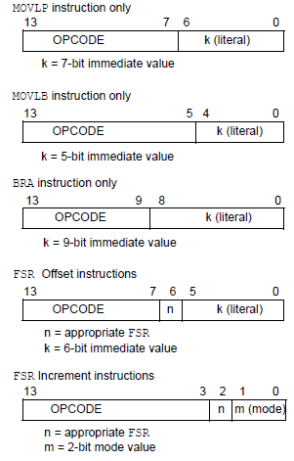
PIC16F1829
Instructions (cont.)
MOVLP/MOVLB: move literal to PCL/BSR
BRA: Relative branch
FSR instructions used in indirect addressing
Microprocessors I: Lecture 20
Notes:
Chapter 9

Slide 5
RAM variables
Memory variable: symbolic name to refer to space in memory (GPRs)
  Usable space on 16F1829: offsets 0x20–0x7F
  Once declared, use symbolic name, not address
Example PIC syntax (cblock/endc):
  cblock 0x20 ; cblock directive needs starting
  ; address
  var1 ; var1 = byte at 0x20
  var2 ; var2 = byte at 0x21
  var3 ; var3 = byte at 0x22
  endc ; End of variable block
Microprocessors I: Lecture 20

Slide 6
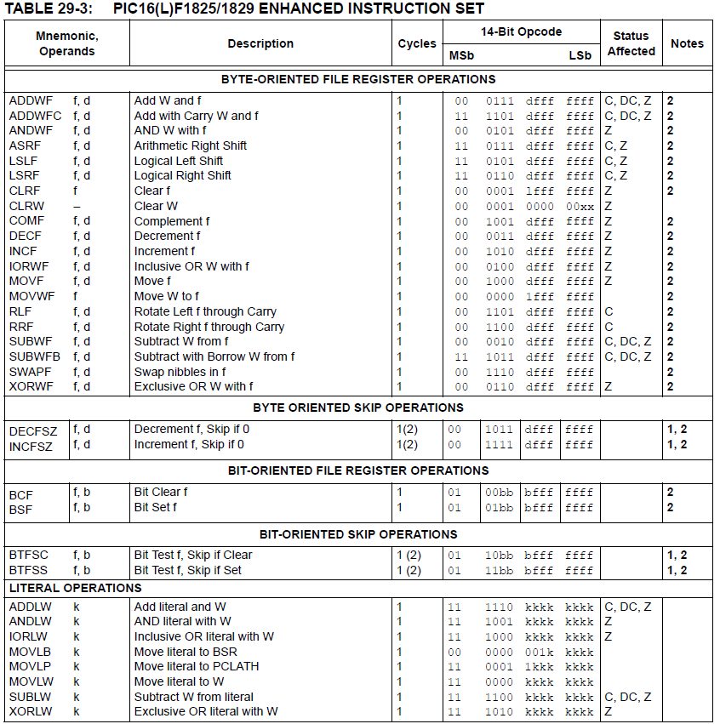
Microprocessors I: Lecture 20

Slide 7
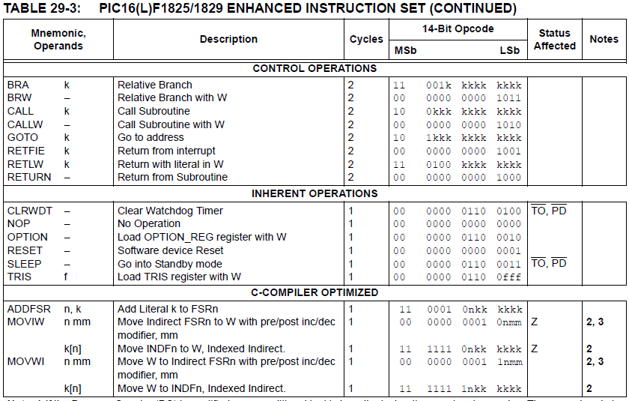
Microprocessors I: Lecture 20

Slide 8
Clear/Move
clrw ; Clear W register
clrf f ; Clear f register
movlw k ; move literal value k to W
movwf f ; move W to f
movf f, F(W) ; move f to F or W
swapf f, F(W) ; swap nibbles of f, putting result in F or W
STATUS bits:
clrw, clrf, movf: Z
movlw, movwf, swapf: none
Examples:
clrf TEMP1 ;Clear variable TEMP1
movlw 5 ;load 5 into W
movwf TEMP1 ;move W into TEMP1
movwf TEMP1, F ;Incorrect Syntax
movf TEMP1, W ;move TEMP1 into W ;
movf TEMP1, TEMP2 ;Incorrect Syntax
swapf TEMP1, F ;Swap 4-bit nibbles of TEMP1
swapf TEMP1, W ;Move TEMP1 to W, swap nibbles, leave TEMP1 unchanged
Microprocessors I: Lecture 20
Notes:
Chapter 9

Slide 9
Single Bit Manipulation
bcf f,b
Operation: Clear bit b of register f, where b=0 to 7
bsf f,b
Operation: Set bit b of register f, where b=0 to 7
STATUS bits:
none
Examples:
bcf PORTB, 0 ;Clear bit 0 off PORTB
bsf STATUS, C ;Set the Carry bit
Microprocessors I: Lecture 20
Notes:
Chapter 9

Slide 10
Example
Show the values of all changed registers after the following sequence
cblock 0x30
x
y
endc
clrw
movwf x
movlw 0xFE
movwf y
swapf y, F
bcf y, 3
bsf x, 3
movf y, W
Microprocessors I: Lecture 20

Slide 11
Example solution
clrw → W = 0x00
movwf x → x = W = 0x00
movlw 0xFE → W = 0xFE
movwf y → y = W = 0xFE
swapf y, F → Swap nibbles of y → y = 0xEF
bcf y, 3 → Clear bit 3 of y = 1110 1111₂
→ y = 1110 0111₂ = 0xE7
bsf x, 3 → Set bit 3 of x
→ x = 0000 1000₂ = 0x08
movf y, W → W = y = 0xE7
Microprocessors I: Lecture 20

Slide 12
Increment/Decrement/
Complement
incf f, F(W) ; increment f, putting result in F or W
decf f, F(W) ;decrement f, putting result in F or W
comf f, F(W) ;complement f, putting result in F or W
STATUS bits:
Z
Examples:
incf TEMP1, F ;Increment TEMP1
incf TEMP1, W ;W <- TEMP1+1; TEMP1 unchanged
decf TEMP1, F ;Decrement TEMP1
comf TEMP1, F ;Change 0s and 1s to 1s and 0s
Microprocessors I: Lecture 20
Notes:
Chapter 9

Slide 13
Addition/Subtraction
addlw k ;add literal value k into W
addwf f, F(W) ;add w and f, putting result in F or W
sublw k ;subtract W from literal value k, putting
;result in W
subwf f, F(W) ;subtract W from f, putting result in F or W
STATUS bits:
C, DC, Z
Examples:
addlw 5 ; W <= 5+W
addwf TEMP1, F ; TEMP1 <- TEMP1+W
sublw 5 ; W <= 5-W (not W <= W-5 )
subwf TEMP1, F ; TEMP1 <= TEMP1 - W
Microprocessors I: Lecture 20
Notes:
Chapter 9

Slide 14
Final notes
Next time:
  Continue with PIC instructions (M 3/21)
  Enjoy your break!
Reminders:
  HW 5 due 1:00 PM, 3/21
  Coming up:
    HW 6 due 1:00 PM, 3/28—no late submissions
    Exam 2 in class Wednesday, 3/30
    PICkits to be handed out after break
      Will have to work in groups (3 students preferred size)
Microprocessors I: Lecture 20

