Slide 1
EECE.3170 Microprocessor Systems Design I
Instructor: Dr. Lin Li & Dr. Michael Geiger
Fall 2019
Lecture 26:
PIC instruction set

Slide 2
Lecture outline
Announcements/reminders
HW 5 to be posted
Today’s lecture: PIC instruction set intro

Slide 3
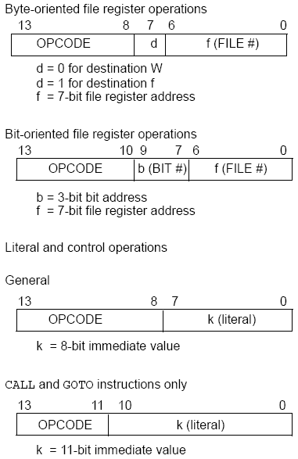
PIC16F1829 Instructions
49 instructions
Each instruction is 14 bits
Byte-oriented OPCODE f, F(W)
Source f: name of a SFR or a RAM variable
Destination F(W):
F if the destination is to be the same as the source register
W if the destination is to be the working register
Bit-oriented OPCODE f, b
Bit address b (0≤b≤7)
Literal and control OPCODE k
Literal value k

Slide 4
RAM variables
Memory variable: symbolic name to refer to space in memory (GPRs)
Usable space on 16F1829: offsets 0x20–0x7F
Once declared, use symbolic name, not address
Example PIC syntax (cblock/endc):
cblock 0x20 ; cblock directive needs starting
; address
var1 ; var1 = byte at 0x20
var2 ; var2 = byte at 0x21
var3 ; var3 = byte at 0x22
endc ; End of variable block

Slide 5
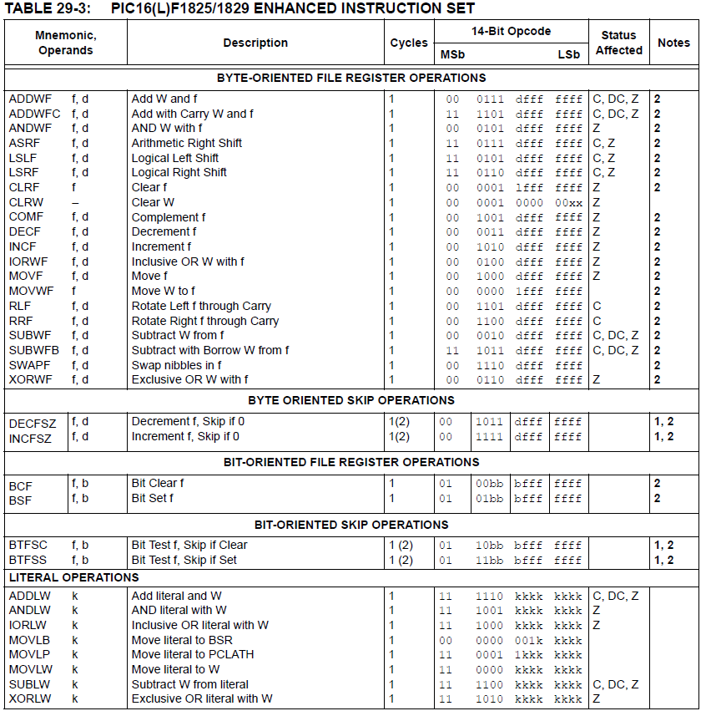

Slide 6
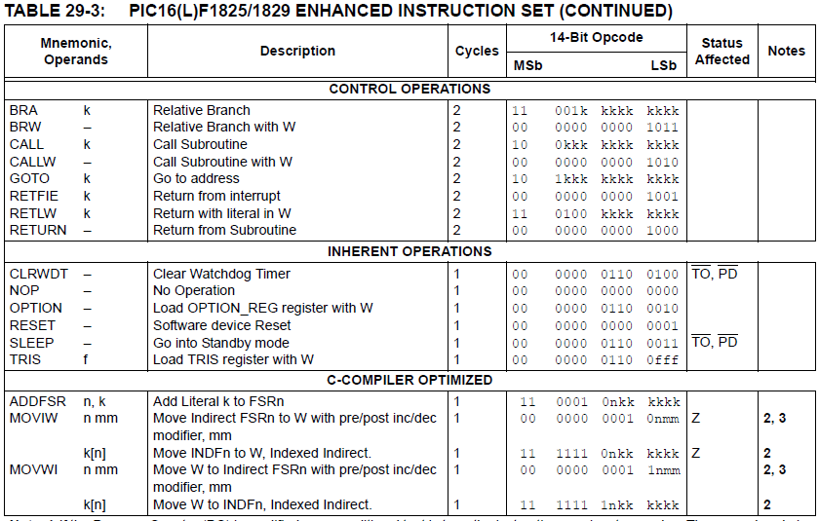

Slide 7
Clear/Move
clrw ; Clear W register
clrf f ; Clear f register
movlw k ; move literal value k to W
movwf f ; move W to f
movf f, F(W) ; move f to F or W
swapf f, F(W) ; swap nibbles of f, putting result in F or W
STATUS bits:
clrw, clrf, movf: Z
movlw, movwf, swapf: none
Examples:
clrf TEMP1 ;Clear variable TEMP1 (TEMP1 = 0)
movlw 5 ; W = 5
movwf TEMP1 ;move W into TEMP1 (TEMP1 = W)
movwf TEMP1, F ;Incorrect Syntax
movf TEMP1, W ;move TEMP1 into W (W = TEMP1) ;
movf TEMP1, TEMP2 ;Incorrect Syntax
swapf TEMP1, F ;Swap 4-bit nibbles of TEMP1
swapf TEMP1, W ;Move TEMP1 to W, swap nibbles, leave TEMP1 unchanged

Slide 8
Single Bit Manipulation
bcf f,b
Operation: Clear bit b of register f, where b=0 to 7
bsf f,b
Operation: Set bit b of register f, where b=0 to 7
STATUS bits:
none
Examples:
bcf PORTB, 0 ;Clear bit 0 off PORTB
bsf STATUS, C ;Set the Carry bit

Slide 9
Example
Show the values of all changed registers after the following sequence
cblock 0x30
x
y
endc
clrw
movwf x
movlw 0xFE
movwf y
swapf y, F
bcf y, 3
bsf x, 3
movf y, W

Slide 10
Example solution
clrw → W = 0x00
movwf x → x = W = 0x00
movlw 0xFE → W = 0xFE
movwf y → y = W = 0xFE
swapf y, F → Swap nibbles of y → y = 0xEF
bcf y, 3 → Clear bit 3 of y = 1110 1111₂
→ y = 1110 0111₂ = 0xE7
bsf x, 3 → Set bit 3 of x
→ x = 0000 1000₂ = 0x08
movf y, W → W = y = 0xE7

Slide 11
Final notes
Next time:
Continue with PIC instructions
Reminders:
HW 5 to be posted

