Slide 1
EECE.3170
Microprocessor Systems Design I
Instructor: Dr. Lin Li & Dr. Michael Geiger
Fall 2019
Lecture 27:
Exam 2 Review

Slide 2
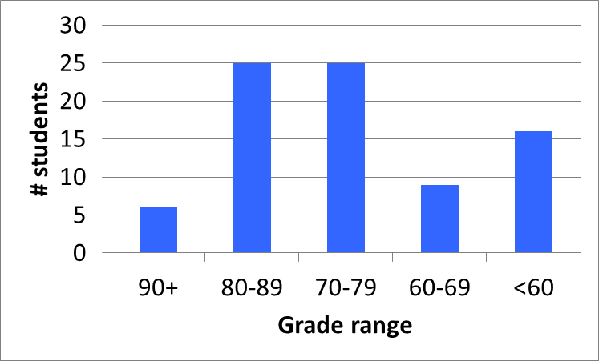
Exam stats & grade distribution
Question-by-question averages:
  Q1: 13.2 / 20 (66%)
  Q2: 16.4 / 20 (82%)
  Q3: 9.9 / 20 (49%)
  Q4: 32.4 / 40 (81%)
Extra credit
  61 students
  5.9 / 10 average
Average: 71.8
Median: 75
Std. deviation: 15.2
Max: 96
Microprocessors I: Lecture 27

Slide 3
Figuring out where you stand
Homework: 55% (4 done; 6 or 7 total)
Exams: 45% (15% + 15% + 15%)
~33-40% of your grade still to be determined
Estimating your grade—done on Blackboard
  Overall avg = HWA * 0.55 + EA * 0.45
Microprocessors I: Lecture 27

Slide 4
Figuring out where you stand
Estimated avg. = HWA * 0.55 + EA * 0.45
Current course averages
  Without extra credit: ~85%, SD ≈ 8.6
  With extra credit: ~86%, SD ≈ 8.8
Key points
  Very likely there will be no grading curve
  Minimum grade to earn a C: 73%
  THESE AVERAGES WILL ALMOST CERTAINLY CHANGE BEFORE SEMESTER’S END—THESE FIGURES ARE JUST ROUGH ESTIMATES!!!!!
Microprocessors I: Lecture 27

