Slide 1
EECE.3170 Microprocessor Systems Design I
Instructors: Dr. Lin Li & Dr. Michael Geiger
Fall 2019
Lecture 28:
PIC instruction set (continued)

Slide 2
Lecture outline
Announcements/reminders
HW 5 to be posted; due 11/22
Common final exam scheduled: Wednesday, 12/18, 6:30-9:30 PM (room TBD)
Review
PIC instruction set basics
Data transfers
Bit manipulation instructions
Today’s lecture
Arithmetic instructions
Logical instructions
Shift/rotate instructions
Control flow

Slide 3
Review: PIC instructions
Four typical instruction formats (+ few special purpose)
Upper bits of all hold opcode
Byte-oriented includes 1 bit destination, 7 bit direct address
Bit-oriented includes 3 bit position (0-7), 7 bit direct address
Literal/control includes 8 bit literal
CALL/GOTO includes 11 bit literal
Variable declarations
cblock <start_address>: start of variable declarations
All names between cblock/endc directives assigned to consecutive bytes starting at <start_address>

Slide 4
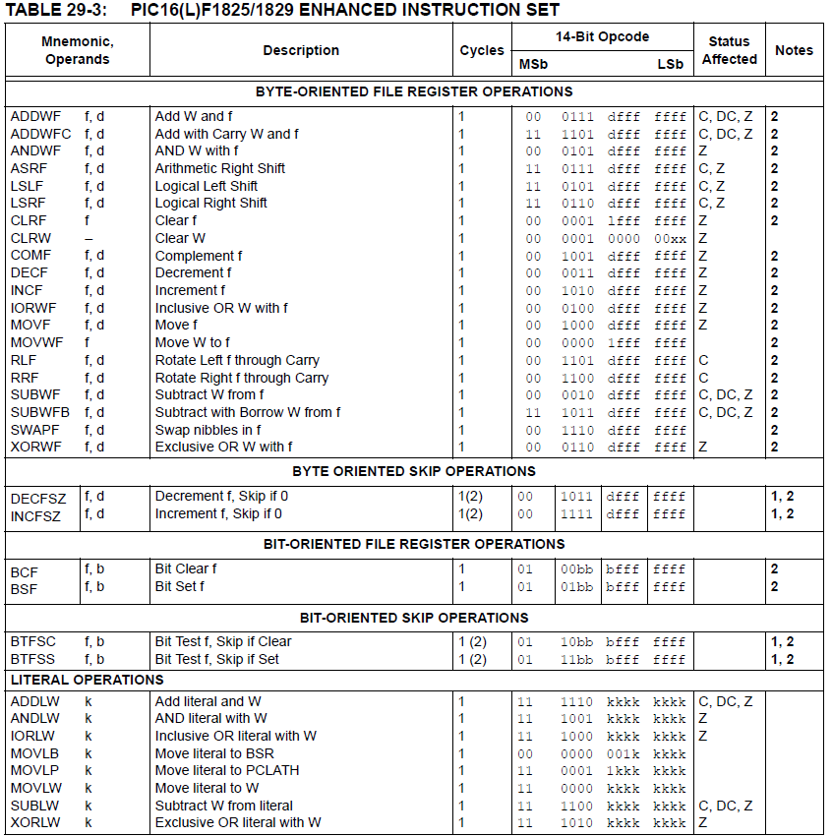

Slide 5
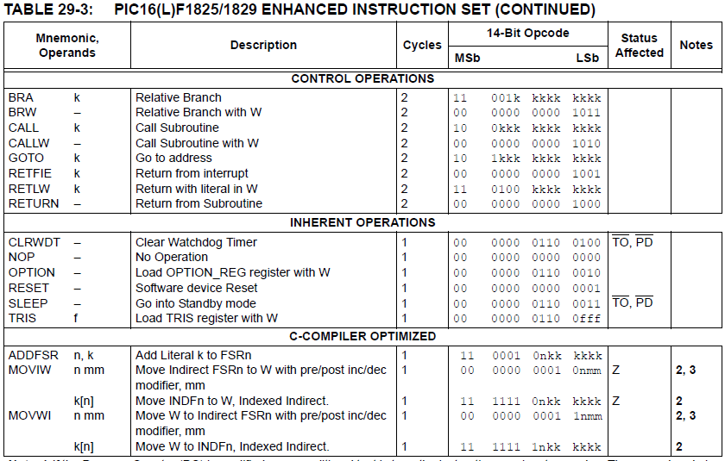

Slide 6
Review: PIC instructions (cont.)
Clearing register: clrw/clrf
Moving values: movlw/movwf/movf
Swap nibbles: swapf
Single bit manipulation: bsf/bcf

Slide 7
Increment/Decrement/ Complement
incf f, F(W) ; increment f, putting result in F or W
decf f, F(W) ;decrement f, putting result in F or W
comf f, F(W) ;complement f, putting result in F or W
STATUS bits:
Z
Examples:
incf TEMP1, F ;Increment TEMP1
incf TEMP1, W ;W <- TEMP1+1; TEMP1 unchanged
decf TEMP1, F ;Decrement TEMP1
comf TEMP1, F ;Change 0s and 1s to 1s and 0s

Slide 8
Addition/Subtraction
addlw k ;add literal value k into W
addwf f, F(W) ;add w and f, putting result in F or W
addwfc f, F(W) ;add w, f, and C, putting result in F or W
sublw k ;subtract W from literal value k, putting
;result in W
subwf f, F(W) ;subtract W from f, putting result in F or W
subwfb f, F(W) ;subtract f – W – (~C), putting result in F or W
STATUS bits:
C, DC, Z
Examples:
addlw 5 ; W = 5+W
addwf TEMP1, F ; TEMP1 = TEMP1+W
sublw 5 ; W = 5-W (not W = W-5 )
subwf TEMP1, F ; TEMP1 = TEMP1 - W

Slide 9
Example
Show the values of all changed registers after the following sequence
cblock 0x20
varA
varB
varC
endc
clrf varA
clrf varB
clrf varC
incf varA, W
sublw 0x0F
addwf varB, F
decf varB, F
comf varB, W
subwf varC, F

Slide 10
Example solution
clrf varA → varA = 0
clrf varB → varB = 0
clrf varC → varC = 0
incf varA, W → W = varA + 1 = 1
sublw 0x0F → W = 0x0F – W = 0x0F – 1
= 0x0E
addwf varB, F → varB = varB + W = 0x0E
decf varB, F → varB = varB – 1 = 0x0D
comf varB, W → W= ~varB = ~0x0D = 0xF2
subwf varC, F → varC = varC – W = 0x0E

Slide 11
Logical Operations
andlw k ; AND literal value k into W
andwf f, F(W) ; AND W with f, putting result in F or W
iorlw k ; Inclusive-OR literal value k into W
iorwf f, F(W) ; Inclusive-OR W with f, putting result in F or W
xorlw k ; Exclusive-OR literal value k into W
xorwf f, F(W) ; Exclusive-OR W with f, putting result in F or W
Examples:
andlw B’00000111’ ;force upper 5 bits of W to zero
andwf TEMP1, F ;TEMP1 <- TEMP1 AND W
andwf TEMP1, W ;W <- TEMP1 AND W
iorlw B’00000111’ ;force lower 3 bits of W to one
iorwf TEMP1, F ;TEMP1 <- TEMP1 OR W
xorlw B’00000111’ ;complement lower 3 bits of W
xorwf TEMP1, W ;W <- TEMP1 XOR W
STATUS bits:
Z

Slide 12
Shift/Rotate
asrf f, F(W) ; copy f into F or W; shift F or W right one bit, keeping
; sign intact; shift LSB into C
lsrf f, F(W) ; copy f into F or W; shift F or W right one bit, shifting
; 0 into MSB; shift LSB into C
lslf f, F(W) ; copy f into F or W; shift F or W left one bit, shifting
; 0 into LSB; shift MSB into C
rlf f, F(W) ; copy f into F or W; rotate F or W left through
; the carry bit
rrf f, F(W) ; copy f into F or W; rotate F or W right through
; the carry bit
STATUS bits:
C

Slide 13
Example
Show the values of all changed registers after the following sequence
Assume the carry bit is initially 0
cblock 0x40
z
endc
clrf z
movlw 0xF0
iorwf z, F
xorlw 0xFF
rrf z, F
andwf z, W
lslf z, F
asrf z, F

Slide 14
Example solution
clrf z → z = 0
movlw 0xF0 → W = 0xF0
iorwf z, F → z = z OR W = 0xF0
xorlw 0xFF → W = W XOR 0xFF
= 0xF0 XOR 0xFF
= 0x0F
rrf z, F → Rotate z right thru carry
Before rotate, (z, carry) = 1111 0000 0₂
→ z = 0111 1000₂ = 0x78, C = 0
andwf z, W → W = z AND W
= 0x78 AND 0x0F = 0x08
lslf z, F → Shift z left
Before shift, z = 0111 1000₂
→ z = 1111 0000₂ = 0xF0, C = 0
asrf z, F → Arithmetic shift right
z = 1111 1000₂ = 0xF8, C = 0

Slide 15
Control flow
STATUS bits:
none
goto label ; Go to labeled instruction
bra label ; Go to labeled instruction
brw ; Relative branch using W as offset
call label ; Call labeled subroutine
callw ; Subroutine call using W as address
return ; Return from subroutine
retlw k ; Return from subroutine, putting literal
; value in W
retfie ; Return from interrupt service routine;
; re-enable interrupts
Examples:
goto There ; Next instruction to be executed is labeled “There”
call Task1 ; Push return address; Next instruction to be
; executed is labeled “Task1”
return ; Pop return address off of stack
retlw 5 ; Pop return address; W <- 5
retfie ; Pop return address; re-enable interrupts

Slide 16
Conditional Execution
Conditional execution in PIC: skip next instruction if condition true
Two general forms
Test bit and skip if bit clear/set
Increment/decrement register and skip if result is 0
STATUS bits:
none
btfsc f, b ;Test bit b of register f, where b=0 to 7, skip if clear
btfss f, b ;Test bit b of register f, where b=0 to 7, skip if set
decfsz f, F(W) ;decrement f, putting result in F or W, skip if zero
incfsz f, F(W) ;increment f, putting result in F or W, skip if zero
Examples:
btfsc TEMP1, 0 ; Skip the next instruction if bit 0 of TEMP1 equals 0
btfss STATUS, C ; Skip the next instruction if C==1
decfsz TEMP1, F ; Decrement TEMP1, skip if TEMP1==0
incfsz TEMP1, W ; W <- TEMP1+1 , skip if W==0 (TEMP1==0xFF)
; Leave TEMP1 unchanged

Slide 17
Example
Show the values of all changed registers after each of the following sequences
What high-level operation does each perform?
(a) movf a, W
sublw 0x1A
btfsc STATUS, Z
goto L1
incf b, W
goto L2
L1
decf b, W
L2
movwf a
(b) movf NUM2, W
subwf NUM1, W
btfss STATUS, C
goto BL
movf NUM1, W
goto Done
BL
movf NUM2, W
Done
movwf MAX

Slide 18
Example solution (part a)
movf a, W → W = a
sublw 0x1A → W = 0x1A – a
btfsc STATUS, Z → Skip goto if result
is non-zero
goto L1 → Goto L1 if result == 0
→ Reach this point if
result non-zero
incf b, W → W = b + 1
goto L2
L1
decf b, W → W = b - 1
L2
movwf a → a = W → value depends
on what’s executed before this
High-level operation:
if (a == 0x1A)
a = b – 1
else
a = b + 1

Slide 19
Example solution (part b)
movf NUM2, W → W = NUM2
subwf NUM1, W → W = NUM1 – W
= NUM1 – NUM2
btfss STATUS, C → Carry indicates borrow of 0
→ if set, NUM1 >= NUM2
goto BL
movf NUM1, W → if (NUM1 >= NUM2)
W = NUM1
goto Done → Skip “below” section
BL
movf NUM2, W → if (NUM1 < NUM2)
W = NUM2
Done
movwf MAX
High-level operation:
if (NUM1 >= NUM2)
MAX = NUM1
else
MAX = NUM2

Slide 20
Final notes
Next time:
PIC programming: examples of common sequences
Reminders:
HW 5 to be posted; due 11/22
Common final exam scheduled: Wednesday, 12/18, 6:30-9:30 PM (room TBD)

