Slide 1
EECE.3170
Microprocessor Systems Design I
Instructor: Dr. Michael Geiger
Spring 2016
Lecture 18
HLL → assembly (continued)

Slide 2
Lecture outline
Announcements/reminders
  HW 4 due 1:00 PM today
  HW 5 to be posted; due 1:00 PM, 3/21
Review: HLL → assembly
  Conditional statements
  Loops
Today’s lecture: HLL → assembly examples
Microprocessors I: Lecture 18

Slide 3
Review: HLL → assembly
Conditional statements (if-then-else)
  Evaluate condition (CMP instruction(s))
  Conditional jump (often to “else” case)
  “If” case ends with unconditional jump to skip “else”
Loops
  Initialize variable at start
  Test loop condition (similar to if)
  Change loop variable
Microprocessors I: Exam 2 Preview

Slide 4
Practice problems
See today’s handout for
  Description of how stack frame should be created
  Description of where to access function arguments, local variables
Functions to be written
  int fact(int n): Calculate and return n!
  int max(int v1, int v2): Return largest value between v1 and v2
  void swap(int *a, int *b): Given addresses a & b, swap contents
Solutions to be posted as PDF online
  C versions in slides that follow; assembly in PDF file
  Will be covered in class today as well
Microprocessors I: Lecture 6

Slide 5
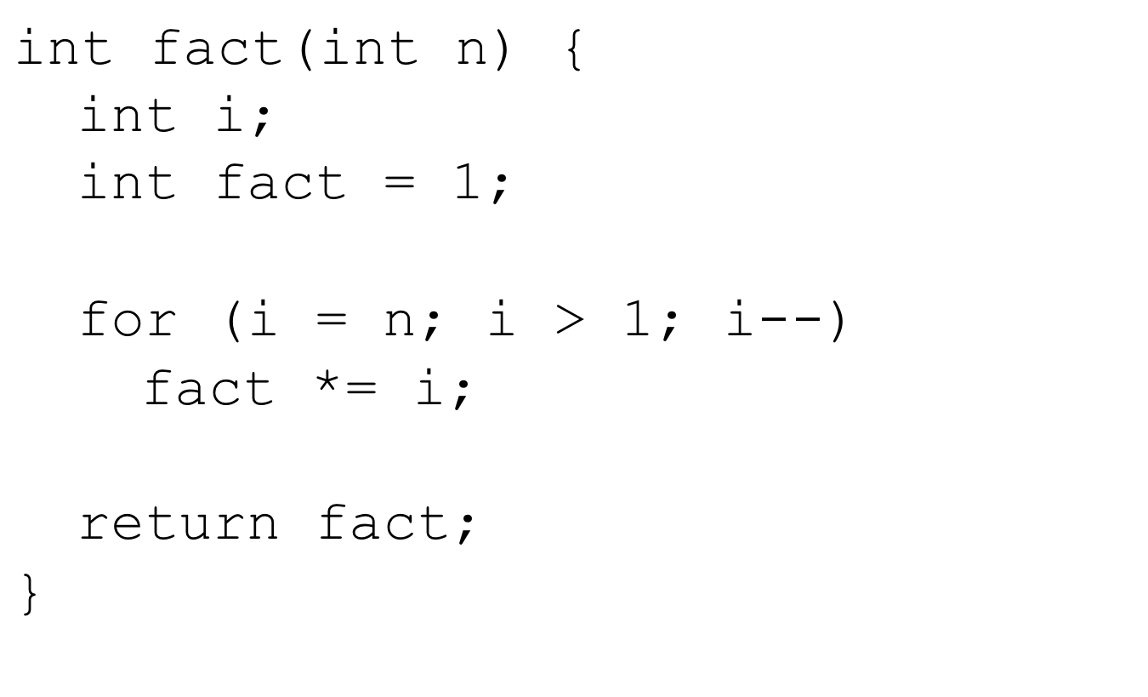
Factorial in C
Microprocessors I: Lecture 6

Slide 6
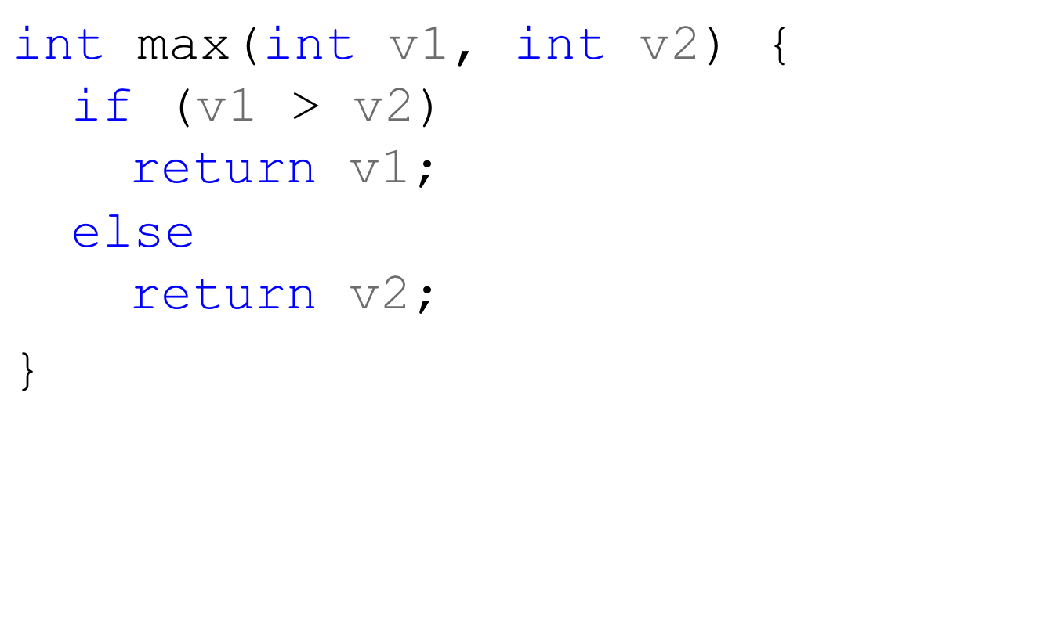
Maximum value function in C
Microprocessors I: Lecture 6

Slide 7
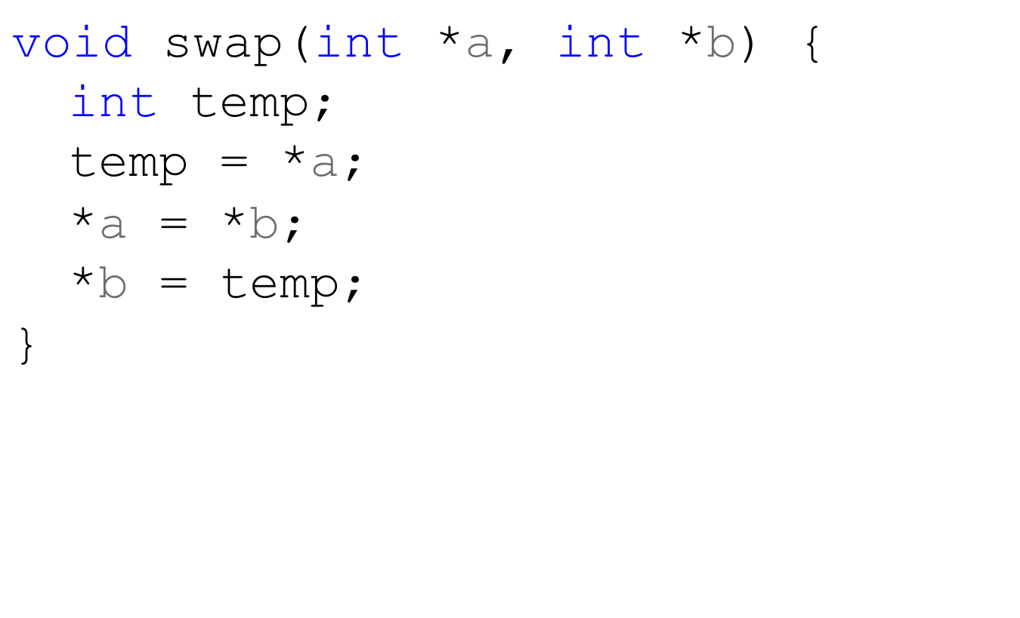
Swap in C
Microprocessors I: Lecture 6

Slide 8
Final notes
Next time:
  PIC intro
Reminders:
  HW 4 due 1:00 PM today
  HW 5 to be posted; due 1:00 PM, 3/21
Microprocessors I: Lecture 18

