Slide 1
EECE.3220 Data Structures
Instructor:
Dr. Michael Geiger
Spring 2019
Lecture 26
Exam 2 Review

Slide 2
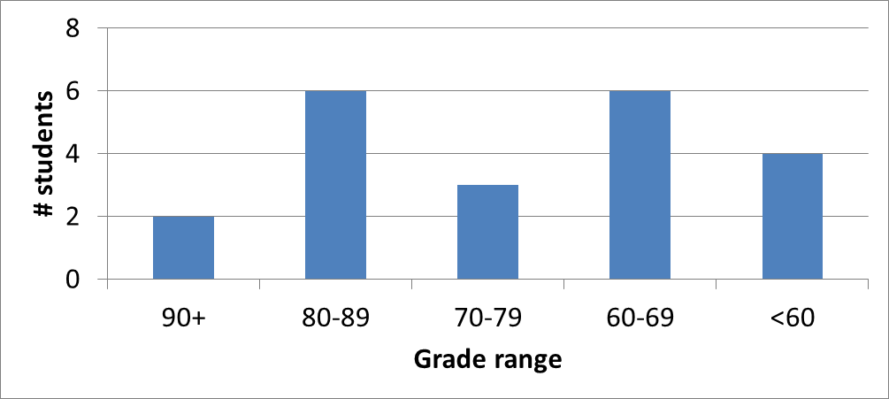
Exam stats & grade distribution
Average: 69
Median: 74
Std. deviation: 21.3
Max: 95
Question-by-question averages:
Q1: 19.6 / 40 (49%)
Q2: 19.9 / 26 (77%)
Q3: 29.5 / 34 (87%)
Extra credit
15 students completed
6.8 average

