Slide 1
16.216
ECE Application Programming
Instructor: Dr. Michael Geiger
Fall 2012
Lecture 33:
PE6: Dynamic memory allocation in data structures

Slide 2
Lecture outline
Announcements/reminders
  Program 9 due today
  Program 10 posted, due 12/10
  Will drop lowest grade
  Final exams: no common final
    Sec. 201 (12:00-12:50): Tues. 12/18, 8:00-11:00 AM, Kitson 301
    Sec. 202 (1:00-1:50): Tues. 12/18, 3:00-6:00 PM, Ball 328
Today’s class: Dynamic memory allocation and data structures
  Dynamic memory allocation and structures
  Pointer-based structures
  Linked lists
    Adding data
    Finding data
    Deleting data
  Sorted linked lists
  Program 10: Doubly-linked lists
ECE Application Programming: Lecture 33

Slide 3
Dynamic allocation and structures
Can use sizeof() to get # bytes in structure
Examples (using StudentInfo struct):
StudentInfo *p;
p = (StudentInfo *)malloc(sizeof(StudentInfo));
StudentInfo *arr;
int n;
printf("Enter array size: ");
scanf("%d", &n);
arr = (StudentInfo *)malloc(n * sizeof(StudentInfo));
ECE Application Programming: Lecture 33

Slide 4
Data structures
Data structure: way of storing and organizing data
  Arrays are one relatively inefficient example
Other structures designed to optimize:
  Organizing / sorting data
  Adding new data
  Removing unwanted data
  Searching for data
ECE Application Programming: Lecture 33

Slide 5
Pointer-based data structures
Many structures extensively use pointers
Each element within structure contains data + pointer(s) to one or more other elements
Usually functions for common operations
  Add new element
    Dynamically allocate new element
    Modify appropriate pointer(s) in other element(s) to point to new element
    Set pointer(s) in new element to point to other(s)
  Delete element
    Modify pointer(s) in other element(s) so they don’t point to element being removed
    Deallocate removed element
  Find element
    Follow pointers to move from one element to next
ECE Application Programming: Lecture 33

Slide 6

Linked list
Simple pointer-based structure: linked list
Each element (node) contains data + pointer to next element in list
Last element points to NULL
Program using list needs pointer to first node
Image source: http://en.wikipedia.org/wiki/Linked_list
ECE Application Programming: Lecture 33

Slide 7
Linked list definition
Structure to hold list of integers
typedef struct node {
int value; // Data
struct node *next; // Pointer to
// next node
} LLnode;
Note definition style has changed slightly
  Type “name” both before and after { }
  Name before (struct node) is necessary to use type inside structure definition
  Name after (LLnode) can be used in rest of program
ECE Application Programming: Lecture 33

Slide 8
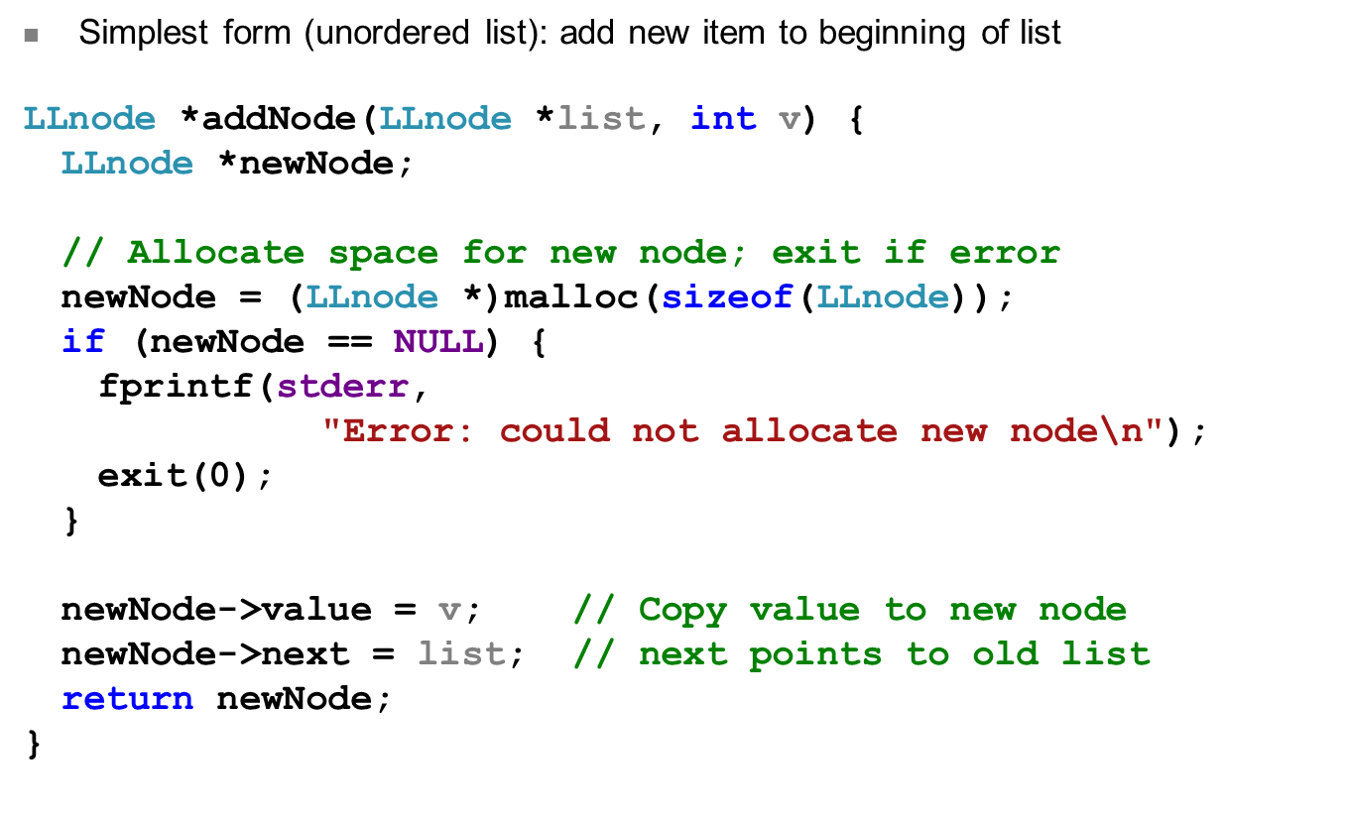
Adding to list
ECE Application Programming: Lecture 33

Slide 9
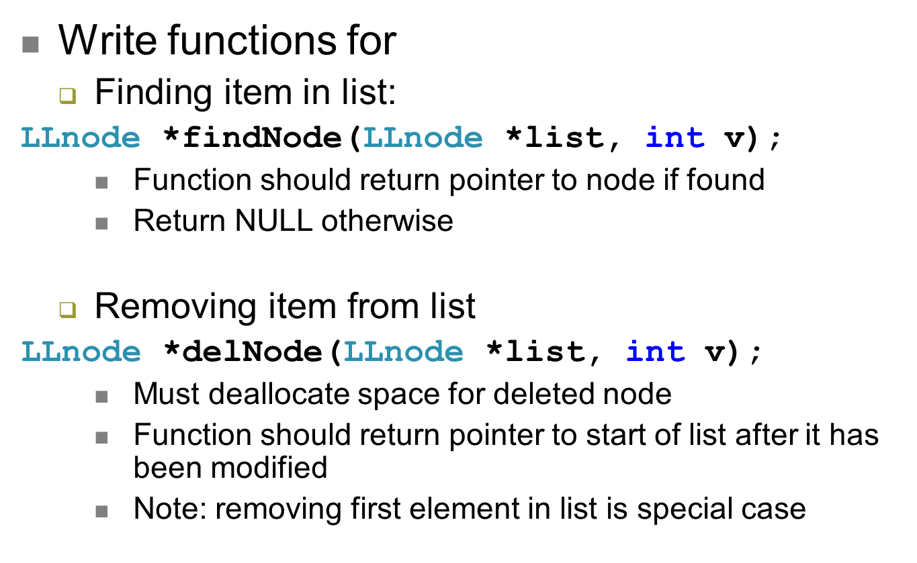
Examples
ECE Application Programming: Lecture 33

Slide 10
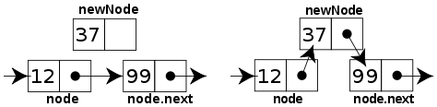
Sorted linked list
Can ensure each item is sorted as it’s added
  Slower item insertion, but faster search
Not easy with arrays: must move existing data
Keeping linked list sorted
  Find appropriate location
    Often done by going “past” appropriate spot
  Modify pointers
    Node before correct spot points to new node
    New node points to node after correct spot
    Image source: http://en.wikipedia.org/wiki/Linked_list
ECE Application Programming: Lecture 33

Slide 11
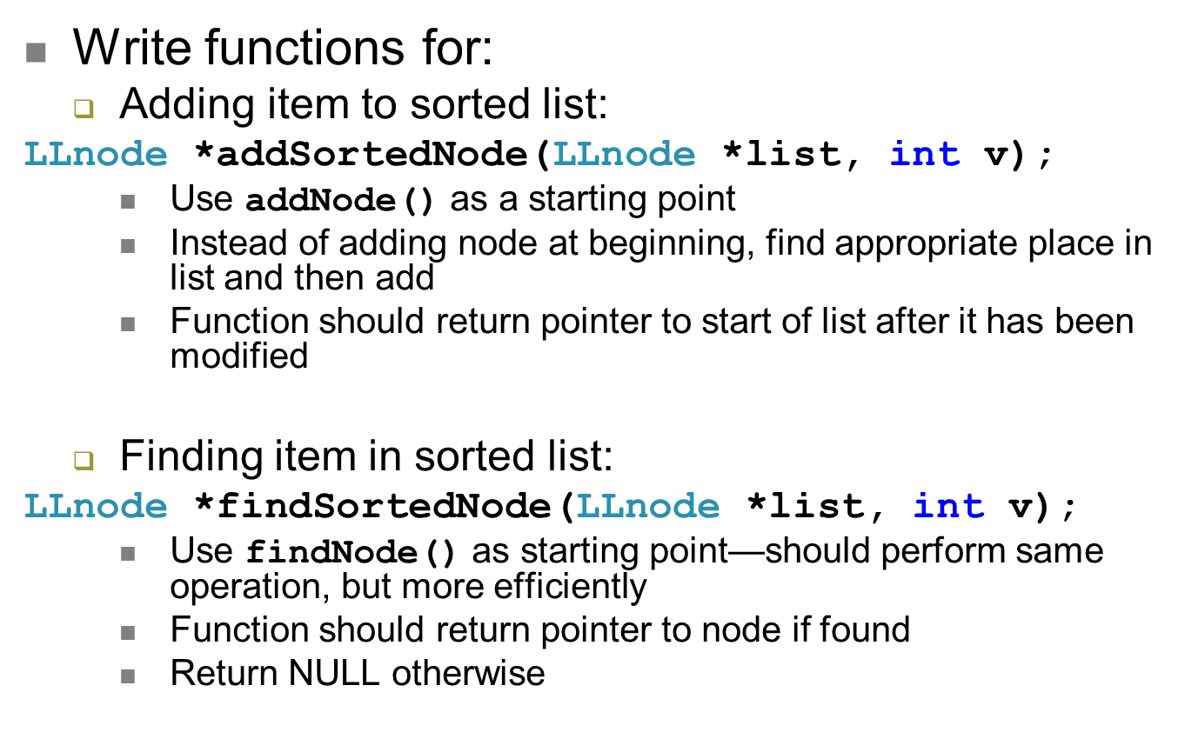
Examples
ECE Application Programming: Lecture 33

Slide 12
Program 10: Doubly-linked lists
Each node (DLNode) points to node before and after itself in list
  Allows traversal of list in both directions
  Adding item slightly harder
  No need for add/delete functions to explicitly track previous node
First and last nodes each point to NULL where appropriate
Not shown: program maintains explicit pointers to first/last nodes
  Done in separate structure (DLList)
ECE Application Programming: Lecture 33

Slide 13
Program 10: Doubly-linked lists (cont.)
Data in node is dynamically allocated string
List is sorted by alphabetical order
  Recall: strcmp() / strncmp() will return non-zero values if strings aren’t equal
    If n = strcmp("add", "subtract") → n < 0
    If n = strcmp("add", "aardvark") → n > 0
You will complete four functions
  Adding new word to list
  Deleting word from list (if present)
  Finding word in list (if present)
  Printing contents of entire list
ECE Application Programming: Lecture 33

Slide 14
Next time
Friday, 12/7: Office hours during lecture time
  12:00-12:50, Kitson 301
  1-1:50, Ball 328
Monday, 12/10: Exam Preview
  Will likely discuss Q&A session scheduling for week of exam (some time Monday, 12/17?)
Course evaluations
  Will be posted on website
  Print and bring to final (or I’ll have hard copies there)
  Must turn in your evaluation to get the exam
Reminders:
  Program 9 due today
  Program 10 posted, due 12/10
ECE Application Programming: Lecture 33

