Slide 1
16.216
ECE Application Programming
Instructor: Dr. Michael Geiger
Fall 2012
Lecture 5:
Formatted output examples
PE1: Flowcharts and debugging

Slide 2
Lecture outline
Announcements/reminders
  Program 2 due Monday, 9/17
  Program 2 notes
    Be careful with integer division
    Rounding errors: likely due to definition of pi
  Office hours: M 2-3:30 (2:30-3:30 next week), W 2-3, Th 1-3
Review
  Input with scanf()
  Formatted output with printf()
Today’s class
  Formatted output examples
  PE1: Flowcharts and debugging
ECE Application Programming: Lecture 5

Slide 3
Review: scanf() basics
To read input, use same format specifiers in scanf() format string as you would in printf(), followed by addresses of variables
  scanf("%d %f",&hours,&rate);
Space only matters if format specifier is %c
Return value tells you # of values read correctly
ECE Application Programming: Lecture 5

Slide 4
Review: field width
Format specifier for printf() takes form:
  %[flags][width][.precision]
Field width: minimum # chars to be printed
  Never truncates—if more chars than width, prints all
  Default behavior—right justify value, print spaces
    printf(“%10d”, n); → 12
    (8 spaces, then number 12)
  Flags allow you to add sign (+), left justify (-), and add leading zeroes (0)
    printf(“%+-10d”, n); → +12_______
    (Number 12 with sign, then 7 spaces)
    printf(“%010d”, n); → 0000000012
  To use a variable to specify field width, use * as the width
    printf(“%*d”, n, n); → 12
    (Field width = 12 → 10 spaces, then the number 12)
ECE Application Programming: Lecture 5

Slide 5
Review: precision
Format specifier for printf() takes form:
  %[flags][width][.precision]
Specifying precision:
  # chars after decimal point for FP (%f, %lf)
    Rounds last digit
    printf(“%.1lf”, x); → 3.8
    printf(“%.0lf”, x); → 4
  Minimum # chars for integer (%d, %i, %u, %x)
    Does not truncate; will pad with leading 0s
    printf(“%.3d”, n); → 012
  Max # chars for string (%s)
    printf(“%.5s”, “one two”); → one t
  No effect for char (%c)
  As with field width, can use * to specify that field width is a variable
ECE Application Programming: Lecture 5

Slide 6
Example: Formatted output
Assume int x = 123; float y = 4.56; double z = 7.89991
What does each of the following lines print?
  printf("%4d %5f %6lf\n", x, y, z);
  printf("%.4d %.4f %.4lf\n",
  x, y, z);
  printf("%08d %-7.1f %+-4.1lf !\n",
  x, y, z);
    The second and third specifiers have precision of 1
    One is a float (%f), the other is a double (%lf)
ECE Application Programming: Lecture 5

Slide 7
Example solution
printf("%4d %5f %6lf\n",
x, y, z);
→ █123█4.560000█7.899910
printf("%.4d %.4f %.4lf\n",
x, y, z);
→ 0123█4.5600█7.8999
printf("%08d %-7.1f %+-4.1lf!\n",
x, y, z);
→ 00000123█4.6█████+7.9█!
ECE Application Programming: Lecture 5

Slide 8
Example: Formatted output
Write a short code sequence to do each of the following:
  Print three integers—x, y, and z
    Use field widths of 10, 20, and 30, respectively
    Put an extra space between each field
    Show the signs of all values and left justify them
  Print four doubles—d1, d2, d3, d4
    Use field widths of 7 for all values
    Put an extra space between each field
    Show 1, 2, 3, and 4 places after the decimal point, respectively
  Given three variables—int w, p; double var;
    Read values for w and p from the input
    Print var using field width w and precision p
ECE Application Programming: Lecture 5

Slide 9
Example solution
Print three integers—x, y, and z
  Use field widths of 10, 20, and 30, respectively
  Put an extra space between each field
  Show the signs of all values and left justify them
printf(“%+-10d %+-20d %+-30d\n”, x, y, z);
Print four doubles—d1, d2, d3, d4
  Use field widths of 7 for all values
  Put an extra space between each field
  Show 1, 2, 3, and 4 places after the decimal point, respectively
printf(“%7.1lf %7.2lf %7.3lf %7.4lf\n”,
d1, d2, d3, d4);
ECE Application Programming: Lecture 5

Slide 10
Example solution (cont.)
Given three variables—int w, p; double var;
  Read values for w and p from the input
  Print var using field width w and precision p
scanf(“%d %d”, &w, &p);
printf(“%*.*lf\n”, w, p, var);
ECE Application Programming: Lecture 5

Slide 11
Flowcharts
Graphical representation of process
  Shows all steps and their order
  In programming, use to organize program before writing code
Basic elements
Process
Terminator (start/end)
Input/Output
Connector
Decision
Connector (off page)
ECE Application Programming: Lecture 5

Slide 12

Example: Quadratic Equation Solver
Start
Output
“Quadratic Equation Solver”
Output
“Enter A, B, C: ”
Input A, B, C
ECE Application Programming: Lecture 5

Slide 13

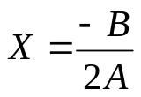

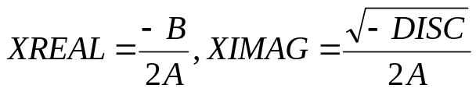
Quadratic Equation Solver (cont.)
A = 0?
TRUE
Output
X
FALSE
DISC=B*B-4*A*C
DISC = 0?
TRUE
Output
X
FALSE
DISC>0?
TRUE
Output
X1,X2
FALSE
Output
XREAL + XIMAG i
XREAL – XIMAG i
ECE Application Programming: Lecture 5
Done

Slide 14
Exercise: Flowchart
Design a flowchart to solve the following:
  Prompt a user to enter four numbers on a single line, which represent the contents of a 2x2 array
  After reading the values, your program should print the matrix represented by these values
    For example, if the user enters “1 2 3 4”, print:
  1 2
  3 4
    Assume all values have the same number of digits
  Also, calculate the matrix discriminant and print it on a separate line
    In the example above, discriminant = (1x4) - (2x3) = 4-6 = -2
ECE Application Programming: Lecture 5

Slide 15
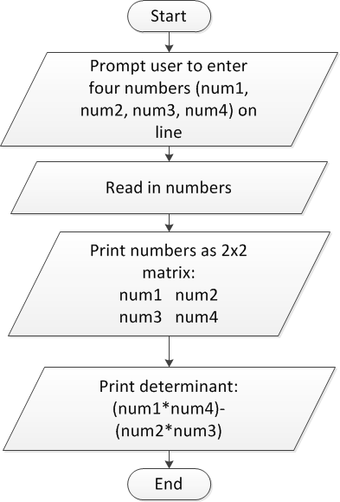
Flowchart: solution
ECE Application Programming: Lecture 5

Slide 16
Converting flowchart to program
What data are used in the process?
  Can those data be represented as constants?
  If not, what variables are needed?
    How many?
    What type(s)?
    How should variables be named?
What C statement corresponds to each process step?
  Input statements: scanf()
  Output statements: printf()
  Terminators: start/end of main() function
    Will generalize later to any function
  General process steps: basic expressions
    May need multiple lines of code
ECE Application Programming: Lecture 5

Slide 17
Debugging
Most IDEs allow ability to view state of program while running through debugger
  View variable values
  Execute program:
    One line at a time (single step)
    By running until reaching a pre-defined stopping point (breakpoint)
Can isolate bugs without altering program
  Alternate solution: inserting print statements to show program state at various points
  Disadvantages
    Inefficient--repeated compilation, must keep adding statements
    May actually alter operation of other statements
ECE Application Programming: Lecture 5

Slide 18
Debugger demonstration
Demonstration of Visual Studio debugger
  Variables
    Watch window
    Autos window
    Locals window
  Single step options
    Step over
    Step into/step out
  Breakpoints
    Setting breakpoints
    Running to next breakpoint
ECE Application Programming: Lecture 5

Slide 19
Next time
Operators
Reminders:
  Program 2 due Monday, 9/17
  Set your “preferred e-mail” on the discussion group!
ECE Application Programming: Lecture 5

