Slide 1
16.216
ECE Application Programming
Instructor: Dr. Michael Geiger
Fall 2013
Lecture 35:
Exam 3 Preview

Slide 2
Lecture outline
Announcements/reminders
  Program 10 due today
  Exam 3: Wednesday, 12/18, 8:00-11:00 AM
    Must complete course evaluation (to be posted online) prior to exam
    Q & A session: Tuesday, 12/17?
  All regrades will be due Thursday, 12/19
    Yes, I know you need the initial grades to work on the regrades
Today’s class: Exam 3 Preview
ECE Application Programming: Exam 3 Preview

Slide 3
Exam 3 notes
Allowed one 8.5” x 11” two-sided note sheet
  No other notes or electronic devices
Exam lasts 3 hours (but is written for ~50 min)
Covers all lectures after Exam 2
Format similar to Exams 1/2
  1 multiple choice problem (likely dynamic memory allocation, although that topic may show up elsewhere)
  1 code reading problem
  1 code writing problem
Can look at old exams on web, but we’ve covered some material in more depth than before (file I/O, structures, dynamic memory allocation)
ECE Application Programming: Exam 3 Preview

Slide 4
Review: bit manipulation
Bitwise operators: | & ^ ~
  Used for desired logical operations
  Used to set/clear bits
Bit shifts: << >>
  Used to shift bits into position
  Used for multiplication/division by powers of 2
Common operations
  Setting/clearing/flipping individual bit
  Setting/clearing/flipping multiple bits
ECE Application Programming: Exam 3 Preview

Slide 5
Review: hexadecimal output
To print a number in hex, use %x or %X
  %x prints characters a-f in lowercase
  %X prints characters A-F in uppercase
To show leading 0x, use the # flag
To show leading 0s, use precision with total # chars
  Field width + 0 flag also works unless value = 0
Examples (assume var1 = 0x1A2B)
  printf(“%x”, var1) → 1a2b
  printf(“%X”, var1) → 1A2B
  printf(“%#x”, var1) → 0x1a2b
  printf(“%.6x”, var1) → 001a2b
  printf(“%#.6x”, var1) → 0x001a2b
ECE Application Programming: Exam 3 Preview

Slide 6
Review: Structures
User-defined types; example:
typedef struct {
char first[50];
char middle;
char last[50];
unsigned int ID;
double GPA;
} StudentInfo;
Can define variables of that type
  Scalar: StudentInfo student1;
  Array: StudentInfo classList[10];
  Pointer: StudentInfo *sPtr;
Access members using
  Dot operator: student1.middle = ‘J’;
  Arrow (if pointers): sPtr->GPA = 3.5;
Typically passed to functions by address
ECE Application Programming: Exam 3 Preview

Slide 7
Review: dynamic memory allocation
Basic block allocation:
void *malloc(size_t size);
Allocate block and clear it:
void *calloc(size_t nmemb,
size_t size);
Resize previously allocated block:
void *realloc(void *ptr,
size_t size);
Deallocation function:
void free(void *ptr);
ECE Application Programming: Exam 3 Preview

Slide 8
Review: dynamic memory allocation
Pitfalls:
  Memory leaks: must free memory before changing pointer
  Dangling pointers: reassign pointer after calling free()
Dynamically allocated array
arr = (int *)malloc(n * sizeof(int));
  Can then use array notation: arr[i] = 0;
Note that return value from allocation functions must be type cast to correct type
ECE Application Programming: Exam 3 Preview

Slide 9
Review: dynamically allocated arrays
1-D array
arr = (int *)malloc(n * sizeof(int));
  Can then use array notation: arr[i] = 0;
2-D array
  Data type: “pointer to pointer”: int **twoDarr;
  1st dimension depends on # rows
    twoDarr = (int **)malloc(nRows * sizeof(int *));
  2nd dimension depends on # columns
    Must allocate for each row
    for (i = 0; i < nRows; i++)
    twoDarr[i] = (int *)malloc(nCols * sizeof(int));
ECE Application Programming: Exam 3 Preview

Slide 10

Review: pointer-based data structures
Data structures to optimize data organization
Structure containing pointer(s) to other structure
  Adding data: allocate space for new node, then adjust pointers
  Deleting data: adjust pointers, then free space for node
Example: linked list
typedef struct node {
int value; // Data
struct node *next; // Pointer to
// next node
} LLnode;
    Image source: http://en.wikipedia.org/wiki/Linked_list
ECE Application Programming: Exam 3 Preview

Slide 11
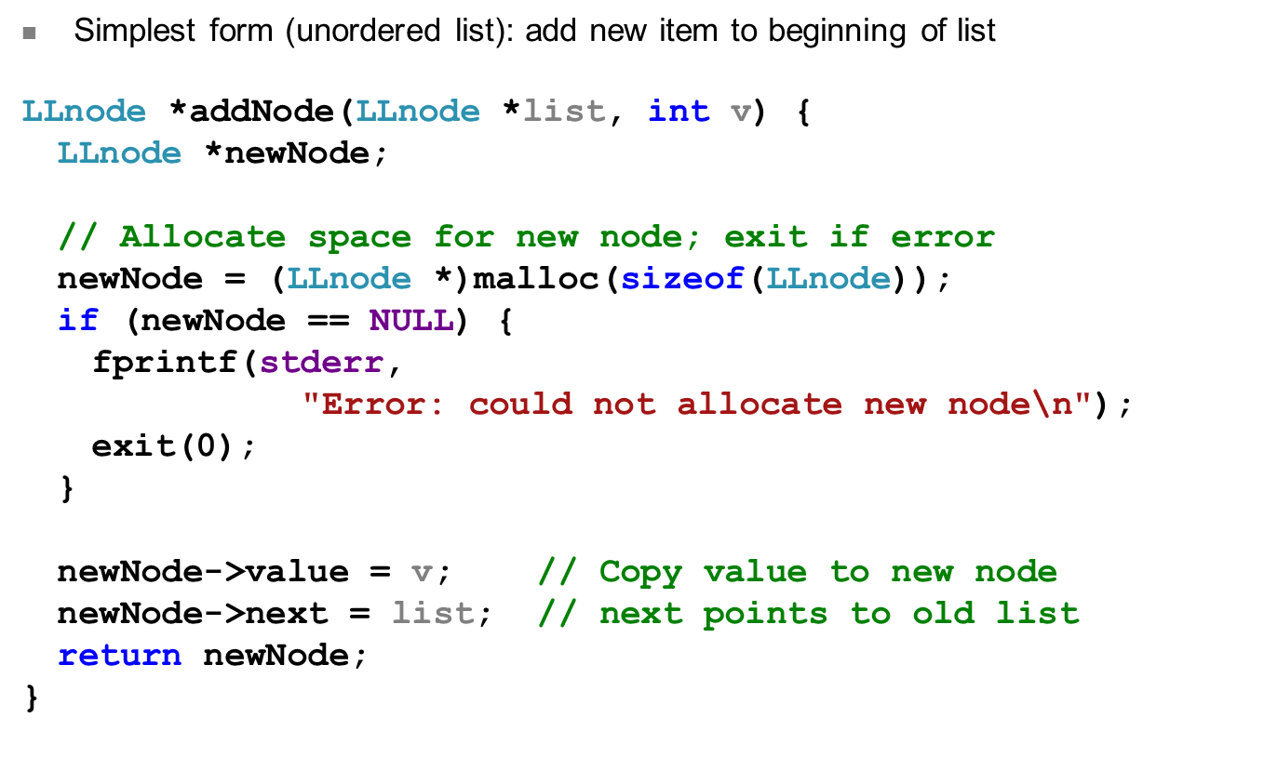
Review: Adding to list
ECE Application Programming: Exam 3 Preview

Slide 12
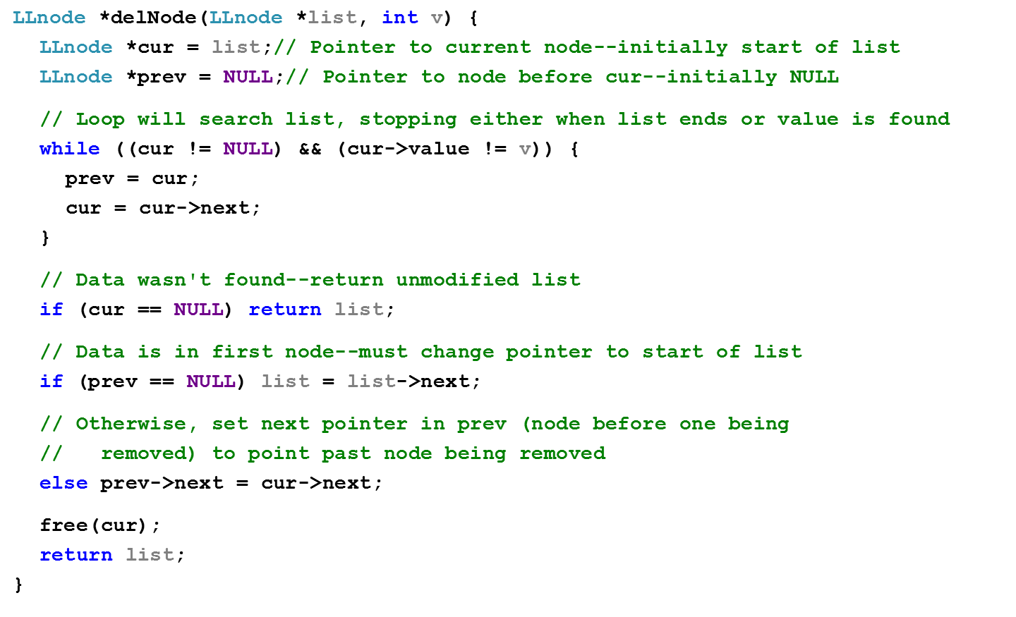
Review: deleting from list
ECE Application Programming: Exam 3 Preview

Slide 13
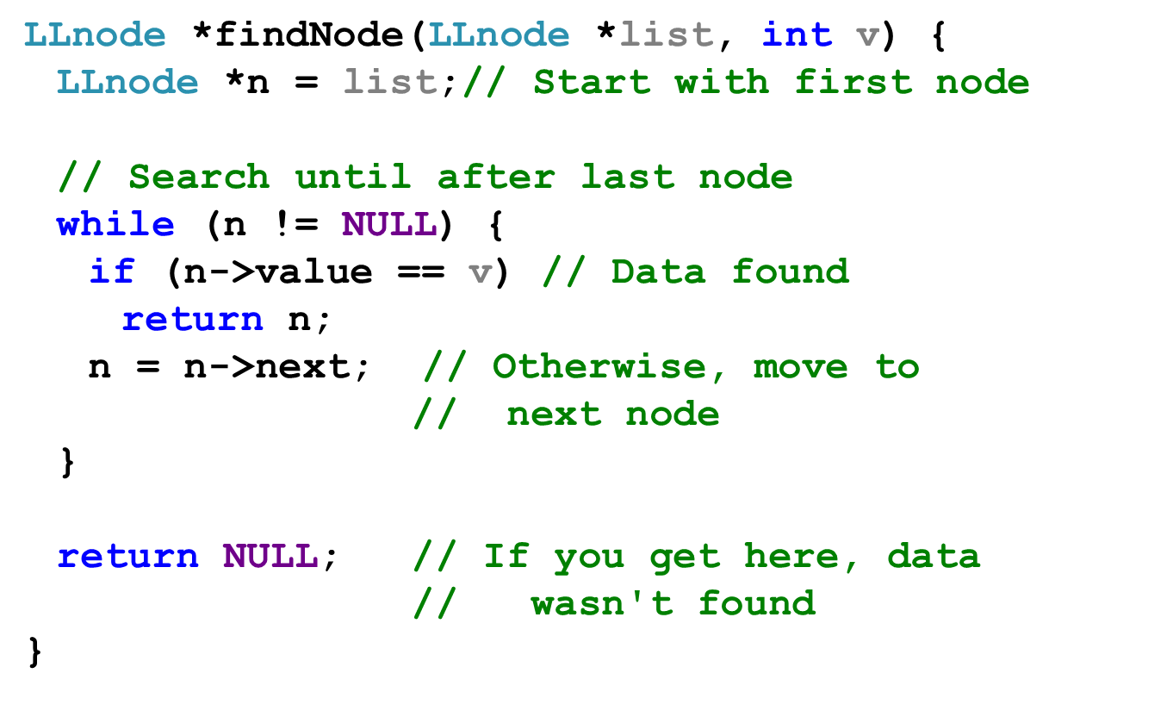
Review: finding data in list
ECE Application Programming: Exam 3 Preview

Slide 14
Next time
Exam 3
Reminders:
  Program 10 due today
  Exam 3: Wednesday, 12/18, 8:00-11:00 AM
    Must complete course evaluation (to be posted online) prior to exam
    Q & A session: Tuesday, 12/17?
  All regrades will be due Thursday, 12/19
    Yes, I know you need the initial grades to work on the regrades
ECE Application Programming: Exam 3 Preview

