Slide 1
16.216
ECE Application Programming
Instructor: Dr. Michael Geiger
Fall 2014
Lecture 17:
More pointer argument examples
PE3: Functions

Slide 2
Lecture outline
Announcements/reminders
  Program 5 due 10/20
  Program 6 due 10/30
    Uses arrays, which we’ll cover next week
    Already online in case you want to work ahead
Review
  Pointers
  Pass by address
Today’s lecture
  More pointer examples
  PE3: Functions
ECE Application Programming: Lecture 17

Slide 3
Review: pointers
Pointer: address of a variable
  Can get address of existing object using &
  Can get value of existing pointer using *
  Can assign pointers of same type to each other
  Pointer declaration:
  <base type>* <pointer name>
    Base type determines how reference is interpreted
Use pointers as function arguments → pass by address
ECE Application Programming: Lecture 17

Slide 4
Review: pointer arguments
Functions can only return one value
Arguments passed by value hold copy of value from calling function
Arguments passed by address hold location of variable in calling function
  Argument type is pointer (e.g., int *ptr)
  Allows function to change multiple values outside its scope
  Dereference pointer to access “value being pointed to”: *ptr
ECE Application Programming: Lecture 17

Slide 5
Example: writing functions with pointers
Write a function that:
  Given two integer arguments, x and y, store the quotient and remainder of x / y into locations specified by arguments q and r, respectively.
  Uses pointers to swap the values of two double-precision variables
ECE Application Programming: Lecture 17

Slide 6
Example solution
  Given two integer arguments, x and y, store the quotient and remainder of x / y into locations specified by arguments q and r, respectively.
void divQR(int x, int y,
int *q, int *r)
{
*q = x / y;
*r = x % y;
}
ECE Application Programming: Lecture 17

Slide 7
Example solution (cont.)
  Use pointers to swap the values of two double-precision variables
void swap(double *a, double *b)
{
double temp;
temp = *a;
*a = *b;
*b = temp;
}
ECE Application Programming: Lecture 17

Slide 8
PE3: Change problem
Given any amount of change under $2.00, determine and print out the minimum number of coins required to make that amount of change.
  Available coins are Halves (half dollars), Quarters, Dimes, Nickels, and Pennies.
ECE Application Programming: Lecture 17

Slide 9
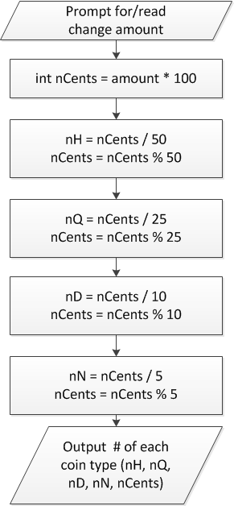
Flowchart
Treat change amount as integer (nCents)
  Can now use division & modulus
nCents = # pennies after previous four coin types have been taken out
ECE Application Programming: Lecture 17

Slide 10
When to use functions
Find a particular step or series of steps being repeated in your code
  If code is exactly the same, you need no arguments
  If one or more values change, but actual calculations are the same, values can be function arguments
  If function modifies:
    1 variable: just return it
    2+ variables: use pointer argument(s)
Reassess change example
  Steps for creating change are extremely similar
  What changes each time?
  How should we use those values in a function?
    Inputs, outputs, variables … ?
ECE Application Programming: Lecture 17

Slide 11
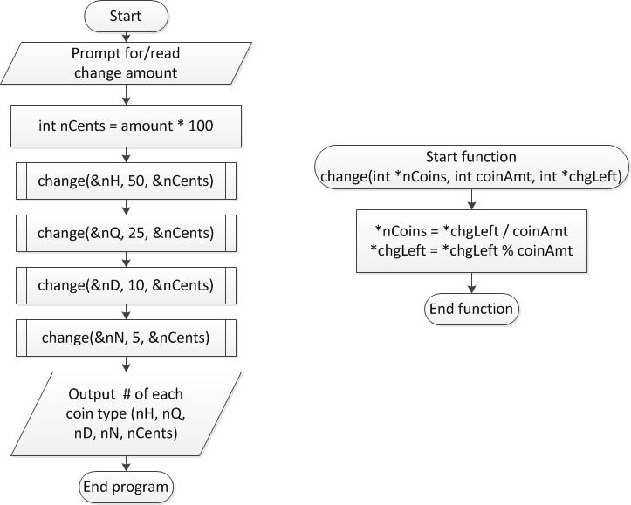
Overall flowchart
ECE Application Programming: Lecture 17

Slide 12
Final notes
Next time
  Arrays
Reminders
  Program 5 due 10/20
  Program 6 due 10/30
    Uses arrays, which we’ll cover next week
    Already online in case you want to work ahead
ECE Application Programming: Lecture 17

