Slide 1
16.216
ECE Application Programming
Instructor: Dr. Michael Geiger
Fall 2014
Lecture 33:
Dynamic memory allocation (continued)

Slide 2
Lecture outline
Announcements/reminders
  Program 9 due today
  Program 10 due 12/10 (last day of classes)
  Grading notes
    P5 grading done; just needs review
    Late penalties halved (starting with P4)
      Divide actual late days by 2
      No deduction for 1 day late, -1 for 2-3 days late, etc.
    Max penalty still -32
    Will drop lowest of 10 program grades
Review
  Dynamic memory allocation basics
Today’s class
  Dynamically allocated data structures
ECE Application Programming: Lecture 33

Slide 3
Review: dynamic memory allocation
Basic block allocation:
void *malloc(size_t size);
Allocate block and clear it:
void *calloc(size_t nmemb,
size_t size);
Resize previously allocated block:
void *realloc(void *ptr,
size_t size);
Deallocation function:
void free(void *ptr);
ECE Application Programming: Lecture 33

Slide 4
Review: allocating arrays
1-D array
arr = (int *)malloc(n * sizeof(int));
  Can then use array notation: arr[i] = 0;
String containing n characters
str = (char *)malloc(n + 1);
2-D array
  Data type: “pointer to pointer”: int **twoDarr;
  1st dimension depends on # rows
    twoDarr = (int **)malloc(nRows * sizeof(int *));
  2nd dimension depends on # columns
    Must allocate for each row
    for (i = 0; i < nRows; i++)
    twoDarr[i] = (int *)malloc(nCols * sizeof(int));
ECE Application Programming: Lecture 33

Slide 5
Example
Complete each of the following functions
  char *readLine(): Read a line of data from the standard input, store that data in a dynamically allocated string, and return the string (as a char *)
    Hint: Read the data one character at a time and repeatedly reallocate space in the string
  int **make2DArray(int total, int nR): Given the total number of values and number of rows to be stored in a two-dimensional array, determine the appropriate number of columns, allocate the array, and return its starting address
    Note: if nR does not divide evenly into total, round up. In other words, an array with 30 values and 4 rows should have 8 columns, even though 30 / 4 = 7.5
ECE Application Programming: Lecture 33

Slide 6
Solution
char *readLine() {
char c; // Input character
char *str = NULL; // String to hold line
int n = 1; // Length of str
// Repeatedly store character in str until
// '\n' is read; resize str to hold char
while ((c = getchar()) != '\n') {
str = (char *)realloc(str, n+1);
str[n-1] = c;
n++;
}
str[n-1] = '\0'; // Null terminator
return str;
}
ECE Application Programming: Lecture 33

Slide 7
Solution (continued)
int **make2DArray(int total, int nR) {
int **arr; // 2-D array
int nCols; // # of columns
int i; // Row index
// Calculate nCols; round up if nR does not divide evenly
nCols = total / nR;
if ((total % nR) != 0)
nCols++;
// Allocate array--first array of rows, then each row
arr = (int **)malloc(nR * sizeof(int *));
for (i = 0; i < nR; i++)
arr[i] = (int *)malloc(nCols * sizeof(int));
return arr;
}
ECE Application Programming: Lecture 33

Slide 8
Dynamic allocation and structures
Can use sizeof() to get # bytes in structure
Examples (using StudentInfo struct):
StudentInfo *p;
p = (StudentInfo *)malloc(sizeof(StudentInfo));
StudentInfo *arr;
int n;
printf("Enter array size: ");
scanf("%d", &n);
arr = (StudentInfo *)malloc(n * sizeof(StudentInfo));
ECE Application Programming: Lecture 33

Slide 9
Data structures
Data structure: way of storing and organizing data
  Arrays are one relatively inefficient example
Other structures designed to optimize:
  Organizing / sorting data
  Adding new data
  Removing unwanted data
  Searching for data
ECE Application Programming: Lecture 33

Slide 10
Pointer-based data structures
Many structures extensively use pointers
Each element within structure contains data + pointer(s) to one or more other elements
Usually functions for common operations
  Add new element
    Dynamically allocate new element
    Modify appropriate pointer(s) in other element(s) to point to new element
    Set pointer(s) in new element to point to other(s)
  Delete element
    Modify pointer(s) in other element(s) so they don’t point to element being removed
    Deallocate removed element
  Find element
    Follow pointers to move from one element to next
ECE Application Programming: Lecture 33

Slide 11

Linked list
Simple pointer-based structure: linked list
Each element (node) contains data + pointer to next element in list
Last element points to NULL
Program using list needs pointer to first node
Image source: http://en.wikipedia.org/wiki/Linked_list
ECE Application Programming: Lecture 33

Slide 12
Linked list definition
Structure to hold list of integers
typedef struct node {
int value; // Data
struct node *next; // Pointer to
// next node
} LLnode;
Note definition style has changed slightly
  Type “name” both before and after { }
  Name before (struct node) is necessary to use type inside structure definition
  Name after (LLnode) can be used in rest of program
ECE Application Programming: Lecture 33

Slide 13
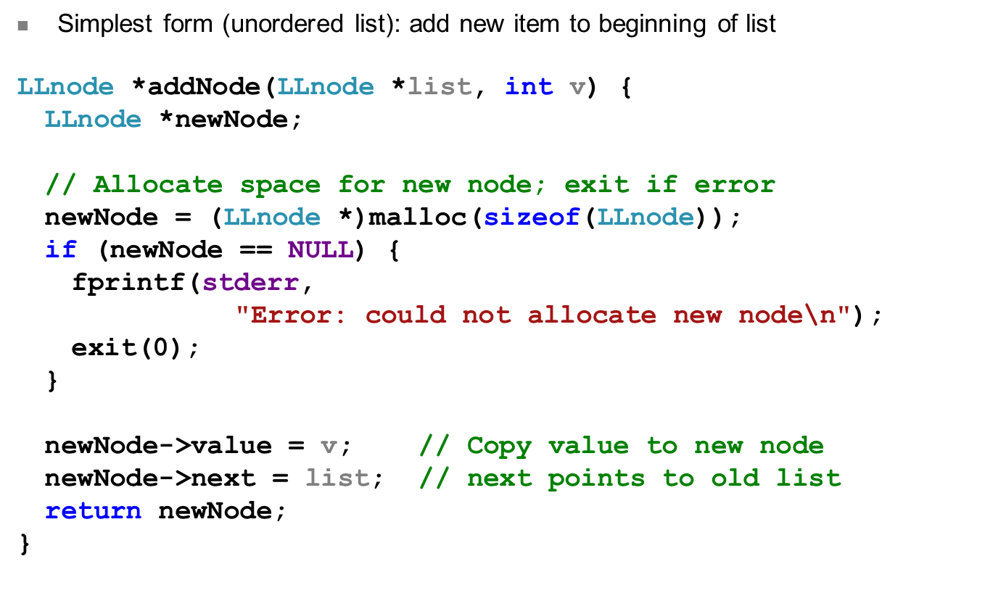
Adding to list
ECE Application Programming: Lecture 33

Slide 14
Next time
Continue discussing dynamically allocated data structures
Reminders:
  Program 9 due today
  Program 10 due 12/10 (last day of classes)
  Grading notes
    P5 grading done; just needs review
    Late penalties halved (starting with P4)
      Divide actual late days by 2
      No deduction for 1 day late, -1 for 2-3 days late, etc.
    Max penalty still -32
    Will drop lowest of 10 program grades
ECE Application Programming: Lecture 33

