Slide 1
16.216
ECE Application Programming
Instructor: Dr. Michael Geiger
Fall 2014
Lecture 36:
Dynamically allocated data structures (continued)

Slide 2
Lecture outline
Announcements/reminders
  Program 10 due 5:00 PM, 12/18
  Grading notes
    P5 grading done
    Late penalties halved (starting with P4)
      Divide actual late days by 2
      No deduction for 1 day late, -1 for 2-3 days late, etc.
    Max penalty still -32
    Will drop lowest of 10 program grades
Today’s class
  Continue with dynamically allocated data structures
ECE Application Programming: Lecture 36

Slide 3
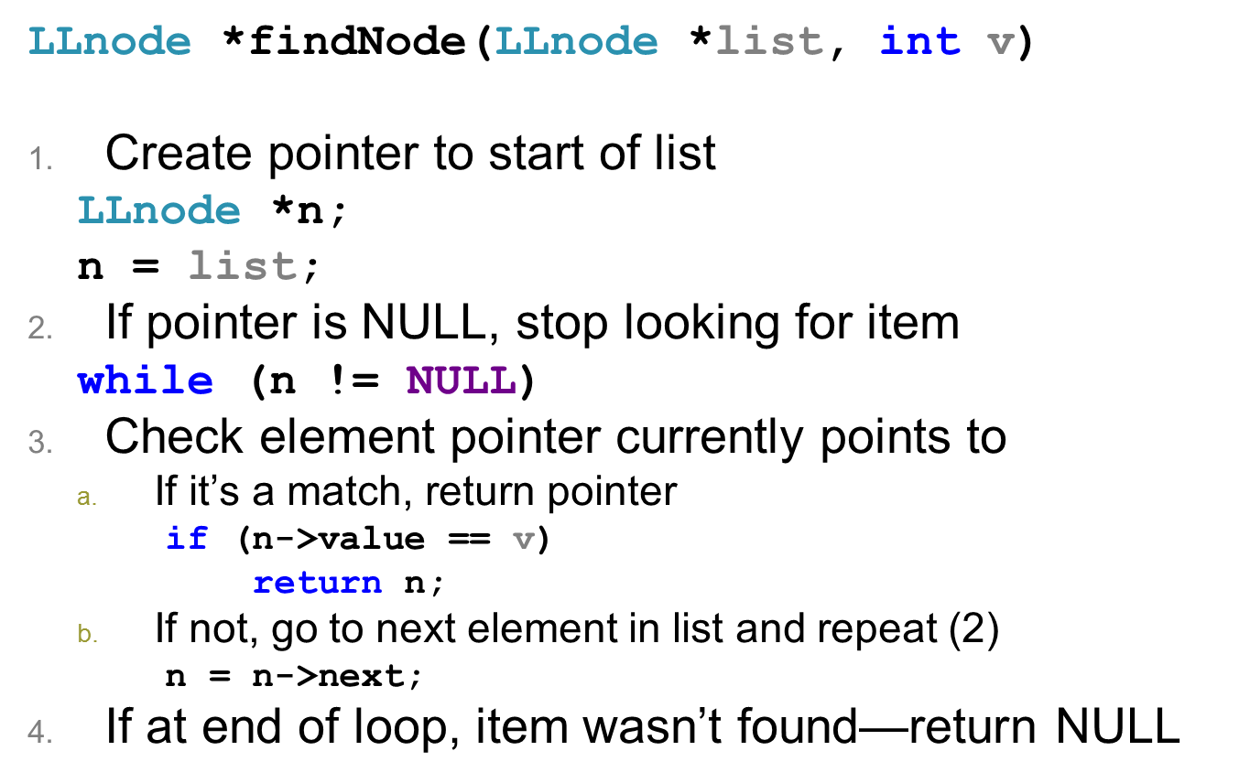
Review: Finding item in list
ECE Application Programming: Lecture 36

Slide 4
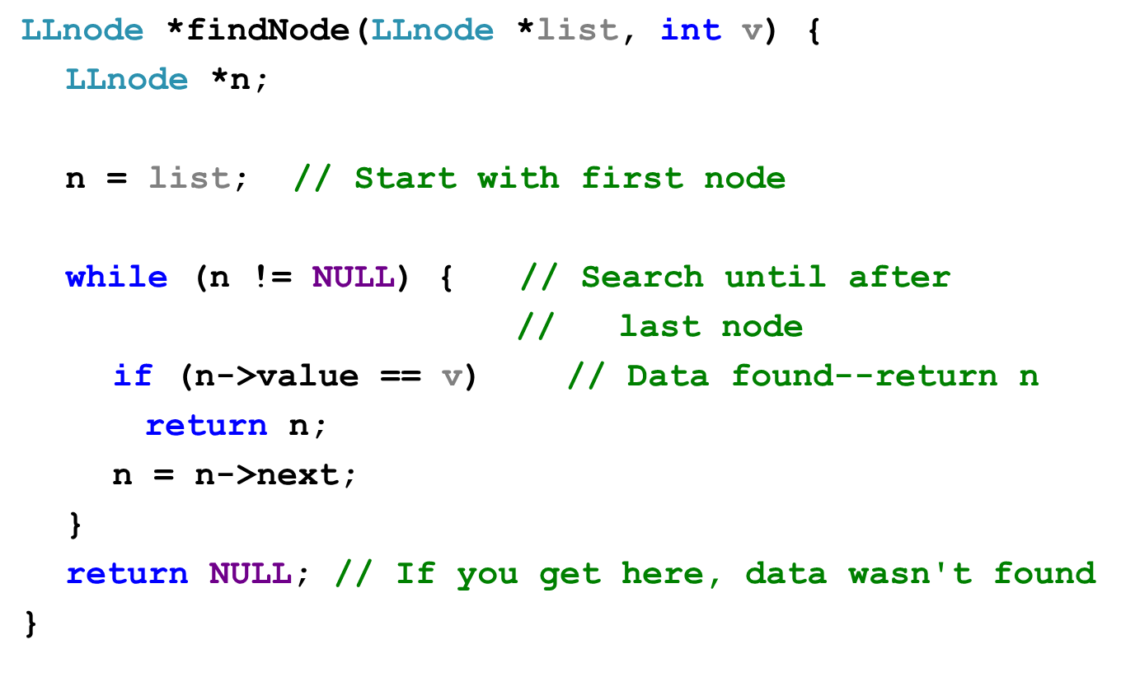
Solution
ECE Application Programming: Lecture 36

Slide 5
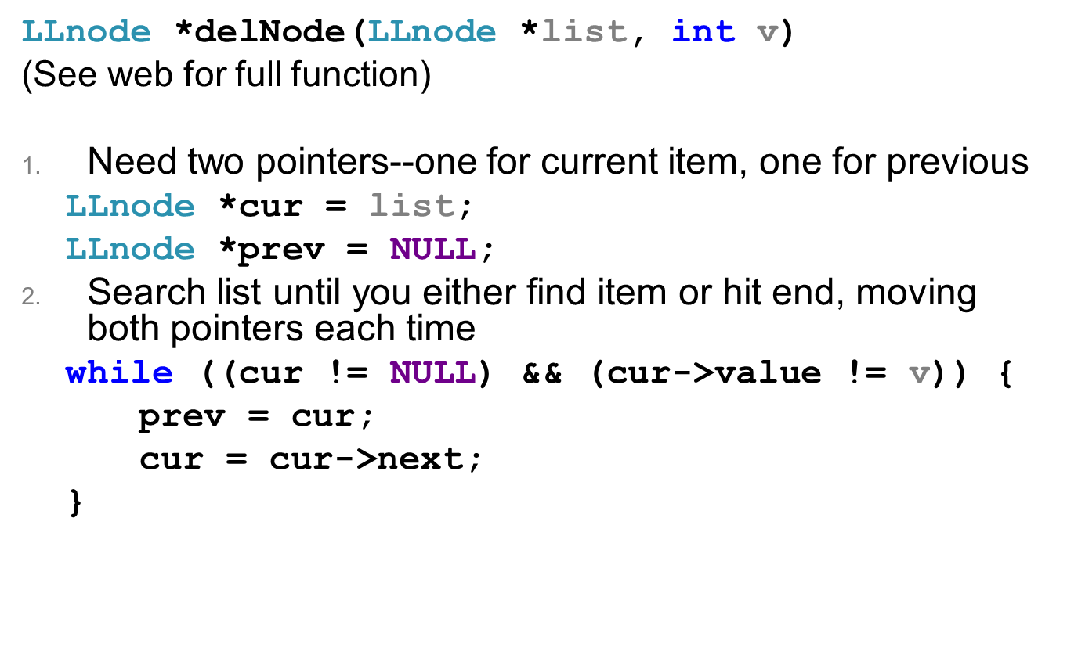
Deleting item from list
ECE Application Programming: Lecture 36

Slide 6
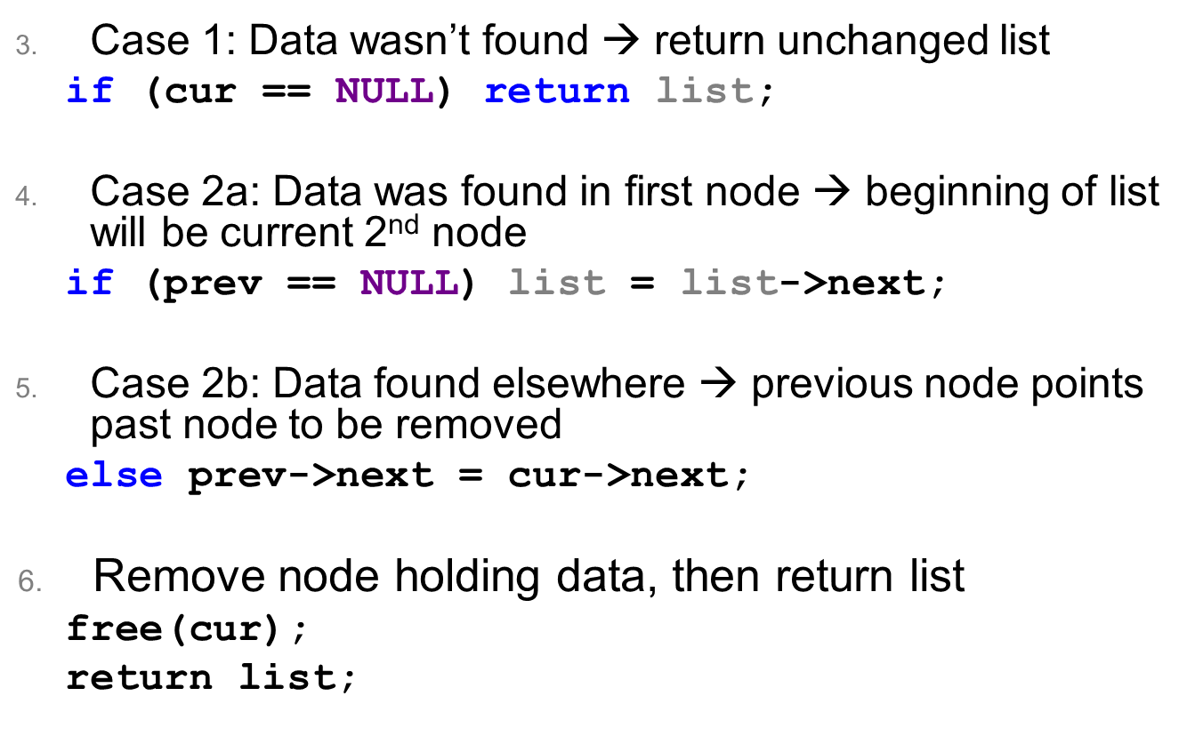
Deleting item from list (continued)
ECE Application Programming: Lecture 36

Slide 7
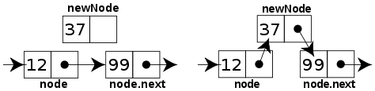
Sorted linked list
Can ensure each item is sorted as it’s added
  Slower item insertion, but faster search
Not easy with arrays: must move existing data
Keeping linked list sorted
  Find appropriate location
    Often done by going “past” appropriate spot
  Modify pointers
    Node before correct spot points to new node
    New node points to node after correct spot
    Image source: http://en.wikipedia.org/wiki/Linked_list
ECE Application Programming: Lecture 36

Slide 8
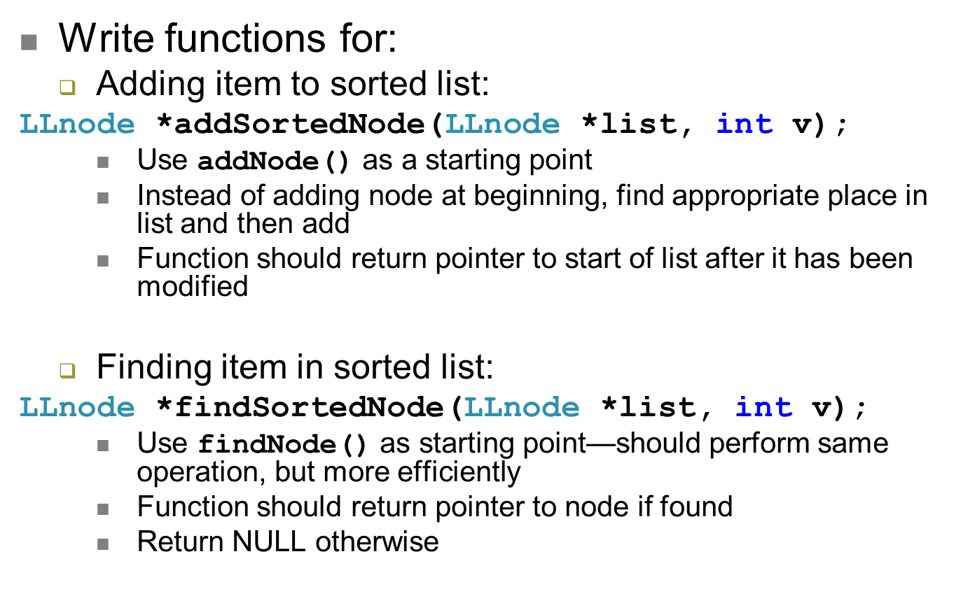
Examples
ECE Application Programming: Lecture 36

Slide 9
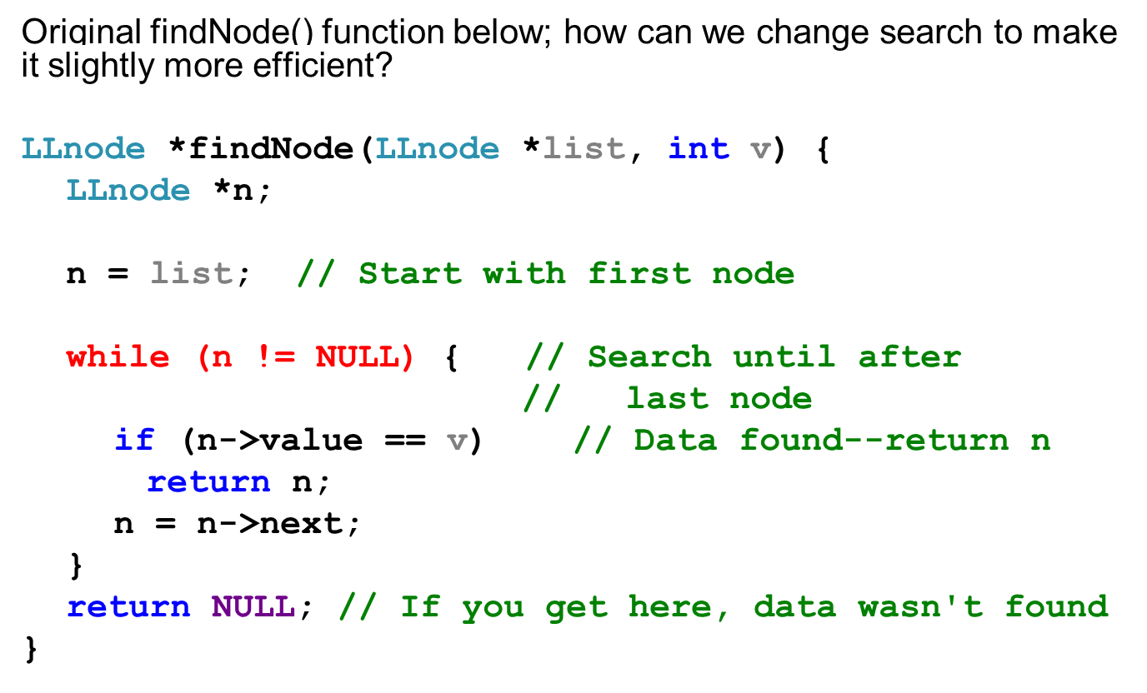
Going from findNode → findSortedNode
ECE Application Programming: Lecture 36

Slide 10
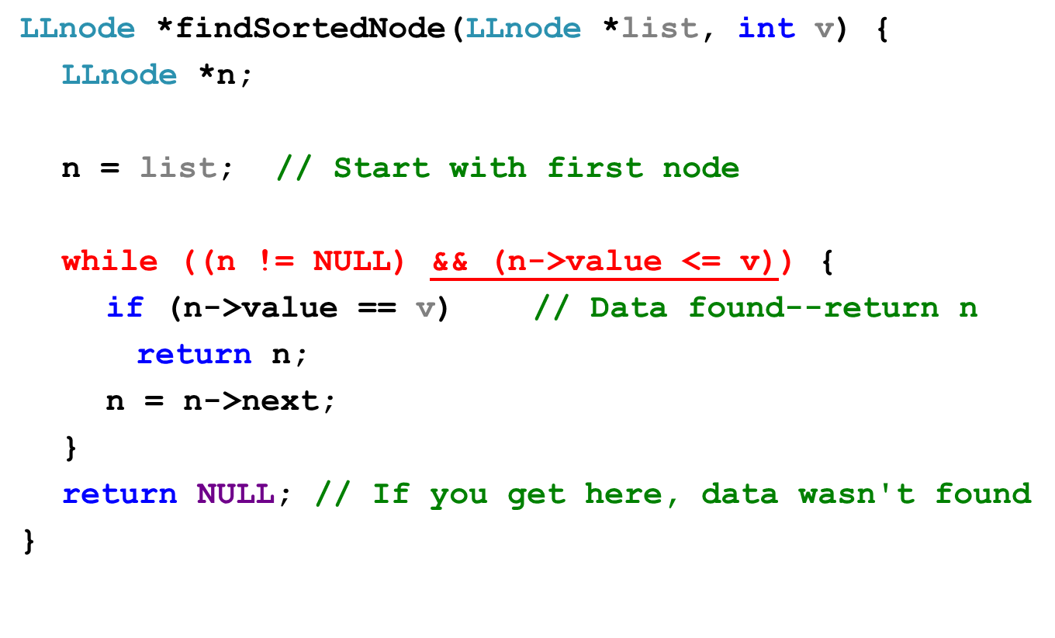
Going from findNode → findSortedNode
ECE Application Programming: Lecture 36

Slide 11
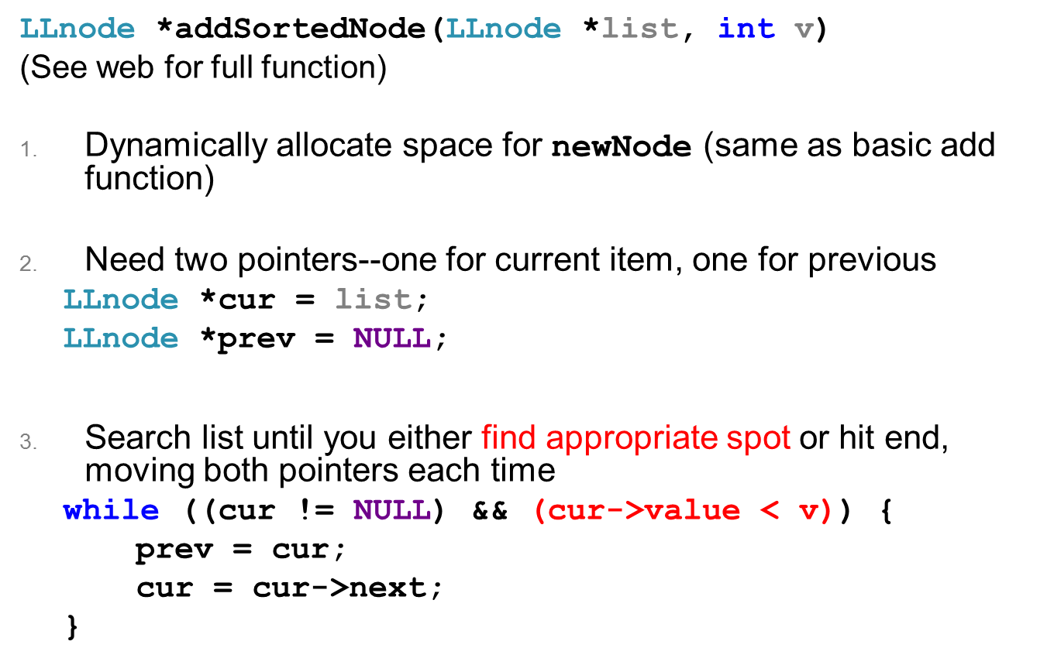
Adding item to sorted list
ECE Application Programming: Lecture 36

Slide 12
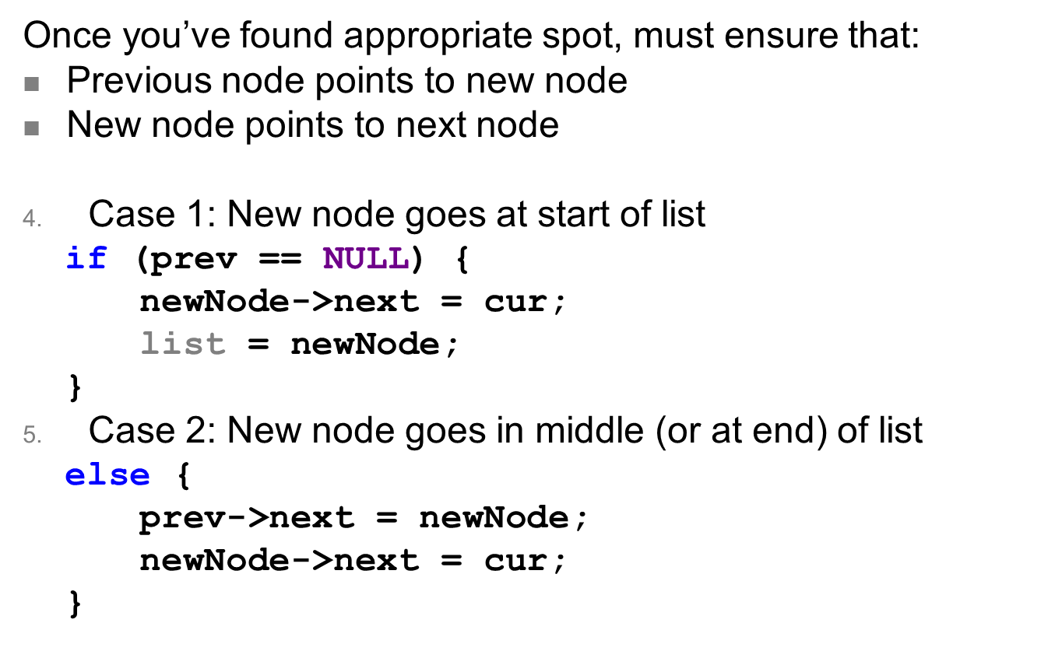
Adding item to sorted list (continued)
ECE Application Programming: Lecture 36

Slide 13
Program 10 notes
DLList structure: pointers to first and last nodes
  Main program starts with DLList structure in which both pointers are NULL
DLL → more pointers to change
  Adding to list
    Must dynamically allocate space for string to add it
    Make sure that prev & next pointers are set in all appropriate nodes
      New node, previous node, next node
    Special cases for first and last node
  Deleting from list
    Previous & next nodes must point past node to be removed
    First & last nodes are special cases
    Make sure you free string before freeing node
  Finding, printing: similar to basic linked list
ECE Application Programming: Lecture 36

Slide 14
Next time
Exam 3 Preview
Reminders:
  Program 10 due 5:00 PM, 12/18
  Grading notes
    P5 grading done
    Late penalties halved (starting with P4)
      Divide actual late days by 2
      No deduction for 1 day late, -1 for 2-3 days late, etc.
    Max penalty still -32
    Will drop lowest of 10 program grades
ECE Application Programming: Lecture 36

