Slide 1
16.216
ECE Application Programming
Instructor: Dr. Michael Geiger
Spring 2012
Lecture 12: PE2

Slide 2
Lecture outline
Announcements/reminders
  Program 3 grading to be done ASAP, regrades TBD
  Program 4 posted; due Monday, 2/27
    Extra credit: flowcharts due Wednesday, 2/22
  No class Monday, 2/20
  Exam 1: Friday, 2/24
    Review lecture Wednesday, 2/22
    Old exams → only problems about material we cover
    Will be allowed one 8.5” x 11” double-sided sheet of notes
Today
  Review: if statements
  PE2: Using if statements
ECE Application Programming: Lecture 12

Slide 3
Review: if statements
Form:
  if (<expression>)
  <statement>
  [ else brackets show
  <statement> ] else is optional
Expression frequently uses relational operators to test equality/inequality
  < > <= >= == !=
  e.g., if (x <= 5)
Can combine conditions using logical operators
  AND : && OR: ||
  e.g., if ((x <= 5) && (x > 0))
Can test if condition is false using logical NOT: !
  e.g., if (!(x < 5))
May test multiple conditions using if/else if/.../else
  Second condition is tested only if first is false; third condition tested only if first two are false, etc.
  Else case used only if all previous tests false
ECE Application Programming: Lecture 12

Slide 4

Example: Quadratic Equation Solver
Start
Today’s exercise—turn the flowchart on the next two slides into an actual program
Output
“Quadratic Equation Solver”
Output
“Enter A, B, C: ”
Input A, B, C
ECE Application Programming: Lecture 12

Slide 5

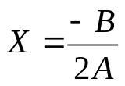

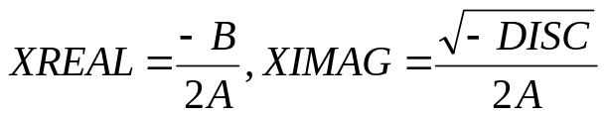
Quadratic Equation Solver (cont.)
A = 0?
TRUE
Output
X
FALSE
DISC=B*B-4*A*C
DISC = 0?
TRUE
Output
X
FALSE
DISC>0?
TRUE
Output
X1,X2
FALSE
Output
XREAL + XIMAG i
XREAL – XIMAG i
ECE Application Programming: Lecture 12
Done

Slide 6
Additional notes
A, B, and C (the coefficients of Ax² + Bx + C) can be any real number.
All roots should be printed with 2 places after the decimal point.
To implement the square root function,
  Include the math library (<math.h>)
  Use the function sqrt()
    x = sqrt(y); assigns square root of y to x.
    For example, if
      y == 9, x == 3
      y == 10, x == 3.162277
ECE Application Programming: Lecture 12

Slide 7
Questions
What variables do you need?
  What types?
  What should you name them?
How do we implement the initial I/O?
How would you organize just the conditional statements in this program?
  What condition(s) are you testing?
  Does each if statement need an else case? One or more “else if” cases?
What goes inside each if or else block?
ECE Application Programming: Lecture 12

Slide 8
Solution
See file(s) posted on web page
Both zipped Visual Studio project and standalone .c file are available
ECE Application Programming: Lecture 12

Slide 9
Next time
Exam 1 Preview (on Wednesday)
  Remember, Monday is a holiday
ECE Application Programming: Lecture 12

