Slide 1
16.216
ECE Application Programming
Instructor: Dr. Michael Geiger
Spring 2013
Lecture 22:
Exam 2 Review

Slide 2
Lecture outline
Announcements/reminders
  Program 7 due 4/1
Today’s class: Exam 2 Review
  Exam stats
  Regrade requests: due, in writing, 4/5
  Figuring out where you stand
  Exam solution
ECE Application Programming: Exam 2 Review

Slide 3
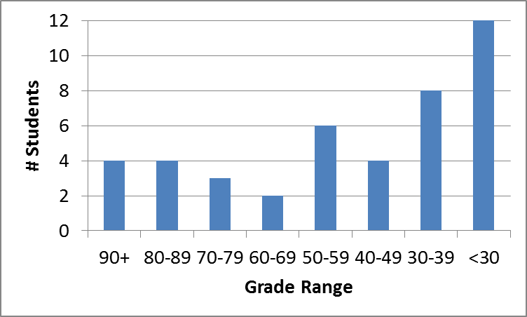
Exam stats & grade distribution
Average: 48.2
Median: 47
Std. deviation: 26.2
Max: 94
Question-by-question averages:
  Q1: 12.4 / 20 (62%)
  Q2: 20.3 / 40 (51%)
  Q3: 15.5 / 40 (39%)
Extra credit
  11 students completed
  5.7 average
ECE Application Programming: Exam 2 Review

Slide 4
Figuring out where you stand
Programs: 60% (6/11 done; 5/11 graded)
  Will likely allow you to drop lowest score
Exams: 40% (10% + 15% + 15%)
  Lowest score between Exams 1 & 2 will count for 10%
  Other will count for 15%
~35-40% of your grade still to be determined
Estimating your grade
  Program avg (PA) = (total program points) / 4.5
  Exam avg (EA) =
  ((Low exam) + (High exam * 1.5)) / 2.5
  Overall avg = PA * 0.6 + EA * 0.4
ECE Application Programming: Exam 2 Review

Slide 5
Figuring out where you stand
Estimated avg = PA * 0.6 + EA * 0.4
Current course avg (will change):
  Without extra credit: ~76%, SD = 16
  With extra credit: ~77%, SD = 16
  No XC, drop 1 program: ~79%, SD = 13
  XC, drop 1 program: ~80%, SD = 13
Likely avg up, SD down once grades/regrades done
May be curve, but do not assume there will be
Typical grading scale without curve
  A: 93+
  A-: 90-92
  B+: 88-89
  B: 83-87
  B-: 80-82
  C+: 78-79
  C: 73-77
  C-: 70-72
  D+: 68-69
  D: 60-67
  F: < 60
ECE Application Programming: Exam 2 Review

Slide 6
Next time
Character arrays and strings
Reminders:
  Program 7 due 4/1
ECE Application Programming: Exam 2 Review

