Slide 1
16.216
ECE Application Programming
Instructor: Dr. Michael Geiger
Spring 2014
Lecture 34:
Dynamically allocated data structures (cont.)

Slide 2
Lecture outline
Announcements/reminders
  Program 10 due 5/2 (last day of classes)
Review
  Dynamically allocated data structures
Today’s class
  Continue with discussion of linked list
  Discuss Program 10 (doubly-linked list)
ECE Application Programming: Lecture 34

Slide 3

Review: pointer-based data structures
Data structures to optimize data organization
Structure containing pointer(s) to other structure
  Adding data: allocate space for new node, then adjust pointers
  Deleting data: adjust pointers, then free space for node
Example: linked list
typedef struct node {
int value; // Data
struct node *next; // Pointer to
// next node
} LLnode;
    Image source: http://en.wikipedia.org/wiki/Linked_list
ECE Application Programming: Lecture 34

Slide 4
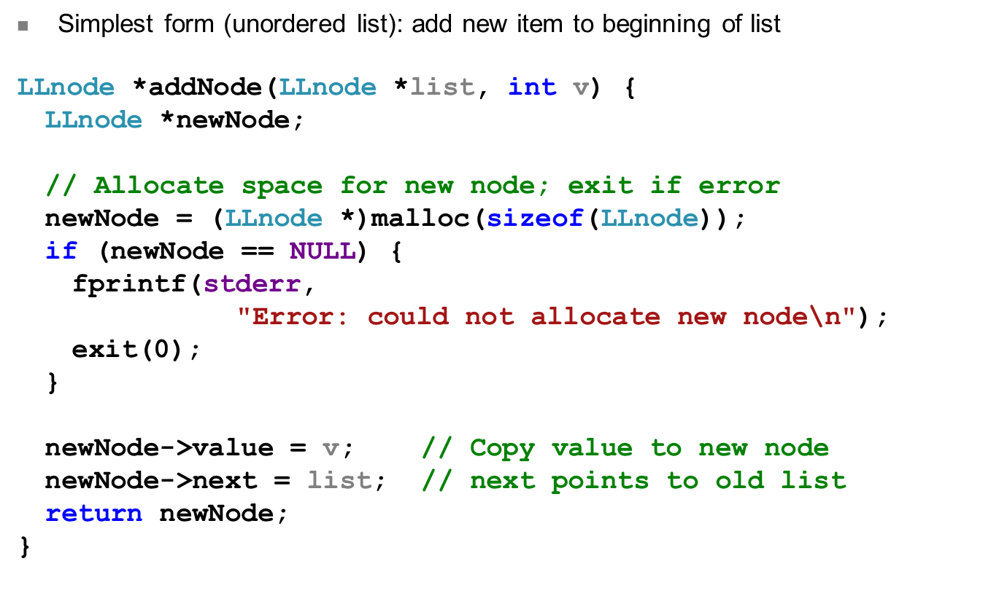
Review: Adding to list
ECE Application Programming: Lecture 34

Slide 5
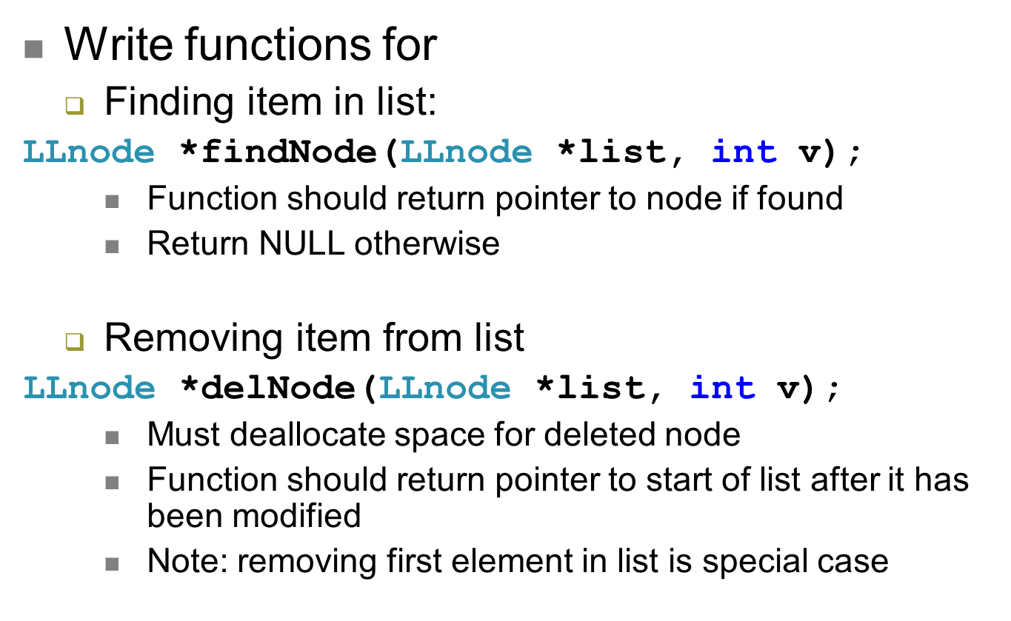
Examples
ECE Application Programming: Lecture 34

Slide 6
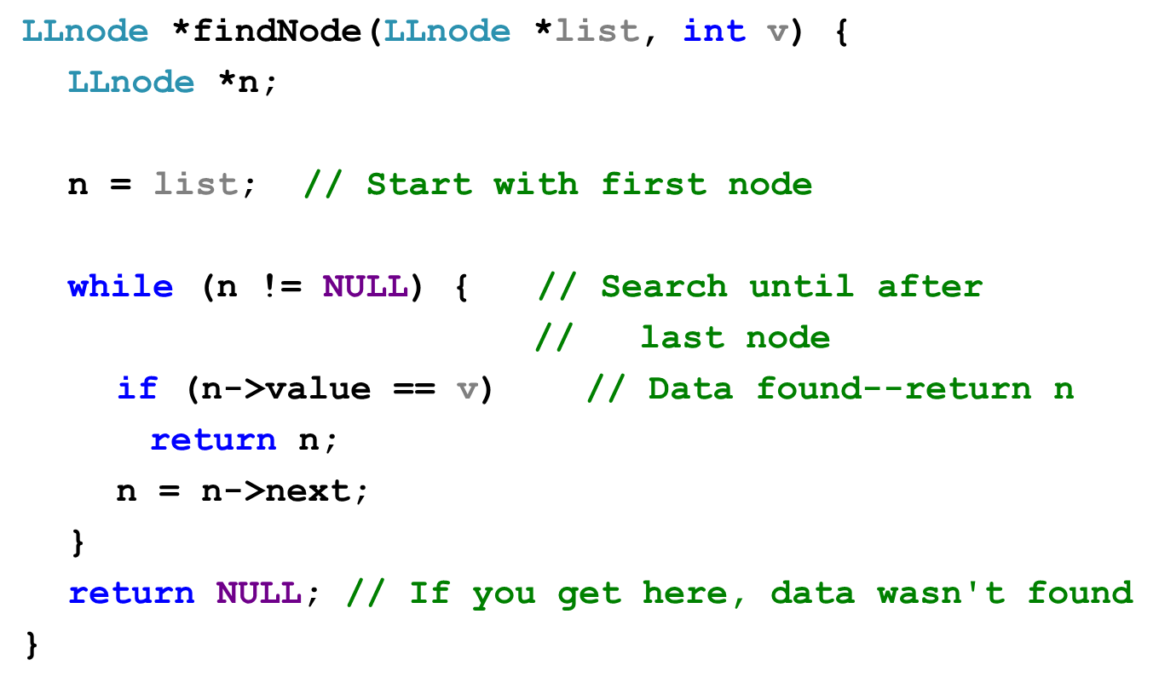
Solution
ECE Application Programming: Lecture 34

Slide 7
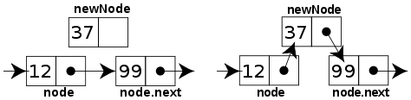
Sorted linked list
Can ensure each item is sorted as it’s added
  Slower item insertion, but faster search
Not easy with arrays: must move existing data
Keeping linked list sorted
  Find appropriate location
    Often done by going “past” appropriate spot
  Modify pointers
    Node before correct spot points to new node
    New node points to node after correct spot
    Image source: http://en.wikipedia.org/wiki/Linked_list
ECE Application Programming: Lecture 34

Slide 8
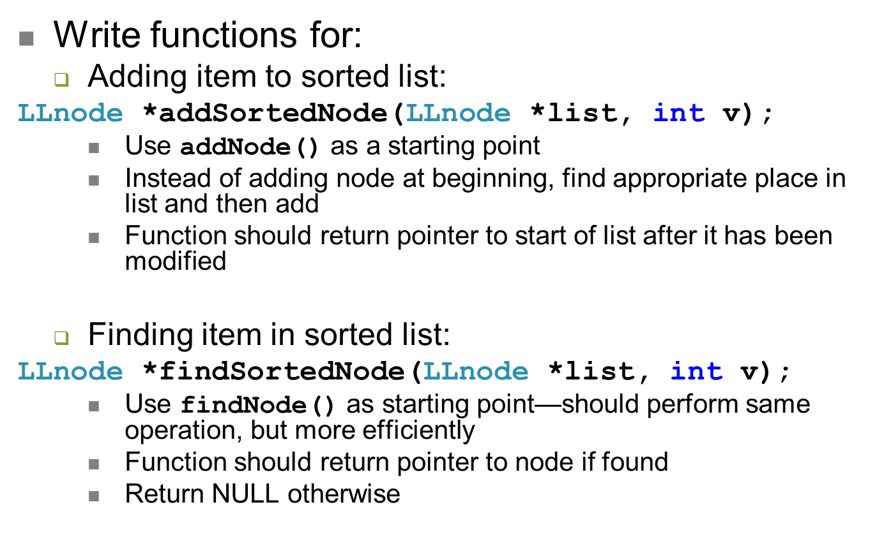
Examples
ECE Application Programming: Lecture 34

Slide 9
Next time
In-class office hours on Wednesday
  Feel free to bring laptops and ask questions about programs
Exam 3 Preview on Friday
Reminders:
  Program 10 due 5/2
ECE Application Programming: Lecture 34

