Slide 1
16.216
ECE Application Programming
Instructor: Dr. Michael Geiger
Spring 2015
Lecture 13:
PE2: Loops and conditionals

Slide 2
Lecture outline
Announcements/reminders
  Program 4 due 3/4
  Graded exams to be returned Monday
Review
  For loops
Today’s lecture
  PE2: Conditionals and while loops
ECE Application Programming: Lecture 10

Slide 3
Review: for loops
for (<init var>; <test>; <change var>)
<statements>
Operators to directly change variable
  x++, x-- → post-increment/decrement
  ++x, --x → pre-increment/decrement
  +=, -=, *=, /= → augmented assignment
ECE Application Programming: Lecture 10

Slide 4
Today’s program should:
Prompt user to enter an input character and an integer, n.
  If not correctly formatted, print error, clear line, and repeat
Depending on the character entered, do the following:
  ‘F’ or ‘f’: Compute and print the factorial of n, n!
    For example, if the user enters F 5, print 5! = 120
  ‘P’ or ‘p’: Compute 2^{n}, but only if n >= 0.
    For example, if the user enters p 2, print 2^2 = 4
    Print an error if n < 0.
  ‘X’ or ‘x’: Exit the program
  In all other cases, print an error:
    For example: Invalid command Z entered
If the user enters any command other than ‘X’ or ‘x’, return to the initial prompt and repeat the program.
ECE Application Programming: Lecture 10

Slide 5

ECE Application Programming: Lecture 10

Slide 6
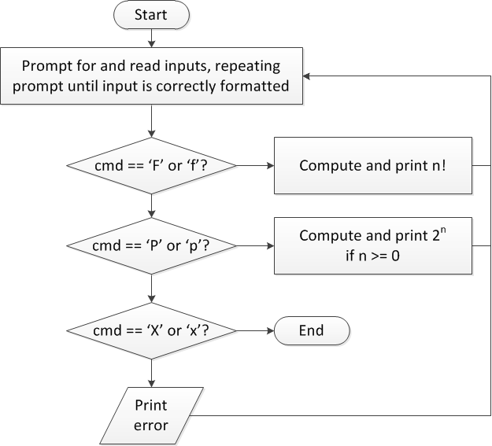
Flow charts: overall flow
ECE Application Programming: Lecture 10

Slide 7
Discussion: Overall flow
Whole program contains loop
  Repeats process until user enters ‘X’ or ‘x’
  Use while or do-while—unknown # of iterations
  Since exit condition ends program, infinite loop
Testing cmd: switch statement
  Checking equality of cmd to constant values
Exiting program: return statement
  Use return at any point to end current function (including main)
ECE Application Programming: Lecture 10

Slide 8
Code: overall flow (skeleton code)
while (1) { // Loop repeats until user enters 'X' or 'x'
/* Code to read cmd, n */
/* Evaluate cmd and perform appropriate operation */
switch (cmd) {
case 'F':
case 'f':
/* Calculate n! */
break;
case 'P':
case 'p':
/* Calculate 2^n, if n >= 0; print error otherwise */
break;
case 'X':
case 'x':
return; // Exit program
default:
printf("Invalid command %c entered\n", cmd);
}
}
ECE Application Programming: Lecture 10

Slide 9
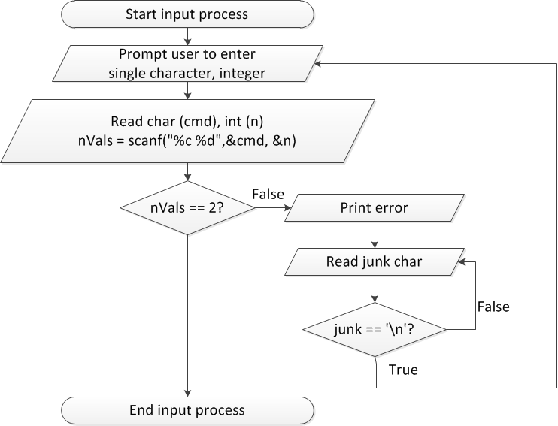
Flow charts: reading input
ECE Application Programming: Lecture 10

Slide 10
Discussion: Reading input
Loop that repeats as long as input incorrect
Loop inside that one to handle reading of remainder of line
  Read character until you reach end of line
Both while/do-while loops
ECE Application Programming: Lecture 10

Slide 11
Code: Reading input
do {
printf("Enter command and integer: ");
nVals = scanf("%c %d", &cmd, &n);
// Otherwise, print error & clear line
if (nVals != 2) {
printf("Incorrectly formatted input\n“);
do {
scanf("%c", &junk);
} while (junk != '\n');
}
} while (nVals != 2);
ECE Application Programming: Lecture 10

Slide 12
Next step
Write flowcharts for
  Computing n!
  Computing 2^{n} if n >= 0
Complete code
ECE Application Programming: Lecture 11

Slide 13
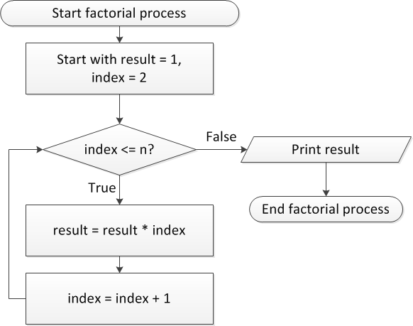
Flow charts: Calculating n!
ECE Application Programming: Lecture 11

Slide 14
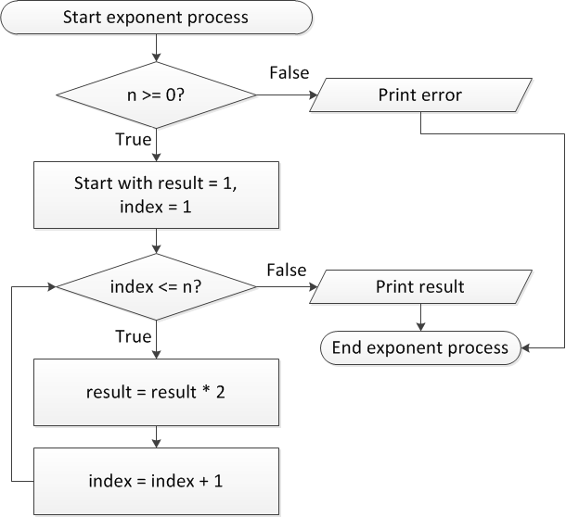
Flow charts: Calculating 2^{n}
ECE Application Programming: Lecture 11

Slide 15
Discussion: Factorial/2^{n}
Loop for each process covers fixed range of values
  Use for loop
Can declare single variable to hold both results, since only one will be calculated
ECE Application Programming: Lecture 11

Slide 16
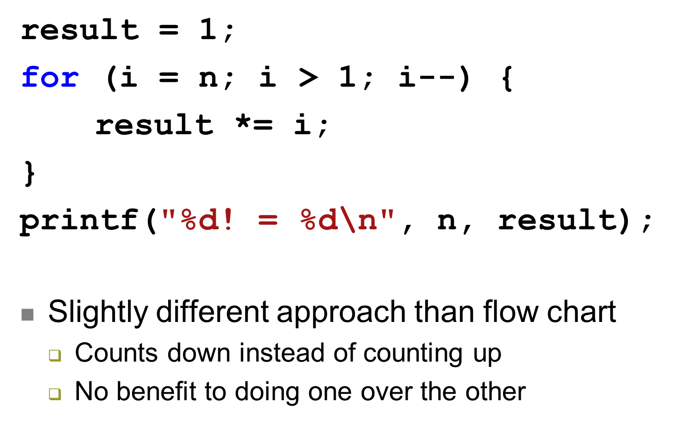
Code: factorial
ECE Application Programming: Lecture 11

Slide 17
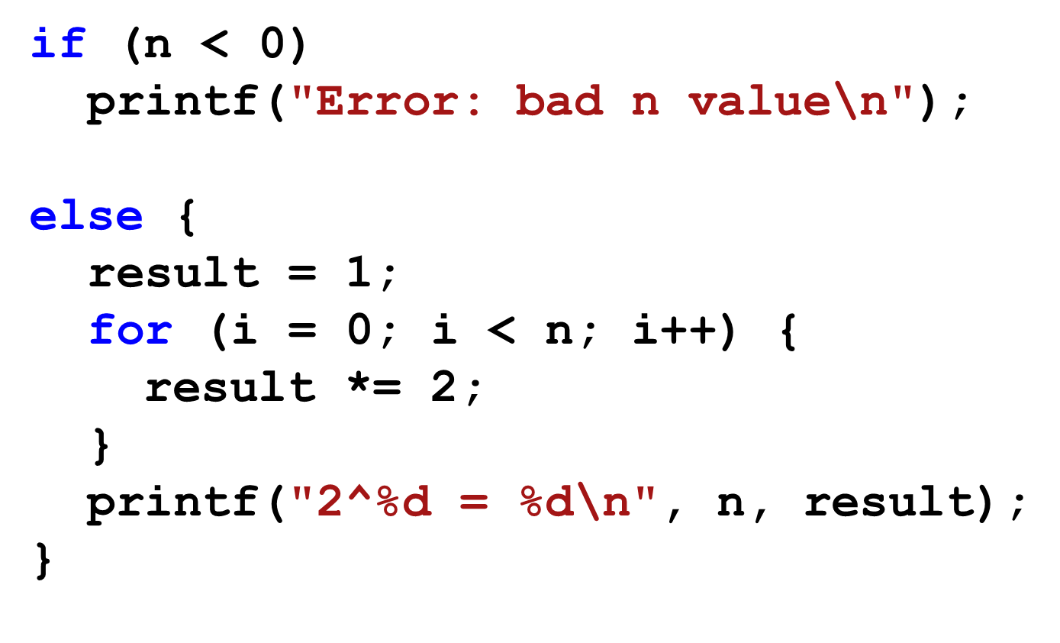
Code: 2^{n}
ECE Application Programming: Lecture 11

Slide 18
Final notes
Next time
  Return exams
Reminders:
  Program 4 due 3/4
  Graded exams to be returned Monday
ECE Application Programming: Lecture 10

