Slide 1
16.216
ECE Application Programming
Instructor: Dr. Michael Geiger
Spring 2015
Lecture 26
Exam 2 Review

Slide 2
Lecture outline
Announcements/reminders
  Program 7 due 4/13
Today’s lecture: Exam 2 Review
ECE Application Programming: Lecture 26

Slide 3
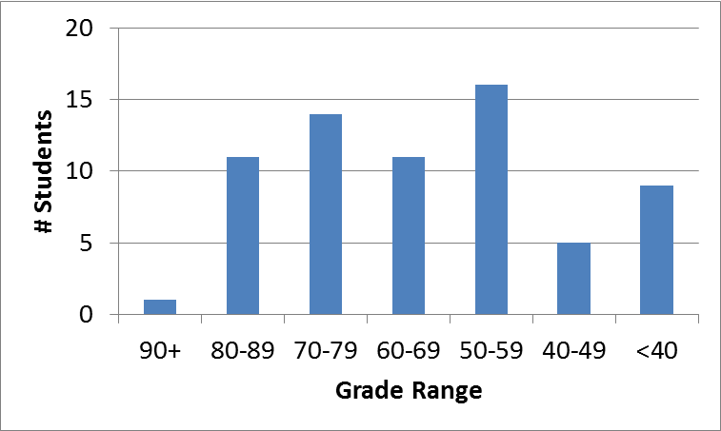
Exam stats & grade distribution
Average: 62.6/90
Median: 65/90
Std. deviation: 18.1
Max: 90
Question-by-question averages:
  Q1: 17.7 / 20 (83%)
  Q2: 22.8 / 30 (76%)
  Q3: 22.1 / 40 (55%)
Extra credit
  33 students completed
  3.0 average
ECE Application Programming: Exam 2 Review

Slide 4
Figuring out where you stand
Programs: 60% (6/10 done; 2/10 graded)
Exams: 40% (10% + 15% + 15%)
  Change → higher grade from Exam 1/2 counts for 15%
  Take Exam 2 grade and divide by 0.9 to scale to 100 pts
~60% of your grade still to be determined
  Note: That 60% includes not-yet-graded assignments for which you’ll have a chance to submit regrades
  Remember, max late penalty = 32 pts
Estimating your grade
  Program avg (PA) = (total program points) / 1.5
  Exam avg (EA) =
  ((min(E1, E2)) + (max(E1, E2) * 1.5)) / 2.5
  Overall avg = PA * 0.6 + EA * 0.4
ECE Application Programming: Exam 2 Review

Slide 5
Figuring out where you stand
Estimated avg = PA * 0.6 + EA * 0.4
Current course avg (will change):
  Without extra credit: ~84%, SD = 15
  With extra credit: ~85%, SD = 15
  Note: exam averages 75.2 and 62.6/90
Likely avg down, SD up once grades/regrades done
May be curve, but do not assume there will be
Typical grading scale without curve
  A: 93+
  A-: 90-92
  B+: 88-89
  B: 83-87
  B-: 80-82
  C+: 78-79
  C: 73-77
  C-: 70-72
  D+: 68-69
  D: 60-67
  F: < 60
ECE Application Programming: Exam 2 Review

Slide 6
Final notes
Next time
  File I/O
Reminders:
  Program 7 due 4/13
ECE Application Programming: Lecture 26

