Slide 1
16.216
ECE Application Programming
Instructor: Dr. Michael Geiger
Summer 2014
Lecture 11:
Dynamically allocated data structures
Exam 3 Preview

Slide 2
Lecture outline
Announcements/reminders
  Will drop lowest program score (keep 9 of 10)
  Program 9 due today
  Program 10 due 12:00 noon, 6/27
  Final deadline for all program submissions (original and regrades): 12:00 noon, 6/28
  Final Exam: Thursday, 6/26
Review
  Structures
  Dynamic memory allocation
Today’s lecture
  Dynamic allocation and data structures: linked list
  Discussion of Program 10
  Exam 3 Preview
ECE Application Programming: Lecture 11

Slide 3
Review: Structures
User-defined types; example:
typedef struct {
char first[50];
char middle;
char last[50];
unsigned int ID;
double GPA;
} StudentInfo;
Can define variables of that type
  Scalar: StudentInfo student1;
  Array: StudentInfo classList[10];
  Pointer: StudentInfo *sPtr;
Access members using
  Dot operator: student1.middle = ‘J’;
  Arrow (if pointers): sPtr->GPA = 3.5;
Typically passed to functions by address
ECE Application Programming: Lecture 11

Slide 4
Review: dynamic memory allocation
Basic block allocation:
void *malloc(size_t size);
Allocate block and clear it:
void *calloc(size_t nmemb,
size_t size);
Resize previously allocated block:
void *realloc(void *ptr,
size_t size);
Deallocation function:
void free(void *ptr);
ECE Application Programming: Lecture 11

Slide 5
Review: dynamic memory allocation
Pitfalls:
  Memory leaks: must free memory before changing pointer
  Dangling pointers: reassign pointer after calling free()
Dynamically allocated array
arr = (int *)malloc(n * sizeof(int));
  Can then use array notation: arr[i] = 0;
Note that return value from allocation functions must be type cast to correct type
ECE Application Programming: Lecture 11

Slide 6
Review
1-D array
arr = (int *)malloc(n * sizeof(int));
  Can then use array notation: arr[i] = 0;
String containing n characters
str = (char *)malloc(n + 1);
2-D array
  Data type: “pointer to pointer”: int **twoDarr;
  1st dimension depends on # rows
    twoDarr = (int **)malloc(nRows * sizeof(int *));
  2nd dimension depends on # columns
    Must allocate for each row
    for (i = 0; i < nRows; i++)
    twoDarr[i] = (int *)malloc(nCols * sizeof(int));
ECE Application Programming: Lecture 11

Slide 7
Dynamic allocation and structures
Can use sizeof() to get # bytes in structure
Examples (using StudentInfo struct):
StudentInfo *p;
p = (StudentInfo *)malloc(sizeof(StudentInfo));
StudentInfo *arr;
int n;
printf("Enter array size: ");
scanf("%d", &n);
arr = (StudentInfo *)malloc(n * sizeof(StudentInfo));
ECE Application Programming: Lecture 11

Slide 8
Data structures
Data structure: way of storing and organizing data
  Arrays are one relatively inefficient example
Other structures designed to optimize:
  Organizing / sorting data
  Adding new data
  Removing unwanted data
  Searching for data
ECE Application Programming: Lecture 11

Slide 9
Pointer-based data structures
Many structures extensively use pointers
Each element within structure contains data + pointer(s) to one or more other elements
Usually functions for common operations
  Add new element
    Dynamically allocate new element
    Modify appropriate pointer(s) in other element(s) to point to new element
    Set pointer(s) in new element to point to other(s)
  Delete element
    Modify pointer(s) in other element(s) so they don’t point to element being removed
    Deallocate removed element
  Find element
    Follow pointers to move from one element to next
ECE Application Programming: Lecture 11

Slide 10

Linked list
Simple pointer-based structure: linked list
Each element (node) contains data + pointer to next element in list
Last element points to NULL
Program using list needs pointer to first node
Image source: http://en.wikipedia.org/wiki/Linked_list
ECE Application Programming: Lecture 11

Slide 11
Linked list definition
Structure to hold list of integers
typedef struct node {
int value; // Data
struct node *next; // Pointer to
// next node
} LLnode;
Note definition style has changed slightly
  Type “name” both before and after { }
  Name before (struct node) is necessary to use type inside structure definition
  Name after (LLnode) can be used in rest of program
ECE Application Programming: Lecture 11

Slide 12
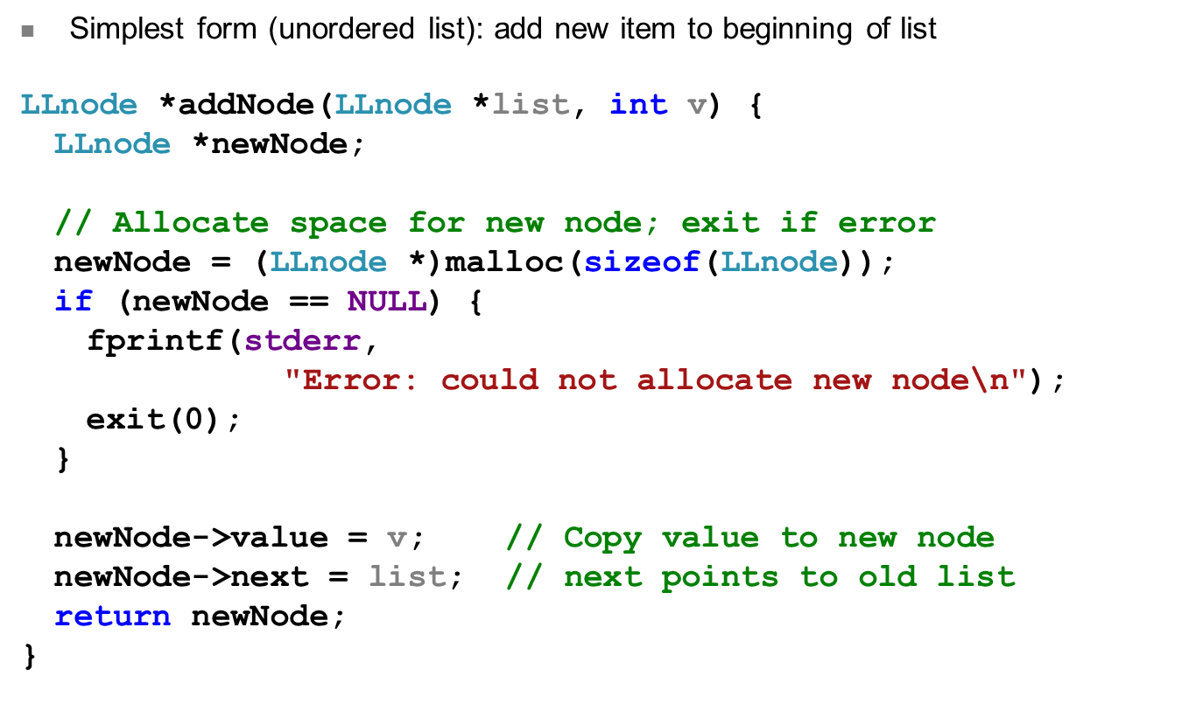
Adding to list
ECE Application Programming: Lecture 11

Slide 13
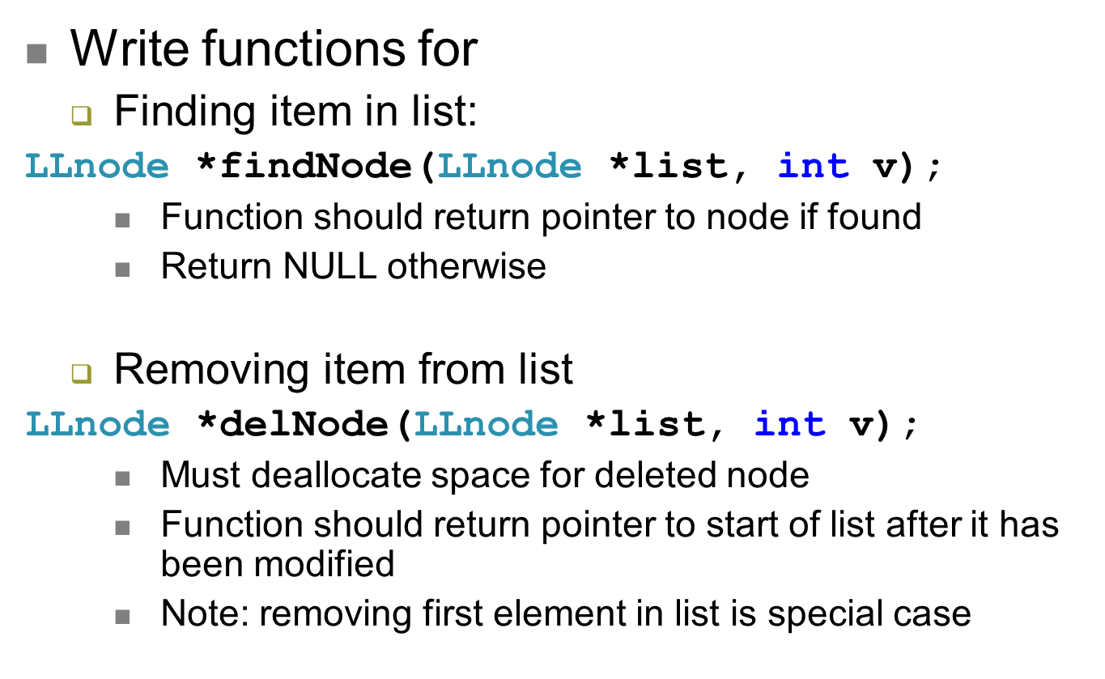
Examples
ECE Application Programming: Lecture 11

Slide 14
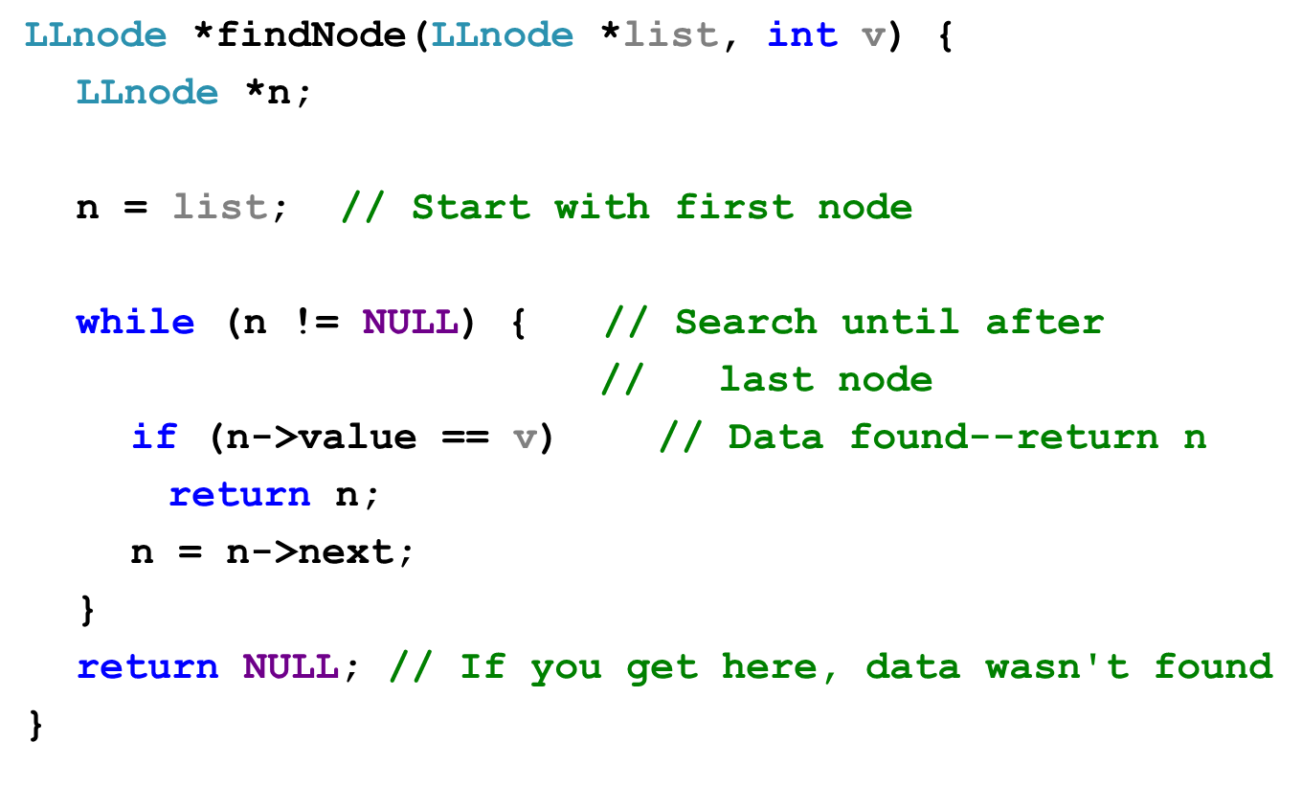
Solution
ECE Application Programming: Lecture 11

Slide 15
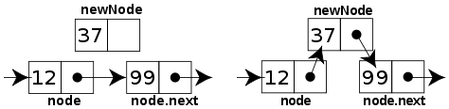
Sorted linked list
Can ensure each item is sorted as it’s added
  Slower item insertion, but faster search
Not easy with arrays: must move existing data
Keeping linked list sorted
  Find appropriate location
    Often done by going “past” appropriate spot
  Modify pointers
    Node before correct spot points to new node
    New node points to node after correct spot
    Image source: http://en.wikipedia.org/wiki/Linked_list
ECE Application Programming: Lecture 11

Slide 16
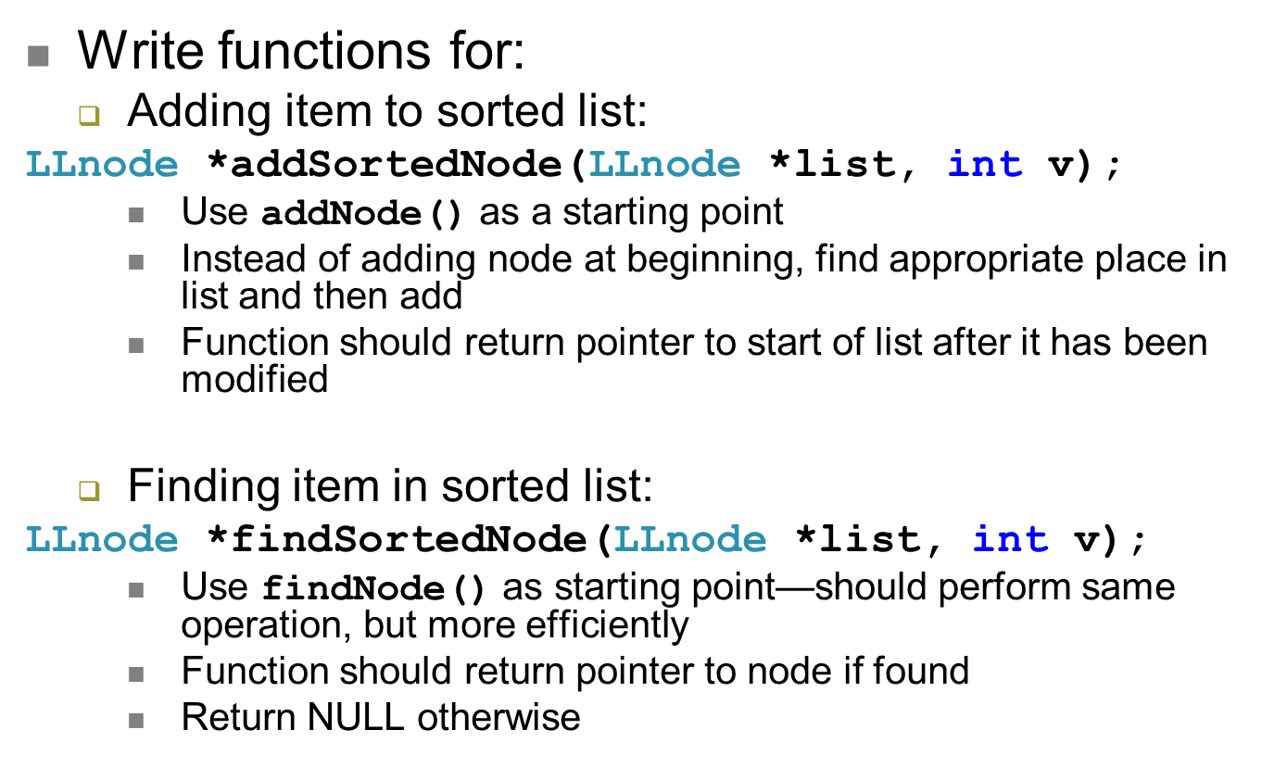
Examples
ECE Application Programming: Lecture 11

Slide 17
Exam 3 notes
Allowed one 8.5” x 11” two-sided note sheet
  No other notes or electronic devices
Exam lasts 3 hours (but is written for ~50 min)
Covers all lectures after Exam 2
Format similar to Exams 1/2
  1 multiple choice problem (likely dynamic memory allocation, although that topic may show up elsewhere)
  1 code reading problem
  1 code writing problem
Can look at old exams on web
  Note that coverage differs from semester to semester
ECE Application Programming: Lecture 11

Slide 18
Review: File I/O
Open file: FILE *fopen(filename, file_access)
Close file: fclose(file_handle)
Formatted I/O:
  fprintf(file_handle, format_specifier, 0+ variables)
  fscanf(file_handle, format_specifier, 0+ variables)
Unformatted I/O:
  size_t fwrite(pointer, element size, # elements, file_handle)
  size_t fread(pointer, element size, # elements, file_handle)
Check for EOF using either fscanf() result or feof(FILE *)
ECE Application Programming: Lecture 11

Slide 19
Review: General I/O (cont.)
Character I/O
  int fputc(int c, FILE *stream);
  int putchar(int c);
  int fgetc(FILE *stream);
  int getchar();
  int ungetc(int c, FILE *stream);
Line I/O
  int fputs(const char *s, FILE *stream);
  int puts(const char *s);
  char *fgets(char *s, int n, FILE *stream);
  char *gets(char *s);
ECE Application Programming: Lecture 11

Slide 20
Review: bit manipulation
Bitwise operators: | & ^ ~
  Used for desired logical operations
  Used to set/clear bits
Bit shifts: << >>
  Used to shift bits into position
  Used for multiplication/division by powers of 2
Common operations
  Setting/clearing/flipping individual bit
  Setting/clearing/flipping multiple bits
  Extracting bits
ECE Application Programming: Lecture 11

Slide 21
Review: hexadecimal output
To print a number in hex, use %x or %X
  %x prints characters a-f in lowercase
  %X prints characters A-F in uppercase
To show leading 0x, use the # flag
To show leading 0s, use precision with total # chars
  Field width + 0 flag also works unless value = 0
Examples (assume var1 = 0x1A2B)
  printf(“%x”, var1) → 1a2b
  printf(“%X”, var1) → 1A2B
  printf(“%#x”, var1) → 0x1a2b
  printf(“%.6x”, var1) → 001a2b
  printf(“%#.6x”, var1) → 0x001a2b
ECE Application Programming: Lecture 11

Slide 22
Review: Structures
User-defined types; example:
typedef struct {
char first[50];
char middle;
char last[50];
unsigned int ID;
double GPA;
} StudentInfo;
Can define variables of that type
  Scalar: StudentInfo student1;
  Array: StudentInfo classList[10];
  Pointer: StudentInfo *sPtr;
Access members using
  Dot operator: student1.middle = ‘J’;
  Arrow (if pointers): sPtr->GPA = 3.5;
Typically passed to functions by address
ECE Application Programming: Lecture 11

Slide 23
Review: dynamic memory allocation
Basic block allocation:
void *malloc(size_t size);
Allocate block and clear it:
void *calloc(size_t nmemb,
size_t size);
Resize previously allocated block:
void *realloc(void *ptr,
size_t size);
Deallocation function:
void free(void *ptr);
ECE Application Programming: Lecture 11

Slide 24
Review: dynamic memory allocation
Pitfalls:
  Memory leaks: must free memory before changing pointer
  Dangling pointers: reassign pointer after calling free()
Dynamically allocated array
arr = (int *)malloc(n * sizeof(int));
  Can then use array notation: arr[i] = 0;
Note that return value from allocation functions must be type cast to correct type
ECE Application Programming: Lecture 11

Slide 25
Review: dynamically allocated arrays
1-D array
arr = (int *)malloc(n * sizeof(int));
  Can then use array notation: arr[i] = 0;
2-D array
  Data type: “pointer to pointer”: int **twoDarr;
  1st dimension depends on # rows
    twoDarr = (int **)malloc(nRows * sizeof(int *));
  2nd dimension depends on # columns
    Must allocate for each row
    for (i = 0; i < nRows; i++)
    twoDarr[i] = (int *)malloc(nCols * sizeof(int));
ECE Application Programming: Lecture 11

Slide 26
Review: pointer-based data structures
Data structures to optimize data organization
Structure containing pointer(s) to other structure
  Adding data: allocate space for new node, then adjust pointers
  Deleting data: adjust pointers, then free space for node
Example: linked list
typedef struct node {
int value; // Data
struct node *next; // Pointer to
// next node
} LLnode;
    Image source: http://en.wikipedia.org/wiki/Linked_list
ECE Application Programming: Lecture 11

Slide 27
Review: Adding to list
ECE Application Programming: Lecture 11

Slide 28
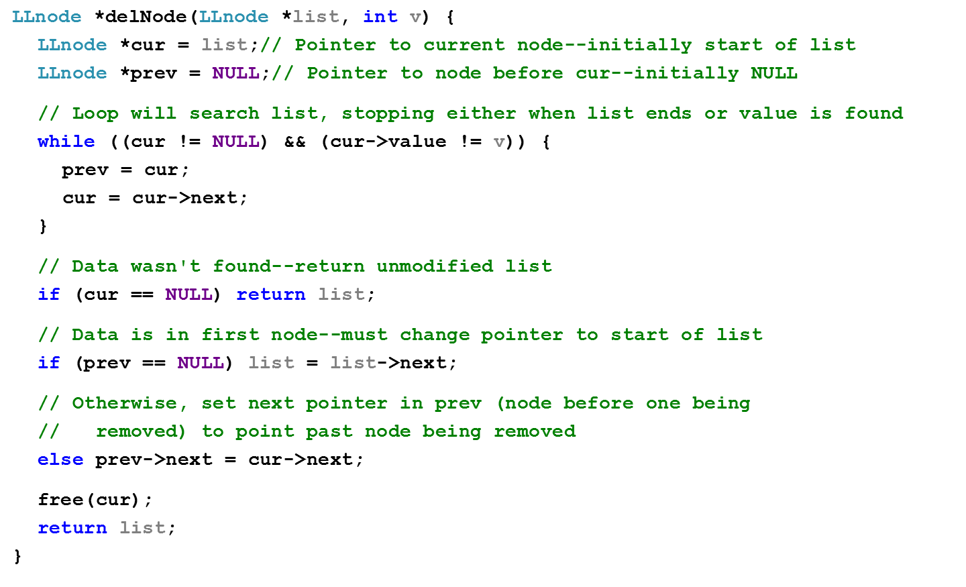
Review: deleting from list
ECE Application Programming: Lecture 11

Slide 29
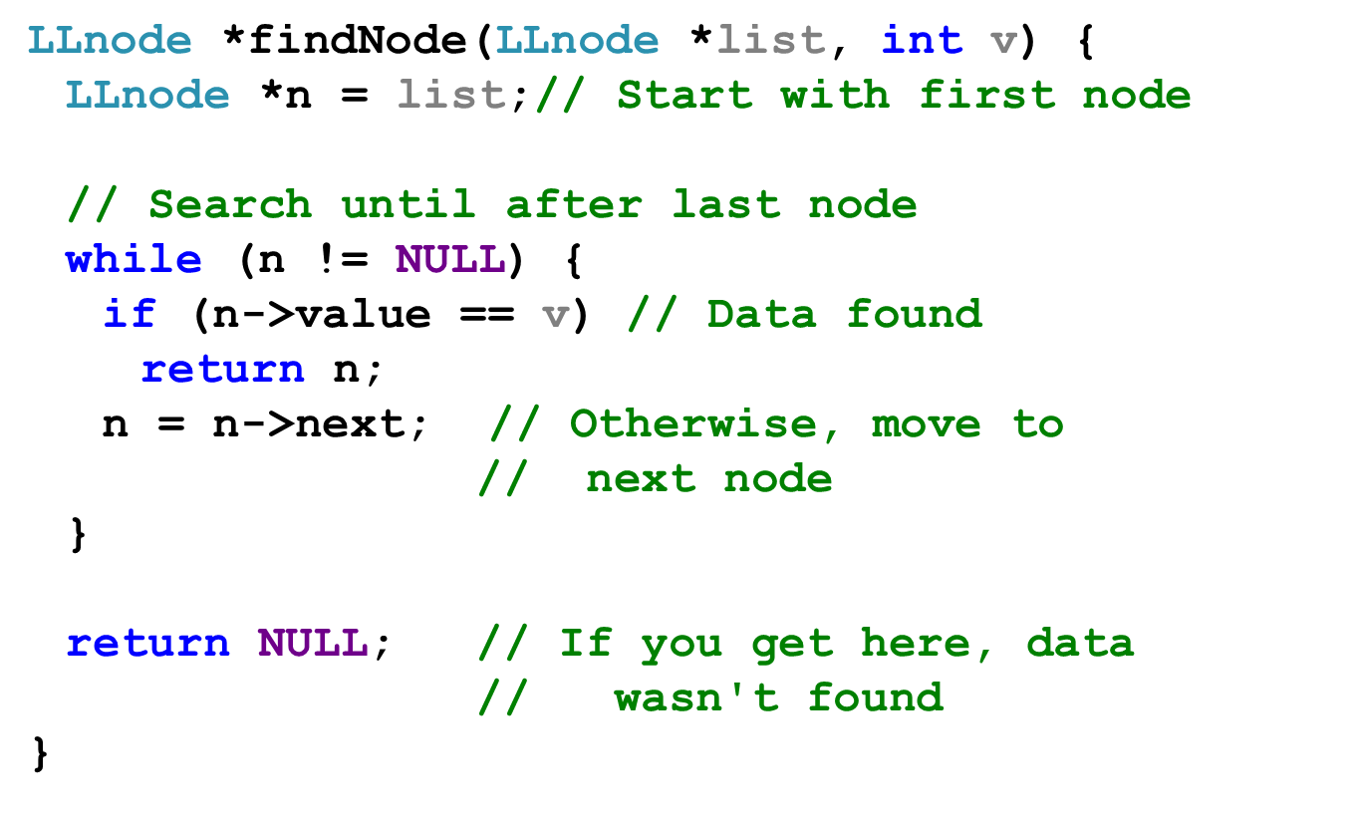
Review: finding data in list
ECE Application Programming: Lecture 11

Slide 30
Final notes
Next time:
  Exam 3
Reminders:
  Will drop lowest program score (keep 9 of 10)
  Program 9 due today
  Program 10 due 12:00 noon, 6/27
  Final deadline for all program submissions (original and regrades): 12:00 noon, 6/28
  Final Exam: Thursday, 6/26
ECE Application Programming: Lecture 11

