Slide 1
16.317
Microprocessor Systems Design I
Instructor: Dr. Michael Geiger
Fall 2012
Lecture 23:
Exam 2 Preview

Slide 2
Lecture outline
Announcements/reminders
  HW 3 solution to be posted tonight
  Lab 2 due 11/14
  Exam 2: Wednesday, 11/7
Today’s lecture: Exam 2 Preview
Microprocessors I: Exam 2 Preview

Slide 3
Exam 2 notes
Allowed
  One 8.5” x 11” double-sided sheet of notes
  Calculator
No other notes or electronic devices (phone, laptop, etc.)
Exam will last 50 minutes
Covers all lectures after Exam 1
Format similar to previous exam
  1 multiple choice question
  2 short problems to solve/code sequences to evaluate
Microprocessors I: Exam 2 Preview

Slide 4
Review: subroutines
Subroutines: low-level functions
  When called, address of next instruction saved
    Return instruction ends routine; goes to that point
  May need to save state on stack
80386 specifics
  CALL <proc>: call procedure
    <proc> can be label (16-/32-bit imm), reg, mem
  RET: return from procedure
  Saving state to stack: push instructions
    Store data “above” current TOS; decrement SP
    Basic PUSH stores word or double word
    Directly storing flags: PUSHF
    Storing all 16-/32-bit general purpose registers: PUSHA/PUSHAD
  Restoring state: POP/POPF/POPA/POPAD
Microprocessors I: Exam 2 Preview

Slide 5
Review: protected mode
Protected mode
  Supports memory management, multitasking, protection
  Changes in control/flag registers, IP, memory accesses
Selectors: pointers into descriptor tables
  Contains requested privilege, global/local, and table index
Descriptors: provide info about segments
  8 bytes in length
  4 bytes: base address
  2 bytes: limit (max offset within segment)
    Segment size = (limit + 1) bytes
  2 bytes: access info (privilege, R/W, executable, etc.)
Microprocessors I: Exam 2 Preview

Slide 6
Review (cont.)
Descriptors stored in descriptor tables
  Specific memory range dedicated to table
  GDTR points to global descriptor table
    Contains base address, limit for GDT
  LDTR cache points to global descriptor table
    Contains base address, limit for current LDT
    Values loaded from entry in GDT, pointed to by LDTR
Global memory access
  Selector indicates access is global (TI == 0)
  Index field in selector chooses descriptor from GDT
  Descriptor provides starting address of segment
Local memory access
  Selector indicates access is local (TI == 1)
  Index field in selector chooses descriptor from LDT
  Descriptor provides starting address of segment
Microprocessors I: Exam 2 Preview

Slide 7
Review: HLL → Assembly
Data accesses
  Allocate enough space to hold data (int = 4 bytes)
  Function arguments passed on stack
  Local variables allocated on stack
  Use base pointer (BP/EBP) to access locations inside stack
Array accesses: scaled addressing
  A[i] → (base address of A) + (i * # bytes)
Conditional statements
  Conditional jump to “if” code
  “Else” code contains jump to end
Loops
  Initialize index
  Check condition
  At end, change index
Microprocessors I: Exam 2 Preview

Slide 8
Review: Microcontroller/PIC basics
Microcontrollers: CPU integrated with storage, I/O devices
  Examples
    Timers/event counters
    Parallel & serial ports
    Clock generator
    Analog to digital converter
  Benefits: low cost/low power, easy to program
  Limitations: storage, computational power
Introduced PIC 16F684 microcontroller
  14 pins—12 multiplexed I/O + power/ground
  All computations using 2 values use accumulator
  Harvard memory architecture
  Memory divided into SFR / GPR
  Dedicated 8-entry system stack for return addresses (subroutines/interrupts)
Microprocessors I: Exam 2 Preview

Slide 9
Review: PIC Data Memory Organization
Made up of SFRs and GFRs
Banking: 128 byte chunks
  Max offset within bank 0x7f
  Controller may have 2 or 4 banks
Addressing Modes
  Direct addressing:
    7 bit address (within bank)
    RP1:RP0 selects bank
  Indirect addressing:
    Access to INDF causes indirect addressing
    Actual memory address in IRP+FSR
I/O ports
  Control register (e.g. TRISA) controls direction of each pin
    Bit = 1 → input, Bit = 0 → output
  Data register (e.g. PORTA) contains actual port state
Microprocessors I: Exam 2 Preview

Slide 10
Review: PIC instructions
Four instruction formats
  Upper bits of all hold opcode
  Byte-oriented includes 1 bit destination, 7 bit direct address
  Bit-oriented includes 3 bit position (0-7), 7 bit direct address
  Literal/control includes 8 bit literal
  CALL/GOTO includes 11 bit literal
Variable declarations
  cblock <start_address>: start of variable declarations
  All names between cblock/endc directives assigned to consecutive bytes starting at <start_address>
Microprocessors I: Exam 2 Preview

Slide 11
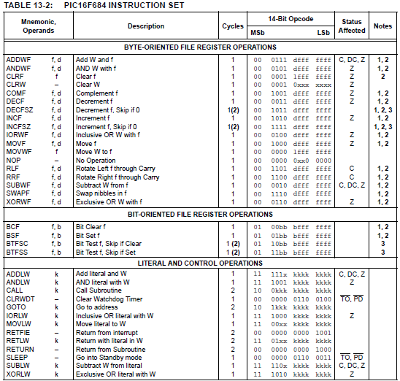
Microprocessors I: Exam 2 Preview

Slide 12
Review: PIC instructions (cont.)
Clearing register: clrw/clrf
Moving values: movlw/movwf/movf
Swap nibbles: swapf
Single bit manipulation: bsf/bcf
Unary operations: incf/decf/comf
Arithmetic: addlw/addwf/sublw/subwf
Microprocessors I: Exam 2 Preview

Slide 13
Review: PIC instructions (cont.)
Logical operations
  andlw/andwf
  iorlw/iorwf
  xorlw/xorwf
Rotates
  rrf
  rlf
Jumps/calls/return
  goto
  call
  return/retlw/retfie
Miscellaneous
  nop
  sleep/clrwdt
Conditional execution
  Test bit and skip next instruction if clear/set: btfsc/btfss
  Increment/decrement register and skip next instruction if zero: incfsz/decfsz
Example use: combined with goto to create conditional jump
Microprocessors I: Exam 2 Preview

Slide 14
Final notes
Next time: Exam 2
  Allowed one 8.5” x 11” double-sided note sheet
  Allowed to use calculator
  No other notes or electronic devices allowed
Microprocessors I: Exam 2 Preview

