Slide 1
16.317
Microprocessor Systems Design I
Instructor: Dr. Michael Geiger
Fall 2013
Lecture 27:
PIC instruction set

Slide 2
Lecture outline
Announcements/reminders
  HW 6 to be posted; due date TBD
  Exam regrade requests due today
Today’s lecture: PIC instructions
Microprocessors I: Lecture 27

Slide 3
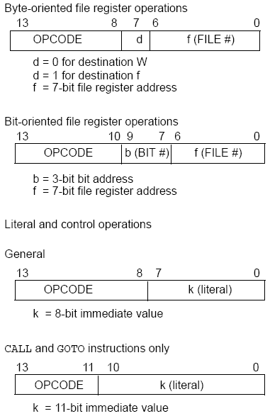
PIC16F684
Instructions
35 instructions
Each instruction is 14 bits
Byte-oriented OPCODE f, F(W)
  Source f: name of a SFR or a RAM variable
  Destination F(W):
    F if the destination is to be the same as the source register
    W if the destination is to be the working register
Bit-oriented OPCODE f, b
  Bit address b (0≤b≤7)
Literal and control OPCODE k
  Literal value k
Microprocessors I: Lecture 27
Notes:
Chapter 9

Slide 4
RAM variables
Memory variable: symbolic name to refer to space in memory (GPRs)
  Usable space on 16F684: 0x20–0x7F (Bank 0), 0xA0 – 0xBF (Bank 1)
  Once declared, use symbolic name, not address
Example PIC syntax (cblock/endc):
  cblock 0x20 ; cblock directive needs starting
  ; address
  var1 ; var1 = byte at 0x20
  var2 ; var2 = byte at 0x21
  var3 ; var3 = byte at 0x22
  endc ; End of variable block
Microprocessors I: Lecture 27

Slide 5
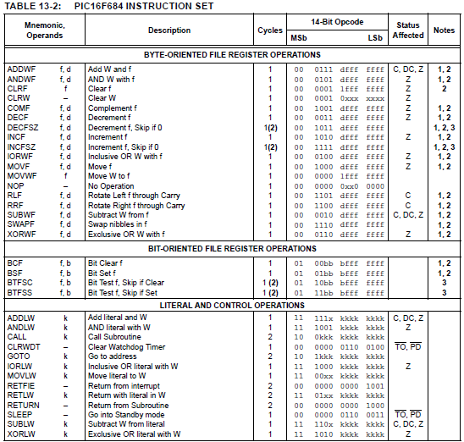
Microprocessors I: Lecture 27

Slide 6
Clear/Move
clrw ; Clear W register
clrf f ; Clear f register
movlw k ; move literal value k to W
movwf f ; move W to f
movf f, F(W) ; move f to F or W
swapf f, F(W) ; swap nibbles of f, putting result in F or W
STATUS bits:
clrw, clrf, movf: Z
movlw, movwf, swapf: none
Examples:
clrf TEMP1 ;Clear variable TEMP1
movlw 5 ;load 5 into W
movwf TEMP1 ;move W into TEMP1
movwf TEMP1, F ;Incorrect Syntax
movf TEMP1, W ;move TEMP1 into W ;
movf TEMP1, TEMP2 ;Incorrect Syntax
swapf TEMP1, F ;Swap 4-bit nibbles of TEMP1
swapf TEMP1, W ;Move TEMP1 to W, swap nibbles, leave TEMP1 unchanged
Microprocessors I: Lecture 27
Notes:
Chapter 9

Slide 7
Single Bit Manipulation
bcf f,b
Operation: Clear bit b of register f, where b=0 to 7
bsf f,b
Operation: Set bit b of register f, where b=0 to 7
STATUS bits:
none
Examples:
bcf PORTB, 0 ;Clear bit 0 off PORTB
bsf STATUS, C ;Set the Carry bit
bcf STATUS, RP1 ;
bsf STATUS, RP0 ;Select Bank 1
Microprocessors I: Lecture 27
Notes:
Chapter 9

Slide 8
Example
Show the values of all changed registers after the following sequence
cblock 0x30
x
y
endc
clrw
movwf x
movlw 0xFE
movwf y
swapf y, F
bcf y, 3
bsf x, 3
movf y, W
Microprocessors I: Lecture 27

Slide 9
Example solution
clrw → W = 0x00
movwf x → x = W = 0x00
movlw 0xFE → W = 0xFE
movwf y → y = W = 0xFE
swapf y, F → Swap nibbles of y → y = 0xEF
bcf y, 3 → Clear bit 3 of y = 1110 1111₂
→ y = 1110 0111₂ = 0xE7
bsf x, 3 → Set bit 3 of x
→ x = 0000 1000₂ = 0x08
movf y, W → W = y = 0xE7
Microprocessors I: Lecture 27

Slide 10
Increment/Decrement/
Complement
incf f, F(W) ; increment f, putting result in F or W
decf f, F(W) ;decrement f, putting result in F or W
comf f, F(W) ;complement f, putting result in F or W
STATUS bits:
Z
Examples:
incf TEMP1, F ;Increment TEMP1
incf TEMP1, W ;W <- TEMP1+1; TEMP1 unchanged
decf TEMP1, F ;Decrement TEMP1
comf TEMP1, F ;Change 0s and 1s to 1s and 0s
Microprocessors I: Lecture 27
Notes:
Chapter 9

Slide 11
Addition/Subtraction
addlw k ;add literal value k into W
addwf f, F(W) ;add w and f, putting result in F or W
sublw k ;subtract W from literal value k, putting
;result in W
subwf f, F(W) ;subtract W from f, putting result in F or W
STATUS bits:
C, DC, Z
Examples:
addlw 5 ; W <= 5+W
addwf TEMP1, F ; TEMP1 <- TEMP1+W
sublw 5 ; W <= 5-W (not W <= W-5 )
subwf TEMP1, F ; TEMP1 <= TEMP1 - W
Microprocessors I: Lecture 27
Notes:
Chapter 9

Slide 12
Example
Show the values of all changed registers after the following sequence
cblock 0x20
varA
varB
varC
endc
clrf varA
clrf varB
clrf varC
incf varA, W
sublw 0x0F
addwf varB, F
decf varB, F
comf varB, W
subwf varC, F
Microprocessors I: Lecture 27

Slide 13
Example solution
clrf varA → varA = 0
clrf varB → varB = 0
clrf varC → varC = 0
incf varA, W → W = varA + 1 = 1
sublw 0x0F → W = 0x0F – W = 0x0F – 1
= 0x0E
addwf varB, F → varB = varB + W = 0x0E
decf varB, F → varB = varB – 1 = 0x0D
comf varB, W → W= ~varB = ~0x0D = 0xF2
subwf varC, F → varC = varC – W = 0x0E
Microprocessors I: Lecture 27

Slide 14
Final notes
Next time:
  Continue PIC instruction set
Reminders:
  HW 6 to be posted; due date TBD
  Exam regrade requests due today
Microprocessors I: Lecture 27

