Slide 1
16.317
Microprocessor Systems Design I
Instructor: Dr. Michael Geiger
Fall 2013
Lecture 3:
Addressing modes
x86 introduction

Slide 2
Lecture outline
Announcements/reminders
  HW 1 posted; due 9/16
  Sign up for the course discussion group on Piazza!
Review
  Role of the ISA
  Data types
  Data storage
Today’s lecture
  Memory issues: alignment and endianness
  Addressing modes
  x86 introduction
Microprocessors I: Lecture 2

Slide 3
Review: instruction set architecture
Defines how programmer interfaces with hardware
Operations generally fall into one of four groups
  Data transfer: move data across storage locations
  Arithmetic: add, subtract, etc.
  Logical: AND, OR, shifts, etc.
  Program control: jumps/branches/calls
Operands: the data being operated on
  How are the bits interpreted? (int, FP, signed/unsigned)
  What size are they? (byte, word, etc.)
  How do we reference operands?
Instruction formats: how instructions are encoded
Microprocessors I: Lecture 2

Slide 4
Review: data storage
Registers
  Small, fast set of on-chip storage (primarily for speed)
  Referenced by name
Memory
  Larger, slower set of storage (primarily for capacity)
  Organized as hierarchy …
  … but programmer references single range of addresses
Microprocessors I: Lecture 2

Slide 5
Memory (continued)
Accessing single byte is easy
Considerations with multi-byte data
  Are the data aligned?
    Easier/faster to access aligned data
  How are the data organized in memory (“endianness”)?
    Given 32-bit number: DEADBEEFH or 0xDEADBEEF
    Which byte—MSB (0xDE) or LSB (0xEF) gets stored in memory first?
Microprocessors I: Lecture 1

Slide 6
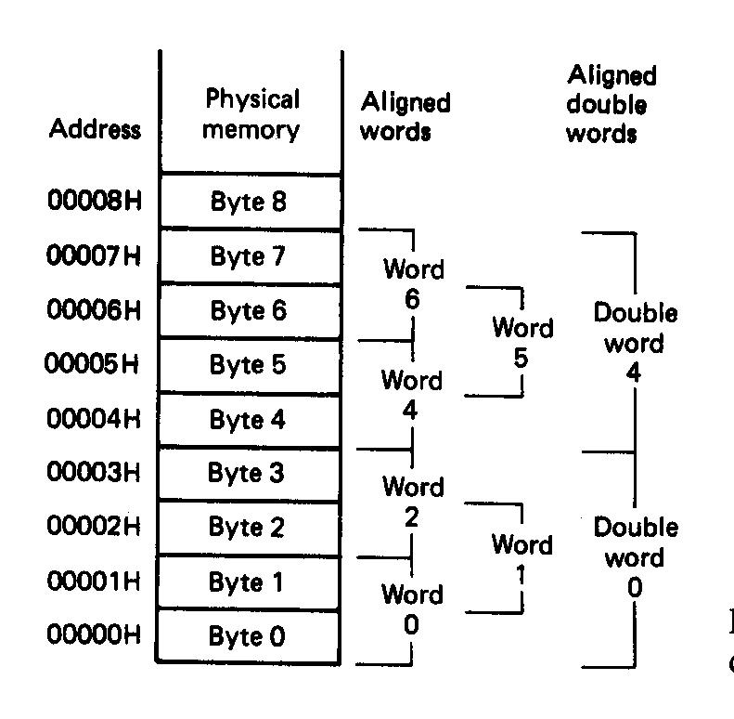
Aligned Words, Double words
Aligned data: address is divisible by number of bytes
  2 bytes → address must be even
  4 bytes → address must be multiple of 4
In figure at left
  Words 0, 2, 4, 6 aligned
  Double words 0, 4 aligned
  “Word X” = word with starting address X
Microprocessors I: Lecture 1
Notes:
Chapter 2

Slide 7
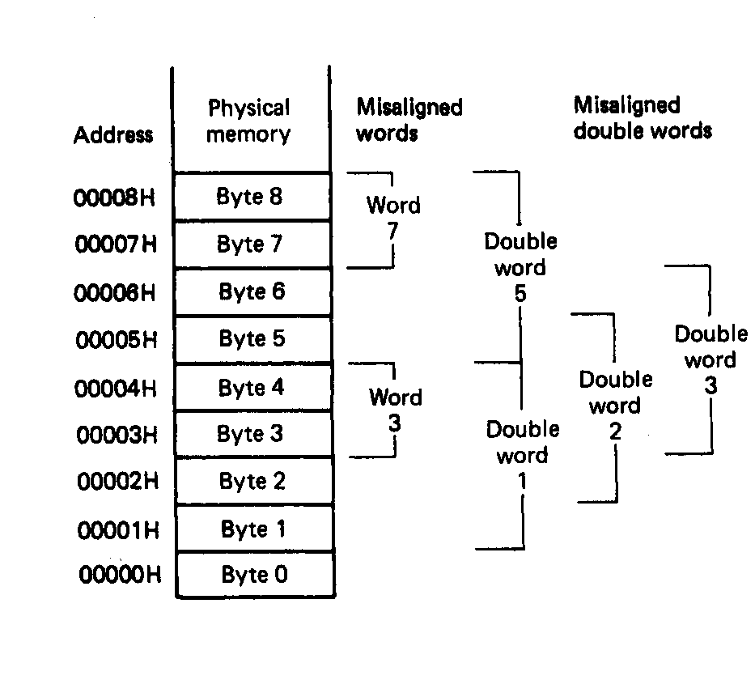
Misaligned Words
x86 architecture doesn’t require aligned data access
In figure, misaligned data:
  Words 3, 7
  Double words 1, 2, 3, 5
Performance impact for accessing unaligned data in memory (32-bit data bus)
Microprocessors I: Lecture 1
Notes:
Chapter 2

Slide 8
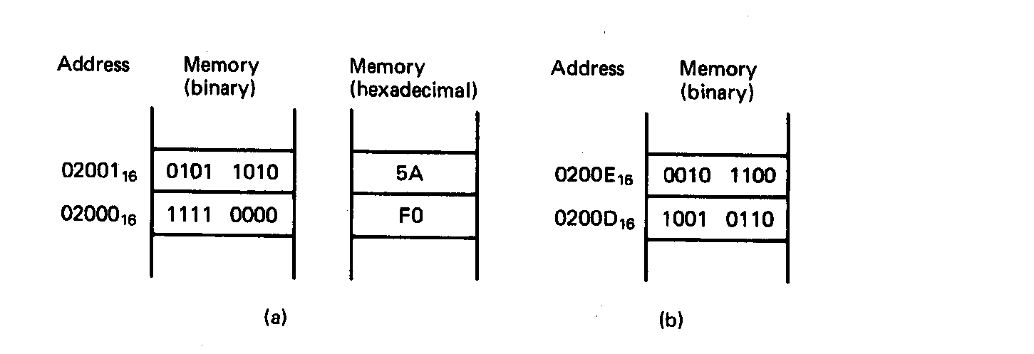
Examples of Words of Data
“Little endian” organization
Most significant byte at high address
Least significant byte at low address
Example [Fig. 2.5 (a)]
(02001₁₆) = 0101 1010₂=5AH= MS-byte
(02000₁₆) = 1111 0000₂=F0H= LS-byte
as a word they give
01011010 11110000₂=5AF0H
Microprocessors I: Lecture 1
Notes:
Chapter 2

Slide 9
Examples of Words of Data
What is the data word shown in this figure?
  Express your result in hexadecimal
Is the word aligned?
Answer:
  MSB = 00101100₂ = 2C₁₆
  LSB = 10010110₂ = 96₁₆
  → Full word = 2C96₁₆
  Starting address = 0200D₁₆
  → Address not divisible by 2
  → Word is not aligned
Microprocessors I: Lecture 1
Notes:
Chapter 2

Slide 10
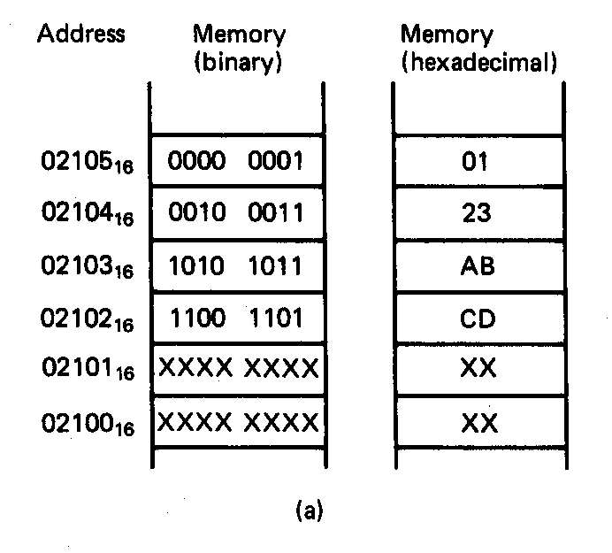
Example of Double Word
What is the double word shown in this figure?
Is it aligned?
Answer:
  LSB = CD₁₆
  MSB = 01₁₆
  → Arranging as 32-bit data:
  0123ABCD₁₆
  Starting address = 02102₁₆
  → Not divisible by 4
  → Double word is unaligned
Microprocessors I: Lecture 1
Notes:
Chapter 2

Slide 11
Addressing modes
Addressing modes: ways of specifying operand location
Where are operands stored? (3 location types)
  Registers → register addressing
    Provide name of register; value read from register
  Memory
    Provide address in memory; value read from that location
    Several modes for specifying memory address
  In the instruction → immediate addressing
Microprocessors I: Lecture 1

Slide 12
Memory addressing
Instructions accessing memory generate effective address (EA)
  Address calculated as part of instruction
  EA can be used as
    Actual memory address in a simple memory system
    Address within a particular segment in a segmented memory architecture
Effective address calculations can involve
  A constant value
  One or more values stored in registers
  Some combination of register and constant
Microprocessors I: Lecture 1

Slide 13
General memory addressing modes
Memory direct addressing
  EA = constant value encoded in instruction
Register indirect addressing
  EA = value stored in register
Base + displacement addressing
  EA = constant displacement + base register(s)
  Can have variations of this mode based on number and type of registers
Less commonly used modes on some MPUs
  Memory indirect addressing
  Scaled addressing
Microprocessors I: Lecture 1

Slide 14
x86 intro
“x86” → family of Intel processors
  Starts with 8086 processor (1978)
  Used (w/extensions) in current processors
General purpose processor
Supports use of 8, 16, 32, or 64 bit data
Allows both register and memory operands
Segmented memory architecture
Real and protected mode operation
  Protected mode supports virtual memory
Microprocessors I: Lecture 2

Slide 15
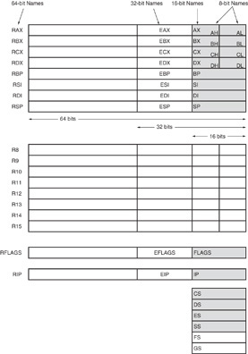
Register Set
Nine 32-bit registers
  (4) Data registers- EAX, EBX, ECX, EDX, can be used as 32, 16 or 8bit
  (2) Pointer registers- EBP, ESP
  (2) Index registers- ESI, EDI
  (1) Instruction pointer- EIP
Six 16-bit registers
  (6) Segment registers- CS, DS, SS, ES, FS, GS
Flags (status) register-EFLAGS
Microprocessors I: Lecture 2
Notes:
Chapter 2

Slide 16
Register Set
64-bit extensions
  Added with Pentium 4
  Data/pointer/index/IP/ flag register extended to 64 bits
  8 additional data registers (R8-R15)
Microprocessors I: Lecture 2
Notes:
Chapter 2

Slide 17
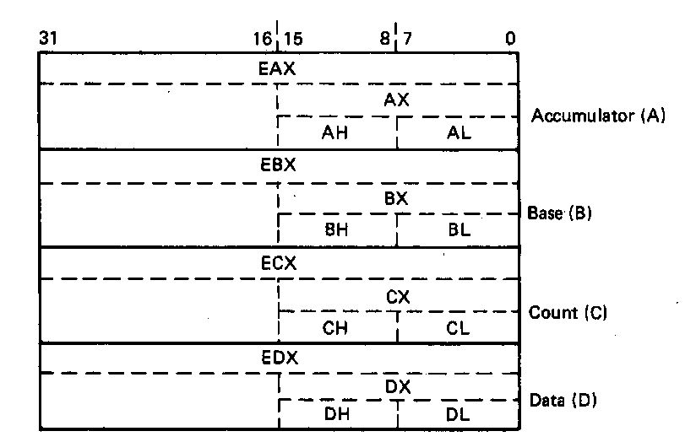
General Purpose Data Registers
Four general purpose data registers
  Accumulator (A) register
  Base (B) register
  Count (C) register
  Data (D) register
Can hold 8-bit, 16-bit, or 32-bit data
  AH/AL = high and low byte value
  AX = word value
  EAX = double word value
General uses:
  Hold data such as source or destination operands for most operations—ADD, AND, SHL
  Hold address pointers for accessing memory
Some also have dedicated special uses
  C—count for loop,
  B—table look-up translations, base address
  D—indirect I/O and string I/O
Microprocessors I: Lecture 2
Notes:
Chapter 2

Slide 18
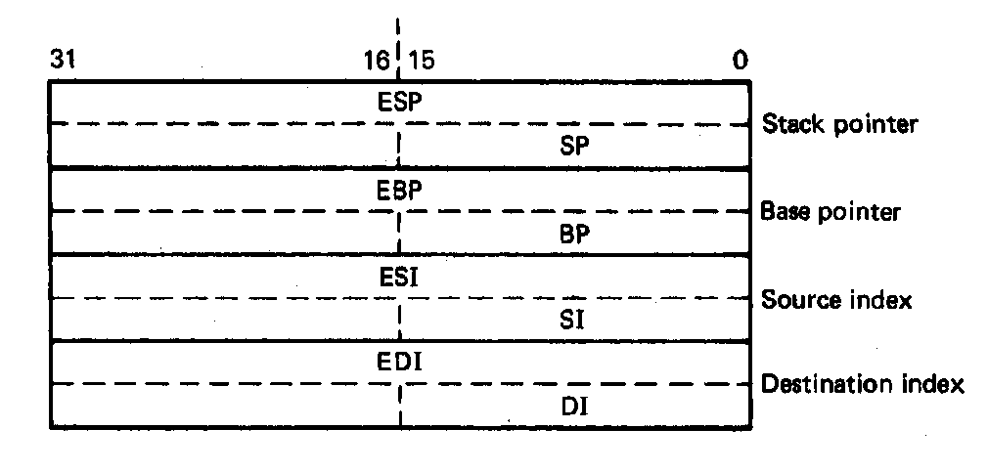
Pointer Registers
Two pointer registers
  Stack pointer register
    ESP = 32-bit extended stack pointer
    SP = 16-bit stack pointer
  Base pointer register
    EBP = 32-bit extended base pointer
    BP = 16-bit base pointer
Use to access information in stack segment of memory
  SP/BP offsets from the current value of the stack segment base address
  Select a specific storage location in the current 64K-byte stack segment
    SS:SP—points to top of stack (TOS)
    SS:BP—points to data in stack
Microprocessors I: Lecture 2
Notes:
Chapter 2

Slide 19
Index Registers
Two index registers
  Source index register
    ESI = 32-bit source index register
    SI = 16-bit source index register
  Destination index registers
    EDI = 32-bit destination index register
    DI = 16-bit destination index register
  Used to access source and destination operands in data segment of memory
    DS:SI—points to source operand in data segment
    DS:DI—points to destination operand in data segment
    Also used to access information in the extra segment (ES)
Microprocessors I: Lecture 2
Notes:
Chapter 2

Slide 20
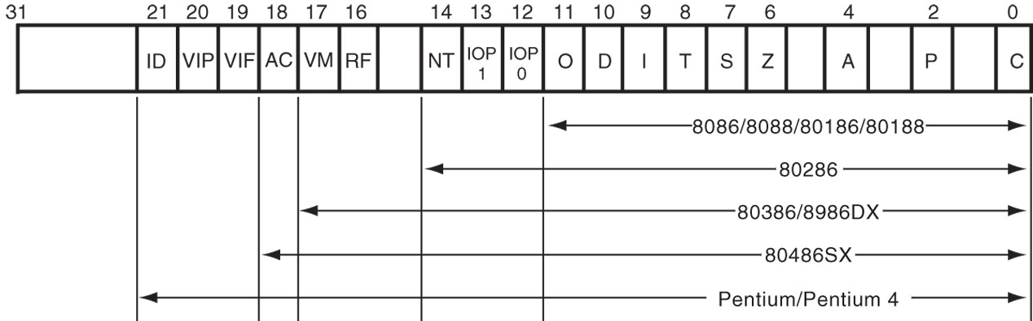
Flags Register
32-bit register holding single bit status and control information
9 active flags in real mode
Two categories
  Status flags: conditions resulting from instruction
    Most instructions update status
    Used as test conditions
  Control flags: control processor functions
    Used by software to turn on/off operating capabilities
Microprocessors I: Lecture 2
Notes:
Chapter 2

Slide 21
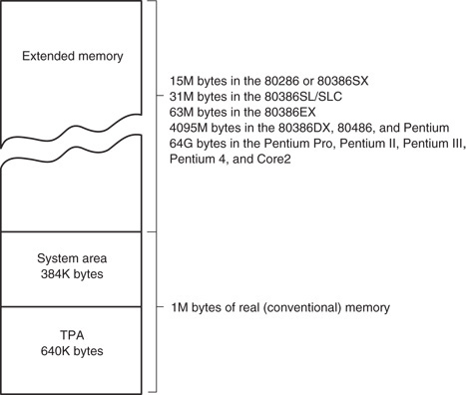
x86 memory spaces
x86 architecture implements independent memory and input/output (not shown) address spaces
Memory address space
  1 MB “real” memory
    System + transient program area (TPA)
  Extended memory size dependent on processor
Input/output address space- 65,536 bytes long (64KB)
Microprocessors I: Lecture 2
Notes:
Chapter 2

Slide 22
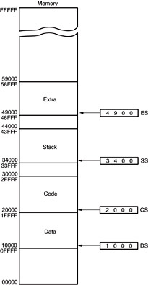
Memory segmentation
Only subset of address space is active (accessible)
Memory split into segments
  Active sections of memory
  Segments may overlap
  Segment size can be fixed (as in x86 real mode) or variable (as in protected mode)
Architecture requires register(s) to store start of active segment(s)
Microprocessors I: Lecture 2
Notes:
Chapter 2

Slide 23
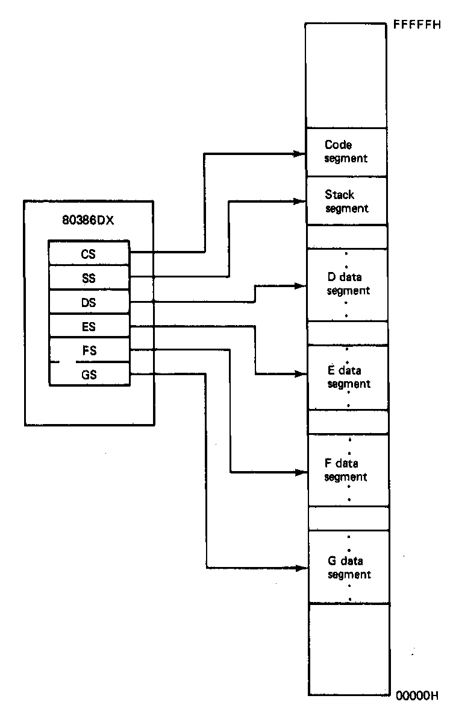
Segmentation in x86
Each real mode segment 64KB
Six programmer-controlled segment registers indicate start of each segment
Each segment must start on 16-byte boundary
  Valid starting addresses: 00000H, 00010H, 00020H, etc.
Total active memory: 384 KB
  64 KB code segment (CS)
  64 KB stack segment (SS)
  256 KB over 4 data segments (DS, ES, FS, GS)
Microprocessors I: Lecture 2
Notes:
Chapter 2

Slide 24
x86 memory addressing
Two pieces to address in segmented memory
  Starting address of segment
  Offset within segment
x86 real mode specifics
  All addresses are 20 bits
  Segment registers hold upper 16 bits of segment base address
    Where are the lower 4 bits of the base address?
      Always 0, since starting address must be divisible by 16
  Calculated effective address used as 16-bit offset
    Why is offset 16 bits?
      64KB = 2¹⁶ → 16 bit address needed to choose location within segment
Microprocessors I: Lecture 2

Slide 25
x86 memory addressing
Within instruction, address is combination of segment register/effective address
  Address of form SBA:EA
    SBA = segment base address
    EA = effective address
  EA based on addressing mode
  Address examples
    CS:IP → address of current instruction
    SS:SP → address of top of stack
    DS:0100H → address within current data segment with offset 0100H
Use this information to find linear address
  Program-generated location in memory space
Microprocessors I: Lecture 2

Slide 26
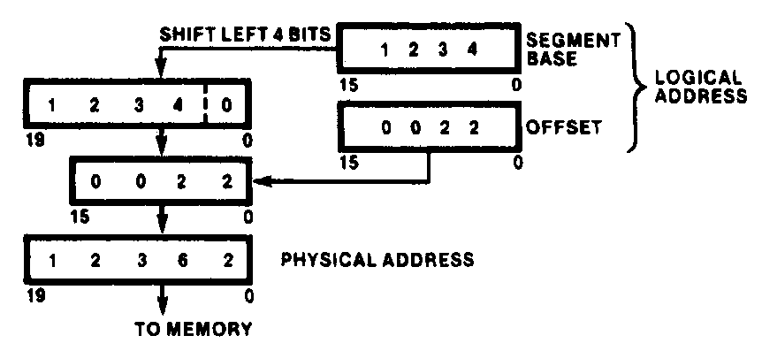
Generating Real-Mode Memory Address
  Segment base address = 1234H
  Offset = 0022H
  1234H = 0001001000110100₂
  0022H = 0000000000100010₂
  Shifting base address,
  00010010001101000000₂ = 12340H
  Adding binary segment address and offset
00010010001101000000₂ + 0000000000100010₂
= 00010010001101100010₂
    = 12362H
  In hex:
  12340H + 0022H = 12362H
Microprocessors I: Lecture 2
Notes:
Chapter 2

Slide 27
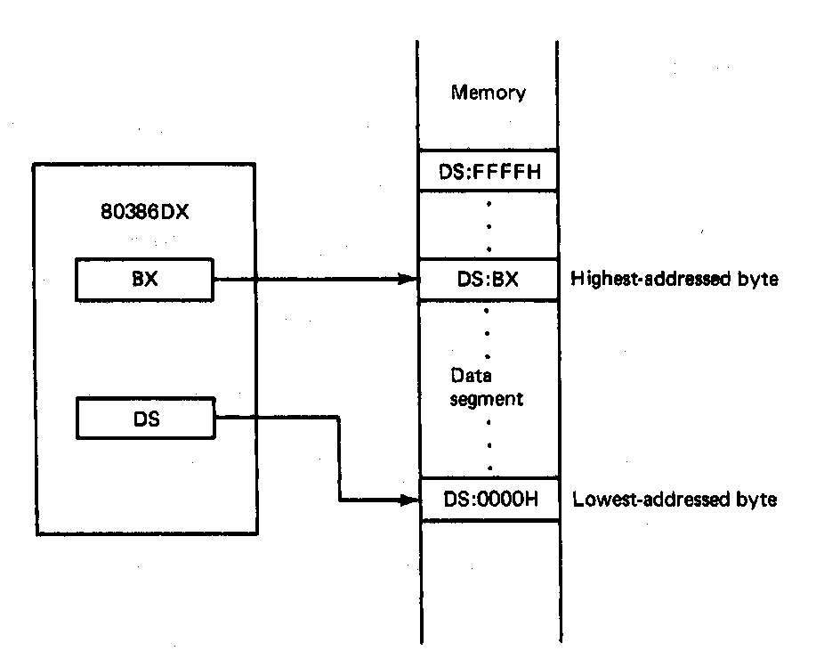
Boundaries of a Segment
Six active segments: CS, DS, ES. GS, FS, SS
  Each 64K-bytes in size → maximum of 384K-bytes of active memory
    64K-bytes for code
    64K-bytes for stack
    256K-bytes for data
Starting address of a data segment
DS:0H → lowest addressed byte
Ending address of a data segment
DS:FFFFH → highest addressed byte
Address of an element of data in a data segment
  DS:BX → address of a byte, word, or
  double word element of data in the
  data segment
Microprocessors I: Lecture 2
Notes:
Chapter 2

Slide 28
Address generation examples
Given the following register values:
  CS = 0x1000
  SS = 0x2000
  DS = 0x3000
  ES = 0x4000
  EIP = 0x00000100
  ESP = 0x0002FF00
  EBP = 0x0000F000
  ESI = 0x0001000E
  EBX = 0xABCD1234
What linear addresses correspond to the following logical addresses?
  CS:IP
  SS:SP
  SS:BP
  DS:SI
  ES:BX
Microprocessors I: Lecture 2

Slide 29
Example solutions
CS:IP
  CS << 4 = 0x10000
  Address = 0x10000 + 0x0100 = 0x10100
SS:SP
  SS << 4 = 0x20000
  SP = lower 16 bits of ESP = 0xFF00
  Address = 0x20000 + 0xFF00 = 0x2FF00
SS:BP
  SS << 4 = 0x20000
  BP = lower 16 bits of EBP = 0xF000
  Address = 0x20000 + 0xF000 = 0x2F000
Microprocessors I: Lecture 2

Slide 30
Example solutions (cont.)
DS:SI
  DS << 4 = 0x30000
  SI = lower 16 bits of ESI = 0x000E
  Address = 0x30000 + 0x000E = 0x3000E
ES:BX
  ES << 4 = 0x40000
  BX = lower 16 bits of EBX = 0x1234
  Address = 0x40000 + 0x1234 = 0x41234
Microprocessors I: Lecture 2

Slide 31
Final notes
Next time:
  More on x86 memory
Reminders:
  HW 1 posted; due 9/16
  Sign up for the discussion group on Piazza
Microprocessors I: Lecture 2

