Slide 1
16.317
Microprocessor Systems Design I
Instructor: Dr. Michael Geiger
Fall 2013
Lecture 6:
Assembly basics
Data transfer instructions

Slide 2
Lecture outline
Announcements/reminders
  HW 1 due today
  HW 2 to be posted; due 9/23
Review: x86 memory
Today’s lecture
  Assembly programming basics
  Data transfer instructions
Microprocessors I: Lecture 6

Slide 3
Review: x86 memory
Six segment registers: CS (code), SS (stack), DS, ES, FS, GS (data)
Each segment 64 KB, starts on 16B boundary
  Lowest hex digit of 20-bit address = 0
Logical address → SBA:EA
  Examples: DS:SI, SS:SP, CS:IP, DS:1000H
Physical address: actual memory address
  Shift 16-bit segment register to left by 4 bits = SBA
  Add 16-bit EA to SBA
Calculating EA
  Direct addressing: EA = const
  Register indirect: EA = reg
    Only BP/SP use SS; others use DS by default
  Based-indexed: EA = base reg. + index reg.
  Register relative: EA = reg. + const
  Base-relative-plus-index: EA = base reg. + index reg. + const.
  Scaled-index: EA = register + (scaling factor * second register)
Microprocessors I: Lecture 6

Slide 4
Instruction Assembly Notation
Each instruction is represented by a mnemonic that describes its operation—called its operation code (opcode)
  MOV = move (data transfer)
  ADD = add (arithmetic)
  AND = logical AND (logic)
  JMP = unconditional jump (control transfer)
Operands are the other parts of an assembly language instructions
    Identify whether the elements of data to be processed are in registers or memory
      Source operand– location of one operand to be process
      Destination operand—location of the other operand to be processed and the location of the result
Microprocessors I: Lecture 6

Slide 5
Assembly Language Statements
General structure of an assembly language statement
LABEL: INSTRUCTION ;COMMENT
  Label—address identifier for the statement
  Instruction—the operation to be performed
  Comment—documents the purpose of the statement
  Example:
START: MOV AX, BX ; Copy BX into AX
Other examples:
  INC SI ;Update pointer
ADD AX, BX
  Few instructions have a label—usually marks a jump to point
  Not all instructions need a comment
Microprocessors I: Lecture 6
Notes:
Chapter 3

Slide 6
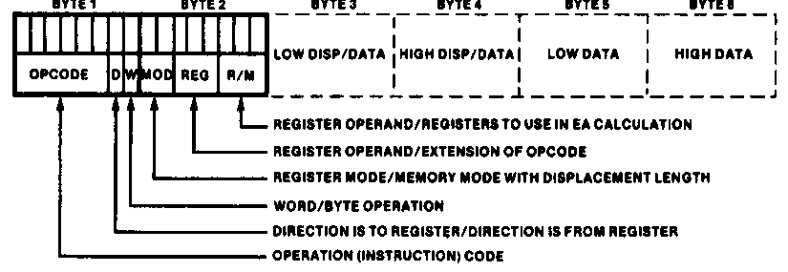
Instruction Encoding
80x86’s instruction set is variable length
  Multiple instruction sizes
    1 to 6 bytes in length for 8088/8086
    Up to 17 bytes for 80386,80486, and Pentium
  Variable length advantages (trait of CISC)
    Allows for many addressing modes
    Allows full size (32-bit) immediate data and addresses
    Instructions can use as many bytes as necessary
  Disadvantage of variable length
    Requires more complicated decoding hardware—speed of decoding is critical in modern uP
    Most uP use fixed length (trait of RISC)
Microprocessors I: Lecture 6
Notes:
Chapter 4

Slide 7
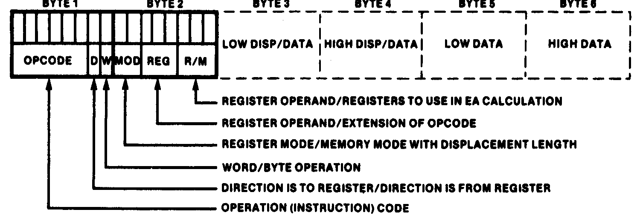
Instruction Encoding
Information encoded in an instruction
  What operation ?
  What operands ?
  Byte, word or double-word ?
  Operands in register or memory ?
  How the address is to be generated, if mem?
Microprocessors I: Lecture 6

Slide 8
x86 data types (“review”)
Refresher on x86 registers
  Gen. purpose registers: 16 or 32 bits
  Data registers can hold 8 bit data as well
  Determining size: register name
  Example: “accumulator” register
    8 bit data: AL = lowest byte; AH = next lowest byte
    16 bit data: AX = lowest 16 bits (AH/AL together as word)
    32 bit data: EAX = entire 32 bits
Say EAX = 1A2B3C4DH
  What are AL, AH, and AX?
  AL = 4DH, AH = 3CH, AX = 3C4DH
Microprocessors I: Lecture 6

Slide 9
x86 memory accesses
# bytes from memory usually = # bytes in register
Example: MOV AX, [100H]
  AX is 16-bit register → move word from DS:100H to AX
Sometimes necessary to specify size
  Use “<size> PTR”: BYTE PTR, WORD PTR, DWORD PTR
  Example: MOVZX EAX, BYTE PTR [100H]
    Take byte from memory
    Zero-extend data to 32 bits and store in EAX
Remember, x86 uses little-endian data
Microprocessors I: Lecture 6

Slide 10
Instruction types
Recall the four general types of instructions used by most microprocessors
  Data transfer
  Arithmetic
  Logical (including shifts, bitwise, etc.)
  Program control
x86 has some additional types (which we may not cover)
  Processor control
  String instructions
  Input/output instructions
Microprocessors I: Lecture 6

Slide 11
Data transfer instructions
MOV
MOVSX
MOVZX
XCHG
LEA
Load full pointer
Additional data transfer instructions (covered later, if at all)
  PUSH/POP (stack transfers)
  INS/OUTS (I/O)
  MOVS/LODS/STOS (string instructions)
  BSWAP (switch from little endian to big endian)
  XLAT (table lookup)
  CMOV (conditional move)
Microprocessors I: Lecture 6

Slide 12
MOV
Used to copy data between
  Registers
  Registers/memory
  Immediate value (source only) to register/memory
Format: MOV D, S
Operation: (D) = (S)
Restrictions
  Immediate value can only be used as source
  If segment register is destination, source must be memory or register (no immediate)
Microprocessors I: Lecture 6

Slide 13
MOV examples
Assume: AX = 0100H, CS = 3000H, (DS:100H) = 00H, (DS:101H) = FFH
MOV BL, AL
  BL = AL = 00H
MOV DX, CS
  DX = CS = 3000H
MOV CX, [100H]
  CX = word starting at DS:100H = FF00H
Microprocessors I: Lecture 6

Slide 14
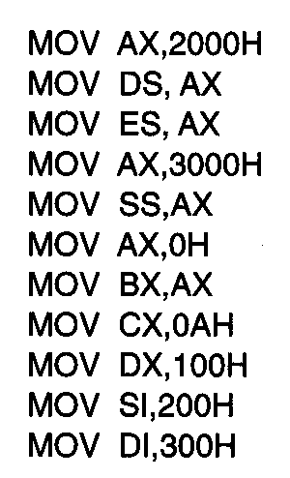
Usage of Move Instruction
Example—Initialization of internal registers with immediate data and address information
  What is the final state of all affected registers?
  Why is AX used to initialize segment registers?
Microprocessors I: Lecture 6
Notes:
Chapter 5 (I)

Slide 15
Usage of Move Instruction (soln)
MOV AX, 2000H → AX = 2000H
MOV DS, AX → DS = AX = 2000H
MOV ES, AX → ES = AX = 2000H
MOV AX, 3000H → AX = 3000H
MOV SS, AX → SS = 3000H
MOV AX, 0H → AX = 0000H
MOV BX, AX → BX = AX = 0000H
MOV CX, 0AH → CX = 000AH
MOV DX, 100H → DX = 0100H
MOV SI, 200H → SI = 0200H
MOV DI, 300H → DI = 0300H
Microprocessors I: Lecture 6
Notes:
Chapter 5 (I)

Slide 16
MOVSX/MOVZX
Move and extend data (fill upper bits with 0/1)
  ZX → zero extend
  SX → sign extend → copy MSB of source
Format: MOVZX D, S
MOVSX D, S
Operation: lower bits of D = S
upper bits of D = 0 (MOVZX) or
upper bits of D = MSB of S (MOVSX)
Restrictions
  Only register/memory operands (no immediates)
  Source must contain fewer bits than destination
  If memory operand used, size must be specified
Microprocessors I: Lecture 6

Slide 17
MOVSX/MOVZX examples
Assume: AX = 0100H, DX = 8100H, (DS:100H) = 00H, (DS:101H) = FFH
What are the results of the following instructions?
MOVSX EBX, AX
MOVSX EBX, DX
MOVZX EBX, DX
MOVSX EBX, BYTE PTR [100H]
MOVSX EBX, WORD PTR [100H]
Microprocessors I: Lecture 6

Slide 18
MOVSX/MOVZX examples (soln)
Assume: AX = 0100H, DX = 8100H, (DS:100H) = 00H, (DS:101H) = FFH
What are the results of the following instructions?
MOVSX EBX, AX
  EBX = AX sign-extended = 00000100H (orig. value underlined)
MOVSX EBX, DX
  EBX = DX sign-extended = FFFF8100H
MOVZX EBX, DX
  EBX = DX zero-extended = 00008100H
MOVSX EBX, BYTE PTR [100H]
  EBX = byte at DS:100 sign-extended = 00000000H
MOVSX EBX, WORD PTR [100H]
  EBX = word at DS:100 sign-extended = FFFFFF00H
Microprocessors I: Lecture 6

Slide 19
XCHG
Swap contents of source and destination
Format: XCHG D, S
Operation: (D) = (S)
(S) = (D)
Restrictions:
  Memory operand can only be used as destination
Microprocessors I: Lecture 6

Slide 20
LEA
Perform effective address computation and store result in register
Format: LEA D, EA
Operation: D = EA
Example: LEA SI, [10H + DI]
Microprocessors I: Lecture 6

Slide 21
Load full pointer
Load contents of memory into both register and segment register
Format: Lxx D, addr
  xx = DS, ES, FS, GS, SS
Operation:
  (D) = contents of addr
  Segment register xx = contents of:
    addr + 2 if D is 16-bit register
    addr + 4 if D is 32-bit register
Microprocessors I: Lecture 6

Slide 22
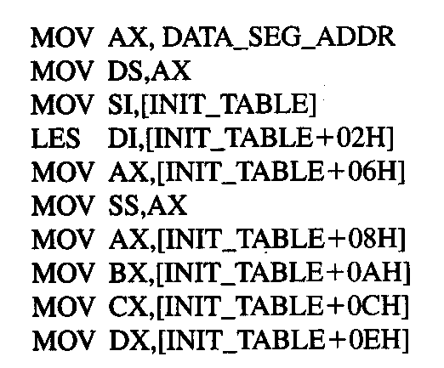
Example
DATA_SEG_ADDR:0000
DATA_SEG_ADDR:INIT_TABLE | 11 | 22
 | 33 | 44
 | 55 | 66
 | 77 | 88
 | 99 | AA
 | BB | CC
 | DD | EE
 | FF | 16
 | 03 | 17
Show the results of running the following program if DATA_SEG_ADDR = 1200H:
Microprocessors I: Lecture 6

Slide 23
Example solution
DATA_SEG_ADDR:0000
DATA_SEG_ADDR:INIT_TABLE | 11 | 22
 | 33 | 44
 | 55 | 66
 | 77 | 88
 | 99 | AA
 | BB | CC
 | DD | EE
 | FF | 16
 | 03 | 17
MOV AX,DATA_SEG_ADDR
  AX = DATA_SEG_ADDR
  = 1200H
MOV DS, AX
  DS = AX = 1200H
MOV SI, [INIT_TABLE]
  SI = memory @ DS:INIT_TABLE
  = 2211H
LES DI,[INIT_TABLE+02H]
  DI = memory @ DS:INIT_TABLE+02H
  = 4433H
  ES = memory @ DS:INIT_TABLE+04H
  = 6655H
Microprocessors I: Lecture 6

Slide 24
Example solution (cont.)
DATA_SEG_ADDR:0000
DATA_SEG_ADDR:INIT_TABLE | 11 | 22
 | 33 | 44
 | 55 | 66
 | 77 | 88
 | 99 | AA
 | BB | CC
 | DD | EE
 | FF | 16
 | 03 | 17
MOV AX,[INIT_TABLE+06H]
  AX = memory @ DS:INIT_TABLE+06H
  = 8877H
MOV SS, AX
  SS = AX = 8877H
MOV AX,[INIT_TABLE+08H]
  AX = memory @ DS:INIT_TABLE+08H
  = AA99H
MOV BX,[INIT_TABLE+0AH]
  BX = memory @ DS:INIT_TABLE+0AH
  = CCBBH
Microprocessors I: Lecture 6

Slide 25
Example solution (cont.)
DATA_SEG_ADDR:0000
DATA_SEG_ADDR:INIT_TABLE | 11 | 22
 | 33 | 44
 | 55 | 66
 | 77 | 88
 | 99 | AA
 | BB | CC
 | DD | EE
 | FF | 16
 | 03 | 17
MOV CX,[INIT_TABLE+0CH]
  CX = memory @ DS:INIT_TABLE+0CH
  = EEDDH
MOV DX,[INIT_TABLE+0EH]
  DX = memory @ DS:INIT_TABLE+0EH
  = 16FFH
Microprocessors I: Lecture 6

Slide 26
Final notes
Next time:
  More on x86 memory
Reminders:
  HW 1 due today
  HW 2 to be posted; due 9/23
Microprocessors I: Lecture 6

