Slide 1
16.317
Microprocessor Systems Design I
Instructor: Dr. Michael Geiger
Fall 2014
Lecture 23
Exam 2 Preview

Slide 2
Lecture outline
Announcements/reminders
  Exam 2: Wednesday, 11/5
Today’s lecture: Exam 2 Preview
Microprocessors I: Exam 2 Preview

Slide 3
Exam 2 notes
Allowed
  One 8.5” x 11” double-sided sheet of notes
  Calculator
No other notes or electronic devices (phone, laptop, etc.)
Exam will last 50 minutes
Covers all lectures after Exam 1 except last Wednesday’s lecture (covers 12-21, not 22)
Format similar to previous exam
  1 multiple choice question
  2-3 short problems to solve/code sequences to evaluate
Microprocessors I: Exam 2 Preview

Slide 4
Review: subroutines
Subroutines: low-level functions
  When called, address of next instruction saved
    Return instruction ends routine; goes to that point
  May need to save state on stack
x86 specifics
  CALL <proc>: call procedure
    <proc> can be label (16-/32-bit imm), reg, mem
  RET: return from procedure
  Saving state to stack: push instructions
    Store data “above” current TOS; decrement SP
    Basic PUSH stores word or double word
    Directly storing flags: PUSHF
    Storing all 16-/32-bit general purpose registers: PUSHA/PUSHAD
  Restoring state: POP/POPF/POPA/POPAD
Microprocessors I: Exam 2 Preview

Slide 5
Review: HLL → assembly
Data accesses
  Global variables → static; allocated in data segment
  Other variables → dynamic; allocated on stack
  Stack frame for each function contains (from top)
    Saved variables within function
    Local variables for function (starting at EBP – 4)
    Saved EBP
    Saved EIP
    Function arguments (starting at EBP + 8)
Conditional statements (if-then-else)
  Evaluate condition (CMP instruction(s))
  Conditional jump (often to “else” case)
  “If” case ends with unconditional jump to skip “else”
Loops
  Initialize variable at start
  Test loop condition (similar to if)
  Change loop variable
Microprocessors I: Exam 2 Preview

Slide 6
Review: Exceptions & interrupts
Exception: unexpected event altering normal program flow
Interrupt: CPU signal that external event has occurred
Interrupt/exception vector: starting address of service routine
  Service routine: function to handle interrupt
  Vectors stored in table
When interrupt occurs
  Processor state (registers, flags) saved
  Interrupt return address pushed on stack
  ISR located (based on vector) and executed
Interrupt pins
  May have multiple levels of priority
  NMI: non-maskable interrupt
  If multiple devices sharing same interrupt, HW or SW required to determine which device actually caused interrupt
Microprocessors I: Exam 2 Preview

Slide 7
Review: PIC instructions
Four typical instruction formats (+ few special purpose)
  Upper bits of all hold opcode
  Byte-oriented includes 1 bit destination, 7 bit direct address
  Bit-oriented includes 3 bit position (0-7), 7 bit direct address
  Literal/control includes 8 bit literal
  CALL/GOTO includes 11 bit literal
Variable declarations
  cblock <start_address>: start of variable declarations
  All names between cblock/endc directives assigned to consecutive bytes starting at <start_address>
Microprocessors I: Lecture 22

Slide 8
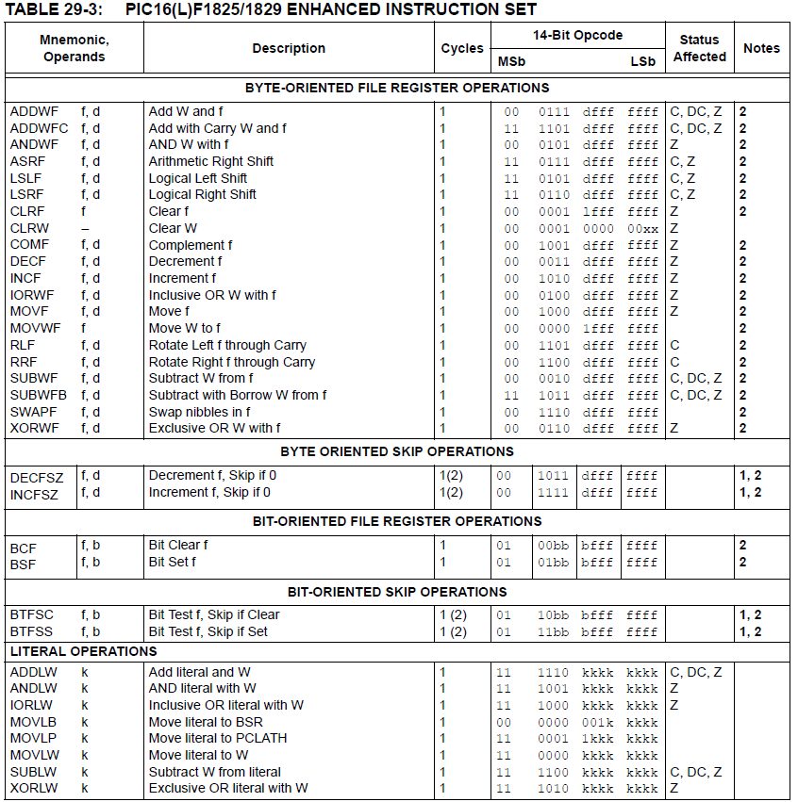
Microprocessors I: Lecture 22

Slide 9
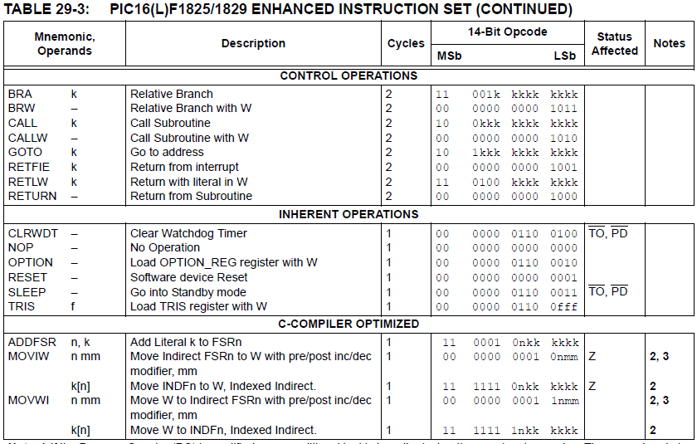
Microprocessors I: Lecture 22

Slide 10
Review: PIC instructions (cont.)
Clearing register: clrw/clrf
Moving values: movlw/movwf/movf
Swap nibbles: swapf
Single bit manipulation: bsf/bcf
Unary operations: incf/decf/comf
Arithmetic: addlw/addwf/addwfc/
sublw/subwf/subwfb
Microprocessors I: Lecture 22

Slide 11
Review: PIC instructions (cont.)
Logical operations
  andlw/andwf
  iorlw/iorwf
  xorlw/xorwf
Rotates/shifts
  rrf/lsrf/asrf
  rlf/lslf
Jumps/calls/return
  goto/bra
  call
  return/retlw/retfie
Conditional execution
  Test bit and skip next instruction if clear/set: btfsc/btfss
  Increment/decrement register and skip next instruction if zero: incfsz/decfsz
Example use: combined with goto to create conditional jump
Microprocessors I: Exam 3 Preview

Slide 12
Final notes
Next time:
  Exam 2—PLEASE BE ON TIME
Microprocessors I: Exam 2 Preview

