Slide 1
16.317
Microprocessor Systems Design I
Instructor: Dr. Michael Geiger
Spring 2014
Lecture 25:
Exam 2 Review

Slide 2
Lecture outline
Announcements/reminders
  HW 5 to be posted; due date TBD
Today’s lecture
  Exam 2 Review
Microprocessors I: Lecture 25

Slide 3
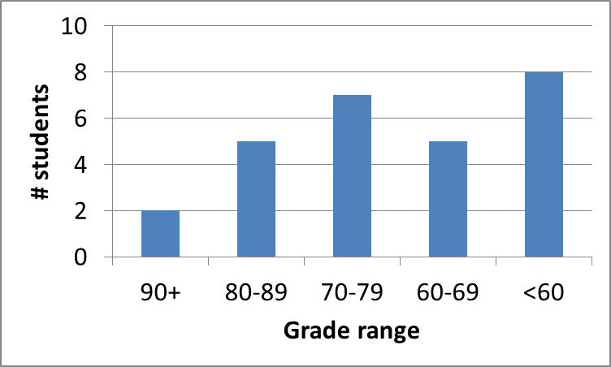
Exam stats & grade distribution
Question-by-question averages:
  Q1: 8.8 / 16 (55%)
  Q2: 15.1 / 16 (94%)
  Q3: 18.2 / 28 (65%)
  Q4: 27.8 / 40 (70%)
Extra credit
  13 students
  5.5 / 10 average
Average: 70
Median: 70
Std. deviation: 13.4
Max: 94
Microprocessors I: Lecture 25

Slide 4
Figuring out where you stand
Homework: 55% (4/6 done; 2/6 graded)
Exams: 45% (15% + 15% + 15%)
1/3 of your grade still to be determined
Estimating your grade
  Homework avg (HWA) =
  (HW1 * 2 + HW2) / 2
  Exam avg (EA) =
  ((Exam1) + (Exam2)) / 2
  Overall avg = HWA * 0.55 + EA * 0.45
Microprocessors I: Lecture 25

Slide 5
Figuring out where you stand
Estimated avg. = HWA * 0.55 + EA * 0.45
Current course averages
  Without extra credit: ~82%, SD ≈ 9.8
  With extra credit: ~83%, SD ≈ 10.5
Key points
  Very possible there will be no grading curve
  Therefore, right now:
    Min grade for C-: 70
    Min grade for D: 60
    THESE NUMBERS WILL ALMOST CERTAINLY CHANGE BEFORE SEMESTER’S END—THESE FIGURES ARE JUST ROUGH ESTIMATES!!!!!
Microprocessors I: Lecture 25

Slide 6
Final notes
Next time:
  Finish PIC assembly programming
Reminders:
  HW 5 to be posted; due date TBD
Microprocessors I: Lecture 25

