Slide 1
16.317: Microprocessor System Design I
Instructor: Dr. Michael Geiger
Spring 2012
Lecture 26: Exam 2 Preview
Notes:
Chapter 2

Slide 2
Lecture outline
Announcements/reminders
  Lab 3 posted; report due 4/11
Today: Exam 2 Preview
  General exam info
  Topics covered
    Instructions
      Bit test/scan instructions
      Flag control instructions
      Compare instructions
      Jump and loop instructions
      Subroutine instructions
    Protected mode
      Basic characteristics
      Memory accesses
      Virtual memory
    External interfacing
Microprocessors I: Exam 2 Preview

Slide 3
Exam 2 notes
Allowed
  One 8.5” x 11” double-sided sheet of notes
  Calculator
No other notes or electronic devices (phone, laptop, etc.)
Exam will last 50 minutes
Covers all lectures after Exam 1 (Lec. 15-25)
Format similar to Exam 1, but shorter
  1 multiple choice question
    Covers topics not addressed in practice problems
  2-3 short problems to solve/code sequences to evaluate
Microprocessors I: Exam 2 Preview

Slide 4
Review: Bit test/scan, flag control
Bit test instructions
  Check state of bit and store in CF
  Basic test (BT) leaves bit unchanged
  Can also set (BTS), clear (BTR), or complement bit (BTC)
Bit scan instructions
  Find first non-zero bit and store index in dest.
  Set ZF = 1 if source non-zero; ZF = 0 if source == 0
  BSF: scan right to left (LSB to MSB)
  BSR: scan left to right (MSB to LSB)
Flag control instructions
  Initialize carry flag to 0 (CLC), 1 (STC), or ~CF (CMC)
  Set (STI) or clear (CLI) interrupt flag
  Transfer flags to (LAHF) or from (SAHF) register AH
Microprocessors I: Lecture 16

Slide 5
Review: Compare, set on condition
CMP D, S
  Flags show result of (D) – (S)
    Assumes signed computation
  ZF = 1 → D == S
  ZF = 0, (SF XOR OF) = 1 → D < S
  ZF = 0, (SF XOR OF) = 0 → D > S
Condition codes: mnemonics implying certain flag conditions
SETcc D
  Sets single byte destination to all 1s (FFH) if condition true; all 0s (00H) if condition false
  Can be used to build up complex conditions
Microprocessors I: Lecture 17

Slide 6
Review: jump instructions
Two general types of jump
  Unconditional: JMP <target>
    Always go to target address
  Conditional: Jcc <target>
    Go to target address if condition true
Target can be:
  Intrasegment: same segment; only IP changes
    Add constant 8/16 bit offset, or
    Replace IP with 16 bit value from register/memory
  Intersegment: different segment; CS/IP both change
    Target is 32-bit value
    Upper 16 bits overwrite CS; lower bits overwrite IP
Jump applications
  Conditional statements (if/else)
  Loops (pre-/post-tested)
Microprocessors I: Lecture 18

Slide 7
Review: loop instructions
Loop instructions
  Combines CX decrement with JNZ test
  May add additional required condition
    LOOPE/LOOPZ: loop if ((CX != 0) && (ZF == 1))
    LOOPNE/LOOPNEZ: loop if (CX != 0) && (ZF == 0))
Microprocessors I: Lecture 19

Slide 8
Review: subroutines
Subroutines: low-level functions
  When called, address of next instruction saved
    Return instruction ends routine; goes to that point
  May need to save state on stack
80386 specifics
  CALL <proc>: call procedure
    <proc> can be label (16-/32-bit imm), reg, mem
  RET: return from procedure
  Saving state to stack: push instructions
    Store data “above” current TOS; decrement SP
    Basic PUSH stores word or double word
    Directly storing flags: PUSHF
    Storing all 16-/32-bit general purpose registers: PUSHA/PUSHAD
  Restoring state: POP/POPF/POPA/POPAD
Microprocessors I: Lecture 20

Slide 9
Review: protected mode
Protected mode
  Supports memory management, multitasking, protection
  Changes in control/flag registers, IP, memory accesses
Selectors: pointers into descriptor tables
  Contains requested privilege, global/local, and table index
Descriptors: provide info about segments
  8 bytes in length
  4 bytes: base address
  2 bytes: limit (max offset within segment)
    Segment size = (limit + 1) bytes
  2 bytes: access info (privilege, R/W, executable, etc.)
Microprocessors I: Lecture 21

Slide 10
Review: Protected mode (cont.)
Local memory access
  Selector indicates access is global (TI == 1)
  LDTR points to LDT descriptor in GDT
    Actual base, limit of LDT stored in LDTR cache
  Index field in selector chooses descriptor from LDT
    Descriptor addr = (LDT base) + (selector index * 8)
  Descriptor provides starting address of segment
Interrupt descriptors
  Provide starting address, length of interrupt service routines
  Limited to 256 descriptors
  Stored in IDT; IDTR holds base/limit of IDT
Task switching
  Task register (TR): selector for current task state segment (TSS)
  TSS stores all state (register values) for current task
  Task switch: jump/call that changes TR; old TSS saved and new one loaded
Microprocessors I: Lecture 22

Slide 11
Review: Virtual memory
Virtual memory
  Allows programmer to see more memory than system has
  Allows program to function with variable amount of memory
  Address undergoes translation from virtual address to physical address
  Page table handles translation
    Indexed by page #; provides physical frame #
    Page table can have multiple levels to save space
  TLB caches translations to save time
80386 specifics
  Virtual address: 46 bits
    Upper 14 bits of selector + 32 bits of offset
  Physical address: 32 bits
    If just using segments, physical address = linear address
    If using paging (4 KB pages), linear address used to index 2-level page table
Microprocessors I: Lecture 23

Slide 12
Review: Interfacing
Processor interfaces generally contain
  Address outputs: specify location
  Data input/outputs: data to be read/written
  Control signals
    Data size
    Transaction type (read/write, privilege level, etc.)
    Handshaking signals
      Request/acknowledge pairing
      Controls timing of read/write operations
    Bus control
  Interrupt interface
  Some contain special purpose signals
    DMA interface
    Coprocessor interface
Microprocessors I: Exam 2 Preview

Slide 13
Review: 80386 Interfaces (Fig 9.3, p. 376)
A₂-A₃₁
DMA interface
HOLD
HLDA
BE₀-BE₃
D₀-D₃₁
INTR
Interrupt interface
NMI
W/R
Memory/
IO interface
RESET
D/C
M/IO
ADS
PEREQ
READY
Coprocessor interface
BUSY
NA
ERROR
LOCK
BS16
Microprocessors I: Lecture 25
Notes:
Chapter 9

Slide 14
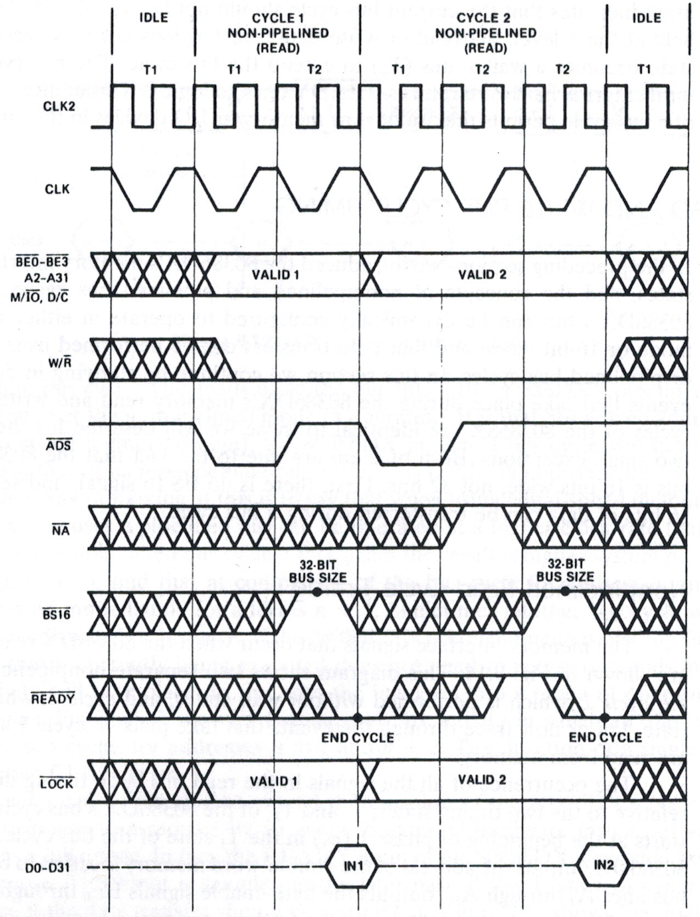
Review: bus cycle
Driven by system clock
Valid address, control signals placed on bus
Cycle concludes when acknowledged by external logic
Microprocessors I: Lecture 25

Slide 15
Next time
Exam 2
  Remember, only 1 note sheet, calculator (no cell phones as calculators)
  Please be on time!
Microprocessors I: Exam 2 Preview

